Slide 1
Establishing a Long-Term Gas Research Strategy to Achieve Aggressive Statewide Carbon Neutrality Goals
Communities, Equity, and Environmental Stakeholder Workshop
June 9, 2022
Contractor Presentation

Slide 2
Today’s Agenda
Time | Items
20 minutes | Background Describe the purpose and background of this effort Walk through the objectives for this workshop Highlight past R&D initiatives and community benefits of decarbonization
50 minutes | Gas Decarbonization Strategies Summarize strategies and associated community benefits and concerns Conduct panel discussion with leaders and experts Q&A with audience
50 minutes | Community Considerations for Research Discuss what’s included in gas system research and community considerations Conduct interactive exercise and group discussion Closing remarks

Slide 3
Purpose of Gas R&D Strategy Project
This program has an annual budget of $24 million to support CA’s gas decarbonization strategy, focused on addressing strategic technology challenges.
The purpose of this project is to produce a long-term research strategy to help decarbonize California’s gas system by 2045.
The strategy is expected to produce prioritized research recommendations that include all stages in the supply chain (production, transmission, storage, and distribution for low carbon fuels) and all gas end use sectors, except for utility-scale power generation.
These recommendations will inform future research on technology development, deployment, and demonstration in the CEC’s Gas Research Program to help transition to a net-zero carbon gas system.

Slide 4
RD&D Supported and Research Areas
Types of RD&D CEC Supports
Research Areas
Research recommendations produced by the project will include the following:
  Scientific, Social, and Techno-Economic Analysis - Developing new knowledge and tools that can inform energy policy and planning decisions.
  Technology Development - Developing early-stage technologies at lab or prototype level.
  Technology Demonstration and Deployment - Demonstrating later stage technologies or systems at a scale that will reflect actual operating, performance, and financial characteristics and risk.
Research recommendations produced by the project must be within the following Research Areas:
  Research Areas:
  Building Decarbonization
  Energy-related Environmental Research
  Gas Infrastructure Integrity, Sustainability, and Security
  Industrial and Agricultural Innovation
  Renewable Energy and Advanced Generation
  Transportation
Recent annual reports and investment plans available at:
https://www.energy.ca.gov/energy-rd-reports-n-publications/energy-research-and-development-investment-plans-and-annual

Slide 5



Objectives for this Workshop
This is the first of two stakeholder workshops on this initiative. The second workshop will take place on June 16th and will be technology-focused.
Obtain feedback on equity and environmental benefits, concerns, and considerations of gas decarbonization that affect Californians, especially under-resourced communities.
Increase awareness and obtain input on high-level research considerations that are being discussed.
Consider how communities can capture benefits from this transition while mitigating cost, safety concerns, and other impacts on communities.
5

Slide 6
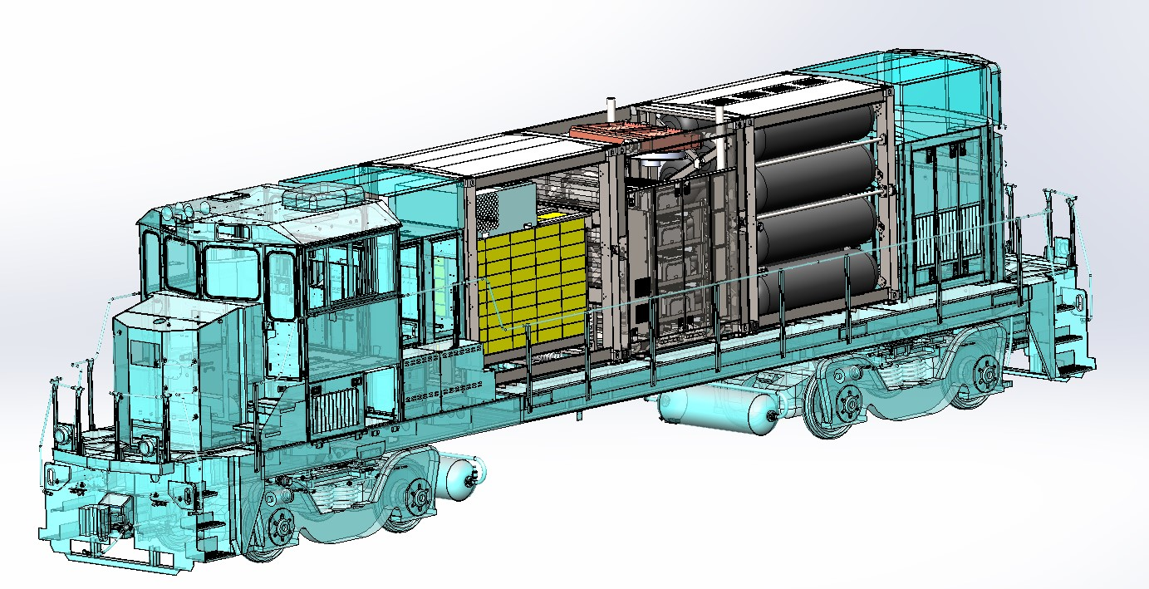









Hydrogen Fuel Cells for Rail
Technology Demonstration and Deployment
  Demonstrate a hydrogen fuel cell-powered switcher locomotive at the Port of West Sacramento.
  Develop multi-modal hydrogen refueling station to support both locomotives and on-road vehicles.
Benefits
  Locomotives contribute to 12% of statewide NOx and 8% of statewide PM2.5 emissions.
  Establish a pathway to decarbonize locomotives and improve air quality around ports and railyards.

Slide 7
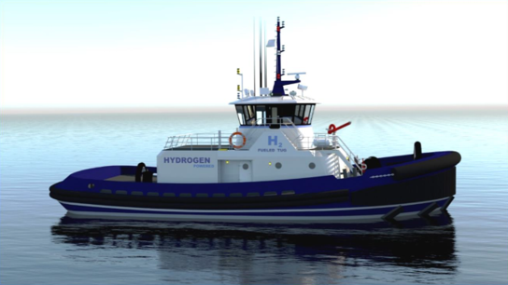






Hydrogen Fuel Cells for Marine
Scientific, Social, and Techno-Economic Analysis
  Design a hydrogen fuel cell-powered harbor tug for future implementation at the Port of Los Angeles.
  Evaluate liquid hydrogen fuel systems and bunkering solutions.
Benefits
  Marine vessels contribute to 60% of diesel PM, and 62% of NOx at the Port of Los Angeles.
  Establish a pathway to decarbonize marine vessels and improve air quality for portside communities.

Slide 8

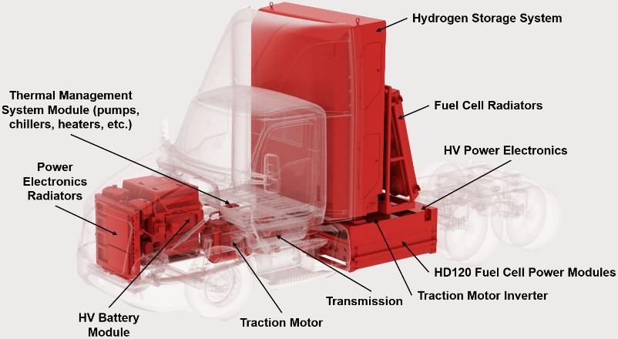
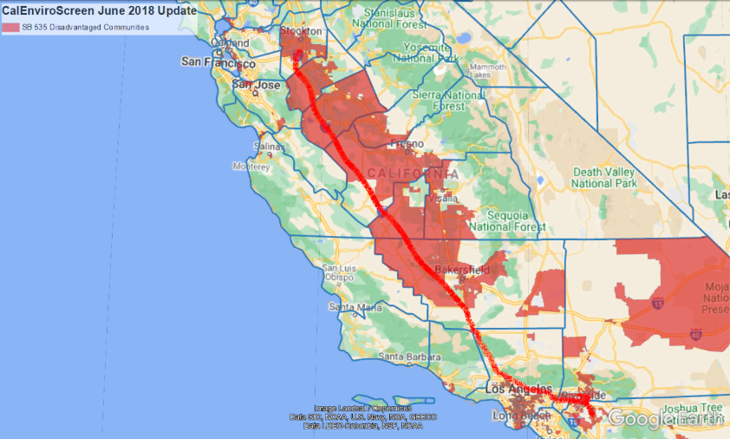



Hydrogen Fuel Cells for HD Trucks
Technology Demonstration and Deployment
  Demonstrate hydrogen fuel cell trucks for bulk gas delivery and extended regional haul operations.
  Improve fuel cell vehicle efficiency, lower costs, and assess feasibility of liquid hydrogen on-board storage.
Benefits
  Around 27,000 CA semi-trucks travel 300+ mi/day – transitioning these trucks can reduce annual GHG emissions by 4.2 MMT CO2e and NOx emissions by 1,100 MT.
  Engage community college students and service/repair facilities with hydrogen fuel cell technology.

Slide 9

Assessment of Ventilation in California Homes
Scientific, Behavioral, and Techno-Economic Analysis:
  Evaluate real world ventilation use in California homes
  Develop energy efficient ventilation strategies that protect health and are used by people
Benefits:
  Public health benefits of kitchen ventilation standards are substantial but dependent on ventilation use
  Simple, inexpensive controls could reduce ventilation-associated energy use by ≥50% for California homes
Sources:
Chan, Wanyu R.; Kim, Yang-Seon; Less, Brennan B.; Singer, Brett C.; Walker, Iain S. (Lawrence Berkeley National Laboratory). 2020. Ventilation and Indoor Air Quality in New California Homes with Gas Appliances and Mechanical Ventilation. CEC-500-2020-023. https://www.energy.ca.gov/publications/2020/ventilation-and-air-quality-new-california-homes-gas-appliances-and-mechanical
Walker, Iain, Brennan Less, Spencer Dutton, David Lorenzetti, Michael Sohn (2020). Smart Ventilation for Advanced California Homes. CEC-500-2020-050. https://ww2.energy.ca.gov/2020publications/CEC-500-2020-050/CEC-500-2020-050.pdf. See also: https://svach.lbl.gov/

Slide 10

Health-Based Approach to Ventilation Standards
Scientific, Social, and Techno-Economic Analysis:
  Evaluate pollutant concentrations in kitchens
  Design improved metrics for measuring range hood performance
  Benefits:
  Study findings resulted in improved Title 24 ventilation standards
  Updated health-protective kitchen ventilation requirements designed to address issues in smaller homes
  Substantial health benefits expected: if high-capture hoods are installed and used more consistently, benefits could exceed $200M
Source: Singer, Brett C.; Wanyu Rengie Chan; William W. Delp; Iain S. Walker; Haoran Zhao. 2021. Effective Kitchen Ventilation for Healthy Zero Net Energy Homes with Natural Gas. CEC-500-2021-005. https://www.energy.ca.gov/publications/2021/effective-kitchen-ventilation-healthy-zero-net-energy-homes-natural-gas

Slide 11





Benefits of Decarbonization
Improved Air Quality
Energy Security
Reduced Environmental Impact
Increased Resiliency
Economic Development

Slide 12
Pre-Workshop Form Responses
This slide will be populated immediately prior to the meeting based on responses received to the Google form.
The Google form will remain open for the week following this workshop. If you have not had the chance to fill it out, we would greatly appreciate your input.

Slide 13
Gas Decarbonization Strategies

Slide 14
Gas Decarbonization Strategies
Using electricity to fuel technologies that currently use fossil gas
Using low-carbon hydrogen to replace select gas end-uses (e.g., heat, transportation)
Methane from renewable sources, reducing dependence on fossil gas
Capture CO₂ to mitigate impacts of emissions.
Electrification
Clean Hydrogen
Renewable Gas
Carbon Capture and Utilization (CCU)
CEC electricity research program (EPIC) leads work in this area
Emissions highly dependent upon electricity generation mix
Preferred solution for most:
New residential and small commercial buildings
Light & medium duty vehicles
Commuter rail
Emissions highly dependent on hydrogen production process
Hydrogen may be blended into existing gas supplies by up to ~15% with current infrastructure
Preferred solution for:
Industry & process heating
Large commercial & multifamily buildings
Heavy duty transportation
Fuel produced from biomass & waste sources, such as landfill gas and agricultural feedstocks
Limited by the amount of readily available feedstock
Can be a carbon neutral fuel
Preferred solution for:
Industrial processes that require carbon feedstock
Captures CO₂ before released to the atmosphere
Captured emissions can be utilized or sequestered.
Retrofitted or built at industrial sites or large generators
Preferred solution for:
Hard to decarbonize industrial processes
Gas Technology Efficiency Improvements
Gas System Strategic Decommissioning

Slide 15
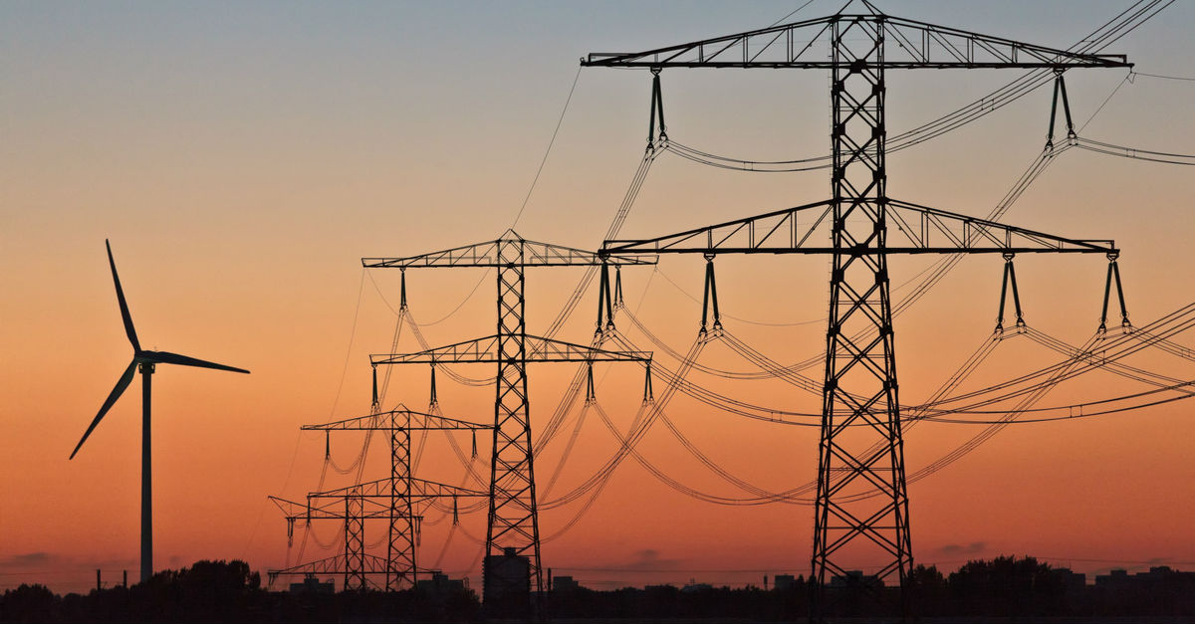
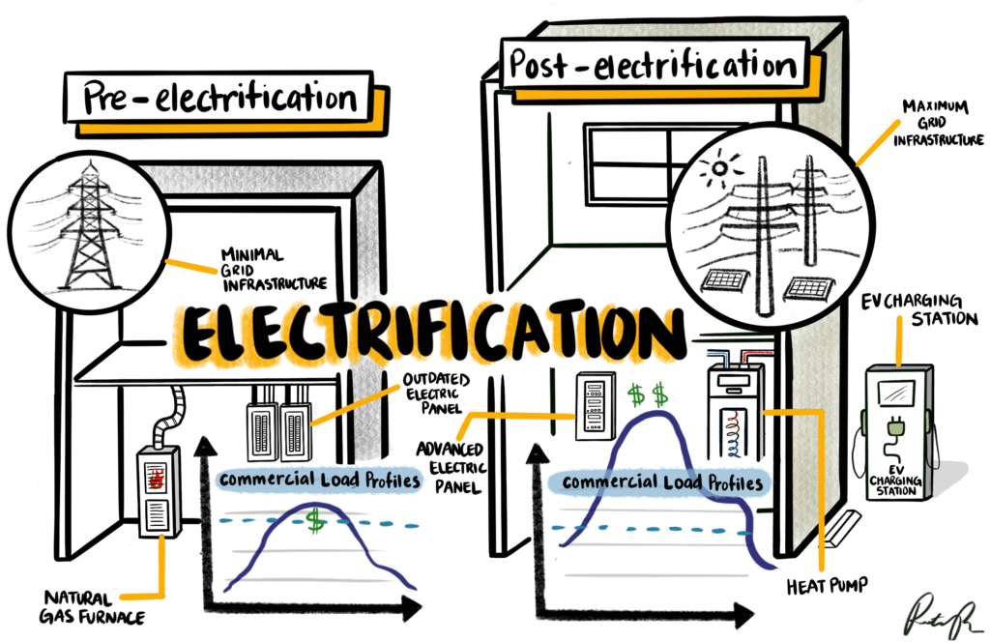


Electrification Considerations
Benefits
Source: IRENA
Source: IMT
Concerns
All electric construction reduces upfront costs
Higher operating costs for some electrification solutions
Gas infrastructure decommissioning can enhance community health and safety
Early retirement of gas appliances can be costly and burdensome
Reduced exposure to fossil gas price volatility
Increases dependence on electricity service reliability

Slide 16

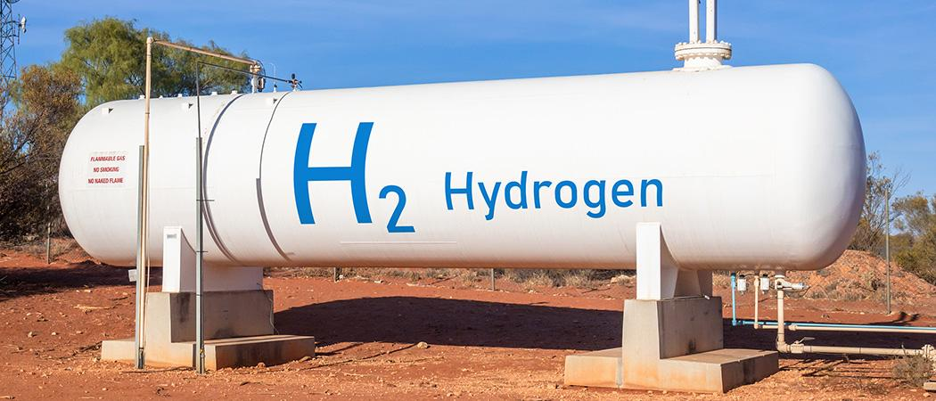
Clean Hydrogen Considerations
Benefits
Source: ALJ
Concerns
Source: Science | Business
Resiliency against multi-day power outages
Expensive gas to produce – area of research
Hydrogen fuel cell technologies release no pollutant emissions at point of use
Combustion can still produce nitrogen oxides (NOx), a criteria pollutant
New or updated infrastructure for pipeline integrity and reliability can be a burden
Faster refueling than battery electric vehicles
High temperature heat for difficult-to-decarbonize industrial processes
Substantial research required to address user safety and performance concerns

Slide 17
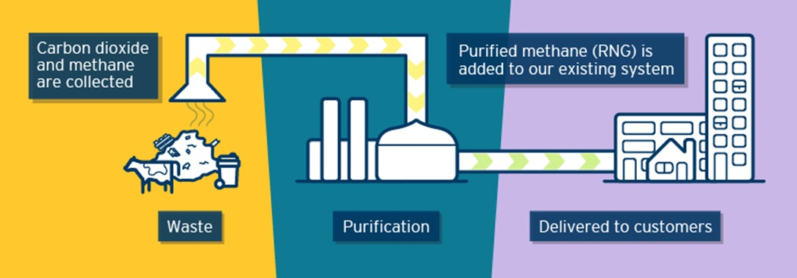

Renewable Gas Considerations
Benefits
Source: FortisBC
Concerns
Source: Eustafor
Doesn’t require new technology adoption for consumers
Limited by feedstock availability and accessibility
Minimal transition costs for gas infrastructure development
End use health and environmental concerns similar to fossil gas
Waste streams potentially provide economic value to California and its communities
Production may require large energy input and significant land use while breakdown of biological waste creates unpleasant odors

Slide 18
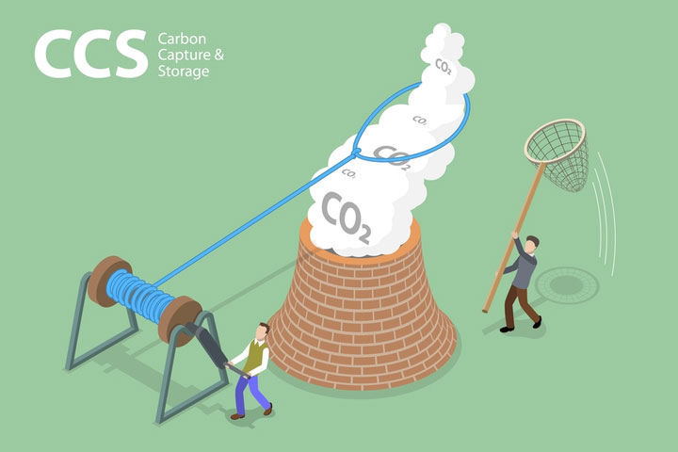
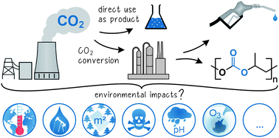
CCU Considerations
Benefits
Source: ResearchDive
Source: Energy & Environmental Science Journal
Concerns
Doesn’t require new technology adoption for non-industrial consumers
Some carbon capture processes are water intensive
Improved air quality from emission reductions
Leakage from CO₂ infrastructure causes environmental harm
Utilization of CO₂ can offer new economic value streams to California
Upfront costs and uncertain long-term impacts

Slide 19



Panel Session
Genevieve Amsalem Research & Policy Director, Central CA EJ Network (CCEJN)
Areas of expertise:
Air quality
Under-resourced community needs
Merrian Borgeson Senior Scientist, Natural Resources Defense Council (NRDC)
Areas of expertise:
Renewable energy policy
Low emission systems
Nick Connell Policy & Regulatory Director, Green Hydrogen Coalition (GHC)
Areas of expertise:
Green hydrogen – HyDeal LA
Regulation and policy

Slide 20
Strategies Q&A
Are there any questions you have about the strategies?
Is there anything else you want us to consider?

Slide 21
Community Considerations for Research

Slide 22










Gas System Overview
The following outlines the key features with respect to different parts of the gas supply chain that have been explored in our research efforts
Industry
Buildings
Transportation
Distributed Generation
Organic Waste and Biomass
Renewable Energy
End Uses
GAS
Storage
Production
Renewable gas, Hydrogen
Distribution
Gas pipelines, liquid, H₂ chemical carrier
Underground (including geologic formations) and above ground

Slide 23




Community-Level Fuel Distribution Considerations
The following represents our understanding of the core community considerations with fuel distribution
Item
Explanation
Safety
Mitigating leakage and accidents is important for human safety with H₂ and gas blends
Cost Burden on Communities
Minimizing cost of decommissioning and modernizing gas infrastructure for communities without sacrificing safety or core functionality
Inequitable Impacts of Gas Infrastructure
Disproportionate risk from gas production, transportation, and storage in under-resourced communities
Under-Resourced Community Access to Reliable and Affordable Energy
Community access to a decarbonization solution that caters to specific needs
.
Prolonging Use of Fossil Fuels
Investing in CCU and renewable gas may prolong California’s reliance on fossil fuels in its energy mix

Slide 24



Community-Level Industrial Considerations
The following represents our understanding of the core community considerations with the industrial sector
Item
Explanation
Workforce Development and Employment
Provide appropriate training for workers to meet skill requirements, which ensures sustainable, well-paying jobs
Handling and Operational Safety
H₂ safety protocols designed and implemented to avoid endangering workers and nearby communities
.
Resource Consumption
Some solutions are water and energy intensive, constraining supply from neighboring communities
Public Awareness
Increasing community education and transparency on H₂ and CCU technologies to enable community involvement

Slide 25
Community-Level Buildings Considerations
The following represents our understanding of the core community considerations within buildings
Item
Explanation
Transition Costs and Challenges
Use of H₂ in buildings requires new appliances, fuel transportation and distribution buildout or retrofit, and some behavioral change
Safety of H₂ within Buildings
H₂ burns differently than fossil gas and requires different equipment and handling procedures
Cost Effectiveness of Building Decarbonization
Balancing demand and technical viability to ensure cost effectiveness of decarbonization solutions
NO_{x} Emissions from H₂ Combustion
NO_{x} emissions, which result from high temperature H₂ combustion, can harm human health and the environment
NO_{x}

Slide 26


Community-Level Transportation Considerations
The following represents our understanding of the core community considerations with the transportation sector
Item
Explanation
Community Value
Zero emission vehicles for public transit (including rail and ferries) and off-road worksites are especially valuable for under-resourced communities
Direct Emission Exposure
Minimizing pollution exposure for open-air vehicle operators and surrounding workers (including agricultural and construction sectors), reduces health hazards
CO₂
Targeted Emission Reductions
Prioritizing zero emission vehicle deployment in areas suffering from poor air quality
Refueling Accessibility
Build-out of convenient refueling options to enable wider adoption of hydrogen fuel cell vehicles

Slide 27
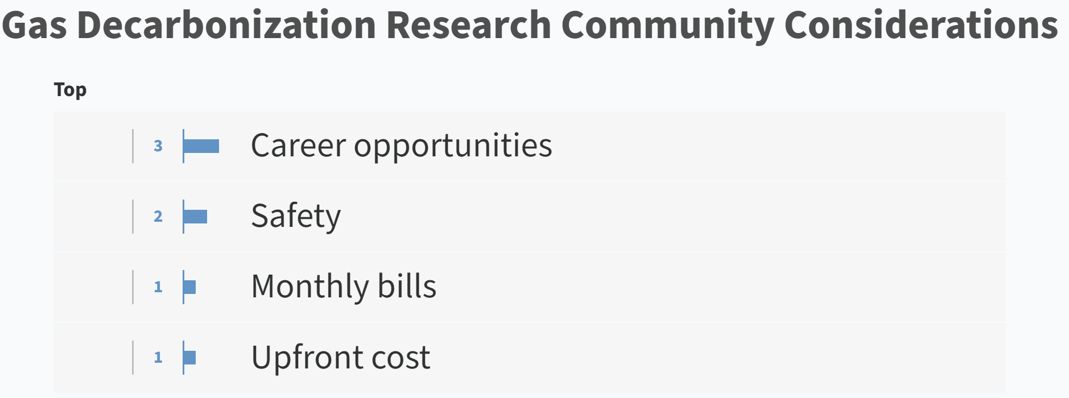
Interactive Exercise
?
Now that we have discussed some of the key decarbonization strategies and associated community considerations, what do you think are the most important concerns for your community that you think CEC research should place an emphasis on?
Instructions
Go to the link that we have posted in the chat
Enter responses in no more than a short sentence.
Input as many entries as you would like.
Upvote other responses that you strongly agree with
Illustrative
We will have a discussion in which you can remark on your responses.

Slide 28
Community Considerations Q&A
Would anyone like to expand on their entries from the interactive exercise?
Have we missed any key considerations from our conversation thus far?

Slide 29
Closing
Do you have any other general feedback or areas you would like us to consider?
If you have not already done so, please complete this form with your feedback. If you have additional input, you can also submit it through the docket here, indicating “Guidehouse Long-term Study” in the subject line.

Slide 30
Contacts
California Energy Commission
Guidehouse Inc.
Harrison Reynolds
California Energy Commission
Energy Research and Development Division
Role: Commission Project Manager
Harrison.Reynolds@energy.ca.gov
Bill Goetzler Guidehouse Partner Role: Project Director 781-270-8351 wgoetzler@guidehouse.com | Javi Luna Guidehouse Consultant 415-399-2121 jluna@guidehouse.com
Warren Wang Guidehouse Associate Director Role: Project Manager 213-618-9019 wwang@guidehouse.com | Matt Chill Guidehouse Consultant 310-968-3159 mchill@guidehouse.com
Kevin Uy
California Energy Commission
Energy Research and Development Division
Role: Commission Office Manager
916-776-0821
kevin.uy@energy.ca.gov
GC Green
Elizabeth Perez GC Green Role: Communities Advisor liz@gcgreen.com | Rick Halperin GC Green rick@gcgreen.com

