Slide 1
Establishing a Long-Term Natural Gas Research Strategy to Achieve Aggressive Statewide Carbon Neutrality Goals
Session 2
Stakeholder Introductory Meeting
January 19, 2022
Contractor Presentation

Slide 2
Introduction
The recommendations from this study will help inform future research planning for the CEC's Natural Gas Research Program but will not be the sole resource upon which future investments are based.
Many factors guide the CEC’s investments (e.g., technology, policy). These factors can change over time and the CEC must be responsive to these changes.
The findings and figures presented herein are preliminary and subject to change as the study progresses.

Slide 3
Questions to Consider
The purpose of this presentation is to gain stakeholder feedback on preliminary results – subsectors which are important, prioritization methodology (Q&A slide)
Sectors & Subsectors:
  Are there any subsectors that are missing?
  Should any subsectors have their priority reassessed?
Prioritization Methodology:
  Are the metrics and score descriptions clear enough?
  Thoughts on the weightings for the metrics?
  Is there anything missing from the metrics and score descriptions that should be considered?

Slide 4
Agenda
Time | Items
5 minutes | Background Natural Gas Research Program Background and Policy Drivers NG R&D Strategy Project
5 minutes | Project Approach and Timeline
5 minutes | Sector & Subsector Overview
25 minutes | Technology Evaluation Evaluation Methodology Sample Scoring Walkthrough Preliminary Evaluation Matrices
20 minutes | Closing and Q&A

Slide 5
Research Program Background
The Natural Gas Research, Development and Demonstration Program is funded by a natural gas ratepayer surcharge established by the California Public Utilities Commission (CPUC) in 2004
The purpose of the Natural Gas RD&D Program is to benefit the ratepayers of natural gas investor-owned utilities*
The Natural Gas RD&D Program funds clean energy technology projects that promote greater natural gas reliability, lower costs, and increased safety
Funded projects must lead to technological advancement and breakthroughs to overcome the barriers that prevent the achievement of the state’s statutory energy goals
Annual program funds total $24 million
* Pacific Gas and Electric Co., San Diego Gas and Electric Co., and Southern California Gas Company

Slide 6
California Policy Drivers
SB 32: Requires the state to reduce greenhouse gas (GHG) emissions to 40% below 1990 levels by 2030; The SB 32 Climate Change Scoping Plan: CARB created and maintains a comprehensive, multi-year program to reduce GHG emissions in California
SB 350: Requires the CEC to establish annual targets for statewide energy efficiency savings
SB 100: Requires the state to achieve 100% renewable and carbon-free electricity by 2045 and 60% renewable electricity by 2030
EO B-55-18: Sets a goal that the entire California economy achieve carbon neutrality by 2045 and achieve and maintain net negative emissions thereafter
AB 3232: Requires the CEC to assess the potential to reduce GHG emissions from residential and commercial buildings by 40% of 1990 levels by 2030
EO N-79-20: Sets a goal of 100% zero emission vehicles (ZEV) for passenger cars, light duty trucks, and drayage vehicles by 2035 and medium- and heavy-duty vehicles by 2045
Integrated Energy Policy Report (IEPR): Provides an overview of major energy trends and issues facing the state and is updated biennially (use hyperlink to access 2021 IEPR draft)
SB: Senate Bill; EO: Executive Order: AB: Assembly Bill

Slide 7
Purpose of R&D Strategy Project
The purpose of this project is to produce a long-term research strategy to help decarbonize California’s natural gas system by 2045.
The strategy is expected to produce prioritized research recommendations that include all stages in the supply chain (production, transmission, storage, and distribution for low carbon fuels) and all natural gas end use sectors, except for utility-scale power generation.
These recommendations will inform future research on technology development, deployment, and demonstration in the CEC’s Gas R&D Program to help transition to net-zero carbon.

Slide 8
RD&D Supported & Research Areas
Types of RD&D CEC Supports
Research Areas
Research recommendations produced by the project will include the following:
  Scientific and Techno-Economic Analysis - Developing new knowledge and tools that can inform energy policy and planning decisions
  Technology Development - Developing early-stage technologies at lab or prototype level (TRL 3-5).
  Technology Demonstration and Deployment - Demonstrating later stage technologies or systems at a scale that will reflect actual operating, performance, and financial characteristics and risk (TRL 6-9).
Research recommendations produced by the project must be within the following Research Areas:
  Research Areas:
  Building Decarbonization
  Energy-related Environmental Research
  Gas Infrastructure Integrity, Sustainability, and Security
  Industrial and Agricultural Innovation
  Renewable Energy and Advanced Generation
  Transportation
Recent annual reports and investment plans available at:
https://www.energy.ca.gov/energy-rd-reports-n-publications/energy-research-and-development-investment-plans-and-annual

Slide 9
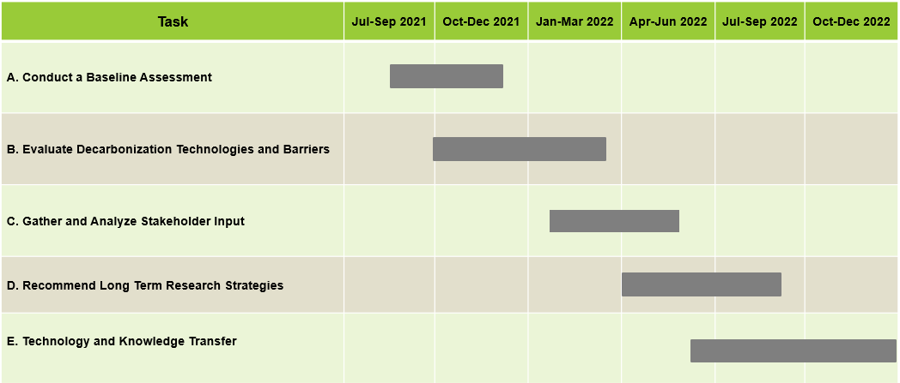
Schedule and Key Dates

Slide 10















Stakeholder Engagement
Stakeholder Interviews
Stakeholder Workshops
Conduct interview series with experts in Q2 2022 to gain direct insight into the following for NG decarbonization technologies:
  Cost and performance attributes
  Areas and strategies for specific research
  Trends and opportunities to facilitate decarbonization of the NG system
  Other critical indicators of success
Interviews may include experts from:
  Academia
  Government/National Labs
  Gas Utilities
  Industry RD&D Groups
  Technology Vendors
  End Users
Public workshops to be held in Q2 2022 to present intermediate results and allow for input from experts and stakeholders
There will be two public stakeholder workshops to accommodate participants’ availability

Slide 11
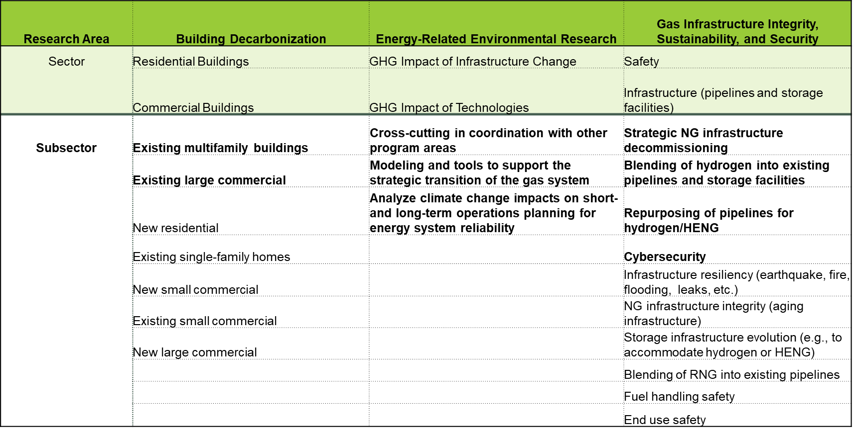
Sectors and Subsectors (1 of 2)
Priority subsectors are in bold.

Slide 12
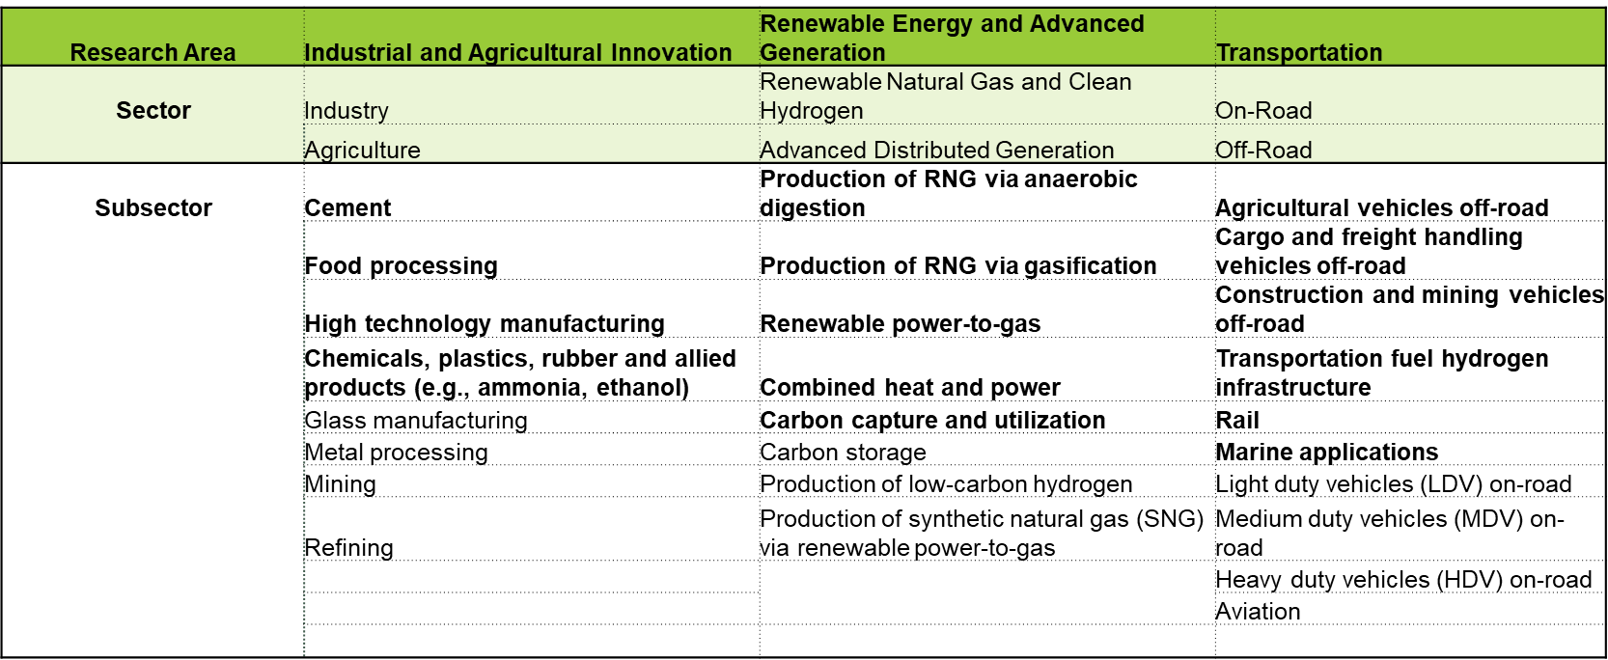
Sectors and Subsectors (2 of 2)
Priority subsectors are in bold.

Slide 13
Feedback Sought
We’re not currently fielding questions, but we want you to consider the following to direct your questions at the end or to enter in the Zoom Q&A box:
Are there any subsectors that are missing?
Should any subsectors have their priority reassessed?
Submit comments to: https://efiling.energy.ca.gov/Lists/DocketLog.aspx?docketnumber=16-PIER-01 by January 31, 2022 and indicate “Guidehouse Long Term Study” in the subject line (comments will not be responded to directly).​

Slide 14
Prioritization Framework
High
Strategic Value (Y-axis) | Weight Range Considered | Current Weight
A. Decarbonization Potential | 20-50% | 50%
B. Economic Value | 20-50% | 25%
C. Technology Equity and Accessibility | 20-50% | 25%
Barriers (X-axis)
D. Technology Readiness | 20-50% | 30%
E. Deployment Ecosystem | 20-50% | 30%
F. Policy Alignment | 20-50% | 40%
Highest Priority
High Risk/High Reward
Strategic Value
Justification Required
Quick Wins
Low
Barriers
High
Low Barrier score is preferred

Slide 15
Prioritization Metrics (1 of 2)
 |  |  | Scoring Methodology
 |  |  |  |  | Score Description
Score Category | Metric | Current Weight | Metric Description | Low (1) | Medium (2) | High (3)
 | Decarbonization Potential | 50% | Focuses on the decarbonization potential of the technology compared to existing technologies with respect to the total amount of emissions that can be abated by this technology. | Emission Reductions: Small addressable emissions pool Effective alternative decarbonization options already exist. | Carbon Neutral / High Impact Emission Reductions: Moderate addressable emissions pool Reduction in difficult to decarbonize sector. | Carbon Negative / High Impact Carbon Neutrality: Large addressable emissions pool Carbon neutral in difficult to decarbonize sector.
Strategic Value | Economic Value | 25% | Economic value of the technology based on costs (CAPEX, OPEX), payback potential, total addressable market, and market demand for the technology or product features. | Low Value: High costs Low payback potential Small addressable market Low demand. | Moderate Value: Moderate costs Moderate payback potential Moderate addressable market Moderate demand. | High Value: Low costs High payback potential Large addressable market High demand.
 | Technology Equity and Accessibility | 25% | Evaluates technology on health, affordability, and accessibility for low-income areas and disadvantaged communities. | Negative Impact: Poor accessibility Unaffordable for many to acquire or use Increased health and safety risks. | Neutral Impact: No impact on accessibility No change in affordability for many to acquire or use No significant health and safety risks. | Positive Impact: Widespread accessibility Affordable for many to acquire or use Decreased or minimal health and safety risks.

Slide 16
Prioritization Metrics (2 of 2)
 |  |  | Scoring Methodology
 |  |  |  |  | Score Description
Score Category | Metric | Current Weight | Metric Description | Low (1) | Medium (2) | High (3)
 | Technology Readiness | 30% | Development stage of the technology itself, using Technology Readiness Level (TRL) metrics as baseline. | Technology RD&D at: Proof of concept Technology component, subsystem development Technology pilot Technology field demonstration | Not Applicable | Competitively Commercialized or Very Early Stage: Commercialized technologies (beyond TRL 9) with multiple vendors Technology concept not formulated (TRL 1-2)
Barriers | Deployment Ecosystem | 30% | Enabling infrastructure and related systems necessary for the technology to succeed. | Low Effort: Minimal enabling infrastructure needed Readily available fuel/ feedstock Few viable alternatives Minimal safety concerns | Moderate Effort: Moderate enabling infrastructure needed Somewhat available fuel/ feedstock Some viable alternatives Moderate safety concerns | High Effort: Significant enabling infrastructure needed Largely unavailable fuel/ feedstock Many viable alternatives Many safety concerns
 | Policy Alignment | 40% | Technology aligns with state policies and CEC NG R&D priorities (i.e., priority subsectors) | Strong Alignment: Strong alignment with state policy goals Aligns with CEC NG R&D priorities | Moderate Alignment: Some alignment with state policy goals Moderately aligns with CEC NG R&D priorities | Weak Alignment: Weak alignment with state policy goals Not aligned with CEC NG R&D priorities

Slide 17
Feedback Wanted
We’re not currently fielding questions, but we want you to consider the following to direct your questions at the end or to enter in the Zoom Q&A box:
Are the metrics and score descriptions clear enough?
Thoughts on the weightings for the metrics?
Is there anything missing from the metrics and score descriptions that should be considered?
Do you think there is a better way to evaluate certain metrics?
Submit comments to: https://efiling.energy.ca.gov/Lists/DocketLog.aspx?docketnumber=16-PIER-01 by January 31, 2022 and indicate “Guidehouse Long Term Study” in the subject line (comments will not be responded to directly).​

Slide 18
Sample Scoring Walkthrough
Technology/ Challenge | Technology/ Challenge Category | Relevant Fuel/ Feedstock | Development Status | Economic Value | Decarbonization Potential | Technology Equity and Accessibility | Technology Readiness | Deployment Ecosystem | Policy Alignment | Score Barrier | Score Strategic Value
H2 Boiler with Zero-Emissions | Boilers | Hydrogen | Demonstration | High (3) | Medium (2) | Medium (2) | Low (1) | Medium (2) | Low (1) | 1.3 | 2.25
Large addressable market for industry results in high economic value.
30% more fuel efficient than existing NG boilers and produces clean steam with no pollutants
Potential for carbon neutrality depending on how H₂ is produced.
Low readiness barriers - technology proven at lab scale with larger demonstrations planned to test certain elements.
Medium deployment ecosystem barriers - technology requires production of clean H₂, potentially produced on site, and infrastructure modifications for H₂.
Aligns well with decarbonization policy goals, including CA Cap-and-Trade program, and CEC’s funding plans.
Strategic Value Considerations
Barrier Considerations

Slide 19



Industrial
Industrial Research Area Context for NG Decarbonization RD&D Needs
Hydrogen (H₂) technologies are a primary pathway for decarbonization of NG industrial uses
Carbon capture & utilization (CCU) technologies are key to minimize emissions in the transition to green H₂.
Challenges include high temperature processes, H₂ enabling infrastructure, and creating value from CO₂.
Industrial Evaluation Matrix Key Insights
CCU Technologies provide negative emissions with high economic and decarbonization value
Hydrogen Heating is the most promising pathway for high temperature processes
Hydrogen Technologies require significant infrastructure buildout or retrofit to support new end-uses and increasing demand
Relevant External Efforts – previous and current efforts relevant to this research area
Carbon Capture Coalition, Hy4Heat (Industrial Appliances), Carbon Utilization Alliance (Companies in CCUS development), UN’s Industrial Deep Decarbonization Initiative , EU’s IPCEIs on Hydrogen (H₂ projects in EU)

Slide 20
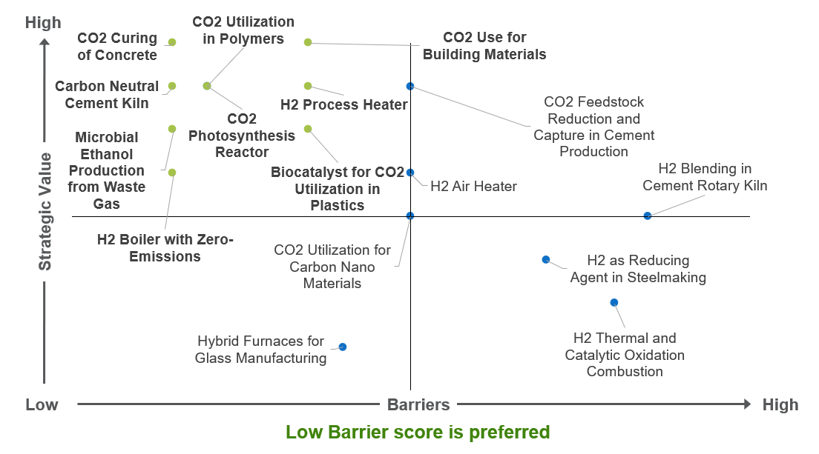
Industrial Evaluation Matrix

Slide 21



Transportation
Transportation Research Area Context for Natural Gas Decarbonization RD&D Needs
H₂ fuel cell (FC) vehicles can serve as complementary ZEV solutions to battery electric vehicles (BEVs) for heavy duty on-road and other off-road applications.
Overarching challenges include refueling and distribution infrastructure, safety concerns, durability, and thermal management.
Transportation Evaluation Matrix Key Insights
Off-road FC trucks offer strong strategic value by addressing high impact regional emissions and low barriers with strong policy alignment
Liquid H₂ onboard storage offers greater energy density, but technical challenges and safety concerns elevate barriers
  H₂ harborcrafts and H₂ rail are promising for investment despite fewer total addressable emissions
  The high capacity mobile H₂ refueler scored favorably as it offers a flexible refueling solution for many applications
Relevant External Efforts – previous and current efforts relevant to this research area
Million Mile Fuel Cell Truck (DOE program supporting FCs as applied to HD trucks), H2Bus (Consortium focused on H₂ bus deployment), Durham Energy Institute’s Network-H2 (Supports H₂ transportation network)

Slide 22
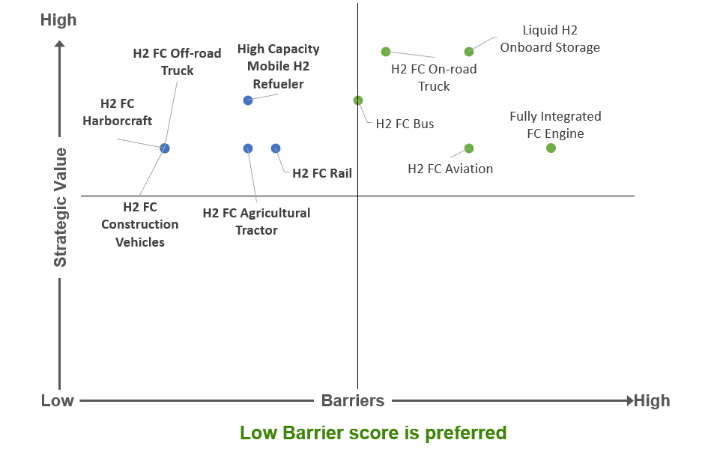
Transportation Evaluation Matrix

Slide 23
Q&A
Sectors & Subsectors:
  Are there any subsectors that are missing?
  Should any subsectors have their priority reassessed?
Prioritization Methodology:
  Are the metrics and score descriptions clear enough?
  Thoughts on the weightings for the metrics?
  Is there anything missing from the metrics and score descriptions that should be considered?
Are there any other inputs or feedback you would like to provide to further develop the study?
Please submit comments to https://efiling.energy.ca.gov/Lists/DocketLog.aspx?docketnumber=16-PIER-01 by January 31, 2022, and indicate “Guidehouse Long Term Study” in the subject line (comments will not be responded to directly).​
Next Steps:
More opportunities for stakeholder input via two Spring 2022 stakeholder workshops (dates TBD)
Expert stakeholder interviews will also be held Spring 2022

Slide 24
Contacts
California Energy Commission
Kevin Uy California Energy Commission Energy Research and Development Division Role: Commission Project Manager 916-776-0821 kevin.uy@energy.ca.gov
Harrison Reynolds California Energy Commission Energy Research and Development Division Role: Commission Deputy Project Manager Harrison.Reynolds@energy.ca.gov
Guidehouse Inc.
Bill Goetzler
Guidehouse
Partner
Role: Project Director
781-270-8351
wgoetzler@guidehouse.com
Warren Wang
Guidehouse
Associate Director
Role: Project Manager
213-618-9019
wwang@guidehouse.com
Javi Luna
Guidehouse
Consultant
415-399-2121
jluna@guidehouse.com
Matt Chill
Guidehouse
Consultant
310-968-3159
mchill@guidehouse.com

Slide 25
Thank you!

