Slide 1
Strategic Pathways and Analytics for Tactical Decommissioning of Portions of Natural Gas Infrastructure in Northern California

Slide 2
Key takeaways
  PG&E’s gas system planning is driven by safety, risk reduction, and compliance; requirements are substantially determined through a stakeholder process at the CPUC and in accordance with code.
1
  PG&E takes a least-cost approach to system upgrades and replacement; this includes decommissioning and electrification options.
2
  Identifying locations for at-scale electrification projects requires numerous data sources and implementation of the projects must overcome barriers that include obligation-to-serve requirements and funding availability for electrification.
3

Slide 3
PG&E considers all options for gas projects during project scoping
Data
Asset planning
Scoping
Finance
Execution
Work Identification:
resolve issues related to safety, compliance, and risk
Mitigation Options:
include status quo solutions, downrate, retirement, and electrification
Additional Considerations:
bundling work and geography
Output:
Detailed scope of work
Note: In some cases, electrification opportunities are also found during execution, even if the project was not identified for electrification during scoping.

Slide 4
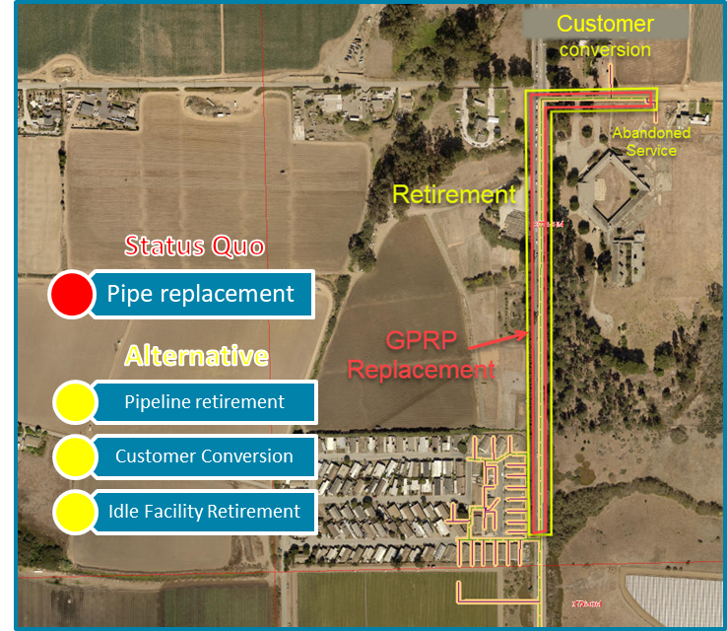
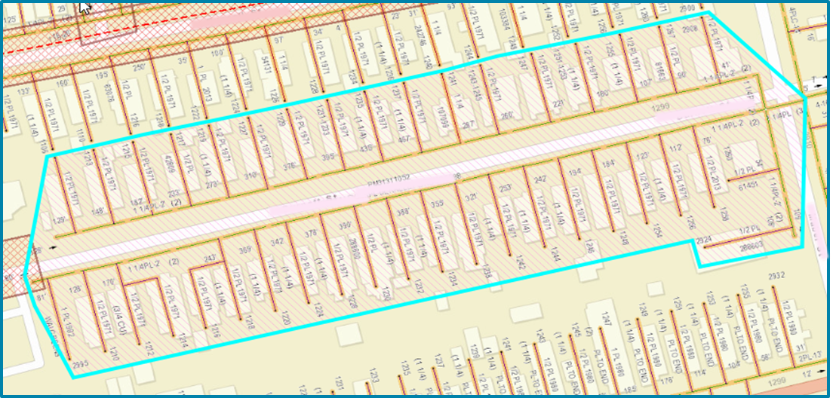
Zonal electrification has the potential to eliminate the need for gas infrastructure and reduce gas system operating costs
PG&E can identify high-potential zonal electrification candidates using a range of data related to the gas system, customer propensity, policy, and other factors
  No single piece of data is sufficient to identify promising candidates
  In all cases, locations need to be validated by detailed engineering review
Identifying high-potential zones is only the first step; other challenging barriers exist
  Customer consensus and/or PG&E’s obligation-to-serve
  Cost of zonal electrification projects and availability of non-utility funding
  Non-uniformity of local decommissioning regulations
Long stretches of pipe serving a small number of customers are attractive candidates today
Areas with large numbers of customers to electrify are more challenging

Slide 5
Multiple sets of data are required to effectively identify opportunities for decommissioning / electrification
Key data considered in PG&E’s internal gas asset analysis tool
Customer Information
Customer type
Gas usage
Demographic
Information
Census data
Customer characteristics
Gas System Infrastructure
Asset locations & information
HIS data & system utilization
Cost vs Revenue
Policy & Risk
Environmental risk
Areas with reach codes
T&D integrity mgmt. scores
Gas System Financials
Distribution projects
Transmission projects
O&M
Electric System
Electric system capacity

Slide 6
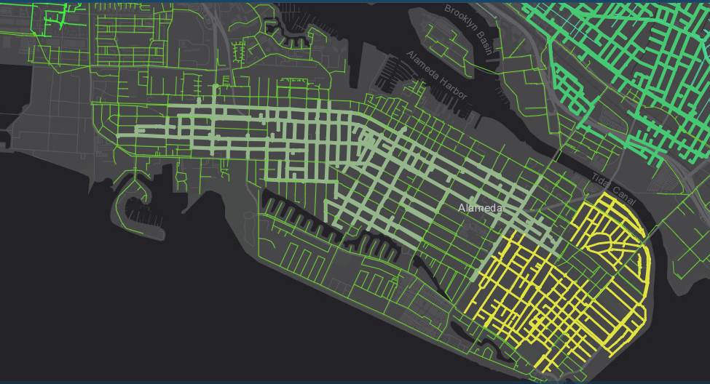
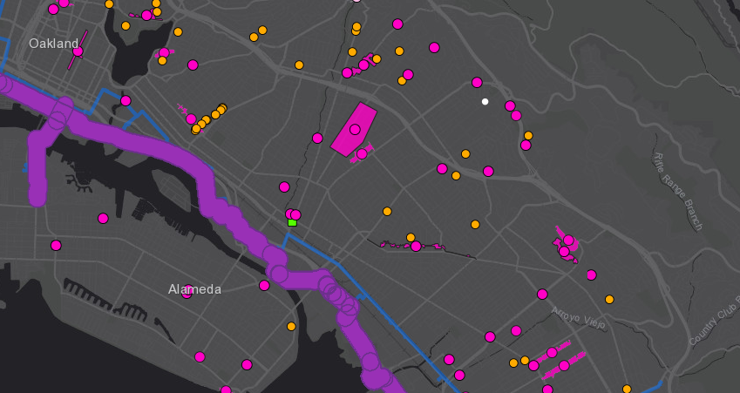
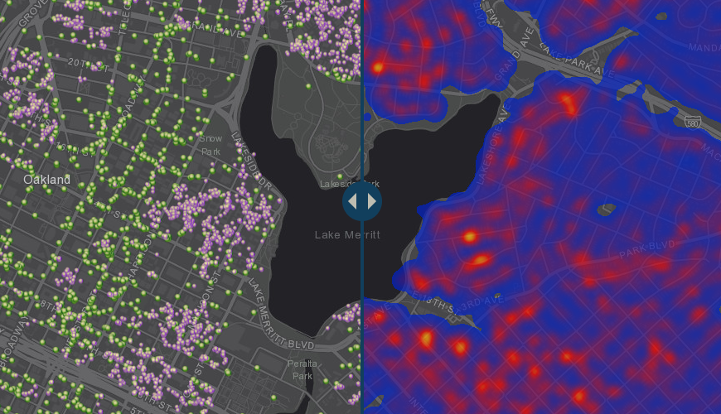
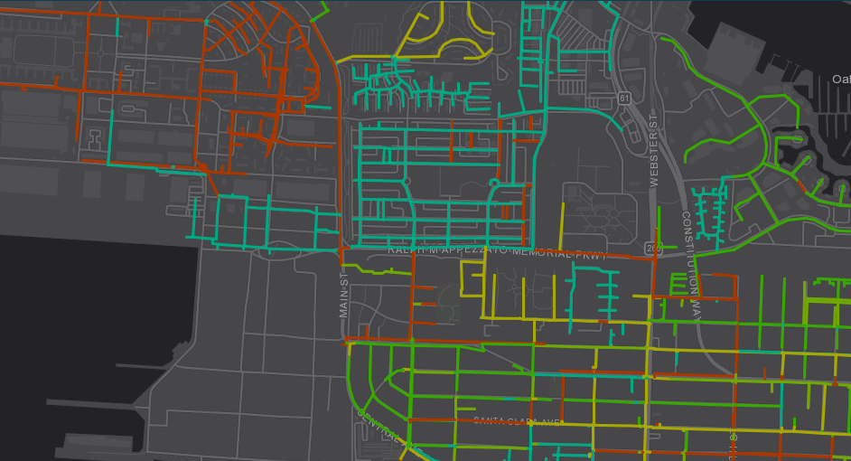
Customer type
PG&E currently uses data visualization to support identification of high-potential zonal electrification areas
Hydraulically independent systems
Upcoming capital projects
Pipe by install date

Slide 7
Thank you

