Slide 1
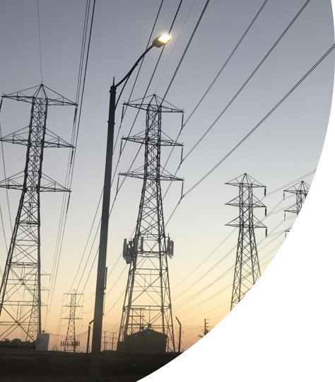

Strategic Pathways and Analytics for Tactical Decommissioning of Portions of Natural Gas Infrastructure in Southern California
Project Kick-Off Meeting
Kelly Klima
RAND, GTI, LARC, SoCalGas
November 17, 2021

Slide 2
Agenda
Project Goals and Objectives
Research Approach & Tasks
Topic 1: What is Equity?
Topic 2: How will community engagement occur?

Slide 3
Project Goals & Objectives
Goal:
Develop an objective analytical framework to identify where natural gas decommissioning in Southern California will (1) serve the interests of affected communities, (2) lead to net economic and societal benefits, and (3) be plausible under a wide range of possible futures.
Objectives:
Develop a framework with a set of criteria for identifying and selecting promising decommissioning sites
Identify & understand community & utility decision criteria. Model equity concerns
Assess economic implications of decommissioning (macro-economic model to determine effects on rate payers and hydraulic model to determine local effects of decommissioning)
Conduct decision analysis under deep uncertainty to inform robust planning for targeted decommissioning
Draft at least three pilot applications for decommissioning natural gas infrastructure

Slide 4
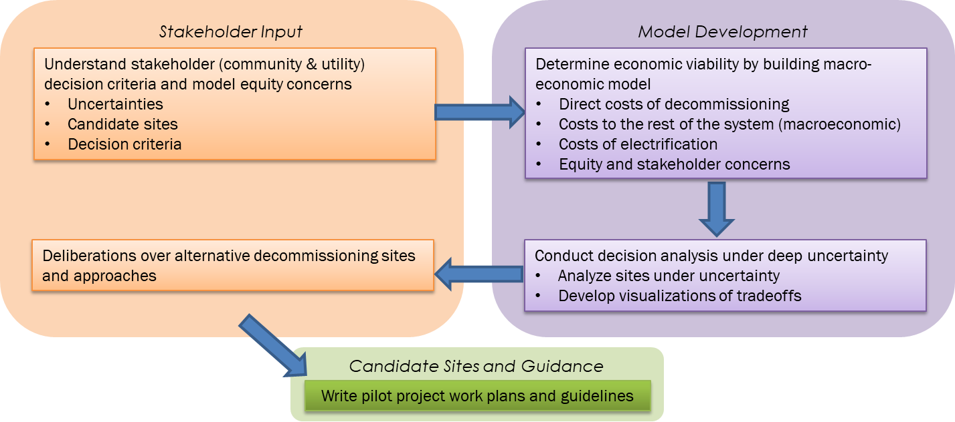
Overall Research Approach

Slide 5
Tasks
Administration
General Project Tasks (including TAC) RAND
Community Research and Engagement RAND & LARC
Economic Modeling GTI, SoCalGas, RAND
Equity Modeling RAND
Evaluation via Robust Decision Making (RDM) RAND
Pilot Project Work Plans RAND with support from all
Guidelines RAND with support from all
Evaluation of Project Benefits RAND with support from all
Tech and Knowledge Transfer Activities RAND with support from all
Stakeholder input
Modelling
Candidate Sites and Guidance

Slide 6
What is equity?
Social vulnerability: Combinations of social, cultural, economic, political, and institutional conditions that shape the ability to withstand and recover from stressors and shocks
Equity:
  A comparative construct of fairness across disparate groups
  Goal is fair access to livelihood, education, and other resources
  Allows for unequal distribution of benefits and costs for net social gain
  Means that sociodemographic characteristics (race, gender, age, etc.) no longer predict negative impacts or distribution of resources

Slide 7
Equity raises four questions
Context: What counts as equity?
Target: Whose equity are we concerned with?
Goal: Why are we concerned with equity?
How are we going to answer questions 1-3?
1. Context: What counts?
2. Target: Who counts?
3. Goal: Why?
See McDermott, Mahanty, & Schreckenberg, 2013

Slide 8
There are three dimensions of equity
Contextual equity – extent to which pre-existing political or socio-economic conditions limit/enable people’s capacity to engage in and benefit from resource distributions [initial conditions]
Procedural equity – extent to which groups are recognized to ensure their inclusion and representation [process]
Distributional equity – the allocation of costs, risks, and benefits [outcomes]
  Principles of distributive justice include equality, social welfare, merit, need
Distributional
Contextual
Procedural
1. Context: What counts?
2. Target: Who counts?
3. Goal: Why?

Slide 9
Agenda – Topic 2
Project Goals and Overview
Research Approach & Tasks
Topic 1: What is Equity?
Topic 2: How will community engagement occur?

Slide 10
There are many types of multi-stakeholder research approaches.
Stakeholders as focus of research
Stakeholders as participants in research
Understand
Co-Produce
Co-Produce
Generate knowledge
Year 1 Workshops
Communicate
Deliberate
Deliberate
Offer new frames
Year 2 Workshops
Source: Lempert, Klima, & Turner, forthcoming, 2021

Slide 11
What does good community engagement look like?
Topics focus on community interests
Communications fit in with local mental models.
Stakeholders are representative of the local population (including businesses, industries, utilities, government, schools, residents, local community groups)

Slide 12
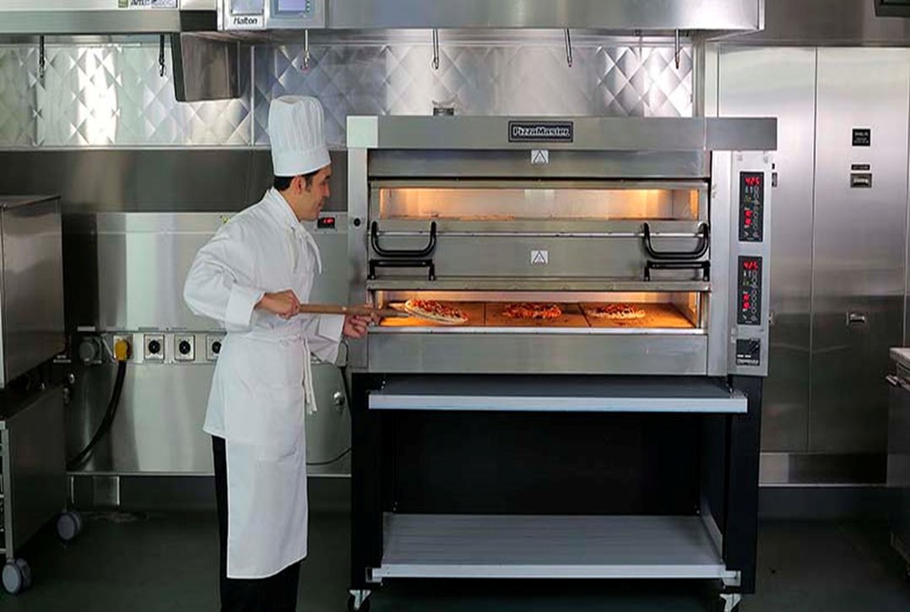
For example, include local restaurants and consideration of induction cooking
The Food Service Technology Center offers electricity utility customers free services
Source: Southern California Edison
Notes:
Foodservice Technology Center (sce.com)

Slide 13
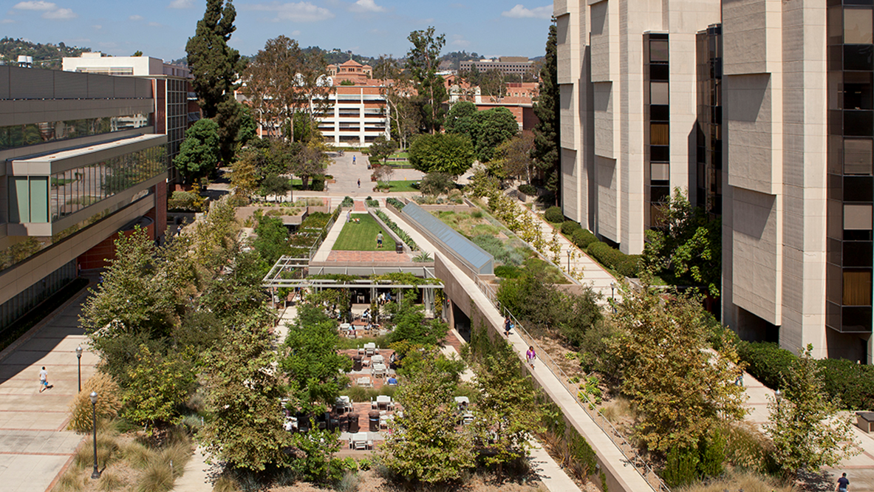

Los Angeles Regional Collaborative for Climate Action and Sustainability
Our team includes the with Los Angeles Regional Collaborative for Climate Action and Sustainability…
LARC is Los Angeles County’s climate and sustainability network.
Housed at UCLA, LARC is a membership organization comprised of climate practitioners from city and county government, regional agencies, non-profits, businesses, and academia.
LARC’s mission is to ensure a sustainable LA prepared for the impacts of climate change.
Sample Project:
“A Greater L.A.: the Framework for Regional Climate Action and Sustainability” – a county-wide climate action and sustainability plan

Slide 14

Project Stakeholders
Technical Advisory Committee
As of September 2021
Association for Energy Affordability
CEC: Le-Quyen Nguyen, Terra Weeks, Ken Rider, Liz Gill, and Peter Puglia
Energy by 5
ENGIE
Environmental Defense Fund
PCS Energy
Redwood Energy
Sempra Energy Utility
Southern California Edison
Southern California Public Power Authority
E3
Communities for Better Environment
Scope LA
South Coast Air Quality Management District
Rocky Mountain Institute
Communities
City of Santa Monica, Sr. Sustainability Analyst
City of Long Beach, Business Operations Manager
County of Los Angeles, Chief Sustainability Officer

Slide 15
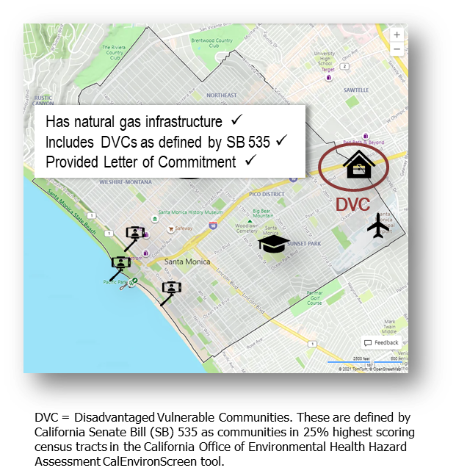
City of Santa Monica
Utilities: Southern California Gas Company. Southern California Edison.
Infrastructure: Santa Monica Airport, universities, aging pipe replacement, manufactured housing communities, homeless camps, tourism traffic.
DVCs: Appears once in CalEnvironScreen tool.
Weather: In Los Angeles County, near the beach, and experiencing similar weather and natural hazards to Long Beach.
Stance on Decommissioning: Recently launched a rebate program (Electrify Santa Monica) to promote switching natural gas end uses to efficient electric alternatives; Climate Adaptation plan explicitly calls out building codes; Energy Reach code incentivizes all electric new construction.
https://www.santamonica.gov/

Slide 16
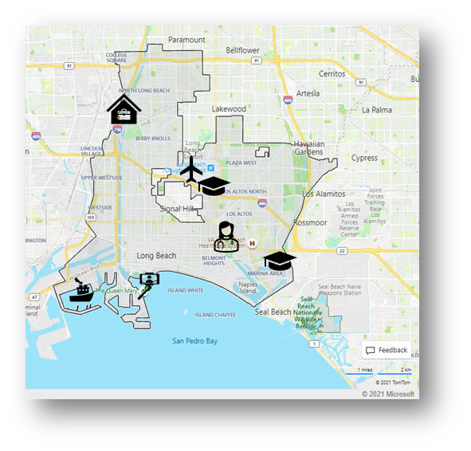
City of Long Beach
Utilities: Municipal gas utility & Southern California Gas Company. Southern California Edison.
Infrastructure: Port of Long Beach, universities, aging pipe replacement, manufactured housing communities, homeless camps, tourism traffic.
DVCs: Appears 57 times in CalEnvironScreen tool.
Weather: In Los Angeles County, near the beach, and experiencing similar weather and natural hazards to Santa Monica.
Related Efforts: City has a proactive approach on position on reducing greenhouse gases. Part of this includes community outreach. Out of development services department, there is a team of advanced planners looking at community outreach.
https://www.longbeach.gov/
Has natural gas infrastructure ✓
Includes DVCs as defined by SB 535 ✓
Provided Letter of Commitment ✓

Slide 17
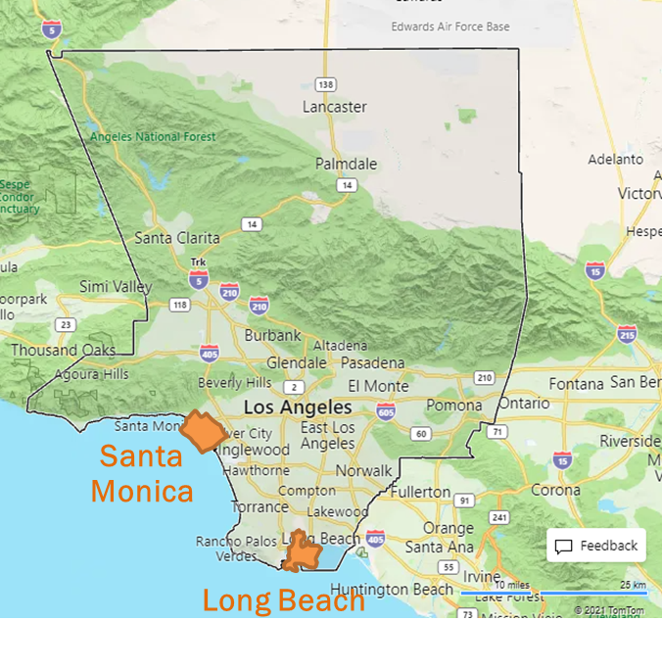

County of Los Angeles
Recent sustainability plan (adopted in 2019), includes focus on environmental justice
Climate vulnerability assessment to be released Fall 2021. Focuses on social vulnerability (i.e., vulnerable populations)
Will be working with us in the City of Santa Monica and City of Long Beach efforts
Working with us now to determine other possible locations in unincorporated LA county community.

Slide 18
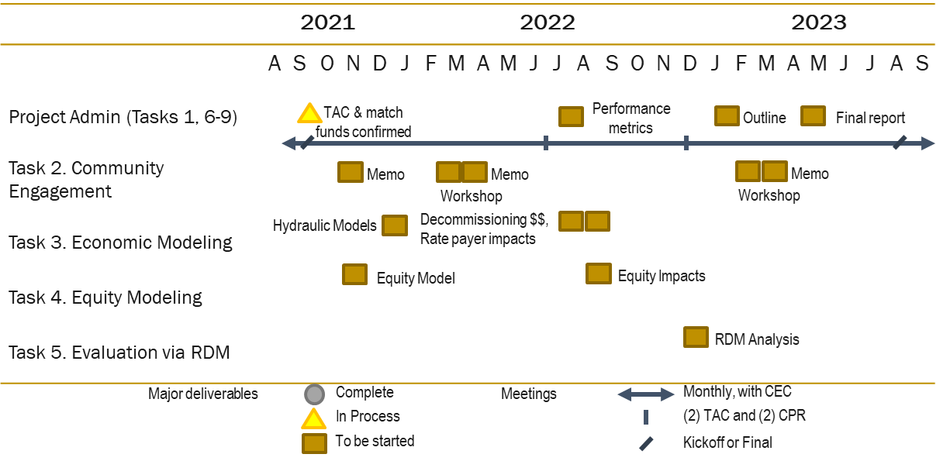
Deliverable Schedule

Slide 19
Questions to Stakeholders
Activity 1. Literature to Review: Please identify Reports/ publications that the researchers of this project should consider and review. Please indicate at least Name, Author and other referential information so that the team can find it.
Activity 2. Additional Outreach. If you think there is benefit for our researchers to reach out to specific individuals please indicate for each suggestion the Name and the Job Title of the person we should reach to

Slide 20
Thank You
Kelly Klima
kklima@rand.org
Nidhi Kalra
nidhi@rand.org

