Slide 1
Staff Workshop
Strategic Pathways and Analytics for Tactical Decommissioning of Portions of Natural Gas Infrastructure
Energy Research and Development Division, California Energy Commission
Presenters: Qing Tian Ph.D. and Reta Ortiz
Date: November 17, 2021

Slide 2
Agenda
Time | Items
10:00 am | Welcome and Introduction
10:10 am | Panel Presentations
 | E3 - Energy and Environmental Economics, Inc.
 | PG&E
 | RAND Corporation
 | SoCalGas
11:20 am | Panel Discussion
11:40 am | Q&A and Public Comments
12:00 | Adjourn

Slide 3
Housekeeping
This workshop will be recorded.
Participants will be muted during the presentation. Please chat your question in the Q&A window.
Submit your comments electronically through the CEC’s “Research Idea Exchange” docket: https://efiling.energy.ca.gov/Ecomment/Ecomment.aspx?docketnumber=19-ERDD-01
Workshop slides and the Zoom recording will be posted on our webpage:
  https://www.energy.ca.gov/event/workshop/2021-11/staff-workshop-strategic-pathways-and-analytics-tactical-decommissioning
Closed captioning service will be enabled for the workshop. Attendees can use the service by clicking on the “live transcript” icon and then choosing either “show subtitle” or “view full transcript.”

Slide 4
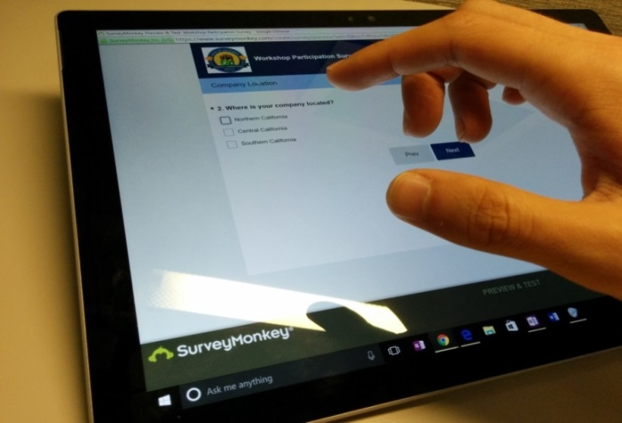
We Want to Hear From You!
Participation Survey
Survey responses will be summarized anonymously to track attendance of underrepresented groups in our workshops for public reporting purposes.
Online participants, please use this link:
https://forms.office.com/g/Eshs2gvHci
Thanks!

Slide 5
Natural Gas Infrastructure Safety and Integrity
  Mission: Conduct assessment and advance technologies that improve the safety of natural gas pipelines & storage systems while reducing GHG emission
  Funding:
  Natural Gas Research and Development Program
    $24 million annually
    ~ $6 million for infrastructure safety and integrity
    Solicitating research ideas for FY22-23
Safety
Decarbonization
Equity

Slide 6
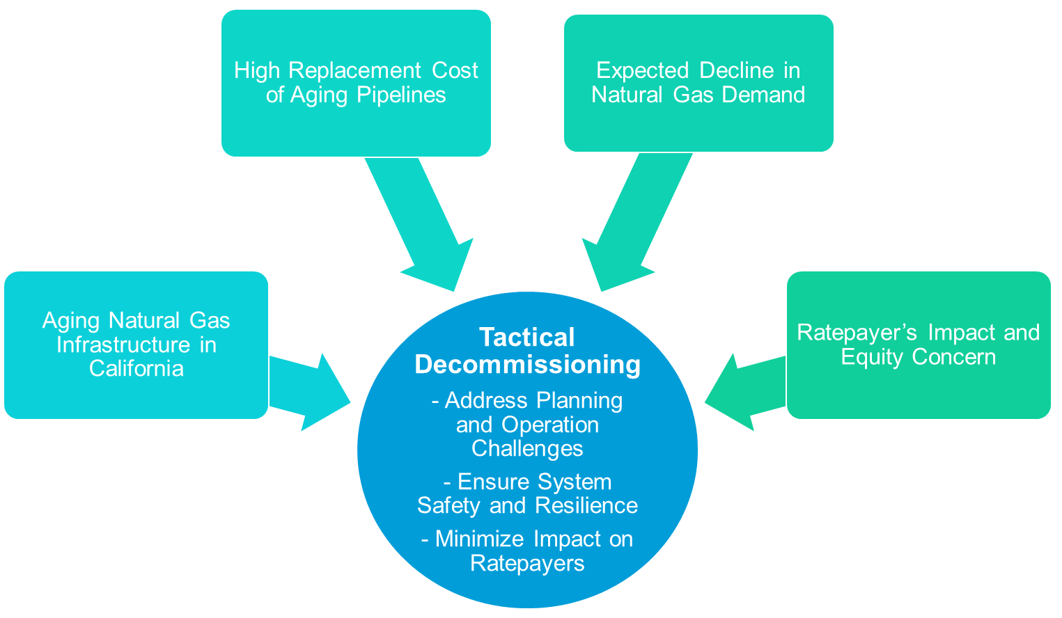
Pathways and Analytics for Tactical Decommissioning
  Tactical Decommissioning
  Stakeholder engagement and community research
  Economic and equity modeling
  Evaluation (decision analysis)
  Pilot deployment and applications
  Guidelines and criteria to replicate the success for broader deployment

Slide 7

Benefits to Californians
Enhance strategic long-term gas planning
Foster transparent, collaborative planning processes
Develop strategies for cost-effective, equitable gas transition
Enable decommissioning opportunities and assessments of potential benefits
Source: national-parks.org

Slide 8
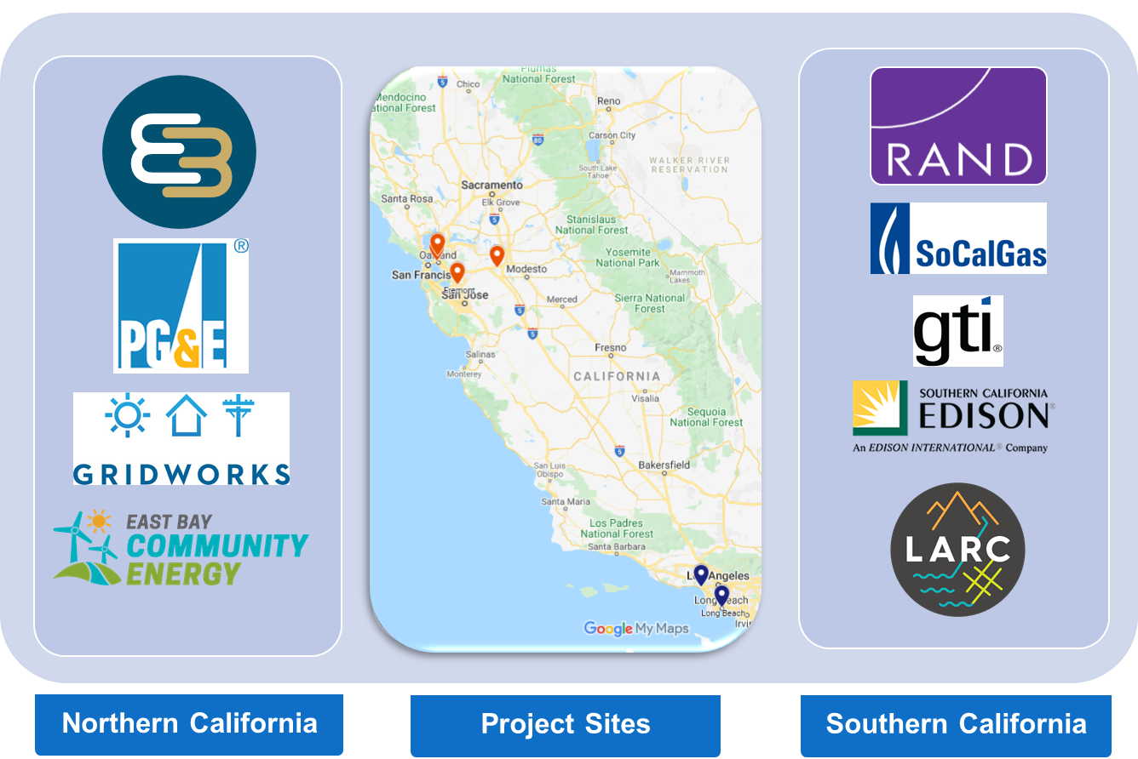
Pilot Demonstration for Tactical Decommissioning
  Develop criteria and a framework for selected decommissioning sites
  Explore methodologies and develop deployment plans for strategic decommissioning while balancing decarbonization, consumer acceptance and safe operations
  Identify community priorities, perspectives, and paths forward on electrification and tactical gas decommissioning
  Identify opportunities to achieve gas system cost reductions through tactical decommissioning

Slide 9
Panel Presentations

Slide 10
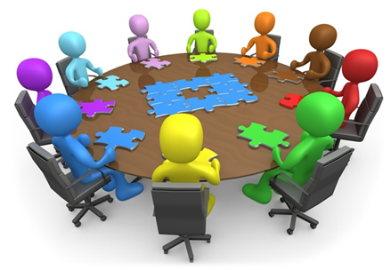
Panel Discussion

Slide 11

Q&A and Public Comments
Please chat your question in the Q&A window
Please raise your hand and you will be called on to unmute yourself. Please remember to introduce yourself by stating your name and affiliation.
Keep comments under 3 minutes to allow time for others.

Slide 12
Thank You!
Please submit your comments electronically through the CEC’s “Research Idea Exchange” docket: https://efiling.energy.ca.gov/Ecomment/Ecomment.aspx?docketnumber=19-ERDD-01

