Slide 1


Strategic Pathways and Analytics for Tactical Decommissioning of Portions of Natural Gas Infrastructure in Northern California
CEC Public Workshop
11/17/2021
Ari Gold-Parker, E3
Amber Mahone, E3

Slide 2



Project Overview
A key challenge facing CA: how to equitably decarbonize buildings in a way that supports and meets the needs of communities while reducing greenhouse gas emissions?
One hypothesis: targeted electrification combined with strategic decommissioning of gas infrastructure can reduce gas system costs and help mitigate future rate impacts for remaining gas customers
This project will develop critical data and information to inform and evaluate the gas decommissioning hypothesis and will develop a deployment plan for three pilot sites to test this hypothesis
Overview of Project Team
Community-Based Organization 1: TBD
Community-Based Organization 2: TBD
Project Partner: PG&E

Slide 3
Project Background and Context
Prior Work
Present Day
CPUC: Long-term gas system planning
E3/CEC, “Deep Decarbonization in a High Renewables Future.” June 2018
E3/CEC, “The Challenge of Retail Gas in California’s Low-Carbon Future.” 2019-2020
Gridworks, “Gas Resource Infrastructure and Planning for California.” January 2021
Gridworks, “California’s Gas System in Transition.” September 2019
CEC: Development of a Data-Driven, Actionable Tool and Case Studies to Support Strategic and Equitable Natural Gas Decommissioning
Ong, Mastrandrea, and Wara, “The Costs of Building Decarbonization Policy Proposals for California Natural Gas Ratepayers.” June 2021
This Project
CEC: Strategic Pathways and Analytics for Tactical Decommissioning of Portions of Natural Gas Infrastructure in Northern California
*Not an exhaustive list of research in this field
Notes:
Don’t want to do this project in a vacuum
Case study needs to be replicable across PG&E’s service territory– must keep broader picture in mind (will this matter)

Slide 4
Project Objectives
Primary Objectives:
  Create a framework for evaluating and characterizing gas decommissioning opportunities within PG&E and East Bay Community Energy’s service territories
  Engage local communities and gauge interest in participating in gas decommissioning and targeted electrification pilots
  Recommend three pilot sites for targeted gas decommissioning with a focus on learning how to address various challenges related to gas decommissioning
  Communicate progress and key findings to a broad audience
Additional Goals:
  Work with PG&E and the broader stakeholder group to identify existing data sources as well as data needs related to targeted gas decommissioning
  Identify regulatory and/or policy barriers to targeted gas decommissioning and communicate these to the CEC, CPUC, and the public
  Ensure that community needs and equity considerations are highlighted throughout the project

Slide 5
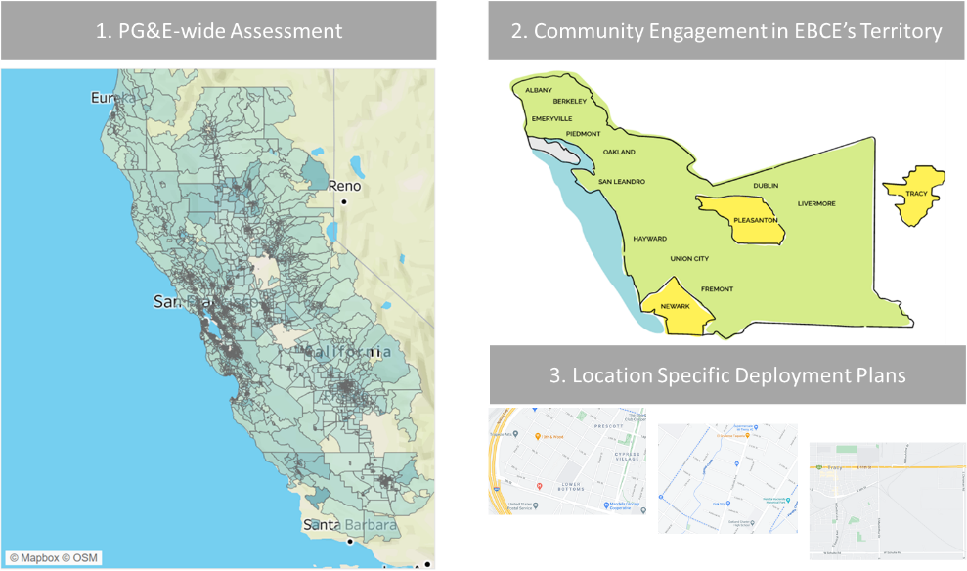
Project Methodology
A. Develop Pilot Selection Criteria and Framework
B. Assess Community Priorities and Needs
Example Criteria | Score
Community priorities and level of opt-in | x
Electrification cost-effectiveness | x
Equity considerations | x
Gas system feasibility and avoided costs | x
C. Pilot Definition and Deployment Plans
D. Knowledge Transfer Activities

Slide 6
A. Develop Pilot Selection Criteria and Framework
Input data may include:
  Demographic and building data from public sources
  Gas system data from PG&E
  Customer usage data from PG&E and East Bay Community Energy
  Community feedback
Criteria will not be given weights and no overall score will be produced
Pilot projects may be selected to explore questions related to one or more criteria
  Diverse pilot projects should produce insights to support a scalable approach
Example Criteria | Score
Community priorities and level of opt-in | x
Electrification cost-effectiveness | x
Equity considerations | x
Gas system feasibility and avoided costs | x

Slide 7
B. Assess Community Priorities and Needs
Engagement with pilot communities will be led by EBCE
Outreach goals include:
  Eliciting community priorities
  Identifying organizations and individuals interested in participating in gas decommissioning pilots
  Identifying barriers to pilot implementation
Project team will contract with 2 or 3 local community-based organizations to support outreach
Multi-pronged approach to community engagement will rely on:
  Recognized and respected community-based organizations
  Professional surveys to gather information on customer perceptions
  Town halls and other meetings to connect with community members not likely to be reached through survey instruments or digital media
Results will inform pilot selection
EBCE Service Territory

Slide 8
C. Pilot Definition and Deployment Plans
This task shifts project focus from analytics to implementation
  Given what we have learned, what sites are proposed and what will the development and implementation of pilot projects entail?
Key goals include:
  Identifying three diverse pilot sites including at least one in a DAC/LMI community
  Engaging with challenges and barriers in pilot implementation
  Considering outside funding that may be required to complete pilots
Project team will also note where challenges arise due to policy or regulatory issues
  May lead to proposed recommendations for policymakers and/or regulators
Pilot Definition and Deployment Plans

Slide 9
D. Knowledge Transfer Activities
Led by Gridworks, this task aims to report out on key project findings throughout the course of the project, using:
  Public workshops (such as this) to provide updates to the public
  A final report that will be available to the public
  Blog posts that will provide education and outreach to stakeholders within and beyond California
Project team will also receive feedback through periodic meetings of a Technical Advisory Committee. Members include:
  Merrian Borgeson (Natural Resources Defense Council)
  Michael Colvin (Environmental Defense Fund)
  Billi Romain (City of Berkeley)
  Mad Stano (Greenlining)
  Larry Waters (Electrify My Home)

Slide 10
Potential Communities
Five potential communities where pilot projects may be explored
Fruitvale (Oakland)
  Historically disadvantaged community
  Currently being studied for neighborhood-scale electrification under a CEC EcoBlock Grant
West Oakland
  Community heavily impacted by air pollution and economic inequality
City of Fremont
  Economics of electrification may be favorable due to newer housing stock and higher prevalence of air conditioning
City of Tracy
  High air conditioning loads and more rural building types than the rest of EBCE’s service territory
  Would provide insight into opportunities and challenges for targeted gas decommissioning in the Central Valley
West Berkeley
  First city to ban gas hookups in some new buildings – may indicate strong local support for a pilot
  Central location within PG&E’s gas service territory and dense mix of building types may lead to challenges
Note: these are preliminary ideas. Final pilot sites will be determined in the course of the project

Slide 11
Project Schedule
 | 2021 | 2022 | 2022 | 2022 | 2022 | 2023
 | Q4 | Q1 | Q2 | Q3 | Q4 | Q1
A. Develop Pilot Selection Criteria and Framework
B. Assess Community Priorities and Needs
C. Pilot Definition and Deployment Plans
D. Knowledge Transfer Activities | PW, AC |  | PW | AC | PW | AC, FR
PW = Public Workshop
AC = Advisory Committee
FR = Final Report

Slide 12
Comments and Opportunities for Feedback
Do you recommend any community-based organizations that may be interested in joining our team to support the identification of pilot projects within EBCE’s service territory for targeted gas system decommissioning?
What kinds of community outreach would you recommend, and what kinds of information should our team collect, to understand community needs and potential interest in participating in a gas decommissioning pilot within EBCE’s service territory?
Comments or suggestions regarding the potential communities identified on slide 10 for further research into possible gas decommissioning pilot projects?
Other comments on the overall workplan as presented?

Slide 13
Thanks!
Ari Gold-Parker aryeh.goldparker@ethree.com
Amber Mahone amber@ethree.com

