Slide 1
Valuation of Investments in Electricity Sector Resilience
Request for Comments on Forthcoming Solicitation
Energy-Related Environmental Research
Energy Research & Development Division
Julia Harnad
November 5th, 2021

Slide 2

Presentation communications
Zoom recording will be posted https://www.energy.ca.gov/event/workshop/2021-11/staff-workshop-regarding-research-valuation-investments-electricity-sector
All participants are muted on Zoom (until Q&A)
To make comments and ask questions
  Please click on the “Q&A” feature for substantive comments and questions.
    Please provide name and affiliation.​
    Please indicate which discussion questions you are commenting on (E.g., 1a, 1b, 2, etc.)
  Please reserve the “Chat” feature for technical issues, etc.

Slide 3
Workshop Agenda
Electric Program Investment Charge (EPIC) Interim Investment Plan funding program.
Purpose of the anticipated solicitation, planned for release in Q3 2022.
Seek input from stakeholders on specific discussion questions regarding proposed research.
Input from today’s workshop plus public comments (oral and/or written comments) will help shape the Grant Funding Opportunity.

Slide 4
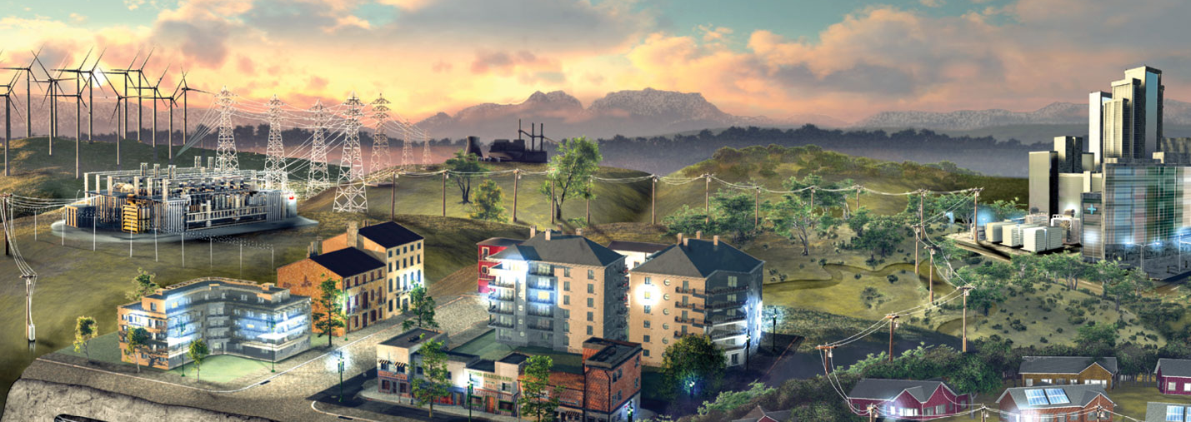
Why We Are Seeking Your Input?
In the summer of 2022, we anticipate releasing a Grant Funding Opportunity (GFO) that will fund up to $1.2 M of research effort.
CEC staff are seeking input from equity experts, state and local agencies, investor-owned utilities (IOUs), researchers and other interested stakeholders to provide refinements to help shape the GFO.
Your input helps us craft a high-impact solicitation to support the state’s ambitious climate goals.
Source: https://www.sciencenews.org/article/u-s-power-grid-desperately-needs-upgrades-handle-climate-change

Slide 5
EPIC Interim Research & Development
CEC’s Electric Program Investment Charge Interim Investment Plan 2021
Research initiative 6 - Valuation of Investments in Electricity Sector Resilience aims to:
  Developing methods to valuate societal benefits with the aim of strengthening electricity resilience especially within Disadvantaged Vulnerable Communities (DVCs).
  Guide future policy making, financial investments and resource allocation in clean electricity sector resilience solutions.
To access report: https://efiling.energy.ca.gov/GetDocument.aspx?tn=236882&DocumentContentId=70037
5

Slide 6
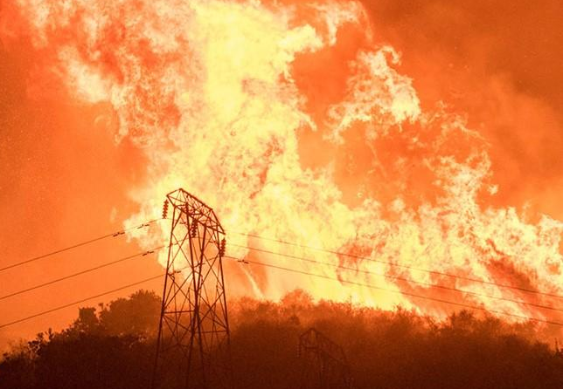
Broader Context for this Research
Climate-related events and associated impacts including energy disruptions are exposing an opportunity to respond to resilience challenges in the energy sector.
Disadvantaged Vulnerable Communities can be disproportionately impacted by climate-related events.
Energy resilience as it pertains to social impacts and benefits is not well defined or quantified in current research.
CPUC rulemaking to Consider Strategies and guidance for Climate Change Adaptation Decision requires IOU’s to develop vulnerability assessments and include focus on equity for DVCs. (https://docs.cpuc.ca.gov/PublishedDocs/Efile/G000/M342/K080/342080840.PDF)
Data and metrics portraying social impacts are important to equitably value and prioritize resilience investments.
Source: Noozhawk.com

Slide 7
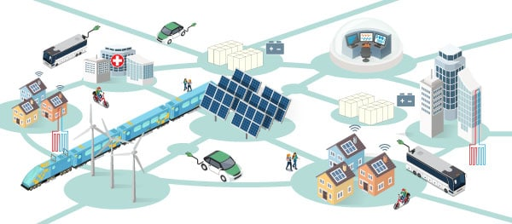
Purpose of Forthcoming Solicitation
Contribute to the development of methods for valuation of societal benefits of customer and grid-resilience investments especially within Disadvantaged Vulnerable Communities.
Analyze recent historical weather-related events that have contributed to power outages.
Source: https://theclimatecenter.org/our-work/cer/

Slide 8

Future Research
This solicitation will contribute to a foundation for future research that can:
Evaluate risks of weather-related events on ratepayers from impacts associated with loss of power, benefits of improved reliability and avoidance of outages.
Generate data and metrics which can in turn be used to improve electricity reliability and avoid power outages especially within DVCs.
Develop a conceptual framework for the value of resilience investments that captures societal benefits.

Slide 9
Comments and Questions
Three ways to provide feedback:
To comment or ask questions live, use the raise hand function in Zoom:
    Zoom Phone controls
      *9 - Raise hand.
      *6 - Toggle mute/unmute.
    Please introduce yourself by stating your name and affiliation.
Type comments and questions in the Q&A function on Zoom:
    Please provide name and affiliation.
Submit written comments to the docket:
  Via e-mail to docket@energy.ca.gov by no later than November 19, 2021, 5 p.m. PDT.
    Include docket number 19-ERDD-01 and “Staff Workshop on Valuation of Electricity Sector Resilience” in the subject line
  Directly to docket: https://efiling.energy.ca.gov/Ecomment/Ecomment.aspx?docketnumber=19-ERDD-01
  Include “Staff Workshop on Valuation of Electricity Sector Resilience” in the subject line

Slide 10
Discussion Questions (1of 2)
What research approaches are needed to measure societal impacts and benefits of energy resilience, with a particular focus on Disadvantaged Vulnerable Communities (DVCs)?
What type of skills, competencies, and expertise should the research team demonstrate, particularly for research that prioritizes DVCs?
This upcoming GFO prioritizes DVCs among other ratepayers.
  Should this research focus on specific geographic locations and areas? At what scale (neighborhood, zip code, county, region, etc.)?
  What types of weather-related events should this research focus on?
  What types of climate-related impacts and social vulnerability factors should be considered?
  Are there other considerations we should be aware of to help maximize benefits to DVCs?
Which existing frameworks or metrics for Valuation of Resilience should be considered for this research?

Slide 11
Discussion Questions (2 of 2)
Please provide feedback on the following:
  Which of the following should be included in the scope of the research?
    Past historical weather-related events prior to the project timeframe?
    Analyzing data from impacts of events during the project timeframe?
    A combination of the above ?
  What data should be collected?
  What types of metrics should be established?
  Beyond metrics, what characterizations of resilience should this research focus on?
What aspects of resilience should this research focus on?
What research is needed to guide efforts to identify and provide resilience for critical services in under-resourced communities?

Slide 12
Thank You!
Please submit written comments & questions:
    Via e-mail to docket@energy.ca.gov by no later than November 19, 2021, 5:00 p.m. PDT.
      - Include docket number 19-ERDD-01 and “Staff Workshop on Valuation of Electricity Sector Resilience” in subject line
    Directly to docket: https://efiling.energy.ca.gov/Ecomment/Ecomment.aspx?docketnumber=19-ERDD-01
      - Include “Staff Workshop on Valuation of Electricity Sector Resilience” in the subject line
Visit website to view the workshop notice, presentation, and recording (forthcoming):
    https://www.energy.ca.gov/event/workshop/2021-11/staff-workshop-regarding-research-valuation-investments-electricity-sector

