Slide 1
California Energy Commission
Public Advisor’s Office
Small Power Plant Exemption
Committee Conference:
Gilroy Backup Generating Facility 6/28/2021
Noemi O. Gallardo
Public Advisor

Slide 2

Agenda
Purpose: Inform the public how to navigate and participate in a Small Power Plant proceeding.
Process:
About Public Advisor
Outreach Conducted
How to Participate
How to Obtain Information
Next Steps for Participation
Contact Information

Slide 3
About CEC’s Public Advisor
Statutorily-mandated role (Warren Alquist Act, Public Resources Code §25217.1)
Licensed attorney nominated by CEC and appointed by Governor for 3 years
Duties (PRC §25222):
  Help public understand CEC processes
  Assist public to participate in proceedings
  Recommend to CEC approaches to engage public
  Ensure timely notices to public
  Identify and conduct outreach to stakeholders
  Assist with access to language services and reasonable accommodations

Slide 4
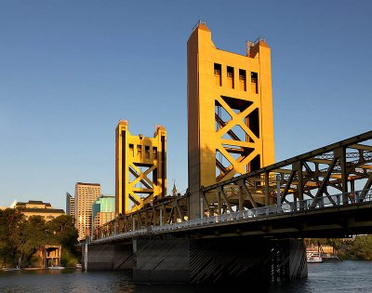
PAO is a Bridge between CEC and Public
Contact us at PublicAdvisor@enegy.ca.gov or 916-654-4489

Slide 5
Outreach Conducted for Gilroy SPPE
Notice of Receipt mailed to residents within 1,000 ft. of project site, California Native American tribes associated with the project area, among others (mailing list to be published in environmental assessment doc)
Notice of Committee Conference emailed to parties to the proceeding and sent via list serve
All notices are docketed
Additional Outreach to Stakeholders via mailing, email or phone:​
  Local & state elected representatives, air, water and transit district officials
  Community-based organizations, environmental and social justice advocates
  Libraries, schools and school districts
  Chambers of commerce, community alliance

Slide 6
“Informal” Participation
Attend events (NOTE: proceedings will be remote until further notice)
Methods to make public comment:
  Speak during public comment period;
  Public Advisor may relate points; and
  Submit written comments to Docket Unit

Slide 7
“Formal” Participation
Become an Intervenor, a person or group that is a "party" to the proceedings who may:
  Present evidence and witnesses
  Object to other parties’ evidence
  Cross-examine other witnesses, and
  File motions
File Petition to Intervene
  Anyone may file; not necessary to be attorney or have legal representation (CCR, §§1206 &1211.7)
  No specific form but must provide required info in petition (CCR, §1200.7(a))
  File early to meet filing and discovery deadlines set by Presiding Member (CCR, §1211.7)
  File in the Docket and include the docket number

Slide 8
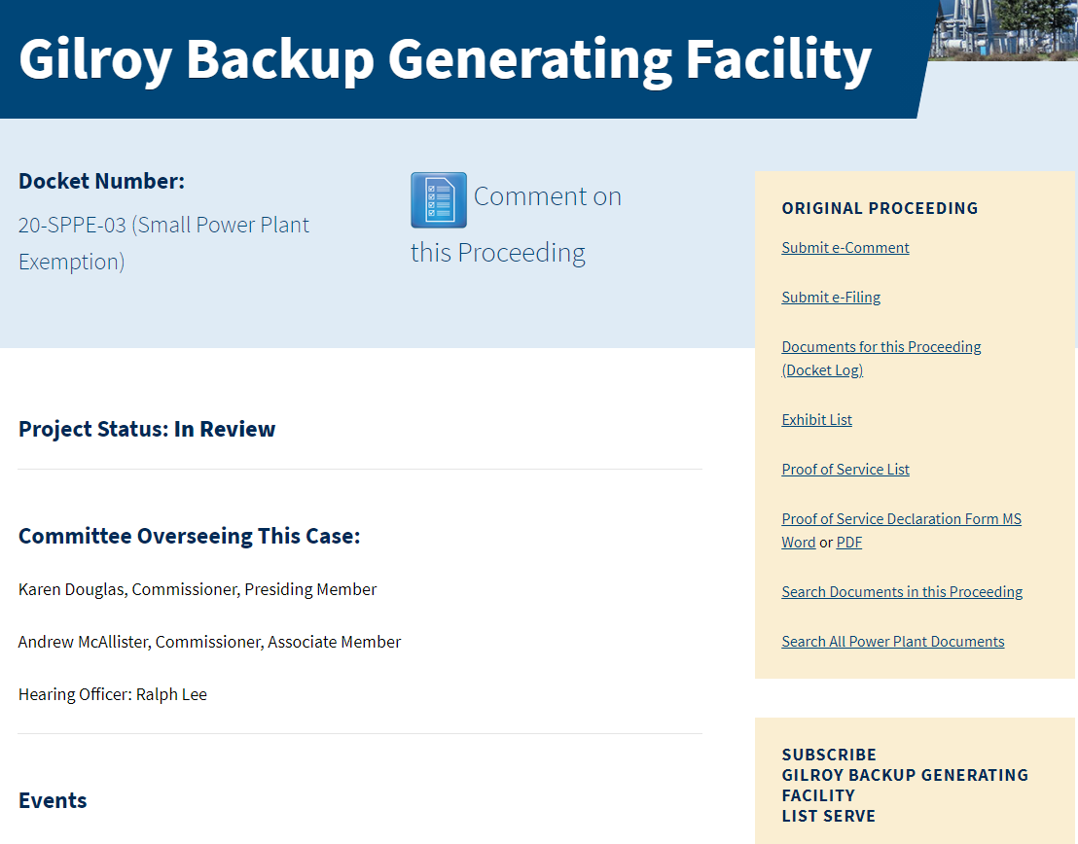
Project Info
https://ww2.energy.ca.gov/sitingcases/gilroybackupgen/
For anyone
For parties to proceeding; staff
All material docketed
Sign up for List Serve

Slide 9
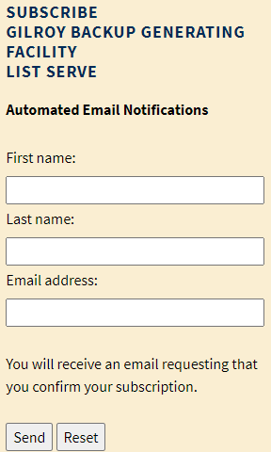
List Serve Signup Process
Step 1: Go to https://ww2.energy.ca.gov/sitingcases/gilroybackupgen/
Step 2: Enter your name, email address and click send
Step 3: Open "confirmation" email; click on link
to complete subscription
Step 4: Look out for email verifying subscription accepted
Once accepted, you'll receive email proceeding notifications and materials.

Slide 10
Upcoming Significant Opportunities to Participate
Publication of the Staff's Environmental Assessment Document
Pre-hearing Conference and Evidentiary Hearing
Commission decision at CEC Business Meeting

Slide 11
Public Advisor Contact Information
Noemí O. Gallardo, Public Advisor
PublicAdvisor@energy.ca.gov
Office Line: (916) 654-4489
Toll Free in CA: (916) 822-6228
Fax: (916) 654-4493
https://www.energy.ca.gov/about/divisions-and-offices/office-public-advisor OR www.energy.ca.gov
California Energy Commission
1516 Ninth Street, MS-10
Sacramento, CA 95814-2950
(New address as of July 12, 2021: 715 P Street, Sacramento, CA 95814)

