Slide 1
Research to Improve Characterization of Methane Emissions from California’s Residential Sector
Request for Comments on Forthcoming Solicitation
Energy-Related Environmental Research
Energy Research & Development Division
May 13, 2021

Slide 2
Housekeeping
All participants muted on Zoom (until Q&A)
Zoom recording
  https://www.energy.ca.gov/event/workshop/2021-05/staff-workshop-forthcoming-solicitation-regarding-research-improve to view the workshop notice, presentation, and Zoom Recording (forthcoming)
Comments and questions
  Please use “Q&A” feature for comments and questions
  Please reserve the “Chat” feature for technical issues, etc.
Notes:
Comments and Questions:
Use the Q&A function for substantive comments
Please provide name and affiliation.
Please indicate which discussion questions you are commenting on (E.g., 1a, 1b, 2, etc.)
Use chat function for technical issues or causal chat

Slide 3
Why We Are Seeking Your Input?
In Q4 2021, we anticipate releasing a Grant Funding Opportunity (GFO) that would fund up to $2M of research to improve characterization of methane emissions from California’s residential sector
CEC staff are seeking input from researchers, policy-makers, and other interested stakeholders to inform the scope and structure of the anticipated solicitation
Your input helps us craft a solicitation designed to support the state’s ambitious climate goals

Slide 4
Workshop Agenda
Background on CEC’s Natural Gas R&D funding program
Issue and overview of prior research related to residential methane emissions
Research gaps identified
Objective of anticipated solicitation
Discussion questions
Input from today’s workshop plus public comments (oral and/or written comments) will help shape the Grant Funding Opportunity.

Slide 5
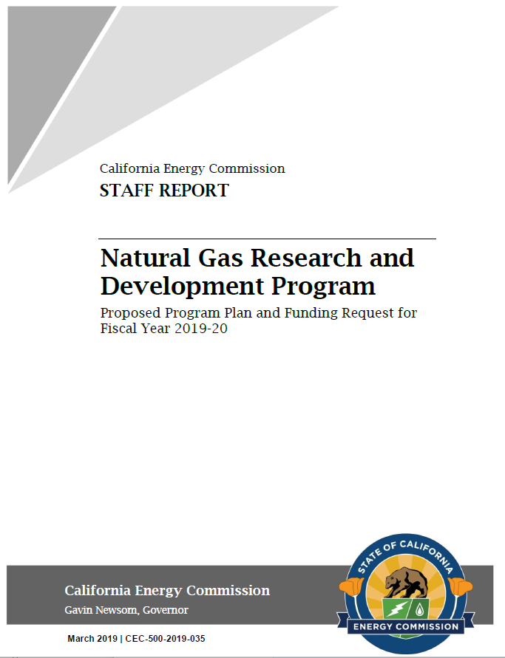
CEC’s Natural Gas Research Program
CEC’s Natural Gas Research Program supports public interest R&D
FY 2019-2020 Natural Gas R&D Funding Plan includes a research initiative that aims to improve characterization of methane emissions from residential sector
Natural Gas Research Program: https://www.energy.ca.gov/programs-and-topics/programs/natural-gas-program
5
Notes:
This proposed research would be funded by the California Energy Commission (CEC) through its Natural Gas Research, which supports public interest R&D investments in technologies and solutions that help the natural gas sector support California’s energy and environmental goals.
The FY 2019-2020 investment plan includes (environmental area):
“Further Characterizing Methane Emissions and Development of Residential Sector Mitigation Methods for Methane Leakage”

Slide 6

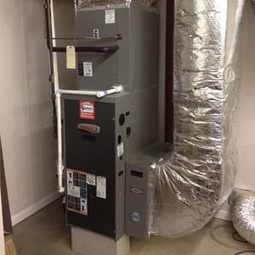
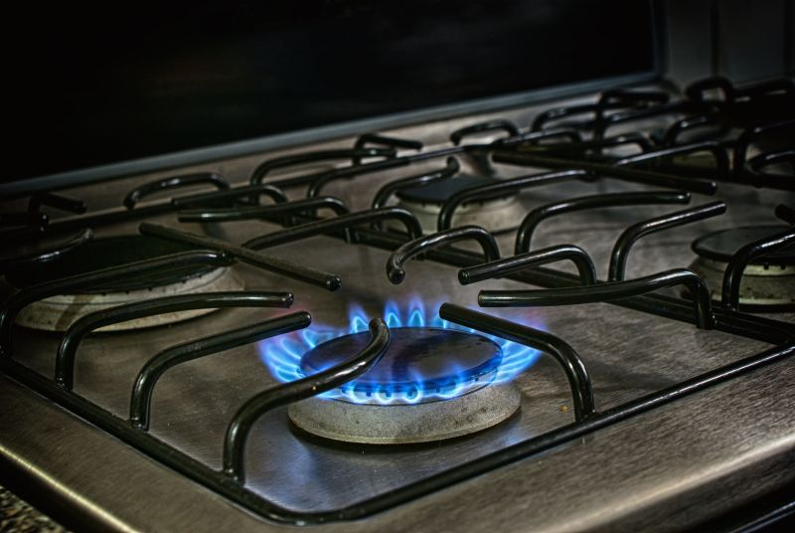
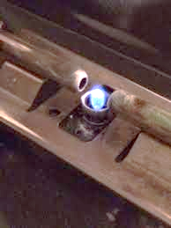
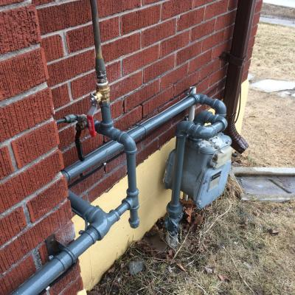
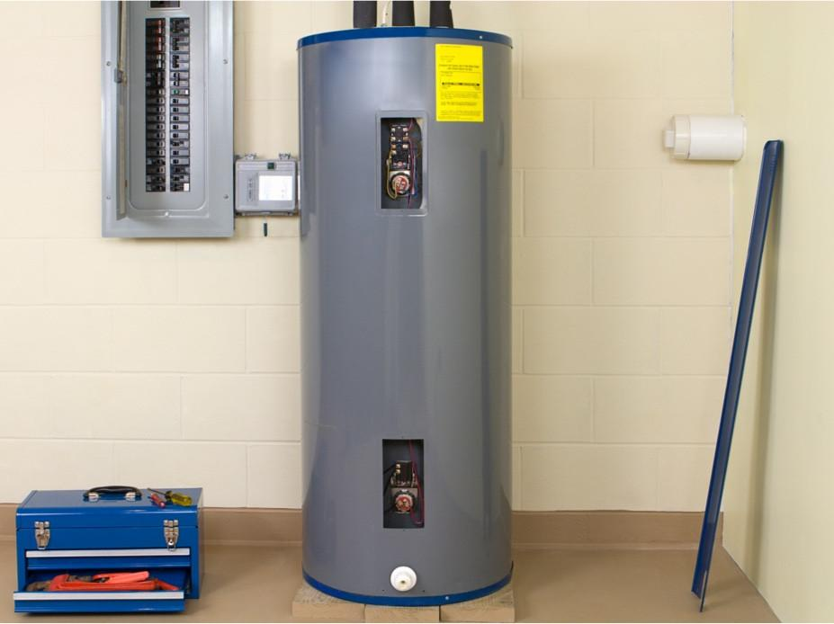
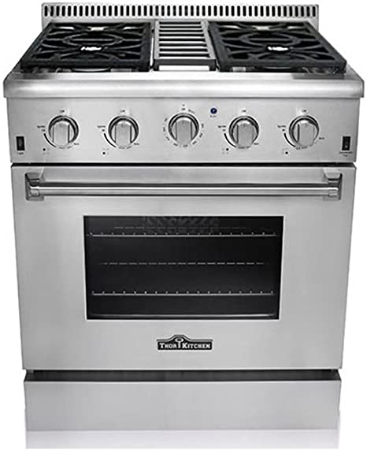
What is the issue addressed?
Residential Methane emissions
Non-combustion, post-meter
Picture Sources: drenergysaverarkansas.com/heating/heating-systems/gas-heating.html, https://appliancerepair-sd.com/lighting-the-pilot-light-in-your-hotpoint-oven/

Slide 7
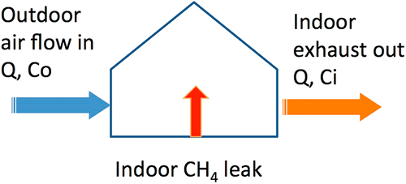
Prior CEC-funded Research
Related to Anticipated Solicitation
Natural Gas Methane Emissions from California Homes (2018)
First-of-its-kind study
Inactive and steady-state methane leaks in single-family California homes (n=75)
Fugitive methane emissions account for ca. 0.5% of residential natural gas consumption
Small fraction of homes may dominate overall emissions
Fischer, M.L. et al (LBNL). 2018. Natural Gas Methane Emissions from California Homes. California Energy Commission. Publication Number: CEC-500-2018-021.
Link to Report: https://ww2.energy.ca.gov/2018publications/CEC-500-2018-021/CEC-500-2018-021.pdf

Slide 8
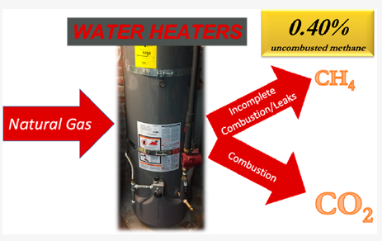
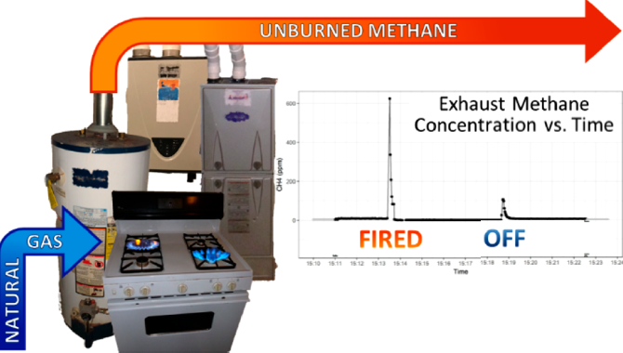
Additional Research Findings
1. Related to Residential Methane Emissions
Lebel et al. 2020 (n=64)
Lebel, E.D.; Lu, H.S.; Speizer, S.A.; Finnegan, C.J.; Jackson, R.B. 2020. Quantifying Methane Emissions from Natural Gas Water Heaters. Environmental Science & Technology, 54, 5737-5745.
Merrin, Z. and Francisco, P.W. 2019. Unburned Methane Emissions from Residential Natural Gas Appliances. Environmental Science & Technology, 53, 5473-5482.
Merrin and Francisco 2019 (n=100)
Nationally, water heaters emitted ~0.40% methane of all natural gas consumed by these appliances
Nationally, residential natural gas appliances emitted ∼0.038% methane of total natural gas consumed by these appliances
Notes:
CEC study used quiescent whole-house CH4 emissions and measurements of individual components within a house to determine the EFs for inactive whole-house leakage and appliance pilot lights. Lebel and Merrin specifically focused on steady-state usage and transient emissions from NG powered appliances at homes. Together, these studies can be used to make estimates for beyond-the-meter CH4 emissions at the national scale.
Highlights from Lebel et al. 2020 and Merrin et al. 2019
Lebel et al. 2020
Quantified transient (leaks, incomplete combustion) and steady state methane emissions from household natural gas water heaters (n=64 northern California homes)
Storage water heaters (SWH): emitted 0.39% methane of the SWH natural gas consumption
Tankless water heaters (TWH): emitted 0.93% methane of the TWH natural gas consumption
Nationally, water heaters emitted 0.40% methane of all natural gas consumed by these appliances
Merrin et al. 2019
Measured unburned methane emissions from natural gas space heating, water heating, and cooking appliances (n=100 homes in Boston and Indianapolis)
U.S. residential natural gas appliances accounts for ∼0.1% of U.S. anthropogenic methane emissions

Slide 9
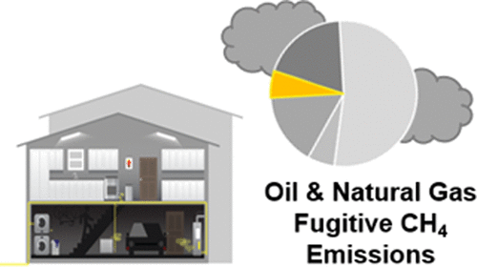
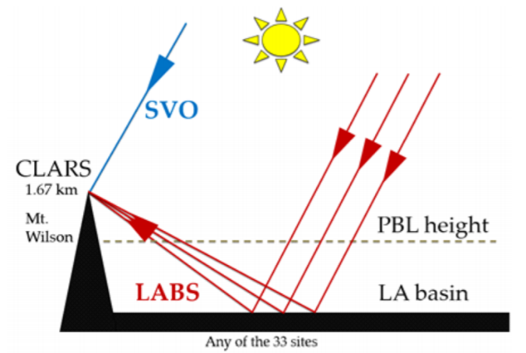
Additional Research Findings
2. Related to Residential Methane Emissions
Saint-Vincent and Pekney, 2020 (NETL whole house and appliance study)
He et al. 2019
(CalTech and JPL top-down study)
Residential homes and appliances release 9.1 Gg CH₄ yearly in the U.S., totaling over 2% of the CH₄ released from the NG sector
LA city’s methane emissions strongly correlated with the consumption of natural gas by residential and commercial consumers, suggested a winter-time leakage rate of 1.4% while the nonseasonal component is 22.9 Gg CH₄/month
Saint-Vincent, P.M.B and Pekney, N.J. 2020. Beyond-the-Meter: Unaccounted Sources of Methane Emissions in the Natural Gas Distribution Sector, Environnemental Science & Technology, 54, 39-49.
He et al. 2019. Atmospheric Methane Emissions Correlate With Natural Gas Consumption From Residential and Commercial Sectors in Los Angeles, Geophysical Research Letters, 46, 8563-8571.

Slide 10
Additional CEC-funded Research
Commercial Sector Methane Emissions
Commercial sector research, GTI study
Development and validation of method to detect and quantify leaks from pipes and appliances, n=20 food service sites and 2 hospitals
~50% of methane leaks accounted for by about 3% of population (of the 179 gas appliances and same for piping components)
0-25% unburned fraction of methane depend on appliance type, heavily weighted to the low end of the histogram
Commercial sector research, ICF study
Fugitive methane emissions from commercial building sector estimated based on field measurements at ~100 buildings
  Central estimate: 311 to 620 million cubic feet per year (~0.14% to 0.28% of commercial building NG consumption)
  Highly uncertain: 78.6 million to 1.1 billion cubic feet per year
Used method developed by GTI study
Small percentage of sources accounts for most emissions
Sweeney, M, et al (Gas Technology Institute). 2020. Assessment of Fugitive Emissions from the Natural Gas System–Commercial Buildings. CEC. Publication Number: CEC-500-2020-035.
Link to Report: https://ww2.energy.ca.gov/2020publications/CEC-500-2020-035/CEC-500-2020-035.pdf
Johnston, E. et al (ICF). 2020. Characterization of Fugitive Methane Emissions from Commercial Buildings in California. CEC. Publication Number: CEC-500-2020-048. Link to Report: https://ww2.energy.ca.gov/2020publications/CEC-500-2020-048/CEC-500-2020-048.pdf

Slide 11
Important research gaps
Related to Residential Methane Emissions
Identify all possible sources of fugitive emissions
Determine the connection, if any, between
    housing type and methane leakage
    appliance and equipment age and methane leakage
Determine the sample size and scope necessary to create a statewide emission factors for individual beyond-the-meter residential components,
    disaggregated by determinants such as housing type, appliance age
Explore temporal variations in emissions under actual operating conditions
Determine appropriate measurement conditions and measurement devices
Saint-Vincent, P.M.B and Pekney, N.J. 2020. Beyond-the-Meter: Unaccounted Sources of Methane Emissions in the Natural Gas Distribution Sector
He et al. 2019. Atmospheric Methane Emissions Correlate With Natural Gas Consumption From Residential and Commercial Sectors in Los Angeles

Slide 12
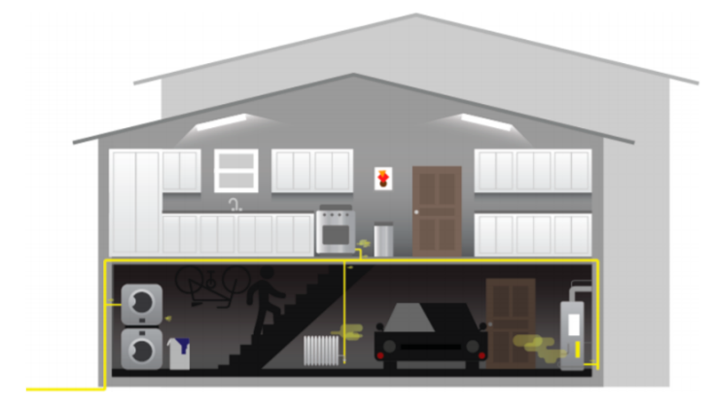
Significance & Purpose of Forthcoming Solicitation
Fugitive methane emissions contribute >~95% of the total methane emissions from CA’s residential sector (CARB’s 2019 edition GHG inventory)
Contribute to enhanced foundation for emissions inventory and support building decarbonization
“Characterization” of methane emissions in residential sector means
Schematic of appliances and devices within a residence that contribute to CH₄ emissions (Source: Saint-Vincent et al. 2020)
Magnitude
Distribution
Determinants of distribution
Measurement methods

Slide 13
Objectives of Forthcoming Solicitation
Research will:
Measure residential emissions from a large sample, including multifamily units
Quantify the total methane emissions from a residential setting considering both steady state and transient emissions and all major appliances
Develop methods and mitigation strategies to cost-effectively identify and stop leaks
Understand the distribution of emissions to target electrification
Notes:
Inventory dimensions backwards and forward as we look into electrification

Slide 14
Comments and Questions
Three ways to provide feedback or ask questions:
Use the raise hand function in Zoom:
  Zoom Phone controls:
    *6 - Toggle mute/unmute.
    *9 - Raise hand.
  Please introduce yourself by stating your name and affiliation.
Type comments and questions in the question function on Zoom:
  Please provide name and affiliation.
  Please indicate which discussion questions you are commenting on (e.g., 1a, 1b, 2, etc.).
Submit written comments & questions:
  Send written comments & questions to docket@energy.ca.gov by no later than May 27, 2021, 5 p.m. PST.
    Include docket number 19-ERDD-01 and “Staff Workshop on Research to Improve Characterization of Methane Emissions from California’s Residential Sector” in the subject line
Notes:
There are three ways to provide feedback to the discussion questions:
1. Use the raise hand function. If you are on the phone it is *9 to raise your hand and *6 to unmute. Please introduce yourself by stating your name and affiliation
2. You can also submit your comments in the Q&A function on Zoom. Please do not use the chat function for this. Please explicitly note which discussion question you are commenting on to help Alex correlate the comments to the appropriate discussion question. Also please include your name and affiliation.
3. You can also submit your comments in written form to the docket. Directions are located on this slide and in the notice for the workshop. Please submit by March 27, 5pm
And please note that all input from today’s workshop plus any written comments submitted to the docket will inform the final development of this funding opportunity.

Slide 15
Discussion Questions
What ongoing or planned research efforts should this work coordinate with or leverage to help inform California’s GHG emissions inventory and building decarbonization goals?
How should the study approach and sample design be structured to provide insights on the following?
  Reducing uncertainty in GHG emissions inventory estimates of methane emissions from California’s residential sector natural gas consumption
  Cost-effectively targeting building decarbonization efforts in the residential sector
  Quantifying GHG emission reductions associated with building decarbonization efforts
How could the proposed solicitation support interpretation of emissions uncertainty and appropriately inform decision-making under uncertainty?

Slide 16
Thank You!
Please submit your written comments by
5:00 p.m. May 27, 2021
Submit electronically through the Energy Commission’s “Research Idea Exchange” docket here: https://efiling.energy.ca.gov/Ecomment/Ecomment.aspx?docketnumber=19-ERDD-01
Or by email to the Docket Unit at: docket@energy.ca.gov
  Please include docket number 19-ERDD-01 and “Staff Workshop on Research to Improve Characterization of Methane Emissions from California’s Residential Sector” in the subject line
Or by paper copy to the Docket Unit: California Energy Commission || Docket Unit, MS-4 || Re: Docket No. 19-ERDD-01 || 1516 Ninth Street || Sacramento, CA 95814-5512
Visit: https://www.energy.ca.gov/event/workshop/2021-05/staff-workshop-forthcoming-solicitation-regarding-research-improve to view the workshop notice, presentation, and the recording (forthcoming).
Notes:
The CEC encourages use of its electronic commenting system.
Written comments may be submitted by email. Include docket number 19-ERDD-01 and “Research to Improve Characterization of Methane Emissions from California’s Residential Sector” in the subject line and email to docket@energy.ca.gov.

