Slide 1


ITEM 3
Joint presentation by Pacific Gas & Electric, Southern California Edison, and San Diego Gas & Electric on Public Safety Power Shutoffs

Slide 2


Public Safety Power Shutoff (PSPS)
Joint IOU Overview
April 16, 2021
Presenters:
Vanessa Bryan, Sr. Manager, PSPS Customer Engagement & Strategy, Pacific Gas & Electric Company (PG&E)
Danielle Kyd, Access and Functional Needs Strategy Manager, San Diego Gas & Electric Company (SDG&E)
Jessica Lim, Principal Manager, Customer Programs & Services, Southern California Edison (SCE)

Slide 3




Meeting Purpose
Provide an overview of the Public Safety Power Shutoff (PSPS) Program, our support for customers and communities and how we are working to improve in 2021.
Topics for Discussion:
PSPS Overview and Context
2020 Recap and Lessons Learned
2021 Key
Focus Areas
IOU Overview

Slide 4
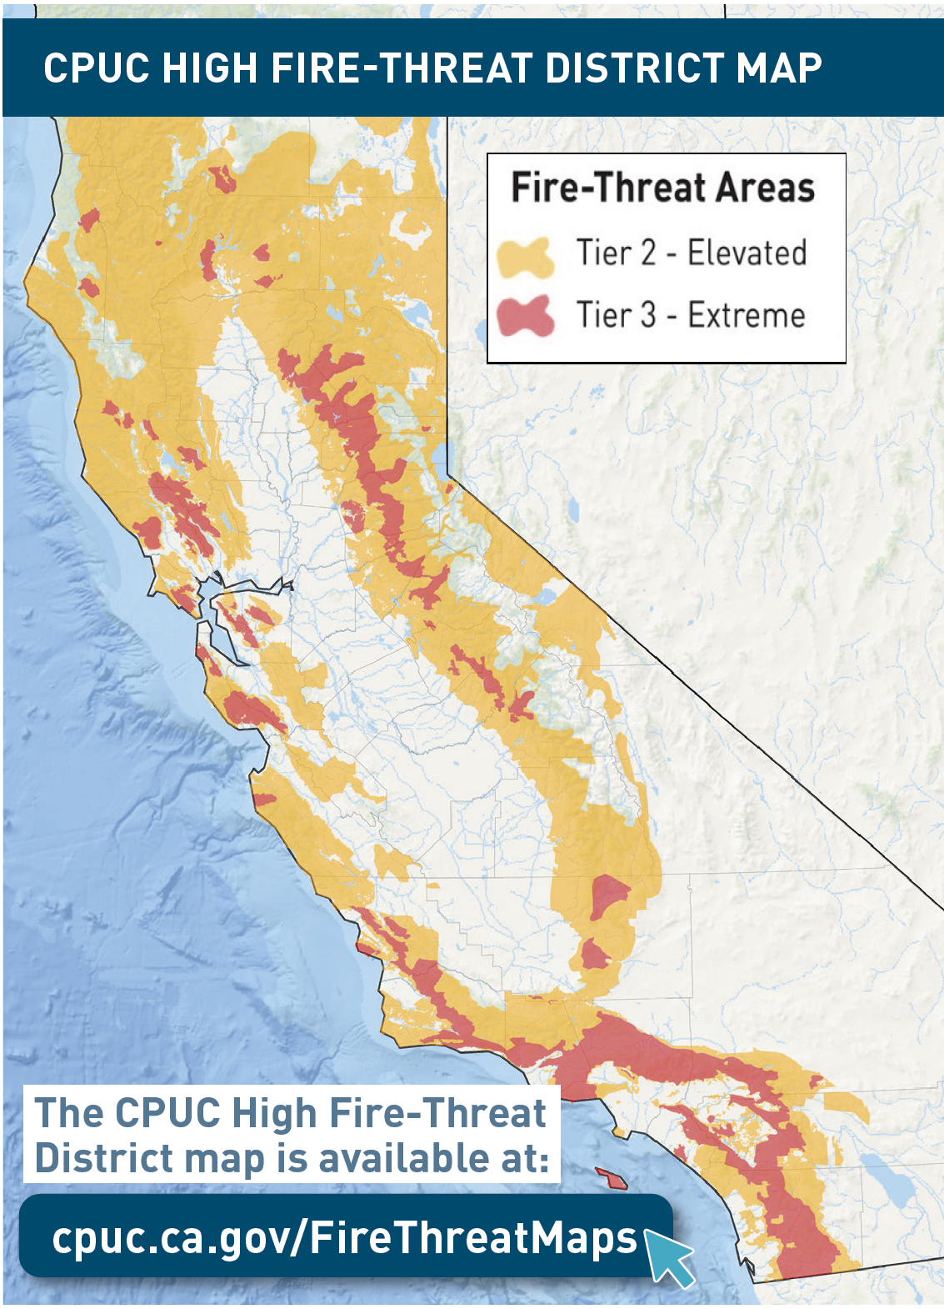




Investor-Owned Utility Overview
Over the past few years, California has experienced an unprecedented number of catastrophic wildfires.
High temperatures, extreme dryness and record-high winds have increased fire risks across the state of California.
As a last resort, we turn off power during times of extreme wildfire risk to keep our customers and communities safe.
 | PG&E SYSTEMWIDE | HIGH FIRE-THREAT DISTRICTS | SCE SYSTEMWIDE | HIGH FIRE-THREAT DISTRICTS | SDG&E SYSTEMWIDE | HIGH FIRE-THREAT DISTRICTS
Electric customers served | 5.5M | 494,200 | 5M | 1.3M | 1.4 mil | 225,000
Overhead distribution line miles | 81,000 | 25,500 | 39,200 | 9,700 | 8,900 | 4,000
Overhead transmission line miles | 18,200 | 5,500 | 12,800 | 4,300 | 1,800 | 1,000

Slide 5
A Brief History of PSPS
PSPS has been adopted by all three major investor-owned utilities in California as a way of mitigating wildfire risk.
PSPS Customer Impacts by Utility:
Utility | 2018 Total | MBL | CARE/FERA | 2019 Total | MBL | CARE/FERA | 2020 Total | MBL | CARE/FERA
PG&E | 60,000 | 2,500 | 10,000 | 2,000,000 | 80,000 | 364,000 | 650,000 | 40,000 | 132,000
SCE | 220 | - | - | 198,000 | 4,000 | 25,900 | 229,800 | 7,700 | 44,700
SDG&E | 30,000 | 1,800 | 5,600 | 50,000 | 2,800 | 6,000 | 100,000 | 6,400 | 16,000
Numbers are approximate and reflect customers who were de-energized during a PSPS event
PSPS Timeline:
2012
2013
2018
2019
2020
2021
Apr 12: CPUC granted electric utilities authority to shut off electric power in order to protect public safety
Oct:
SDG&E:
first PSPS event
July 12: Resolution ESRB-8 adopted; Strengthened notification requirements and required utilities to submit a report within 10 business days after each event
* Oct. 12:
SCE: first PSPS event
Oct. 14:
PG&E: first PSPS event
May 30: CPUC approved R. 18-12-005 Phase 1 (D. 19-05-042) Requirements
May 28: CPUC approved R. 18-12-005 Phase 2 (D. 20-05-051) Requirements
Feb 19: CPUC releases R. 18-12-005 Phase 3 Scoping Memo
*First event utilizing formal PSPS protocol in compliance with ESRB-8
Annual Submission of Wildfire Mitigation Plan by each IOU

Slide 6

SDG&E PSPS 2020 Event Overview
 |  | 2020
EVENT DETAILS |  | SEPT 8-9 | OCT 26-27 | DEC 2-5 | DEC 6-9 | DEC 23-24
 | CUSTOMERS IMPACTED | 49 | 4,373 | 73,977 | 15,528 | 6,797
 | COUNTIES IN SCOPE | 1 | 1 | 1 | 1 | 1
 | TRIBES IN SCOPE | 0 | 3 | 15 | 10 | 10
 | COMMUNITY RESOURCE CENTERS OPEN | 1 | 1 | 10 | 6 | 4
 | PEAK WIND GUSTS | 54 MPH | 63 MPH | 94 MPH | 82 MPH | 71 MPH
 | DAMAGE/HAZARDS | 0 | 0 | 14 | 5 | 3
 | CUSTOMER IMPACT REDUCTION VS. 2019 SCOPE | N/A | N/A | 13,231 | 24,581 | 19,351
 | 2018 | 2019 | 2020
NUMBER OF PSPS EVENTS | 4 | 4 | 5
AVERAGE NUMBER OF CUSTOMERS IMPACTED | ~7,500 | ~12,500 | ~20,000
LARGEST CUSTOMER IMPACT EVENT | ~25,000 | ~28,000 | ~75,000
AVERAGE DURATION TIME | ~47 HR | ~28 HR | ~34 HR

Slide 7
SDG&E 2020 Customer Support: Enhanced Offerings
Community Resource Centers
Food Resources
Portable Battery Program
    Available food resources and delivery
    $100,000 funding for Feeding SD, Meals on Wheels and SD Food Bank
    250 3-day emergency food boxes delivered to seniors in rural SD County by Meals on Wheels
    2,900 meals provided by Neighborhood House Assoc.
    On-Demand 2-1-1 partnership food support
    Portable backup batteries for Medical Baseline participants living in HFTD
    ~1,400 generators delivered to MBL customers
    ~1,300 fuel generator purchase rebates utilized by customers in the HFTD (271 enhanced rebates to CARE customers)
    Launched Emergency Backup Battery Program (EBBP) for real time PSPS event customer support
    A place for customers to get basic power needs, emergency kits & water
      10 locations opened for 2020 events
      ~3,000 vehicles passed through at drive-thru Wildfire Safety Fairs
Critical Customer Support
Support Services and CBO Partnerships
    Partnership with 2-1-1 San Diego, 2-1-1 Orange County, Jewish Family Services, FACT and Salvation Army providing PSPS support services:
    Direct engagement and preparation with critical facilities
    Support for COVID-19 critical facilities and vote tabulation locations
    Ongoing engagement and resiliency planning with telecommunications and water providers
    Listening sessions and webinars with large customers
    and critical service providers
    Readiness Support | Hotel Stays | Accessible Transportation
    Food Delivery | Resiliency items | Safety & Disaster Assessments
CBO Partnerships
    ~200 CBO informational and resource partnerships
    Provided support materials including social media kit and printable flyer

Slide 8
SCE PSPS 2020 Event Overview
 |  | 2020 |  |  |  |  |  | 2020 |  |  |  |  |  | 2021
EVENT DETAILS |  | *MAY 27-30 | *JUN 25-28 | JUL 31 - AUG 4 | SEPT 5-9 | OCT 16 | OCT 23-28 | NOV 3-6 | NOV 14-19 | NOV 24-28 | NOV 29 - DEC 3 | DEC 4-14 | DEC 16-24 | JAN 12 – 21
 | CUSTOMERS IMPACTED | - | - | 17 | 252 | 86 | 36,290 | 1,335 | 509 | 20,687 | 64,348 | 79,154 | 27,519 | 98,583
 | COUNTIES IN SCOPE | - | - | 1 | 2 | 2 | 6 | 3 | 4 | 6 | 6 | 7 | 7 | 7
 | TRIBES IN SCOPE | - | - | 0 | 0 | 0 | 0 | 0 | 0 | 0 | 5 | 2 | 7 | 3
 | COMMUNITY RESOURCE CENTER/VEHICLES OPEN | - | - | 2 | 15 | 0 | 19 | 4 | 5 | 20 | 21 | 18 | 35 | 49
 | PEAK WIND GUSTS | - | - | 57.8 MPH | 59.8 MPH | 56.8 MPH | 96.2 MPH | 68 MPH | 75 MPH | 84.9 MPH | 84.6 MPH | 71 MPH | 77.7 MPH | 66 MPH
 | DAMAGE/HAZARDS | - | - | 1 | 0 | 0 | 2 | 0 | 0 | 0 | 1 | 5 | 3 | 8
 | CUSTOMER IMPACT REDUCTION VS. 2019 SCOPE | 47% |  |  |  |  |  |  |  |  |  |  |  | N/A
 | 2018 | 2019 | 2020
NUMBER OF PSPS EVENTS | 3 | 9 | 12
AVERAGE NUMBER OF CUSTOMERS IMPACTED | 74 | 22,000 | 19,000
LARGEST CUSTOMER IMPACT EVENT | 114 | 126,141 | 79,154
▲AVERAGE RESTORATION TIME | - | 6 HRS | 6 HRS
▲Metric tracking began in 2019
*Event did not result in customer de-energization
Data included in this slide is as of 03/13/21 and subject to change

Slide 9
SCE 2020 Customer Support: Enhanced Offerings
Community Resource Centers
Customer Care
Critical Care Battery Program
    In-event care for local communities
      300% expansion of CRCs
      61 activations of CRCs to 26 locations
      81 Community Crew Vehicles dispatched to 33 locations
      ~6,000 visitors in 2020
    Hot meals served during holidays
    Provided ice vouchers, bulk water, blankets, and firewood at certain locations
    Resiliency items available at CRCs
    Partnered with 10 hotels to provide discounted rates to PSPS impacted customers
    Provided free batteries for low-income Critical Care customers in high fire risk areas
    33% enrollment rate
    Over 700 batteries deployed
    Deployed through ESA contractors
    Expanding to all eligible Medical Baseline (low income and in a high fire risk area); 1,051 deployed in Q1 2021
Critical Infrastructure Customer Support
CBO Partnerships
    Coordinated with critical infrastructure partners in advance of fire season
    Conducted resiliency workshops and review of PSPS protocols with critical infrastructure partners
    Information sharing with telecommunication partners to identify most impacted areas and generation needs
    Coordinated with State, County and Hospital Association on the identification and mitigation plans of COVID-19 facilities in high fire risk areas
    Donated portable batteries to Independent Living Centers to supplement short term battery loan programs
    50 CBOs contracted for PSPS outreach
    1,600 CBOs in SCE's network
    CBOs began outreach in November 2020 and reached over 178K constituents through digital webinars, outreach events and online communications (social media, e-blast, newsletters, etc.).

Slide 10
PG&E PSPS 2020 Event Overview
 |  | 2020 |  |  |  |  |  | 2021
EVENT DETAILS |  | SEPT 7 – 10 | SEPT 27 – 29 | OCT 14 – 17 | OCT 21 – 23 | OCT 25 – 28 | DEC 2 – 3 | JAN 19 – 21
 | CUSTOMERS IMPACTED | 171,947 | 64,297 | 40,574 | 30,154 | 345,470 | 617 | 5,099
 | COUNTIES IN SCOPE | 22 | 15 | 19 | 7 | 35 | 1 | 7
 | TRIBES IN SCOPE | 8 | 0 | 1 | 2 | 14 | 0 | 0
 | COMMUNITY RESOURCE CENTERS OPEN | 50 | 29 | 40 | 19 | 106 | 1 | 7†
 | PEAK WIND GUSTS | 66 MPH | 72 MPH | 73 MPH | 56 MPH | 89 MPH | 72 MPH | 83 MPH
 | DAMAGE/HAZARDS | 83 | 11 | 28 | 8 | 126 | 1 | 423
 | CUSTOMER IMPACT REDUCTION VS. 2019 SCOPE | 55% | 61% | 80% | 47% | 47% | 19% | N/A
 | 2018 | 2019 | 2020
NUMBER OF PSPS EVENTS | 1 | 9 | 6
AVERAGE NUMBER OF CUSTOMERS IMPACTED | 60,000 | 226,000 | 109,000
LARGEST CUSTOMER IMPACT EVENT | 60,000 | 968,000 | 345,470
AVERAGE RESTORATION TIME | 15 HRS | 17 HRS | 10 HRS
Data included in this slide is as of 02/08/21 and subject to change
†Does not include resource centers activated for wind event

Slide 11
PG&E 2020 Customer Support: Enhanced Offerings
Community Resource Centers
Meal Replacements
Portable Battery Program
    A place for customers to get basic power needs
      245 locations opened for 2020 events
      363 locally coordinated sites ready
      ~50,000 visitors in 2020
    Meal replacement/delivery available during and after events
    21 local food banks serving 36 counties
    ~30,000 food packages provided in 2020
    18 Meals on Wheels organizations serving low-income seniors in 20 counties
    ~2,900 additional meals delivered in 2020
    Portable backup batteries for low-income Medical Baseline participants living in HFTDs
    ~5,200 fully subsidized batteries
    ~9,300 energy needs assessments
    Distribution conducted through Low Income Energy Assistance Program contractor partners
Critical Customer Support
CBO Partnerships
    Direct engagement and preparation with critical facilities
    Support for COVID-19-critical hospitals in high fire-risk areas
    Ongoing engagement with telecommunications providers
    Listening sessions and webinars with large customers
    and critical service providers
    Resiliency plans for vote tabulation centers
    Partnership with California Foundation for Independent Living Centers
      ~1,000 batteries
      ~885 food vouchers
      ~520 hotel stays coordinated
      30+ accessible transport to CRCs and hotels
    200+ CBO informational and resource partnerships
    ~4,500 customers served in 2020
    Support for distributing translated materials in 15 languages
    Sponsored outreach to broaden awareness and preparation

Slide 12
2021 Improvements
We are continuing to improve our Public Safety Power Shutoff (PSPS) Program. Improvements to the program have included enhanced operations, communication and coordination before, during and after PSPS events.
SDG&E SCE PG&E Statewide
Target PSPS Events to Highest Risk Areas
Reduce & Mitigate PSPS Impacts
Continuous Improvement & Further Risk Reduction
Collaborative Solutions
Advance undergrounding, covered conductor and other hardening efforts to reduce both wildfire risk and PSPS impacts
Continue to identify, develop and expand PSPS support services, including generator programs, to provide equal access to programs and services
Enhance and expand communications and outreach to effectively engage vulnerable and “hard to reach” communities
Partnership with statewide organizations and agencies to enhance capabilities of identifying AFN customers
Refinement of communication tactics to better reach customers
Enhanced solutions to reduce customer impact
Seek customer insight and feedback on improvements
Increased engagement with community groups
Reduce the need for PSPS
Execute PSPS events effectively with transparency of the decision-making process
Mitigate the impacts of PSPS
Keep partners and customers informed
Enhance and improve post-event reporting
Improve distribution scoping analysis to further incorporate tree overstrike potential
Focus on opportunities to support customers repeatedly impacted
Continue to increase resiliency to offer other wildfire risk mitigations in lieu of PSPS

Slide 13
Discussion and Q&A
General discussion questions:
What are the overall perceived gaps that the IOUs should be thinking about when it comes to disadvantaged communities?
Are there any aspects of what the utilities are doing that you have received positive feedback on that we should make sure we are continuing?
Thoughts on collaborative partnership opportunities?
Other questions?
Contact for additional information, feedback, or questions:
    SDG&E: Danielle Kyd; DKyd@sdge.com
    SCE: wildfireoutreach@sce.com
    PG&E: wildfiresafety@pge.com

