Slide 1

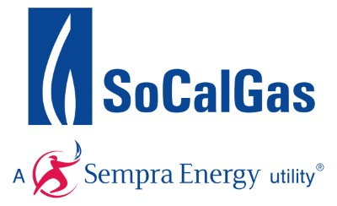
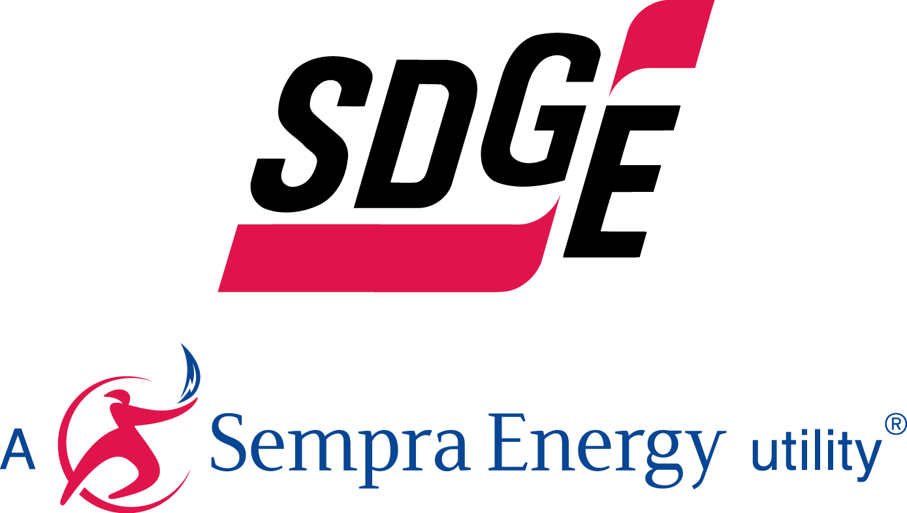
Proposed
Hydrogen blending demonstration program
Southern California Gas Company
San Diego Gas & Electric
Hilary Petrizzo
Hydrogen Engineering

Slide 2
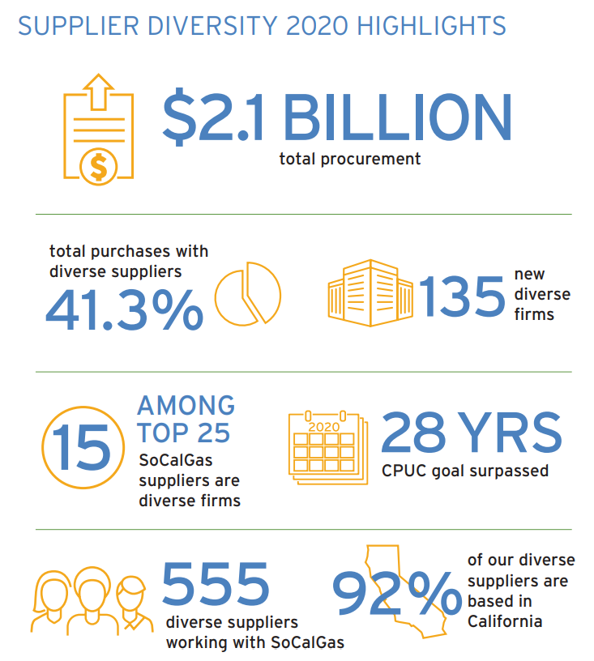
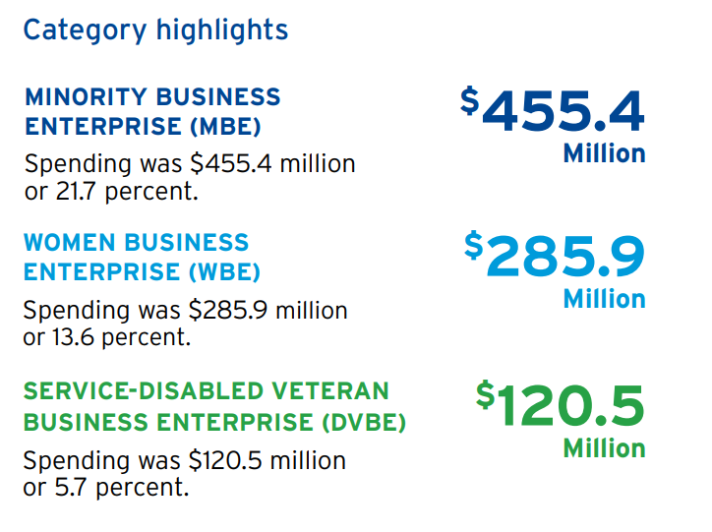
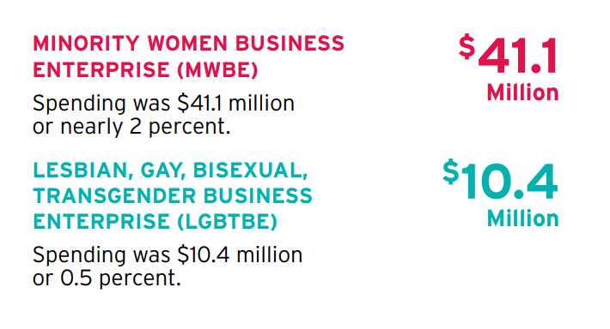
SoCalGas and SDG&E Commitment to diversity

Slide 3
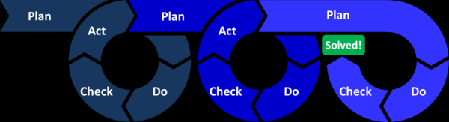
Safety: API 1173 Pipeline Safety Management System
“Plan-Do-Check-Act”
Round 1: SoCalGas has done research and completed literature reviews on Hydrogen Blending
(PG&E and Southwest Gas have also done research and literature reviews and University of California Riverside has initiated the Hydrogen Blending Impacts Study)
Round 2: Prior to injecting system-wide, SoCalGas and SDG&E have proposed small-scale field demonstrations on representative sections of their natural gas distribution and transmission system
(more iterations of demonstrations and research if needed)
Final Round: Propose a Hydrogen Blending Injection Standard
Research Demos Injection Standard

Slide 4
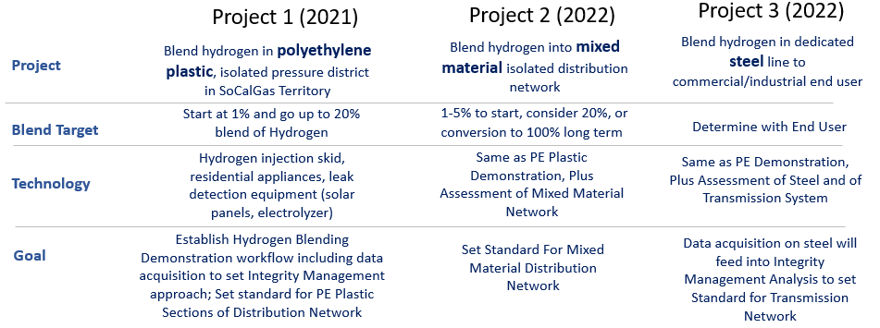
Proposed Hydrogen blending demonstration program

Slide 5
Plan-do-check-act project 3 (2022+)
Plan: Find isolated industrial or commercial customer off a steel transmission line
- Safety training and assessment, operational controls, percent blend level, data acquisition, modify system if needed
Do: Initiate Blending of Renewable Hydrogen at Facility for 12+ months
SCG/SDG&E gather operational and performance metrics on steel pipeline and commercial/industrial customer end use equipment
Check: Risk/Integrity Management Analysis of Data; Compare to Initial Models
- Where can we blend as-is? Where are upgrades needed? Where is more frequent inspection needed? Where do operations need to be modified?
Act: Establish Hydrogen Blending Injection Standard for Steel Transmission Pipelines
- Determine viability of large-scale blending in Transmission System

Slide 6
Demos Safely Build on Research,
Prior to large scale implementation
Pillar | Area | Current Knowledge | Data Collection | Project 1 | Project 2 | Project 3
Safety | Odorant | SoCalGas odorant vendors noted that hydrogen will not affect the stability of current odorants used and the same odorants are suitable when hydrogen is present. | Conduct odorant intensity sampling | P | P | P
 | Leak surveys | Past SoCalGas and UC Irvine testing suggests leakage rates do not significantly increase for hydrogen blends in distribution systems. | Conduct leak surveys prior to, during, and post-demo | P | P | P
 | Leak survey equipment | Past SoCalGas testing suggests that some currently deployed technologies can be used with hydrogen blends. | Conduct leak surveys prior to, during, and post-demo with currently deployed and new/prototype technologies | P | P | P
System Integrity | Distribution system integrity | Research to date indicates that hydrogen does not degrade polyethylene pipes. Hydrogen embrittlement has a greater impact on high tensile strength steels and steel welds than low tensile strength steels (typically used for distribution systems). | Obtain and test samples of pipe and pipeline components during and post-demo to investigate any hydrogen impacts | P | P
 | Transmission system integrity | Research shows hydrogen embrittlement has a greater impact on high tensile strength steels and steel welds than low tensile strength steels. | Obtain and test samples of pipe and pipeline components during and post-demo to investigate any hydrogen impacts |  |  | P
 | End-use equipment | Past SoCalGas appliance testing suggests that 5% hydrogen does not cause flame, combustion stability, or safety issues. Past SoCalGas testing shows inconsistent impacts on NOx. | Perform equipment safety checks prior to, during, and post-demo. Evaluate emissions impacts | P | P | P
 | Metering | SoCalGas surveyed meter manufacturers on hydrogen compatibility, with some manufacturers reporting up to 5% hydrogen being acceptable while others allowed up to 100% hydrogen. | Compare data from customer meters and blending skid data to confirm accuracy and performance of meters | P | P | P
Reliability | Gas usage | Hydrogen has one-third the energy density of methane. An increase in overall gas volume is needed. | Monitor and analyze demand changes to forecast potential future supply needs | P | P | P
 | Blending skid operation | Blending skids have been used around the world to inject hydrogen into natural gas systems. | Monitor blending skid operational data to ensure consistent desired blend levels | P | P | P
Chapters 3 & 4 of Joint IOU Testimony on Hydrogen Blending

Slide 7

Gap Analysis
PLAN-DO-CHECK-ACT Rounds | UCR Hydrogen Blending Impacts Study | SoCalGas and SDG&E Proposed Hydrogen Blending Demo Program | CEC Hydrogen Blending Project
Estimated Budget | $1.5M | $32M | TBD
Round 1: Literature Review and Laboratory Research |  | Based on research and will inform subsequent research | N/A
Round 2.0: Demonstration of Injection in a Newer Distribution System, Collecting Operational and Performance Data | N/A |  | N/A
Round 2.1: Demonstration of Injection in an older Distribution System, Collecting Operational and Performance Data | N/A
Round 2.2: Demonstration of Injection in a Transmission System, Collecting Operational and Performance Data | N/A
Notes:
Clarify that we don’t need to wait on UCR

Slide 8
Thank you

