Slide 1
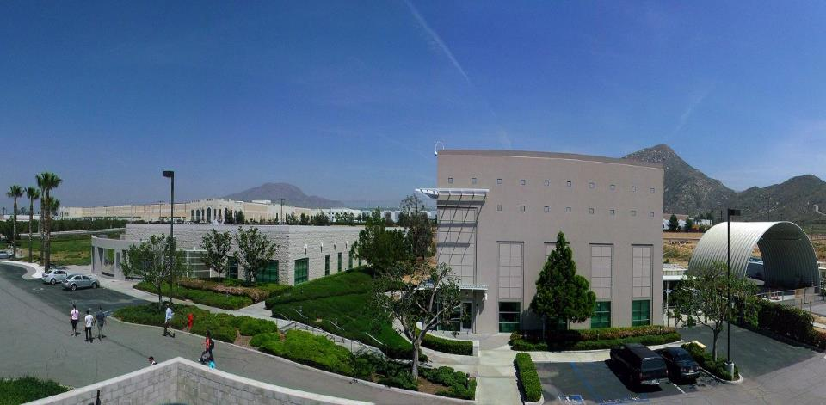
Hydrogen Blending into Existing Natural Gas Systems – Challenges and Opportunities
University of California, Riverside
March 2021

Slide 2
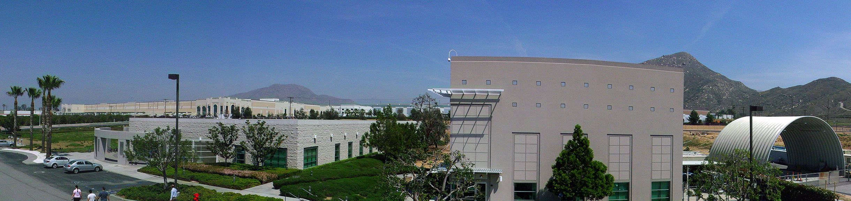
UCR CE-CERT
  CE-CERT is dedicated to addressing society’s most pressing environmental challenges in air quality, climate change, energy and transportation through research, education and public service.
150 student employees
60 faculty & engineers
$ 30 million in ongoing research
30 laboratories and testbeds
Notes:
Touch on strong collaboration with city/county and industry partners

Slide 3
Natural Gas Delivery Pipeline Infrastructure
http://www.eia.gov/state/maps.cfm?v=Petroleum
Notes:
Electricity to storage to electricity pathway by power to gas to power concept.

Slide 4
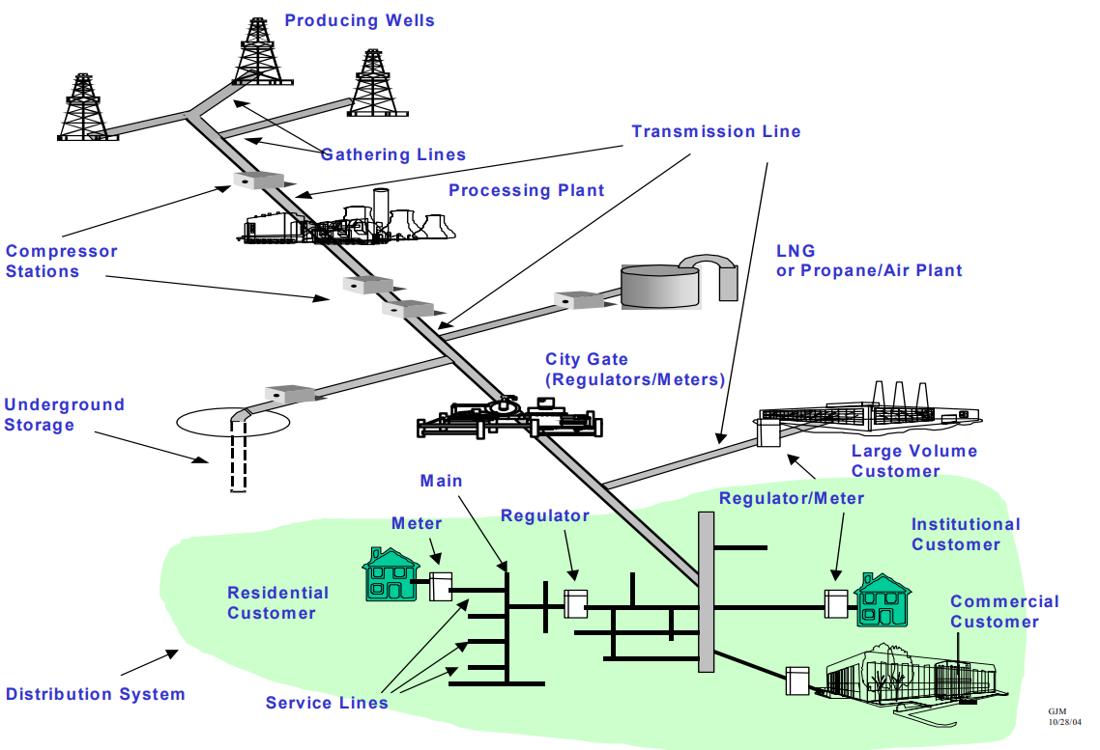
Natural Gas Delivery Pipeline Infrastructure
Figure from AGF report “Safety Performance and Integrity of the Natural Gas Distribution Infrastructure”

Slide 5
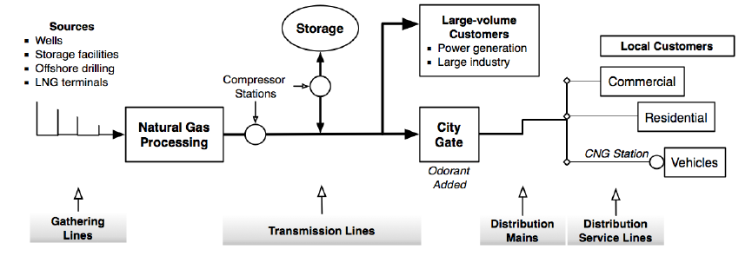
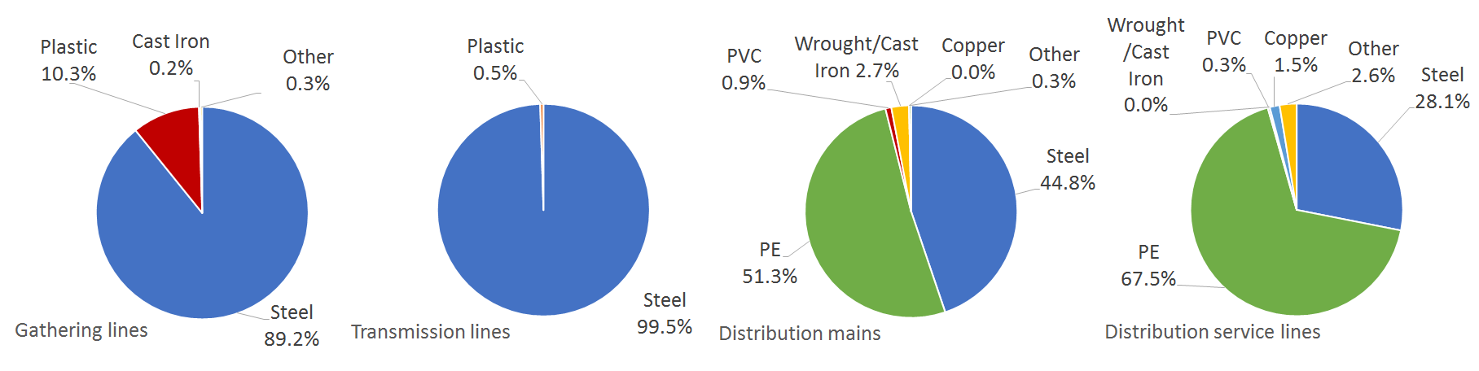
Natural Gas Supply Chain Components & Materials
Pictures from or reproduced based on NREL report by Melaina et al. 2013

Slide 6
Natural Gas Transmission and Gathering Pipeline
Systems in California
Miles of Transmission Pipeline by Material
Miles of Gathering Pipeline by Material
USA DOT PHMSA Annual Report for Gas Transmission and Gathering Pipeline Systems - 2019

Slide 7
Natural Gas Distribution Pipeline System in California
Miles of Mains by Material
Number of Services by Material
USA DOT PHMSA Annual Report for Gas Distribution Pipeline System - 2019

Slide 8
Hydrogen Blending Impacts
Pipeline integrity
  Embrittlement
  Degradation of pipeline materials and other components
  Leakage
Safety aspects
  Leak detection and safety measures
Infrastructure maintenance
  Network maintenance, injection/blending locations, compression stations
Metering & gas quality
  Impact on meter set assemblies and components
  Effect on calorific value of gas
Gas storage facilities
End-use equipment

Slide 9
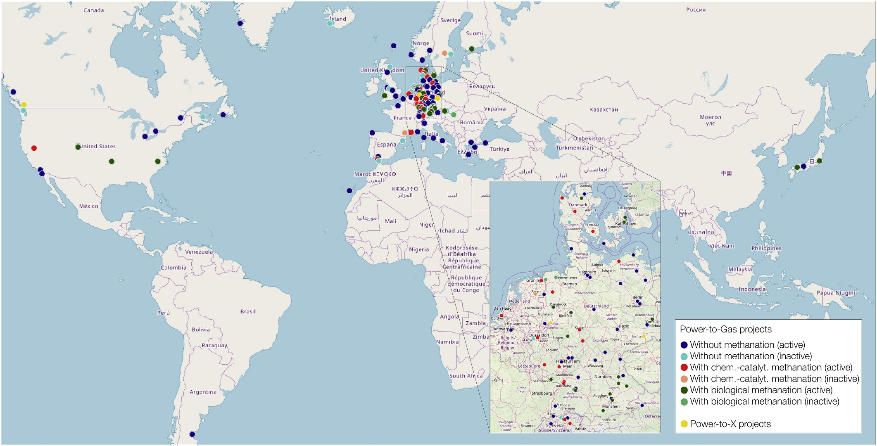
Research and Demonstration Efforts
Thema, M., Bauer, F., & Sterner, M. (2019) Renewable and Sustainable Energy Reviews, 112, 775-787.
Notes:
Location of power to gas projects worldwide

Slide 10
Ongoing Hydrogen+ Study at UCR
Sponsor: California Public Utilities Commission
Goal: Assess safety concerns associated with injecting hydrogen into the existing natural gas pipeline system at various percentages
Potential impact of hydrogen injection on the natural gas infrastructure
Impact on natural gas pipeline leakage rates
Impacts, including degradation, on durability/integrity of the existing natural gas pipeline system
Impact on valves, fittings, materials, and welds due to hydrogen embrittlement
Degradation analysis
Maximum hydrogen blending potential

Slide 11
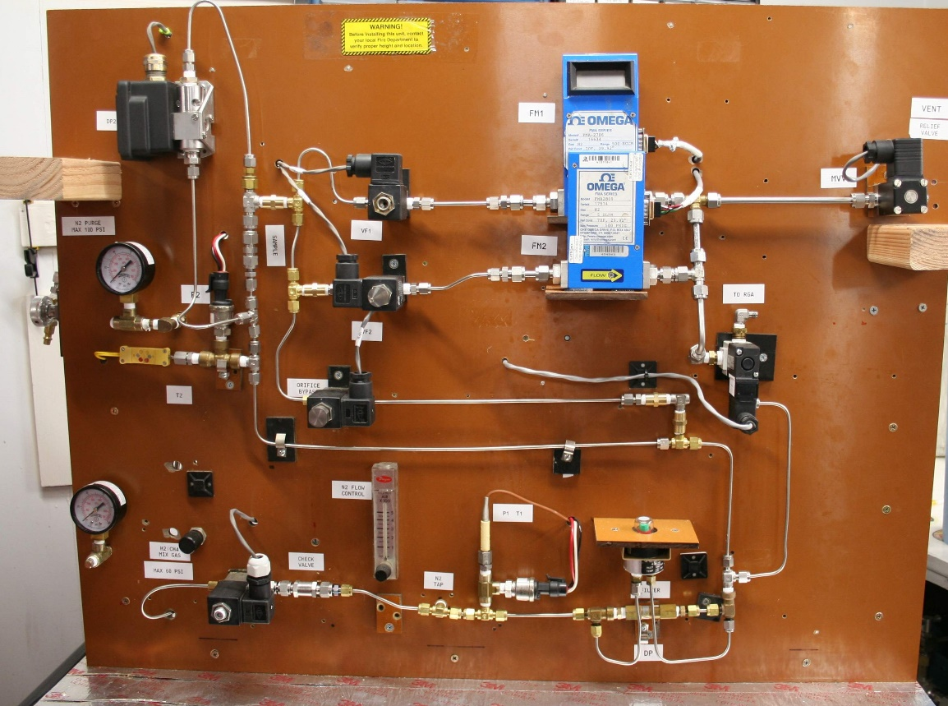
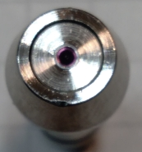
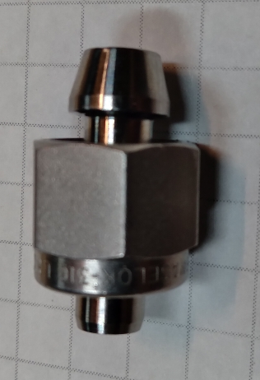
Pipeline Leakage Rates
Modeling and experimental assessment of potential impact on pipeline leakage rates
Compare CH₄/H₂ blend leakage rates
Assess the evolution of leaks in pipes over time
  Experimental work designed to establish controlled leak rates and monitoring of small changes in leak rate over time
Evaluate currently available and proposed leak prevention techniques including coatings and seals

Slide 12
Effects on Degradation, Durability/Integrity of Pipeline Systems
Assess hydrogen blending impact on stainless steel and plastic gas distribution equipment and components.
Assess effect of key parameters including blending ratios
on crack initiation and propagation.
Assess select material durability using select methods.
Thermal Mechanical Analysis
Tensile testing
Compression Testing
International Journal of Hydrogen Energy Vol. 42, pp. 7404-7412, 2017

Slide 13
Impacts due to H₂ Embrittlement
Assessment of any impact on valves, fittings, materials, and welds due to hydrogen embrittlement.
Failure Assessment Diagram: Will provide failure vs. safe condition for pipe system in the hydrogen environment.
Critical Flaw Curves: Will provide the length vs. depth relationship for flaws that would lead to pipe failure, therefore it will determine/inform inspection criteria of ongoing integrity assessments, as well as fitness for service decisions.
Crack Growth Rate Plots: Will provide expected time to failure based on crack growth rates in hydrogen blend environment.
International Journal of Hydrogen Energy Vol. 43, pp. 19615-19624, 2018

Slide 14
Impacts due to H₂ Embrittlement
GTI will perform modeling and run a synthetic design of experiment (DoE) to assess the impact of hydrogen embrittlement. Work will include:
  Create synthetic DoE using existing COMSOL models and steel libraries on an a pipe with an internal axial crack. Two more configurations may be selected by the Sponsor.
  The analysis will systematically introduce brittle behavior to cover the range of 100% brittle to 100% ductile behavior
    The Failure Assessment Diagrams and critical flaw size curves will provide the sensitivity of the fitting configurations to induced brittleness
    Follow on work can investigate the degree of brittleness induced in steels by different blends of hydrogen (these future results can be mapped onto the sensitivity analysis developed in this body of work)

Slide 15
Related Activities
Research funded by SCAQMD, SoCalGas, PG&E, and Cummins
Evaluation of low hydrogen blends with pipeline CNG on an on-road ultra-low NOx HD Cummins engine
  Blends of 2%, 3%, and 5% of hydrogen
  Focus on gaseous and particulate emissions – emphasis on NOx and ultrafine particles
  Toxic pollutants
  Combustion performance and optical diagnostics for better understanding on pollutant formation
  Durability assessment and emissions deterioration over 500 hours of operation

Slide 16
Research Priorities
Identify high priority candidate materials and components for testing
High likelihood of damage and/or failure
  Prioritize safety related aspects
Wide range of materials and parameters are involved
Limit demonstration to select components
Evaluate end use equipment and storage facilities separately
Infrastructure component/equipment specifications need to be revised
Learn from past experience (ex. town gas) and ongoing activities
Identify hydrogen sources of interest and gas quality requirements
Simultaneously pursue mitigation options to address damage/degradation
Policy and regulatory requirements are also critical
Questions: Arun Raju (arun@engr.ucr.edu)

