Slide 1
Hydrogen Blending into
Existing Natural Gas Systems
Scoping Workshop for a Future Solicitation
Qing Tian, Ph.D., Yahui Yang, Ph.D., and Daniel Gehringer
March 18, 2021

Slide 2
Workshop Agenda
Time | Topic
9:00 am | Welcome and Introductions Commitment to Diversity Connect with Us Natural Gas R&D Program Overview and Hydrogen Related Research Opportunities
9:15 am | Information on Future Solicitation Research Initiative Background Solicitation Goals General Requirements Data Collection Requirements
9:30 am | Stakeholder Presentations National Fuel Cell Research Center, UC Irvine Center for Environmental Research and Technology, UC Riverside Pacific Gas and Electric Company Southern California Gas Company
10:30 am | Questions and Comments
11:00 pm | Adjourn

Slide 3
Housekeeping
This workshop will be recorded.
Participants will be muted during the presentation. Please chat your question in the Q&A window.
Workshop slides and the Zoom recording will be posted on our webpage:
  https://www.energy.ca.gov/event/workshop/2021-03/scoping-workshop-upcoming-solicitation-regarding-pilot-test-and

Slide 4
Commitment to Diversity
The Energy Commission adopted a resolution strengthening its commitment to diversity in our funding programs. We continue to encourage disadvantaged and underrepresented businesses and communities to engage in and benefit from our many programs.
To meet this commitment, Energy Commission staff conduct outreach efforts and activities to:
Engage with disadvantaged and underrepresented groups throughout the state
Notify potential new applicants about the Energy Commission's funding opportunities
Assist applicants in understanding how to apply for funding from the Energy Commission's programs
Survey participants to measure progress in diversity outreach efforts

Slide 5
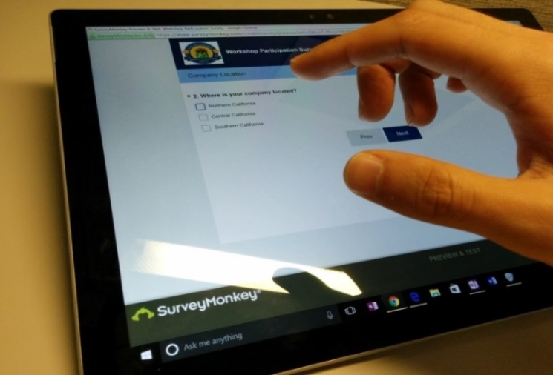

We Want to Hear From You!
1 Minute Survey
The information supplied will be used for public reporting purposes to display anonymous overall attendance of diverse groups.
Zoom participants, please use this link:
https://www.surveymonkey.com/r/CEC-10-11-2017
Thank you for your time!

Slide 6
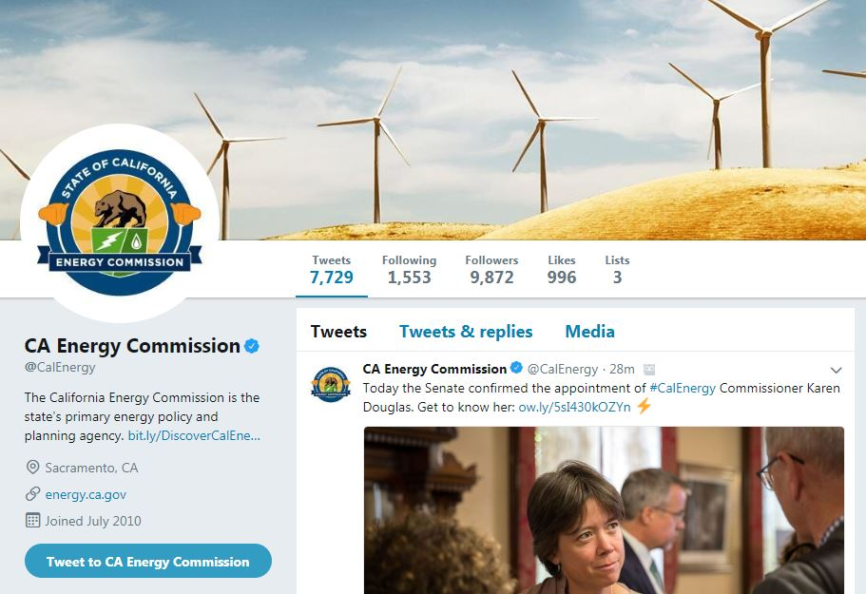
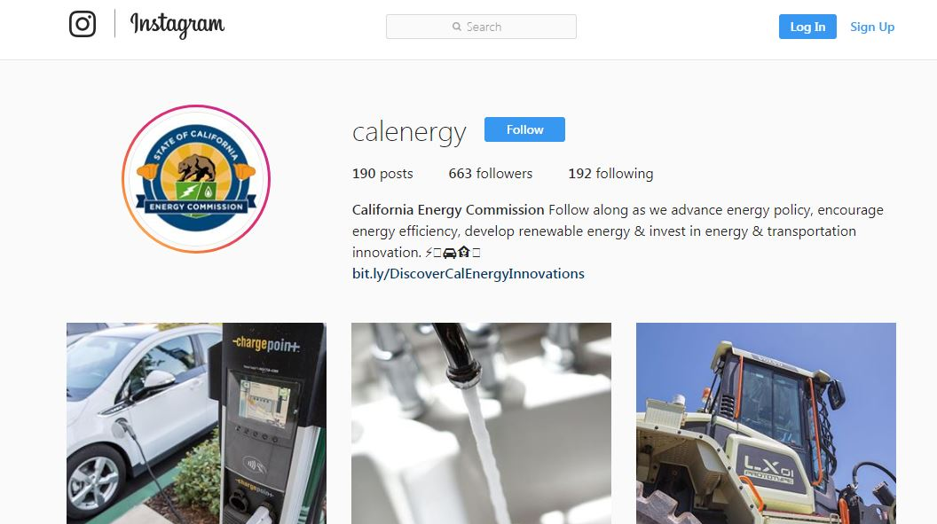
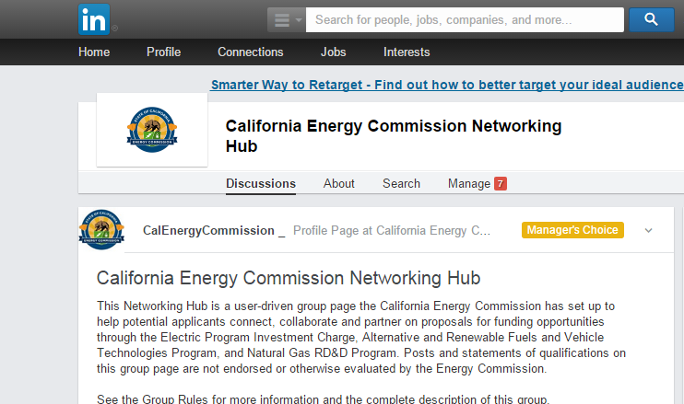




Connect with Us
Twitter
Instagram
LinkedIn

Slide 7
Find a Partner on EmpowerInnovation.net
Empower Innovation strives to accelerate your clean-tech journey with easy access to funding opportunities from the Energy Commission and other funding providers, curated resources and events, and connections to people and organizations.
FIND A PARTNER
Announce your interest in this funding opportunity and message other interested parties to find potential partners.
RESOURCES & TOOLS
Browse the collection of resources for clean tech innovators including Resource Libraries, Funding Sources, Tools, and Databases.
https://www.empowerinnovation.net

Slide 8
Natural Gas Research & Development Program
Annual budget plans of $24M/yr. funded by a natural gas IOU ratepayer surcharge established by the CPUC
Goals for natural gas safety research:
  Advance technologies to improve the safety and integrity of our natural gas system
  Benefit natural gas IOU ratepayers
  Reduce greenhouse gas emissions
Past research focused on natural gas technologies such as damage detection and prevention, risk assessment, and information and integrity management.

Slide 9

Natural Gas System Decarbonization via Hydrogen
  A zero-carbon emissions fuel
  An energy carrier that can be used to store energy over long periods of time
  Infrastructure needs for hydrogen production, delivery, storage, and utilization
  Many barriers to overcome

Slide 10
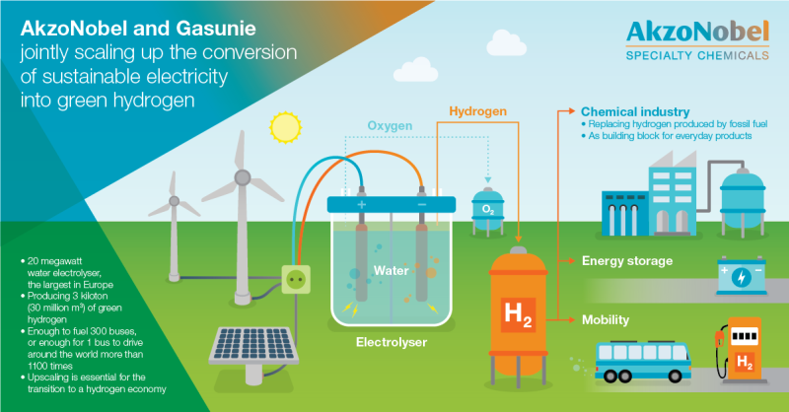
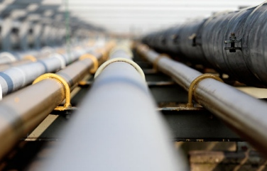
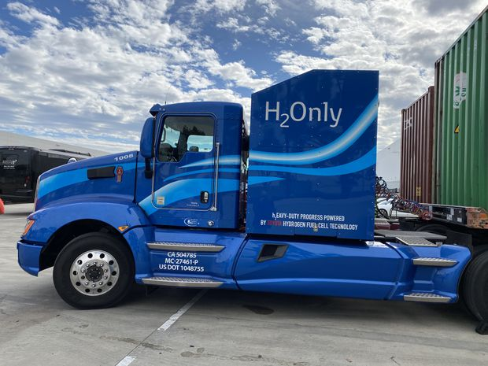

Accelerating Hydrogen Research
Segments | FY 20-21 Natural Gas Research Initiatives for Hydrogen
Production | Decarbonization via Efficient and Cost-Competitive Renewable Hydrogen and Biomethane: Emerging Renewable Hydrogen Production
Delivery | Pilot Test and Demonstration of Hydrogen Blending into Existing California Natural Gas Pipelines
Utilization - Transportation | Technology Integration and Demonstration of Hydrogen Fuel Cell Trucks and Buses
Utilization – End Use Appliances | Examining the Effects of Hydrogen in End-Use Appliances

Slide 11
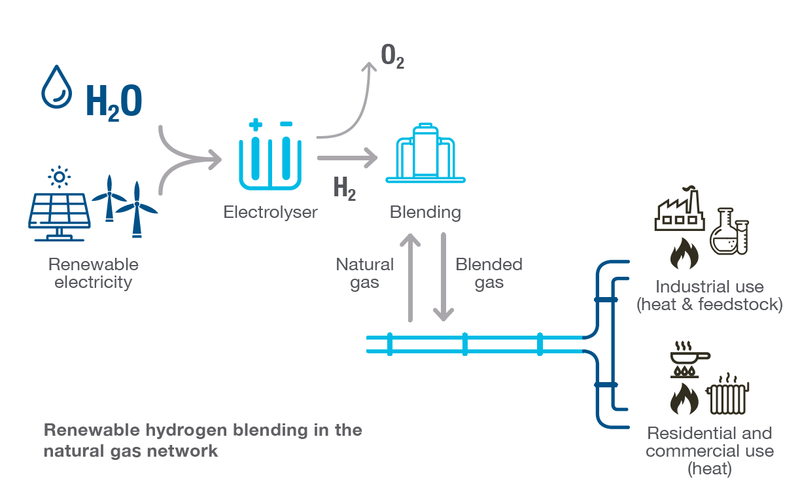
Hydrogen Blending
    Transporting hydrogen is expensive
    Using pipelines is the most economical way to transport and deliver large amounts of hydrogen to end customers
    Several projects worldwide are demonstrating blends with hydrogen concentrations as high as 20%, but the long-term impact of hydrogen on materials and equipment is not well understood

Slide 12
Why Are We Seeking Your Input?
In late 2021, we anticipate releasing a Grant Funding Opportunity (GFO) to support of hydrogen blending demonstration projects.
We are seeking input from stakeholders and the general public to determine how to best facilitate successful demonstrations with measurable benefits.
Ideally, projects funded under the upcoming GFO will spur technology advancement and future market adoption of hydrogen blending while ensuring safety and integrity of our natural gas system.
Input from today’s workshop and the public comment session will help shape a future GFO.

Slide 13
Questions for stake holders
Due to limited funding, should certain application or scale of demonstration projects be prioritized over others for demonstrating hydrogen blending?
What are the key challenges that must be addressed for demonstrating hydrogen blending? How should the technical tasks regarding planning, siting, safety, and measurement verification be approached?
What are the expected outcomes of these demonstration projects? What are the specific performance metrics that should be measured or compared against to evaluate the viability of blending for the demonstration projects?
What other considerations or requirements should be incorporated into the future GFO?

Slide 14
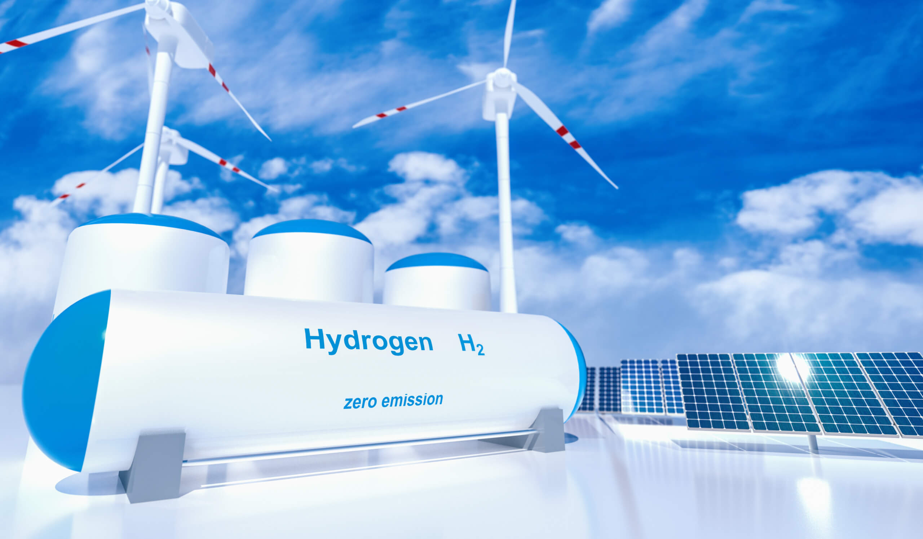
FY2020-21 Natural Gas R&D Program Budget for Hydrogen Blending
FY2020-21 budget plan includes an initiative to pilot test and demonstrate Hydrogen Blending into Existing California Natural Gas Pipelines
https://www.h2-view.com

Slide 15
Background
Why demonstrate hydrogen blending?
Advance studies of blending impacts
  From lab tests to system level
  Long-term impacts
Identify requirements to upgrade existing pipeline to accommodate H₂ mixing
Expand H₂ blending knowledge
  Pipeline integrity management
  Operating practices
Develop deployment strategies tailored for CA gas network
Facilitate the development of H₂ interconnection and blending standards

Slide 16
Benefits of Blending Hydrogen at Scale
Achieve a promising strategy to decarbonize natural gas systems and reduce GHG emission
Avoid the cost of building dedicated hydrogen transmission and distribution networks
Mature the technologies associated with H₂ production and supply
Increase the consumption and generation of H₂ from renewable sources (renewable H₂, per CPUC definition)
  Improve H₂ cost-competitiveness

Slide 17
Solicitation Goals
Pilot test the impacts of H₂ blending on natural gas system safety and integrity
Identify the best use cases for blending by leveraging H₂ supply, injection and end use
Assess natural gas system modification requirements to maximize blending level
Develop H₂ blending methods and deployment strategies

Slide 18
General Requirements May Include
Some or All of the Following
Meet all safety requirements for design and operation, including risk assessments as mandated by industry codes and standards and other authorities
Procure a minimum of 30% renewable hydrogen
Demonstrate a minimum of 12 months of data collection
Include representative pipe materials and components
Provide a minimum of 20% match funds
Demonstration must be within a natural gas investor-owned utility territory (PG&E, SoCalGas, SDG&E)

Slide 19
Performance Metrics May Include Some or All of the Following
Demonstration: 12-month minimum demonstration period
Blending Ratio: up to 20%, and uniformity from injection point to end use point
Operation: gas measurement and quality, compression, and network management
Pipeline Component Performance: material embrittlement, crack growth, gas permeation, sealant performance, system leaks, etc.
Utilization: appliance performance metrics, H₂/NG separation, etc.

Slide 20
Data Collection Requirements May Include Some or All of the Following
System adjustments: essential infrastructure upgrades and modifications for various levels of blending
Inspection and Maintenance: additional requirements to be incorporated in operational manuals, protocols and procedures
Safety: quantification of impacts on material, component and system safety, safety management and risk mitigation
Costs: detailed upfront costs and O&M costs, including parts, fuel, and labor
User Experience: qualitative feedback regarding uptime, ability to meet operational and customer needs, O&M challenges, and perceived safety barriers

Slide 21
Preferred but not Required
Procure 100% renewable hydrogen
  H₂ produced from solar, wind, or other renewable resources
Reach a blending level greater than 20% (vol.)
Include transmission system and storage facilities
  Explore blending at larger scales
  Prepare for massive production of H₂

Slide 22

Questions? Comments?

Slide 23
Thank You!
Please submit your comments by 5 pm April 2, 2021
Submit electronically through the CEC’s “Research Idea Exchange” docket: https://efiling.energy.ca.gov/Ecomment/Ecomment.aspx?docketnumber=19-ERDD-01
Submit by email to the Docket Unit at: docket@energy.ca.gov
Submit paper copy to the Docket Unit: California Energy Commission; Docket Unit, MS-4; Re: Docket No. 19-ERDD-01; 1516 Ninth Street; Sacramento, CA 95814-5512
Yahui Yang
E-mail: yahui.yang@energy.ca.gov

