Slide 1
Forms and Instructions
For Submitting Electricity Demand Forecasts and Resource Plans
March 19, 2021

Slide 2
Agenda
Introduction & Overview
Demand Forms Review
Supply Forms Review
Docket Procedures
Important Dates and Next Steps

Slide 3
Regulations and Authority
California Public Resources Code
  Section 25301 – Integrated Energy Policy Report
  Sections 2516 and 2516.5 provide authority to collect information “on all forms of energy supply, demand…”
California Code of Regulations, Title 20
  § 1345 – Demand Forecasts
  § 1347 – Electricity Resource Plans

Slide 4
Overview
CEC data request to load-serving entities (LSEs)
Staff report adopted every two years
Forms provide a template for data submission
Separate requests for:
  Electricity demand forecasts
  Electricity resource plans

Slide 5
Demand Forecasts

Slide 6
Who Must File - Demand Forecasts
Investor-owned utilities (IOUs)
Publicly owned utiltiies (POUs)
Community choice aggregators (CCAs)
Electric service providers (ESPs)
Exempt: LSEs with peak load less than 200 MW

Slide 7
What information is requested?
Form 1: Historical and Forecasted Load
Form 2: Forecast Inputs / Drivers
Form 3: Load Modifier Impacts
Form 4: Narrative Documentation
Form 7: ESP Load
Form 8: Revenue Requirements

Slide 8
Purpose
Historical record
Forecast comparisons
Sudden load growth / migration
CEC forecast allocation
Assess peak coincidence
Input to CEC forecast

Slide 9
Proposed changes
Several forms removed
  Forms 1.7a,b,c (private supply)
  Form 1.8 (monthly interconnections)
  Form 6 (energy efficiency narrative)
Consolidated Form 3 (incremental load modifiers)
Form 1.6 (hourly loads) requests forecast year 2022
CCA request expanded
  Sales and Peak forecast by sector (Forms 1.1, 1.3)
  Load modifiers impacts (Form 3)
Historical years 2019/2020, forecast through 2032
All demand forms due June 30, 2021

Slide 10
Forms and Filers

Slide 11
Resource Plans

Slide 12
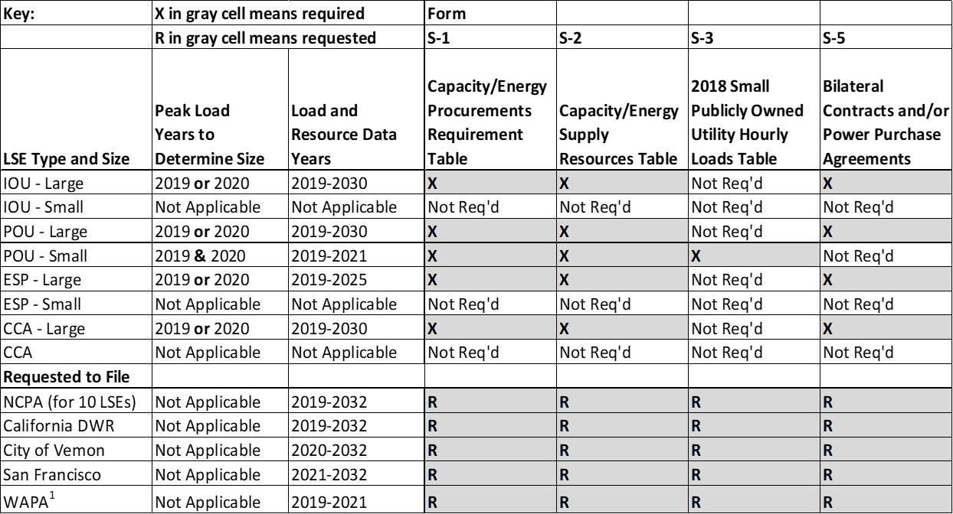
Who Must File - Resource Plans

Slide 13
What Has Changed?
Reporting quality of life improvements: unlock cells.
Inclusion of RA and RMR contracts.
91 day contracts changed to peak hour contracts.
Public and Confidential filing instructions modifications and general instructions.
N-1 contracted capacity and N-1-1 contracted capacity.

Slide 14
Proposed Timeline
Comments due April 2
Staff reports published in April
May 12 business meeting
Demand forecast forms due June 30
Resource Plans (POUs, ESPs, and CCAs) due September 17, 2021 for POUs, ESPs, and CCAs
Resource Plans (IOUs) due September 24

Slide 15
Docket Procedures
Submit Questions, Reports to the Docket
  21-IEPR-02 – Electricity Resource Plans
  21-IEPR-03 – Electricity and Natural Gas Demand Forecast
Request Confidentiality
Request Submittal Extension
Comments are due to the docket by Friday, April 2, 2021

Slide 16
Staff Contacts
Resource Plans: Robert Kennedy
(916) 654-5180
Robert.kennedy@energy.ca.gov
Demand Forms: Kelvin Ke
(916) 237-2517
Kelvin.Ke@energy.ca.gov

