Slide 1
Public Advisor’s Office
SPPE Public Scoping Meeting:
San José Data Center 2/19/2021
Noemi O. Gallardo
Public Advisor

Slide 2
“Informal” Participation
Attend events (via Zoom until further notice)
Share public comment for the record:
  Speak during live public comment period
  Email comments before event for Public Advisor to relate; and
  Submit written comments to Docket Unit

Slide 3
“Formal” Participation
Become Intervenor:
  Present evidence and witnesses
  Object to other parties’ evidence
  Cross-examine other witnesses, and
  File motions
File Petition to Intervene
  Anyone may file; not necessary to be attorney or have legal representation
  No specific form needed; file required information to Docket 19-SPPE-04
  File early to meet filing and discovery deadlines set by Presiding Member
  File in the relevant docket and include docket number

Slide 4
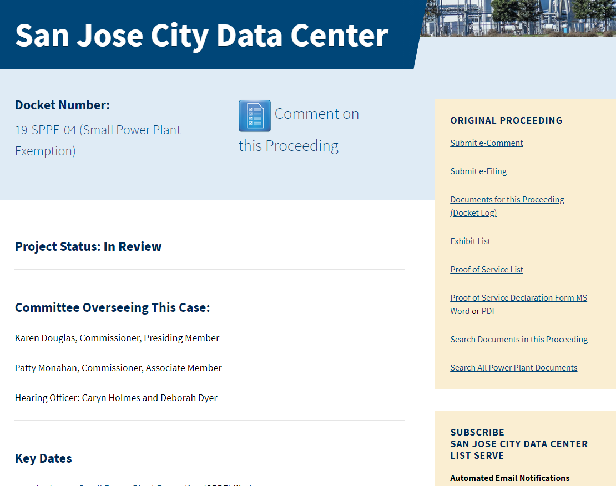
Project Info
https://ww2.energy.ca.gov/sitingcases/sj2/
For anyone
For parties to proceeding; staff
All material docketed
Sign up for list serve

Slide 5
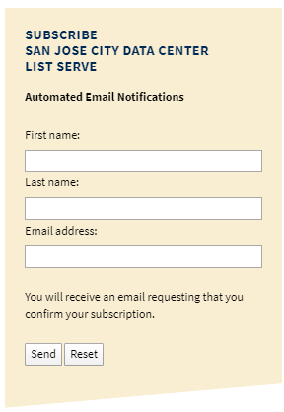
Listserv Signup Process
Step 1: Go to https://ww2.energy.ca.gov/sitingcases/sj2/
Step 2: Enter your name, email address and click send
Step 3: Open "confirmation" email; click on link
to complete subscription
Step 4: Look out for email verifying subscription accepted
Once accepted, you'll receive email proceeding notifications and materials.

Slide 6
Upcoming Participation Opportunities
Publication of the Staff's Environmental Assessment Document
Pre-hearing Conference and Evidentiary Hearing
Committee Proposed Decision
Commission Decision at CEC Business Meeting

Slide 7
Public Advisor Contact Information
Phone: (916) 654-4489
Email: PublicAdvisor@enegy.ca.gov
Web: https://www.energy.ca.gov/about/divisions-and-offices/office-public-advisor
Mail:
California Energy Commission
1516 Ninth Street, MS-10
Sacramento, CA 95814-2950

