Slide 1
Vehicle-to-Building (V2B) for Resiliency Backup Power
Regulatory Context and Opportunities
California Energy Commission (CEC)
January 25, 2021
Roger Salas P.E.
Engineering Manager
Integrated System Strategy
Southern California Edison

Slide 2
Topics
Introduction
About SCE
V2G related pilots at SCE
Discussion of Recent PUC Decision for V2G DC and AC systems
Standards and Process Development to enable V2GDC and V2G AC systems (J3072, UL1741SC, etc.)

Slide 3
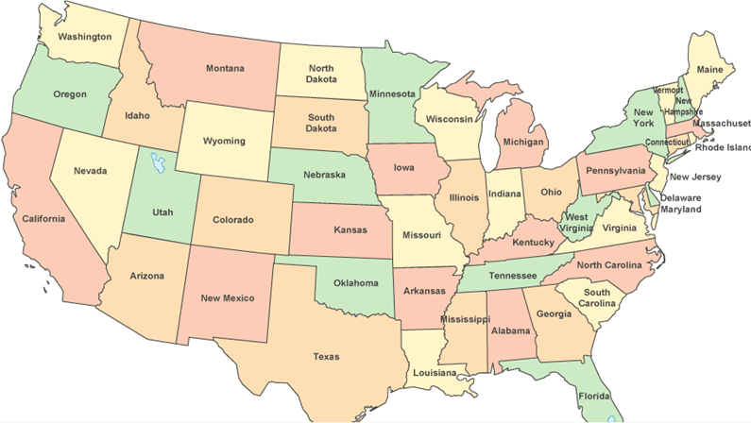
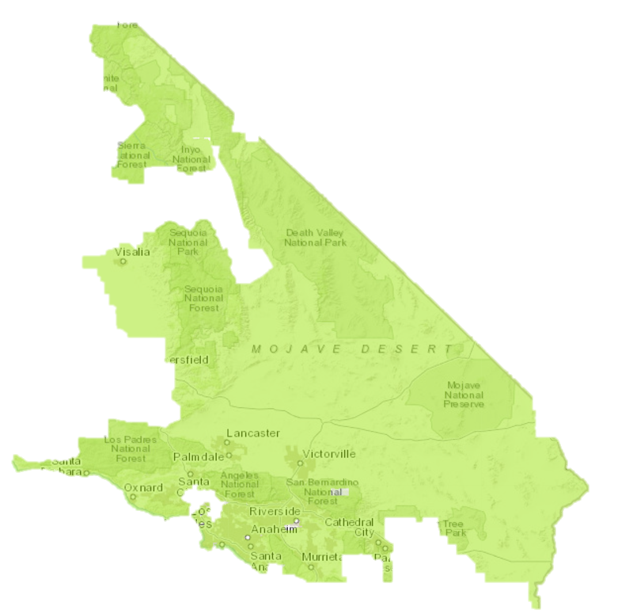


Who is Southern California Edison?
Serves a population of about 15 million people in a 50,000-square-mile service area within central, coastal and Southern California
Nearly 5 million electric meters
SCE has been proving electrical service for more then 125 years
Supporting California’s 2030 greenhouse gas reduction goals

Slide 4
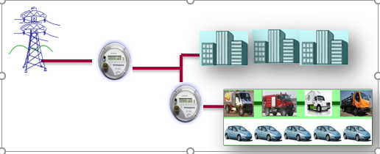
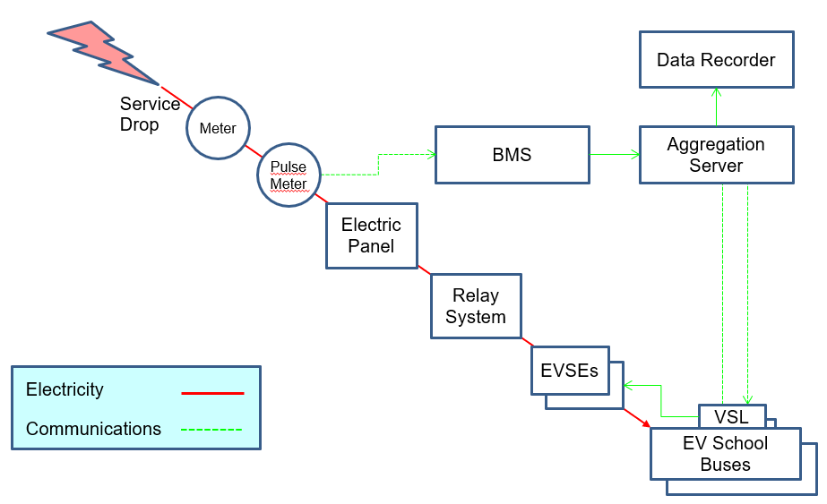
Recent work at SCE
LA Air Force Base Demonstration
  PEV fleet to provide energy and ancillary services to CAISO markets
  Regular Load and PEV load all under on point of interconnection
  PEVs interconnected via WDAT tariff with CAISO meter registering energy flow for the PEV fleet
  CAISO reg up/reg down instructions facilitated by SCE
  Proof-of-Concept demonstrating the technical viability of V2G
  Status: Completed and terminated
Torrance V2G School Bus Project
  BTM installation as a non-exporting generating facility
  V2G project utilize a protective relay for interconnection protection

Slide 5
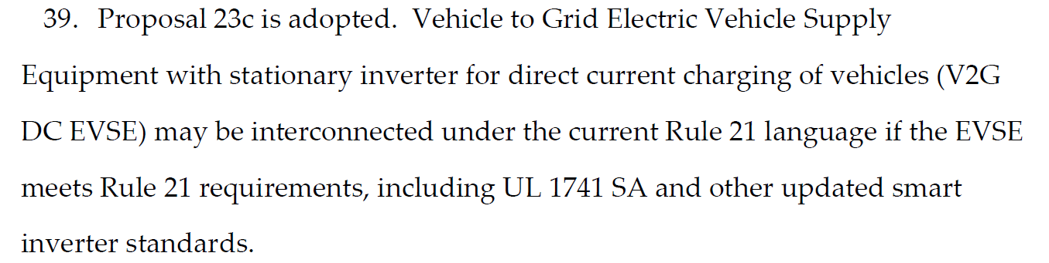
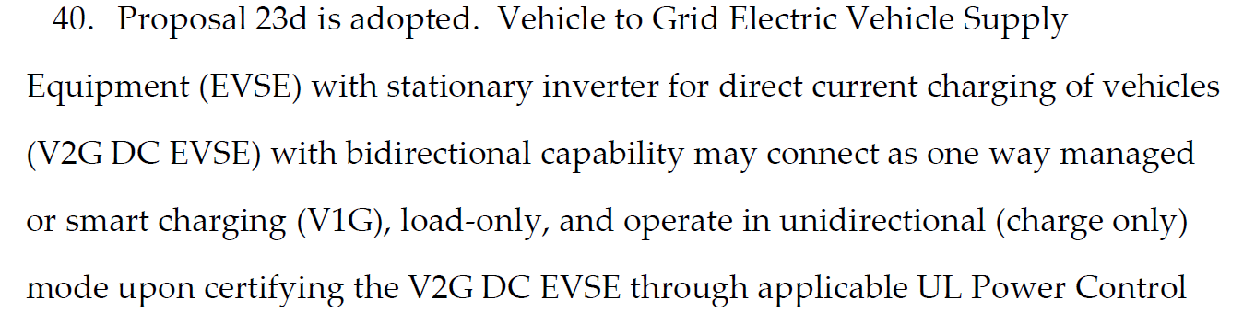
PUC Decision on V2G-DC*
V2G- DC systems are ready for deployment; however, some processes need to still figure out processes
Ordering Paragraph 39: (Proposal 23c) V2G operation on initial installation (V2G ready systems)
  From the interconnection perspective, treated as any other storage type (although specific program may have limitations)
  Must request interconnection as discharging resource through applicable interconnection tariffs (Rule 21, WDAT)
  Must meet all interconnection requirements (certification, attestation, equipment specification)
  EVSE must be certified under UL1741
    UL1741SA-2021(incorporates the applicable Smart Inverter Phase I, III requirements)
    UL1741SB-2022(incorporated IEEE1547-2018/IEEE1547.1-2020)
Ordering Paragraph 40: (Proposal 23d) V2G capable systems initially operated as V1G systems and later the V2G functionality may be enabled
  Customers can purchase a bi-directional capable V2G-DC system and connect it/use it as V1G (charging only)
  Requires that EVSE be certified under UL1741 (UL1741 SA (2021) and UL1741 SB(2022 and after))
  Requires that EVSE be certified under the UL Power Control Systems Standard
    Certify the appropriate function (such “No Export”) at the EVSE
  EVSE shall be set at the factory as charging mode (V1G) default operation
  Mode cannot be changed to bi-direction (V2G) operation without utility Permission to Operate (PTO) which requires customer to apply for interconnection as a discharging resource
*Working Group 2 and 3 PUC Decision D-20.09.035

Slide 6
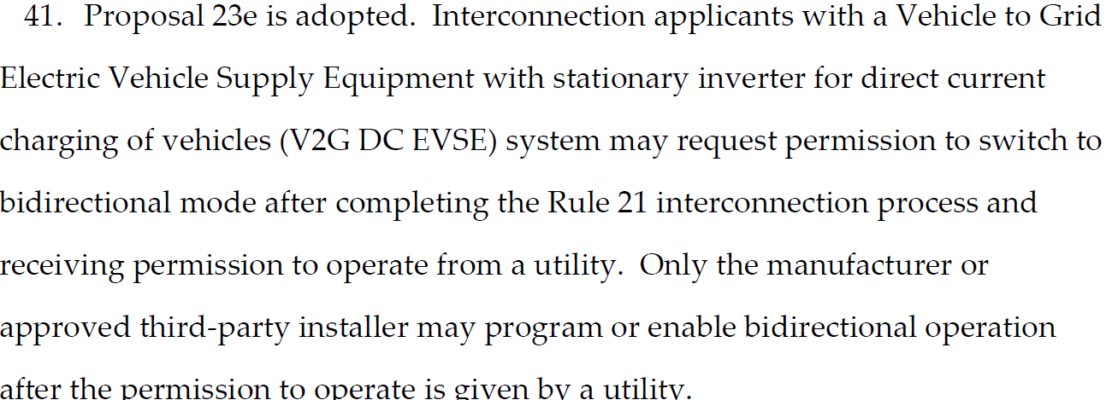
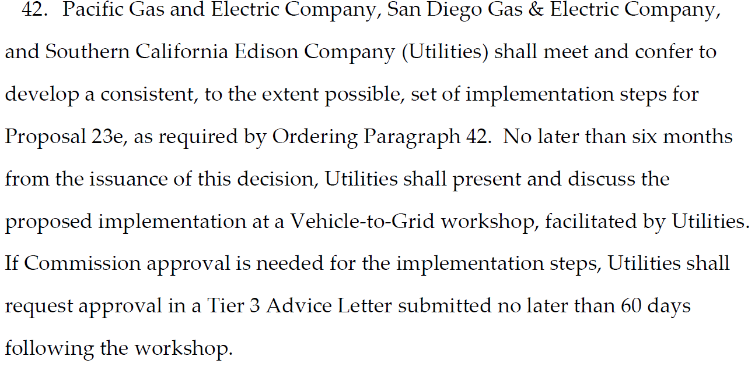
PUC Decision on V2G-DC*
Ordering Paragraph 41: (Proposal 23e) Conversion from V1G operation to V2G Operation for systems connected based on OP 40 requirements
  Extension of OP 40
  May request permission to switch to bidirectional mode
  Must submit a Rule 21/applicable tariff interconnection request
  Must receive Permission to Operate (PTO) from utility prior to switching to mode the mode
  Only manufacturer or approved third-party installer may program or enable the bidirectional mode
Ordering Paragraph 42: Proposal 23e Implementation Process
  Implementation of proposal 23e
  IOUs shall meet and confer to develop consistent, to the extent possible, set of implementation steps
  IOUs to present the implementation proposal at an upcoming Vehicle-to-Grid Workshop (not yet scheduled)
  60 days after the workshop, IOUs to file a tier 3 AL if approval for the implementation plan is required
*Working Group 2 and 3 PUC Decision D-20.09.035

Slide 7
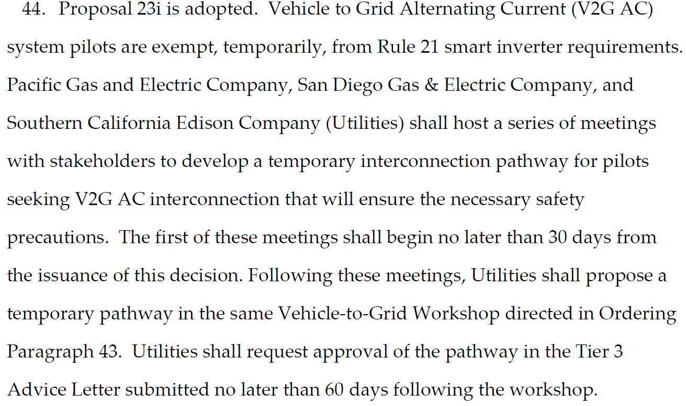
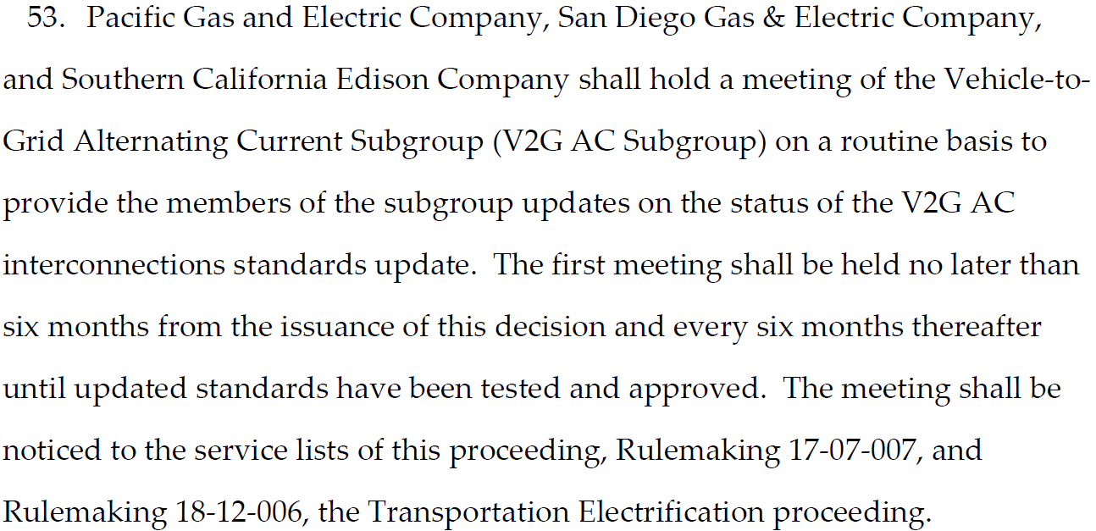
PUC Decision on V2G-AC*
V2G- AC systems require more time to develop standards, certification, and implementation processes
Ordering Paragraph 44: (Proposal 23i) V2G-AC Pilot Projects
  V2G-AC pilot projects are temporary exempt from Rule 21 Smart Inverter Requirements
  IOUs shall host a series of meetings with stakeholders to develop a temporary interconnection pathway for pilots
    Already held three meetings (October, November, December 2020)
    Reached consensus on several areas
    Continue discussion on implementation process
  IOUs shall present the pathway in the same Vehicle-to-Grid workshop as that OP 42
  60 days after the workshop, IOUs to file a tier 3 AL requesting approval of the pathway.
Ordering Paragraph 53: Status Update of the V2G-AC interconnection Standards
  IOUs shall hold routine meetings with the V2G-AC Subgroup to update the subgroup on the status of the V2G-AC Interconnection standards development.
    V2G-AC subgroup formed as part of Rule 21 Working Group #3 to provide guidance on resolving Issue 23 in that working group
  First meeting to be held by late March (6 months from the decision) and every 6 months after until standards have been updated
  Once standards have been approved, IOUs shall inform the Director of Energy Division (OP 54)
*Working Group 2 and 3 PUC Decision D-20.09.035

Slide 8
Standards Development Status
V2G-DC
V2G-AC
Standards development in progress
Standards are available for deployment
UL 1741 SA (2021) UL 1741 SB (2022)
UL PCS Standard (Published in 2019)
  Now being updated to reflect new industry use-cases
  Update projected to be approved in Q1-2021
Detailed implementation procedures/clarifications to be developed as part of OP 42 (see slide 6)
Update to SAE J3072 is in progress
Development of UL1741SC (or adequate UL standard) will be required
  UL will create a task force
Certification procedures are yet to be determined
Listing of certified equipment is yet to be determined

Slide 9
Thank you for the invitation

