Slide 1
Presentation for California Energy Commission V2H/B Workshop
January 25, 2021

Slide 2
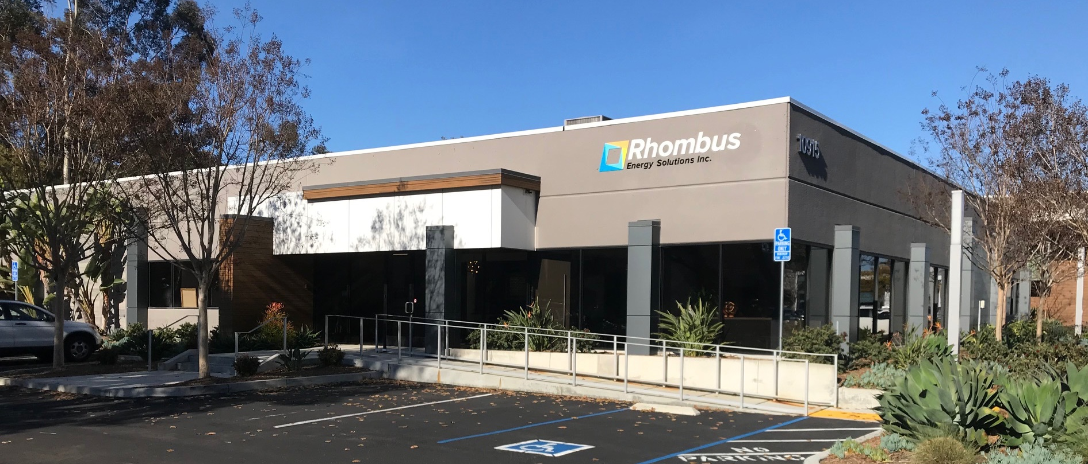
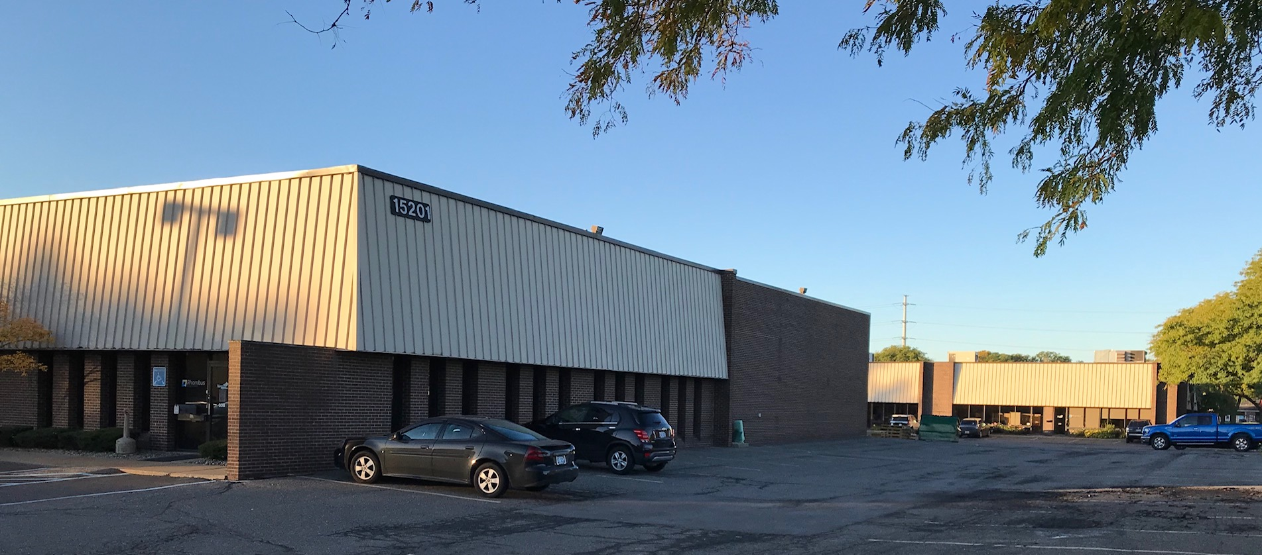
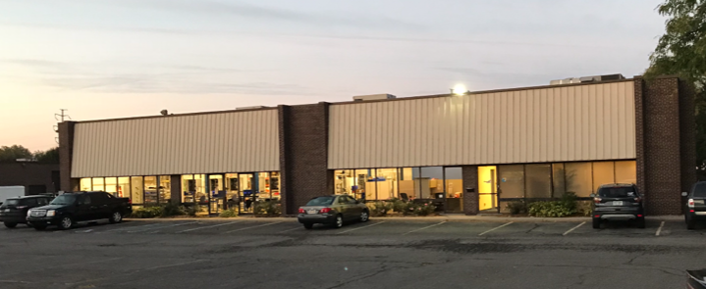
Who is Rhombus Energy Solutions?
Rhombus is an industry leader in advanced power conversion, providing solutions to:
    AC-DC Systems for Transportation Electrification
    Energy Storage Systems For Charging Support / Power Load Leveling
    Microgrids, w/ Integrated Command / Control energy management
Rhombus is headquartered in San Diego with a high-power testing lab and manufacturing in Dearborn as well as a India design center.
Our expertise is developing bidirectional high-power inverters for renewables, energy storage and microgrids… enabling V2G charging
Our products are easily customized for specific EV OEMs and fleet requirements
Rhombus has deployed over 820 systems worldwide
Rhombus is the expert in V2G charging systems for EV fleets

Slide 3
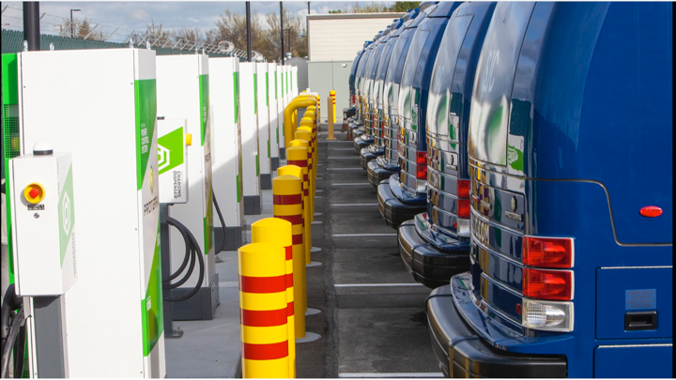

The Attraction of Vehicle To “X” (V2X)
V2X is an incredibly smart idea for EV fleets
  Helps to stabilize the grid during peak demand hours
  Offsets intermittent renewable power resource
  Provides a source of emergency backup power
  V2X can significantly reduce EV fleet energy costs
V2G gaining traction with fleets as the arbitrage economics are proven out.
V2G

Slide 4
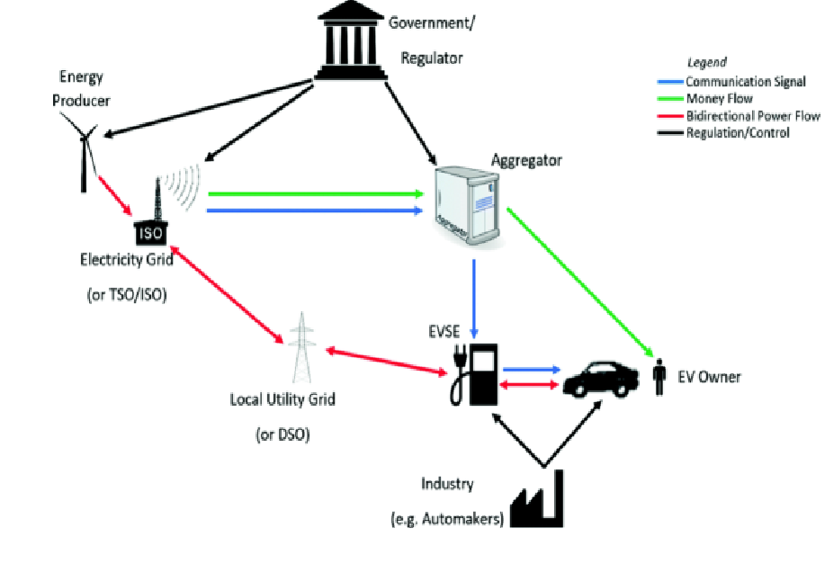
The Challenges of V2X
V2X is not a new concept (originated in 1997)
Why aren’t there many V2X production implementations?
  V2X is complicated
  Lots of elements that have to communicate
  Lots of players, often with conflicting agendas
  Lack of an open interface standard
Who regulates/approves equipment for V2X?
  UL/other standards bodies
  States?
  Utilities?

Slide 5




How Do We Accelerate Vehicle To Grid?
Improved (and ideally simplified) industry standards:
  Grid communication
  Grid Interconnect (for bi-directional power flow)
  EV to charger communication
  EV charger standards
  Aggregator software/service providers
  Safety and Security
In the interim, large fleet deployments will drive forward using semi-custom installations while trying to “future proof”
CA Rule 21 / SEP
OpenADR
IEEE 2030.5
CPO
Aggregator
OEM
Telematics
IEEE 2030.5
IEC 27000
OCPP 1.6 & 2.0
OEM &/or Proprietary
ANSI 12.20, IEC62053
NIST HB44
SAE J2910
SAE J2929
SAE J2344
SAE J2464
SAE J1772
SAE J2836
SAE J2931
ISO 15118-2
CSA 22.2 107.1
NEC
NFPA
IEEE 1547
UL 1741 SA
UL 1741 CRD’s
UL 2202
UL 2231
UL 9741
FCC 15

