Slide 1
CEC Workshop
Vehicle-to-Building (V2B)
for Resilient Backup Power
Customer Demand and Market Opportunity
January 2021
Maria Sanz
Vehicle Grid Integration – Integrated Grid Planning and Innovation

Slide 2
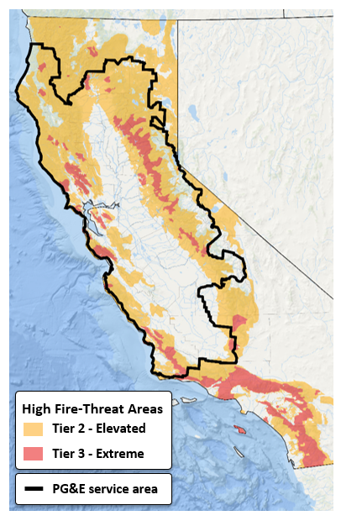
Bidirectional electric vehicles can used as emission free temporary generation
Value of V2H/V2B for PG&E’s PSPS Use Case
Challenge:
High wildfire threat areas in PG&E’s service territory
PG&E may need to turn off power during severe weather to prevent major wildfires. This is called a Public Safety Power Shutoff (PSPS).
Current temporary solution is largely diesel based
Value Proposition of V2H/V2B:
Customer benefits:
Bidirectional Electric Vehicles (EV) could mitigate the effects of power shutoffs by supplying energy to the homes (V2H) or buildings (V2B) affected during PSPS events
Societal benefits:
Utilizing Electric Vehicles as back up power could be zero emission alternative to temporary diesel generation
Source: http://cpuc.ca.gov/FireThreatMaps

Slide 3
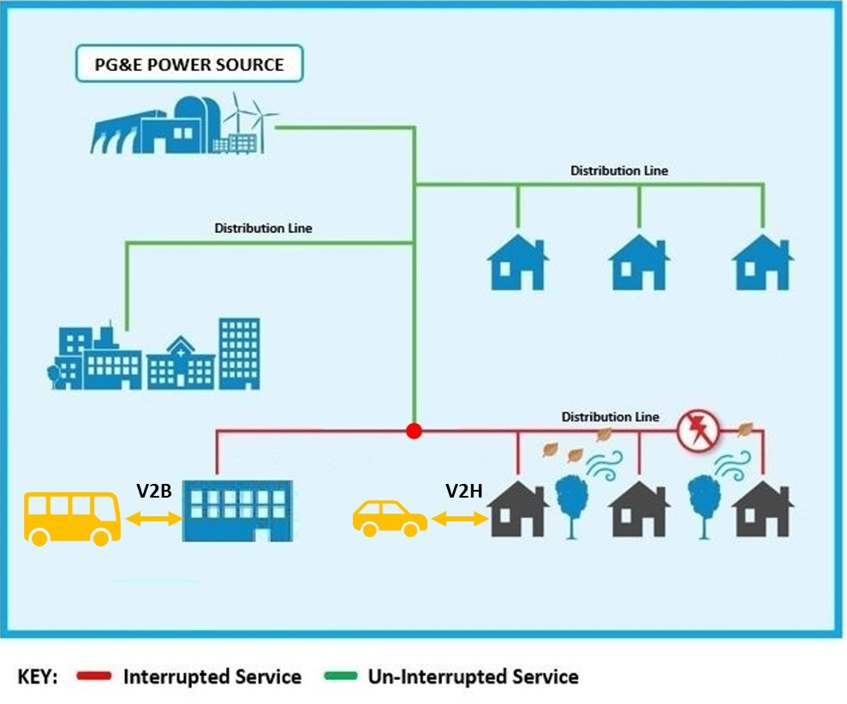
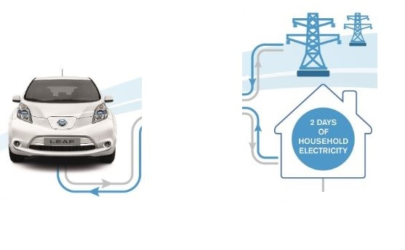
V2H/V2B creates more resilient communities and could unlock the value of V2G
Residential customers could use EVs as back up power during emergency events for several days. Commercial customers could utilize EVs to keep their business running longer during those times.
Heavy and medium duty EVs for V2B are a prominent high value use case.
V2H/V2B could unlock the value of V2G creating new revenue streams and reducing EV ownership cost.
V2H/V2B is still a nascent technology. Adoption will likely increase as more EV models and certified V2G equipment are commercially available, customers awareness grows, and price decreases.
PG&E continue research to ensure safe, reliable, and cost-effective utilization of these technologies.
Interrupted Service
Un-interrupted Service
Bidirectional Home Charging
6.6 kW
Home Charging
- Control system
- Inverter
2 kW
Emission free energy supply

Slide 4
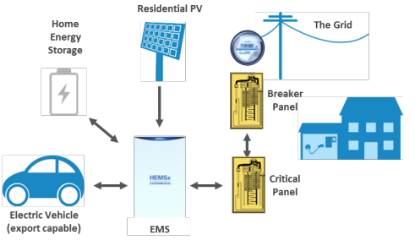
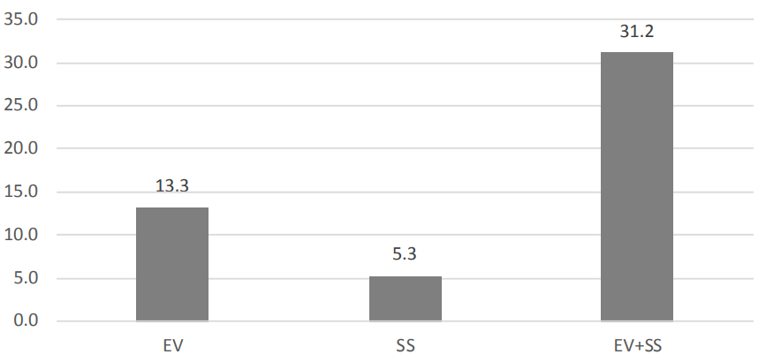
EPIC 2.03.b: Smart Inverter – Vehicle to Home (V2H)
Outage Scenario – Days of resiliency for each configuration combined with PV system
Research proves technical feasibility and high interest from customer in V2H
Project focused on charging and discharging of the EVs in response to demand response (DR) event (providing load drop by islanding the house) or hard islanding events in different configurations and scenarios. [2018]
Pilot tested V2H/V2G’s technical feasibility and cost-effectiveness in lab setting. PG&E conducted survey to understand better customers’ interest in V2H.
Days of resiliency combined with PV system
31.2
Results successfully proved EV-only V2H system was able to supply home during DR events and outages. It was also able to safely export to the grid (V2G use case).
EV added significant incremental value when combined with stationary storage (SS) in long-term outage scenarios.
Number of Days
13.3
5.3
EV
SS
SS + EV
Summer long-term outage scenario
Source: https://www.pge.com/pge_global/common/pdfs/about-pge/environment/what-we-are-doing/electric-program-investment-charge/PGE-EPIC-Project-2.03.pdf

Slide 5
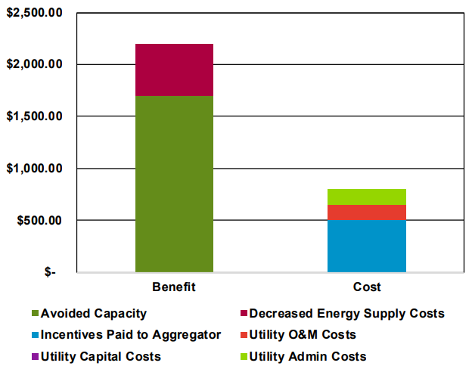
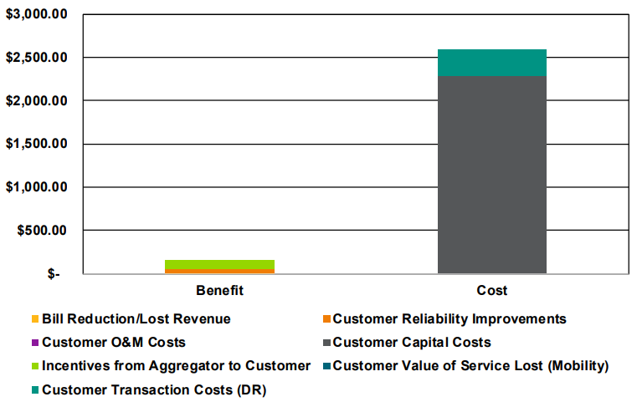
Research proves technical feasibility and high interest from customer in V2H
Key Findings:
V2H and EV-export (V2G) were technically feasible.
High customer interest in V2H (PG&E survey) but discouraged by high cost (PCT) at the time (2018).
Barriers: customers’ upfront cost, battery warranty issues, customer awareness of V2H’s value
Opportunity:
  V2H proved to be cost-effective from a program administrator standpoint (PACT).
  As transportation electrification and markets evolve, incremental cost of bidirectional capabilities will decrease.
  Research data, customer awareness, vehicle-grid-integration (VGI) regulatory framework will reduce barriers.
Cost – Effectiveness results, 2018 EPIC V2H pilot.
Program Administrator Cost Test (PACT)
Participant Cost Test (PCT)
Source: https://www.pge.com/pge_global/common/pdfs/about-pge/environment/what-we-are-doing/electric-program-investment-charge/PGE-EPIC-Project-2.03.pdf

Slide 6
Conclusions
Key Takeaways:
Research proves that V2H/V2B are feasible and could mitigate the effects of power shutoffs.
Opportunity to unlock the value of V2G creating new revenue streams and reducing EV ownership cost.
PG&E’s survey shows high customer interest but there are still technical and economic barriers to overcome.
Data, customer awareness and increasingly available EVs and bidirectional devices will reduce barriers.
Utilities will continue research to ensure safe, reliable, and cost-effective integration of these technologies.
Developments
 | 2020 | 2021 | 2022 | 2023 | 2024 | 2025 | 2030 | 2035
Interconnection Reg. V2G EVSE
State’s VGI Decision and Research
Utilities VGI Pilot Programs
CCS V2G Connectors
V2X/V2G home EVSE

