Slide 1
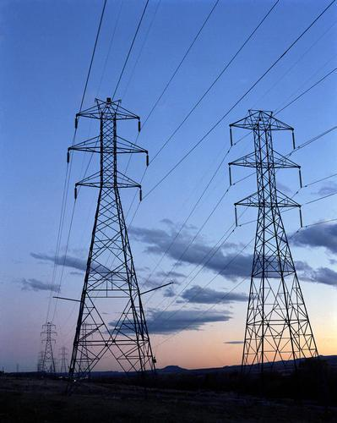

EV V2G School Bus
Demonstration Projects
V2B Background on EV V2G School Bus Demonstration Programs
CEC Workshop on V2B for Resilient Backup Power
1/25/2021

Slide 2











PHASE 1 EV V2G School Bus Partners

Slide 3
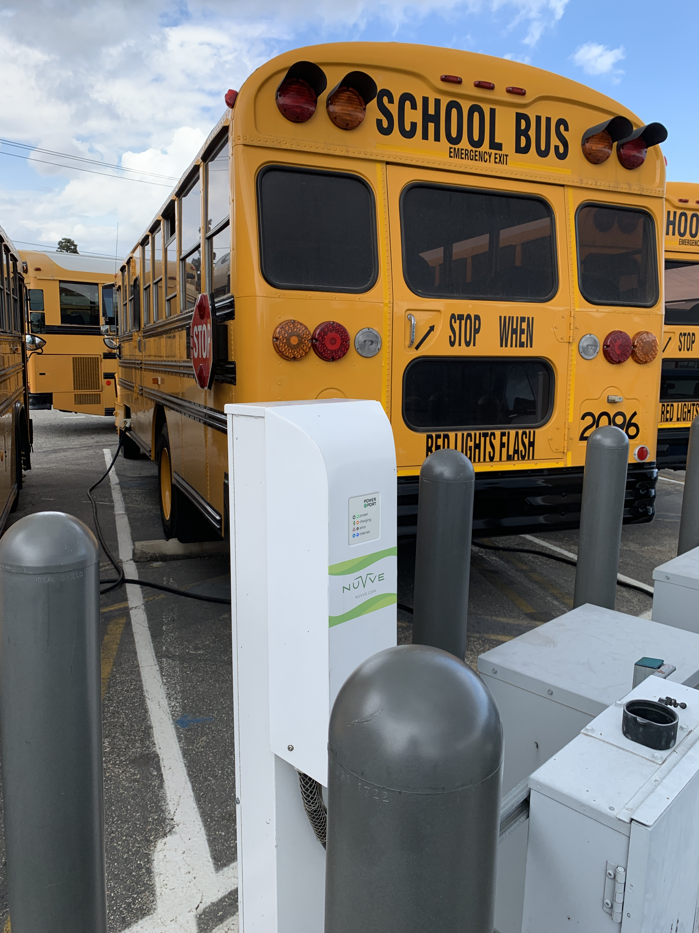
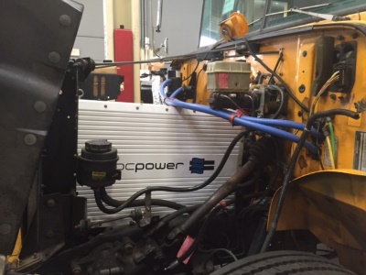
Phase 1 – Proof of Concept
Notes:
NSI awarded grants from California Energy Commission and South Coast AQMD of $3.8M
Project team assembled ranging from school bus drivers to CAISO
Funding to retrofit six school buses with ZEV V2G system with interconnection agreement funding with one IOU (SCE)
All buses met operational requirements for pupil transportation
Battery information:
300 ampere-hour (Ah) lithium iron phosphate (LiFePO4) cells manufactured by Winston, a Chinese battery manufacturer, and distributed in the U.S. by Voltronix
120 cells in the entire subsystem, which provides a total of approximately 115 kilowatt-hours (kWh) of total energy storage

Slide 4
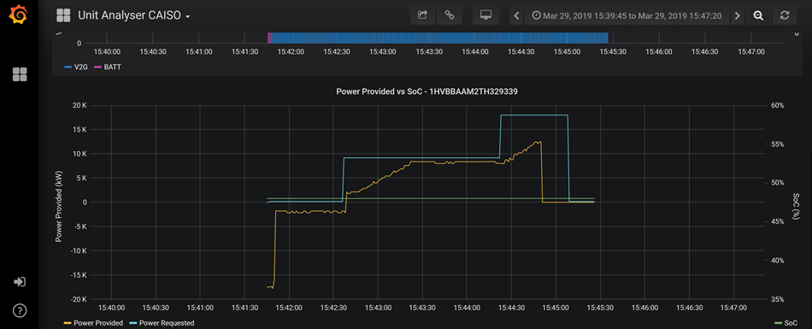
Phase 1 – Proof of Concept
Notes:
Two of six buses deployed to Torrance USD for V2G demonstration with 70kwh bi-directional inverter
Behind-the-Meter Interconnection agreement negotiated with SCE (First V2G school bus agreement in the world)
Two buses were connected to TUSD subpanel to reduce demand charges/power usage related to CNG filling station for school bus fleet
Initial data indicated school buses reduced net energy charge by $5,000 per bus per year
TCO to School Bus Parity was in reach

Slide 5
Findings & Lessons Learned on V2B
Project conducted behind the meter operations
Supplied power to existing CNG Compressor Station at TUSD
Created Economic Benefit of ~$10,000 per year (avoided costs)
SCE was great partner, interconnection agreement was time consuming and additional protective relays added costs
Other Issues:
  UL vs. SAE
  AC Onboard v. DC Offboard
  Emergency/Disaster Response Need – municipal fleet vehicle (from cell phone charging to gas stations to critical infrastructure)

Slide 6
Contact Us
Kevin Matthews
NSI – Managing Director
Co-Project Director EV V2G School Bus Demonstration
(202) 349-7010
kmatthews@nationalstrategies.com

