Slide 1

Doosan Fuel Cell America
Research into Clean Energy Alternatives to Diesel Backup Generation Systems
01-21-21

Slide 2

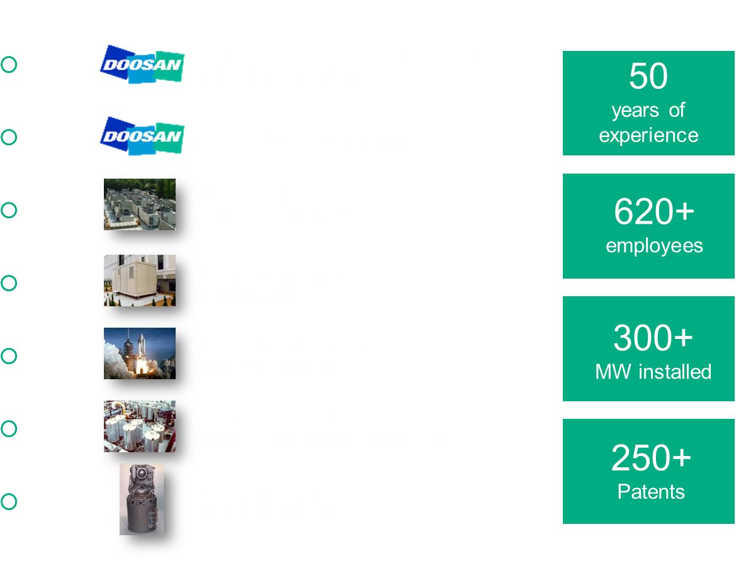
DOOSAN FUEL CELL HISTORY
These materials contain general information that should not be relied upon or used in specific situations without further analysis and consideration by Doosan and any and all warranties regarding the content or its use for particular purposes are disclaimed. No Doosan trademark in these materials is to be used without Doosan’s express written permission.

Slide 3
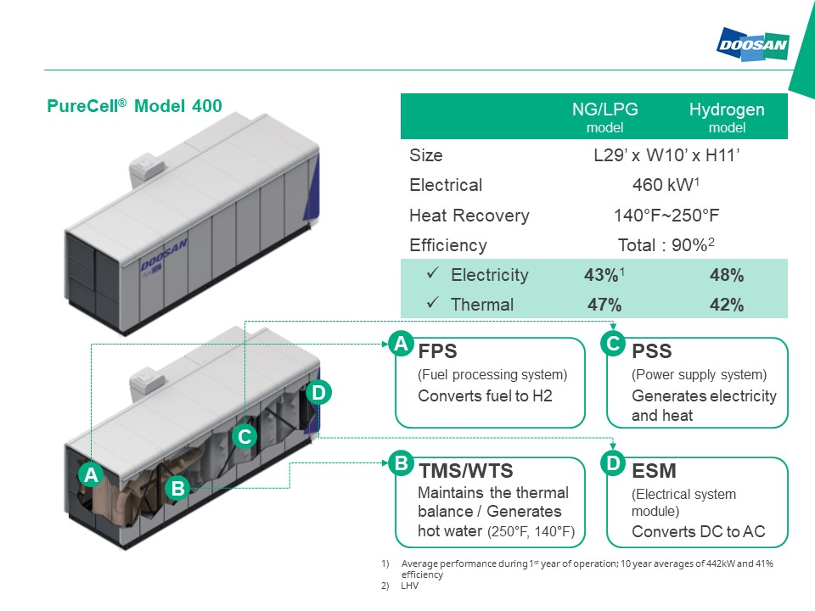
DOOSAN FUEL CELL: M400
These materials contain general information that should not be relied upon or used in specific situations without further analysis and consideration by Doosan and any and all warranties regarding the content or its use for particular purposes are disclaimed. No Doosan trademark in these materials is to be used without Doosan’s express written permission.

Slide 4

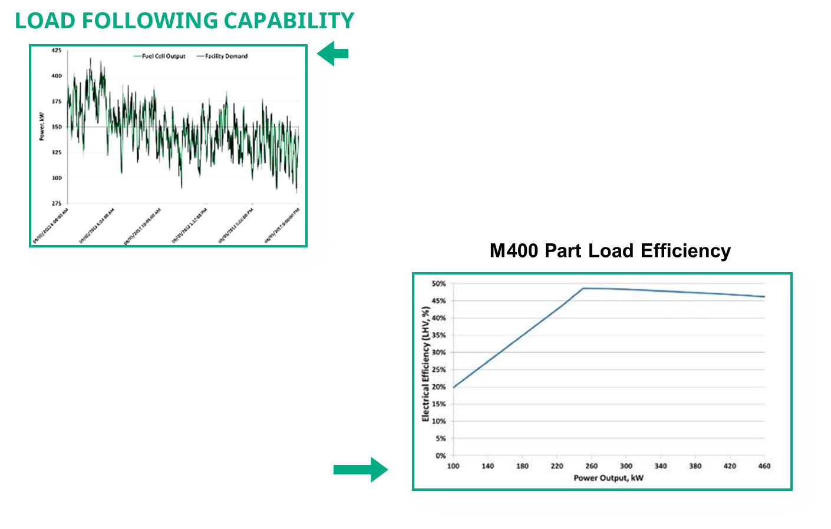
M400 DISPATCHABILITY
Example Case
Supermarket
Continuous load-following
Net-metering with zero utility power import
No impact to life or reliability
Dispatch and Micro-Grid Capabilities
10kW per second ramp rate per M400
50kW step loads per M400
Multi-unit load share
±0.85 power factor with active Volt/VAR support
Efficiency maintained at part load

Slide 5
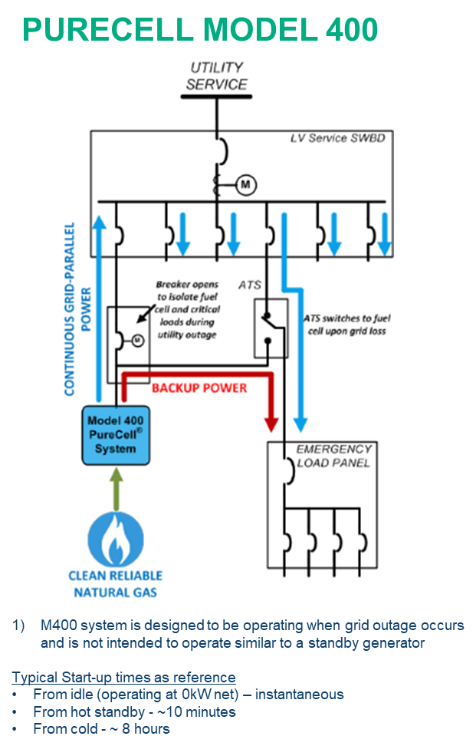
BACKUP POWER – DIESEL REPLACEMENT
Normally Grid Parallel CHP
Utility interactive
UL1741SA, IEEE1547
Clean reliable power
Base-load or load following
During a Utility Outage
Source of emergency power -dedicated loads transferred to fuel cell
<10 sec transition to critical power, 2 sec or UPS available¹
Up to 400kW of power available
Load following
Highly reliable natural gas - no diesel tanks or refueling
Continuous operation – system running when backup power needed¹
No requirement for periodic testing
Greatly reduced noise and emissions
Heat available during grid outage

Slide 6

CRITICAL POWER APPLICATIONS
PROJECT DETAILS
Critical credit card processing center
(4) 200 kW fuel cells installed in 1999
Converted to 400 kW systems in 2014
Continuous-duty baseload operation
Heat recovery for space heating & snow melt
CRITICAL POWER WITH 99.9999% UPTIME
  Redundant electric utility feeds
  Redundant natural gas lines
  Redundant fuel cells
  Piller rotary UPS

Slide 7
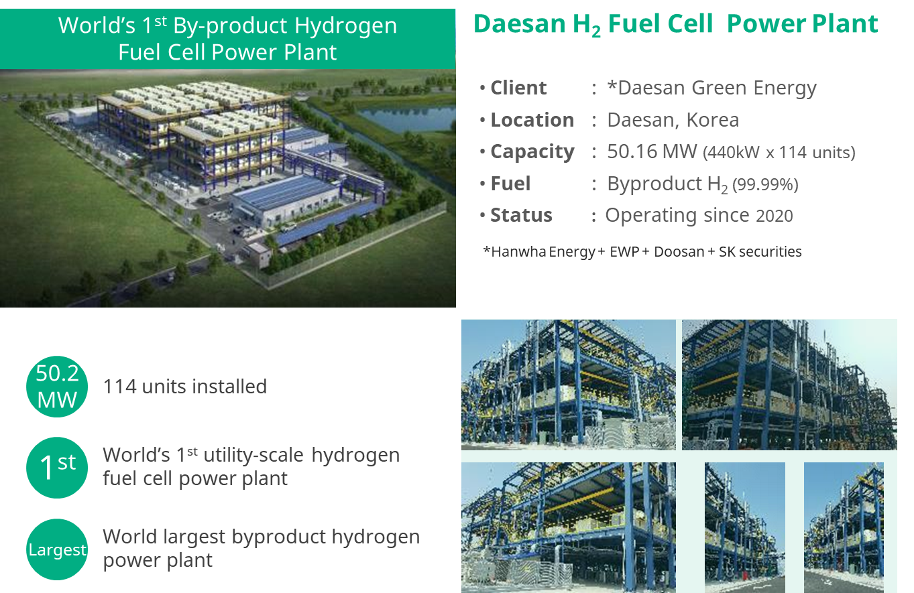
REFERENCE PROJECT- HYDROGEN FUEL CELLS

Slide 8
FUTURE RESEARCH NEEDS
Large system design to meet critical power needs
  Cold load pickup
  Fault current requirements
  BESS integration & paralleling with other generation sources
  Seamless transfer
  MULS and microgrid control
  Reliability, N+1 redundancy
2) Large scale island mode testing
  Optimize microgrid controls
  Test all transient load requirements
  Confirm reliability
  Create reference
  Platform for future technology improvement testing

