Slide 1
Large Scale Stationary Fuel Cell Solutions presented to:
California
Energy
Commission
By: Roy T. Segev
January 21st 2021
Notes:
Good afternoon, I’m happy for the opportunity to present to you Ballard Power systems. First, let me thank Jack for inviting me to take part in this panel.
Ballard is over 40 years in Hydrogen PEM FC business, with over 1,000 employees, Head quartered in the beautiful city of Vancouver.
We shipped over 700 MW of Fuel cell products and equipped over 1,000 buses, 2,000 trucks, 12,000 forklifts ,large DG fuel cells , trains and ships with our Hydrogen Fuel Cells.
My name is Roy Segev and I’m the Director for business development in charge for Ballard’s DG business, I’m currently based in Israel and in this context, I’m happy to testify that I’ve survived Pfizer’s 2 shots vaccine with almost no side effects and with this Let me start with a short clip about the back-yards of data centers

Slide 2
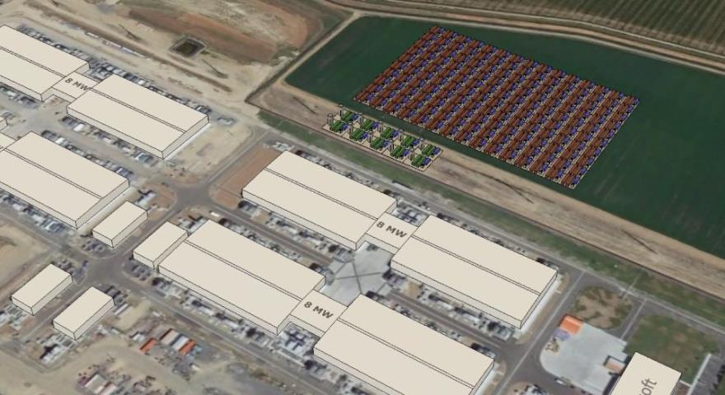
Fuel cell system footprint is 10 X smaller than batteries
30 MW for 48 hours ~ 1.44 GWh
Batteries
Fuel Cells
29,900 M² of Batteries VS. 2,700 M² of Fuel Cell
Notes:
To better understand Fuel Cell advantages, we have assessed other alternatives of Zero-Emission BUP especially for datacenters. In this case, 30 MW datacenter is shown with 48 hours of storage on site. In this short animation we demonstrate the “real-estate” aspect of having 1.4GWh of Lithium batteries compared with Balllard’s Fuel cell solution – in this case the footprint of the Fuel Cell is 10 X smaller than batteries with similar stored capacity.
I can only can guess nobody will want to have 300 containers with Lithium in the back of their yards.

Slide 3
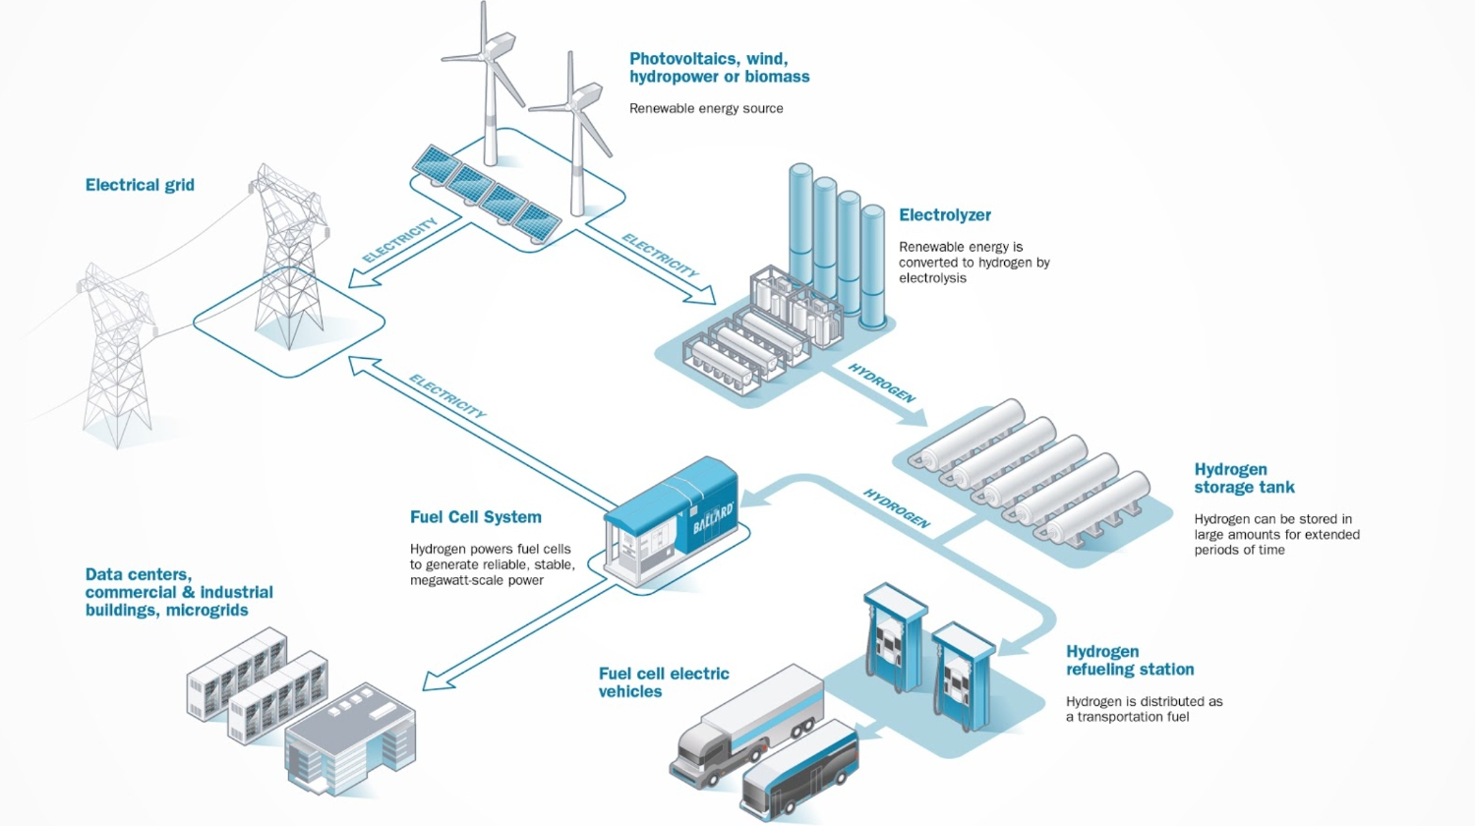
Energy Storage & Power-to-Power (P2P)
Renewable Power to H2 to Storage to Grid & Mobility
Notes:
What are the most important applications for Megawatt Scale Fuel cells ?
Most probably the biggest opportunity for megawatt scale Hydrogen FC is in long duration renewables energy storage and Power to Power concept, however…

Slide 4

Datacenter Backup
Requirement:
  48 hours of backup power with 99.999% reliability
Issues with Diesel Generators:
  Noisy
  Polluting
  Difficult to site due to air quality permitting
  Inhibits growth
Notes:
Datacenter BUP application , is probably the most immediate business for the Hydrogen Fuel Cells today , primarily as the Hydrogen cost has lesser impact on the total cost of ownership. Datacenters BUP systems requires 48 hours of continues operation. Fuel Cell for Data center solves all issues related to Diesel Gensets, they are quite, reliable and most important they are 100% Zero Emission.
I should also mention here that Ballard together with Caterpillar was awarded DOE funding to set-up, 1.5 MW Fuel Cell for one of Microsoft’s data centers in the US.

Slide 5
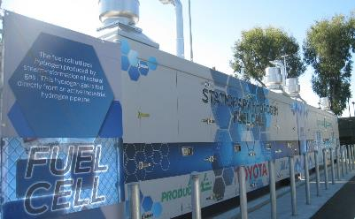
1.1 MW Fuel Cell Power Generator for Toyota
1.1 MW ClearGen™ I fuel cell power generator at Toyota's U.S. headquarters in Torrance, California
Fuel cell power generator utilized hydrogen produced by steam-reformation and supplied via pipeline
Fuel cell power generator enabled Toyota to satisfy its peak and mid-peak power needs.
Cleargen-I at Torrance HQ
Notes:
Ballard has long experience of megawatt scale stationary Fuel cell generators.
One of the very first ones was installed at Toyota’s sales HQ in Torrance California, this 1.1MW system generated gigwatthours of energy to rectify Toyota’s peak power demand.

Slide 6
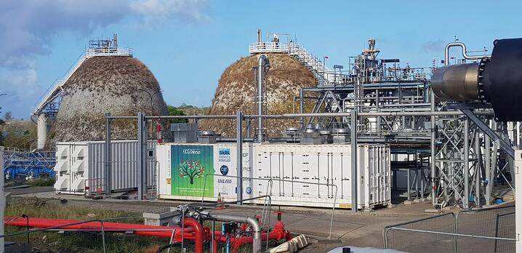
1 MW Fuel Cell Power Generator for HDF, Martinique
Production of electricity from hydrogen co-produced at the SARA refinery in Martinique
ClearGen™I housed in 40-foot container
PPA with local grid operator Follows European and French regulations, as well as high standards of oil & gas sector
Adapted to withstand hurricanes and earthquakes
1 MW FC in Martinique
Notes:
And this is our latest one, 1 MW FC at a refinery in Martinique, utilizing the Hydrogen from oil refining process

Slide 7
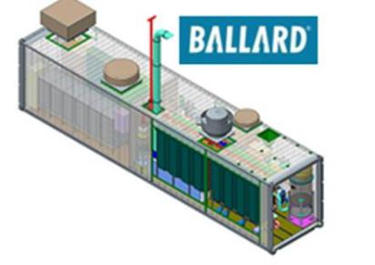
ClearGen™ II 1.5 MW Fuel Cell Power Generator
1.5 MW fuel cell system installed in a single 40’ ISO container
Fuel cell stacks, balance of plant, power conditioning (PCS) and cooling system are included
Radiators and PCS are in separate boxes
Designed and certified to stationary fuel cell power generator requirements as per EU and CSA standards
ClearGen™ II 1.5 MW
Notes:
And now for our stationary fuel cell offering
Cleargen II – is Our biggest product offer – this single 40’ ISO container incorporates our latest LCS stack technology.

Slide 8
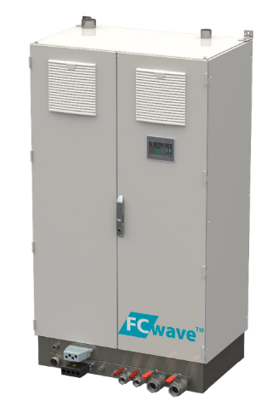
FCwave ™ 200 KW
200 KW fuel cell power generator installed in a single cabinet
Fuel cell stacks, BoP , Power conditioning (PCS) and Cooling system are included
Radiators and PCS are in separate boxes
Designed and certified to stationary fuel cell power generator requirements as per EU and CSA standards
200 KW FC
Notes:
Our smallest fuel cell DG generator. The Fcwave, 200 Kw, designed to meet the maritime standards. The single cabinet Fuel cell can be cascaded up to 1 MW system in a single 20’ container as can be seen in the next slide

Slide 9
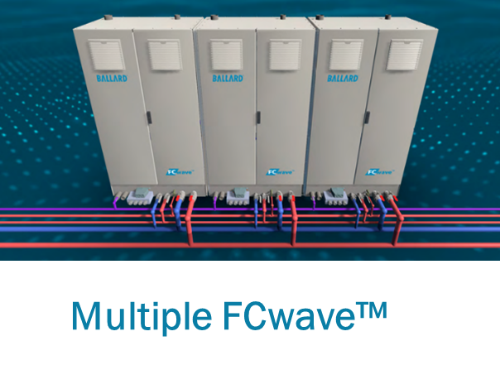
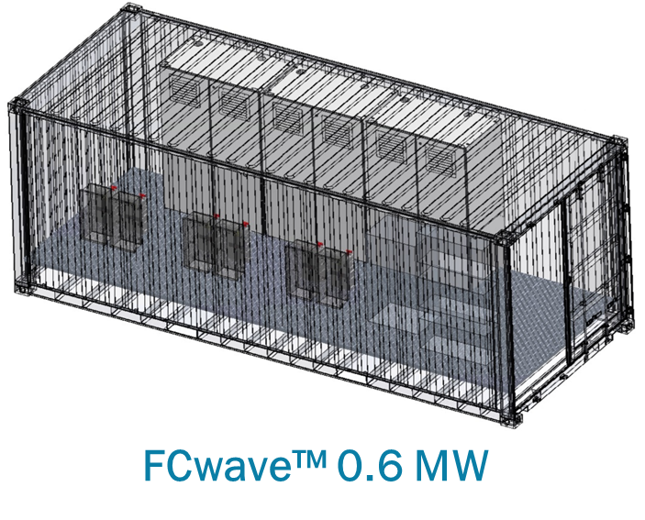
ClearGen™ II 0.4 to 1.0 MW
Multiple FCwave installed in a single 20’ ISO container
Up to 5 FCwave units
Fuel cell stacks, BoP , Power conditioning (PCS) and Cooling system are included
Radiators and fan sets are external
Designed and certified to stationary fuel cell power generator requirements as per EU and CSA standards
Notes:
And just before my time is running-up I’d like to take you to the next slide – which I would recommend as the take-away from my short presentation

Slide 10
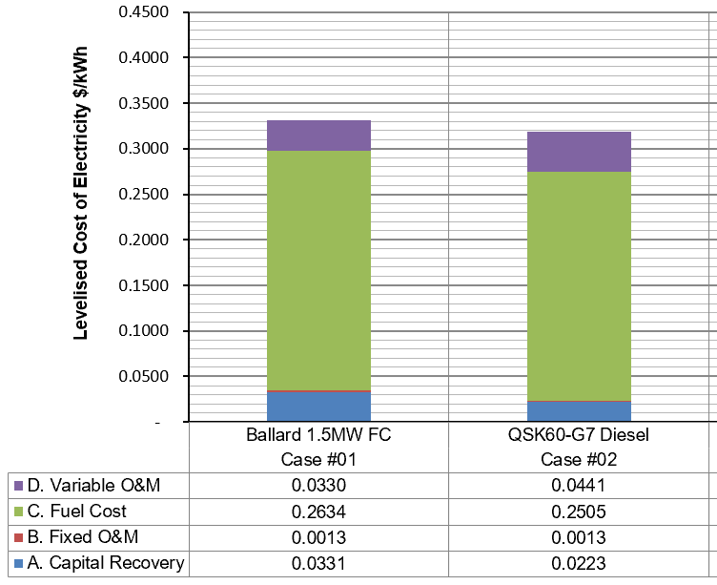
Ballard ClearGen™ II Fuel Cell Power Generator vs. Cummins QSK-60 Diesel Genset
Key Assumptions
Capital
  Diesel genset $800K/MW
  Fuel cell power generator $1500K/MW
  Hurdle rate 6.5%
  Term 12 years
  Escalation 2%
Fixed overhead is equal for both units
Fuel Cost
  Diesel $0.85/litre
  Hydrogen $4.0/kg
Direct Operation and Maintenance Costs
  Diesel genset $0.04/kWh
  Fuel cell power generator $0.022/kWh
LCOE charts of Cleagen II Vs. QSK-60
Notes:
This one is a head-to-head comparison of our Cleargen II 1.5 MW Vs. QSK-60, which is one of Cummins most popular diesel gensets.
In this analysis , I’ve assumed the of cost of Diesel at 3.1 dollars for 1 Gallon and 4.0 dollars for 1 Kilogram of Green Hydrogen – 4 USD per KG in California should be considered as a conservative assumption given Calirornia solar resources.
This one, clearly shows that the LCOE generated by Hydrogen fuel-cell is par with Diesel Genset, where in both cases about 80% of the LCOE is the cost of the fuel.
And with this one, I’d like to say thank you for listening and back to you Jack

Slide 11
Thank you
Please contact Roy Segev for more information
Roy.Segev@ballard.com
+972-544-40-90-74
Ballard.com
Power to Change the World®

