Slide 1
CEC
Diesel Alternatives Workshop
Darin Painter, VP of Sales - Stationary Power

Slide 2
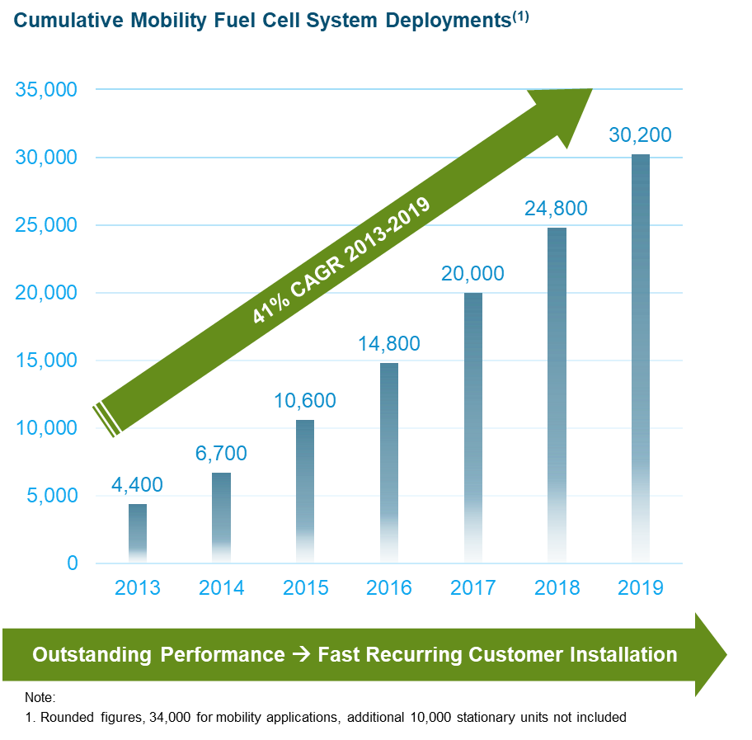
Plug Power is Leader in Hydrogen and Fuel Cell Technology
Global Leader in Fuel Cell Technology Commercialization
~40,000 Vehicle Systems in Field (Largest FCEV fleet deployment)
~70% Blue-Chip Customer Base
625MM+ Commercial Operating hours
Complete turn-key solution for equipment, infrastructure & H2 fuel
In-House MEA to System Solutions
Leader In Hydrogen Fueling Infrastructure Network
110+ Hydrogen fueling sites
Largest buyer of liquid hydrogen (Surpass NASA since 2018)
30 Ton+ liquid H2 used daily | 34MM+ Fuelings
50% Green Hydrogen by 2024
Notes:
Units
Fuelings
Cost Reductions
Customer list – rattle off some names
TR –

Slide 3
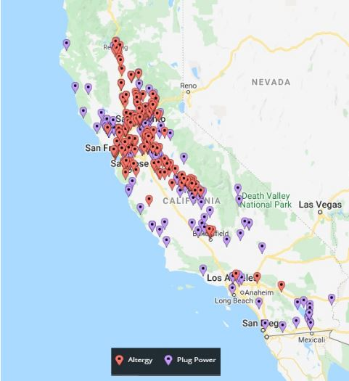
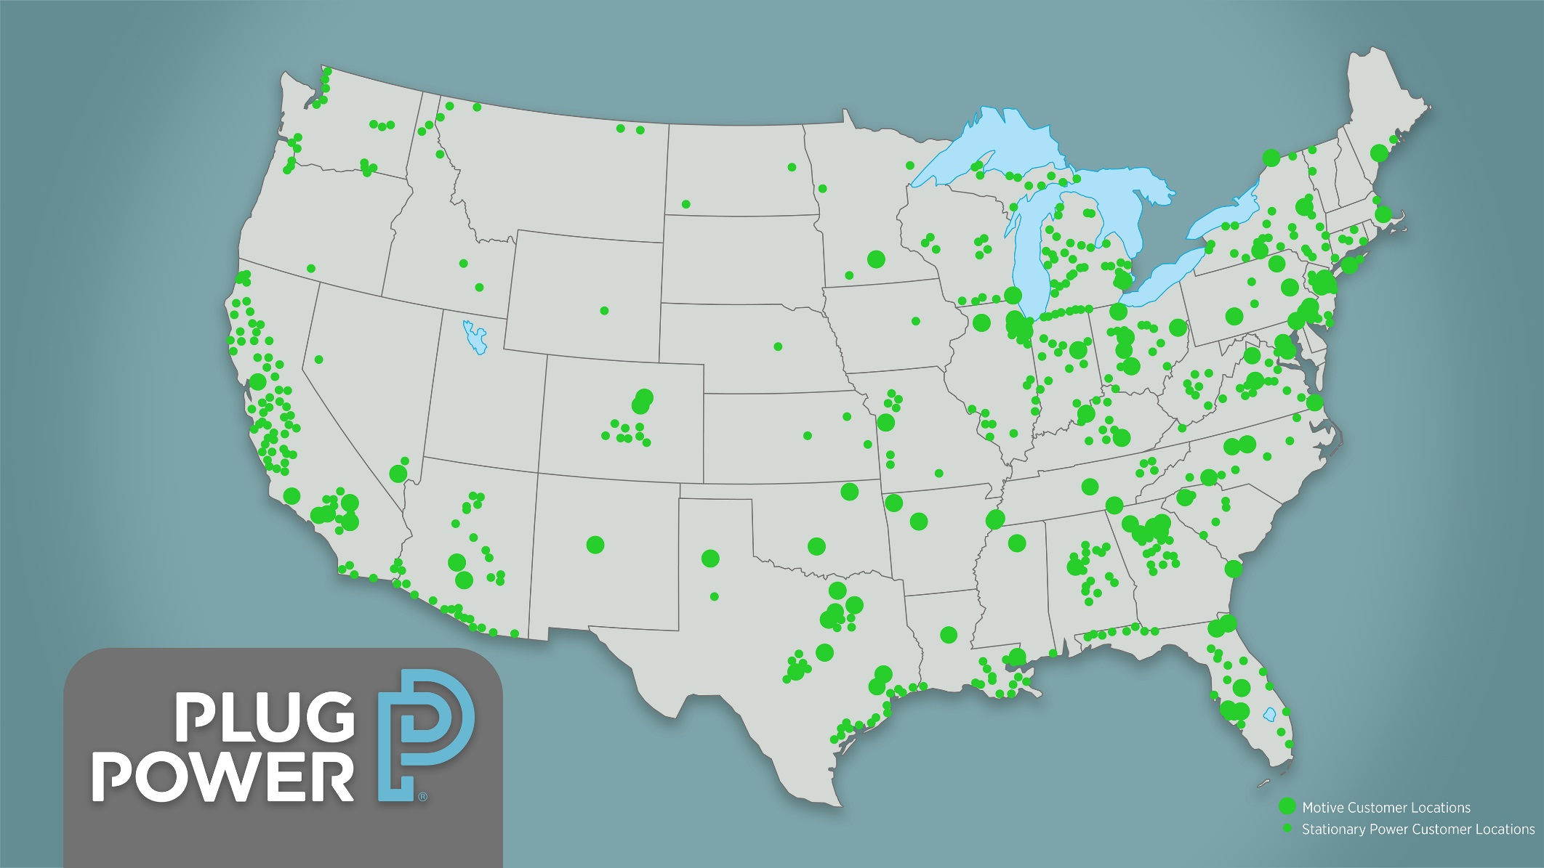
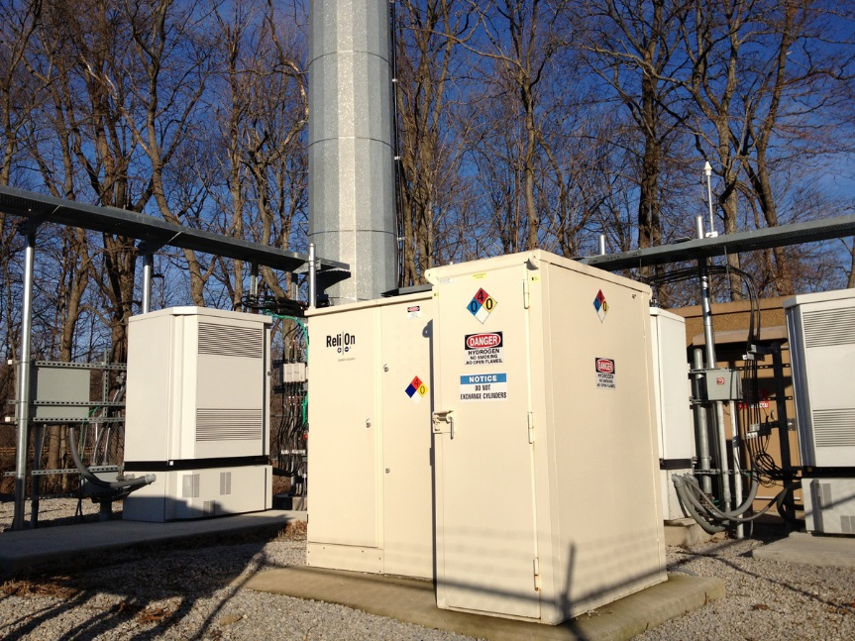
Fuel Cells are Being Used for Backup Power Today

Slide 4
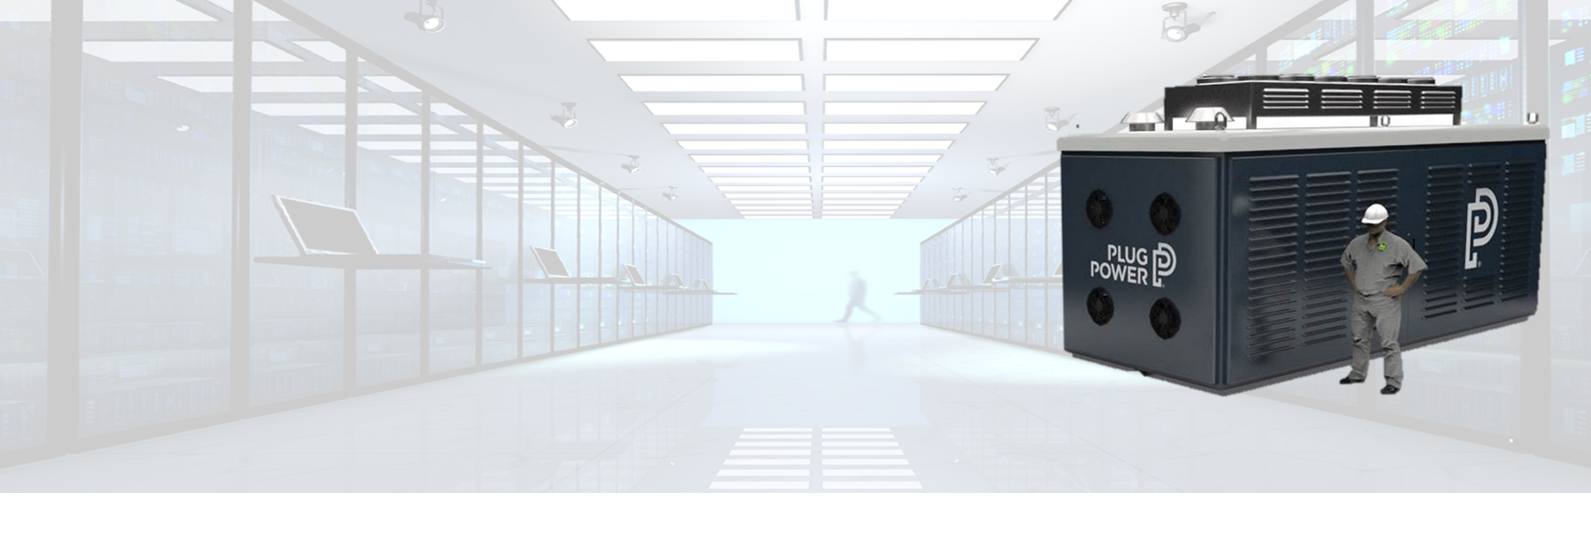
Zero-emission fuel cells for large-scale backup power
GenSure HP Systems
  Direct ICE genset replacement
  Scales from 100s of kW to 100s of MW
  Planning pilots with some of the largest data center operators in the world in 2021
Notes:
GenSure HP Systems are efficient, ultra reliable and environmentally responsible replacements for diesel generators in high power, mission critical applications.
Scaling based on our 125kW ProGen GenSure platform, these systems enable growth and capacity expansion for the life of your facility needs.

Slide 5
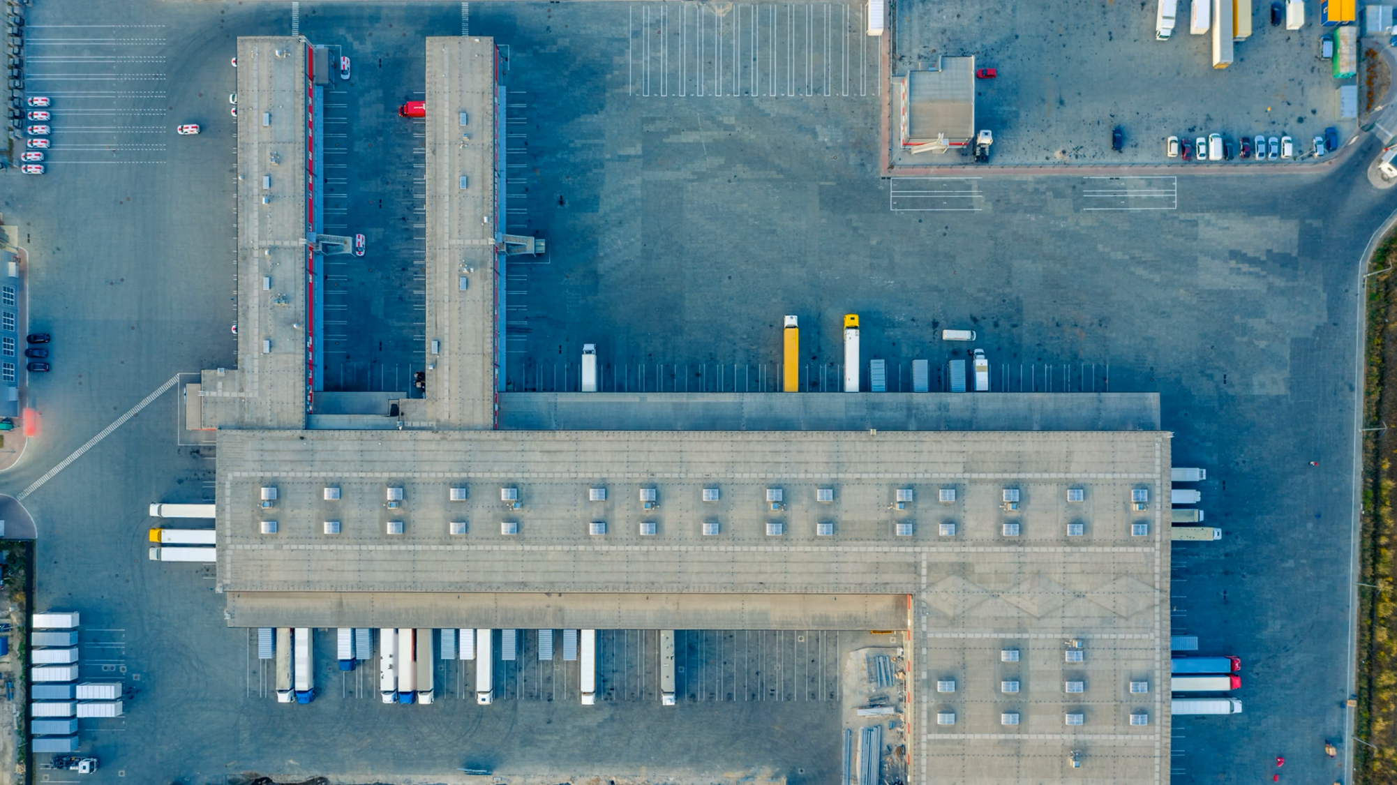

World’s first PEM Technology Gigaplant
Driving Scale in Fuel Cell Technology
Annual Capacity (2024)
1.5+
7M+
7M+
500+MW
Green H2
60,000+
Gigawatts
output
MEAs
Bi-Polar
Plates
Of Electrolyzers
Onsite generation
Fuel Cell Stacks

Slide 6
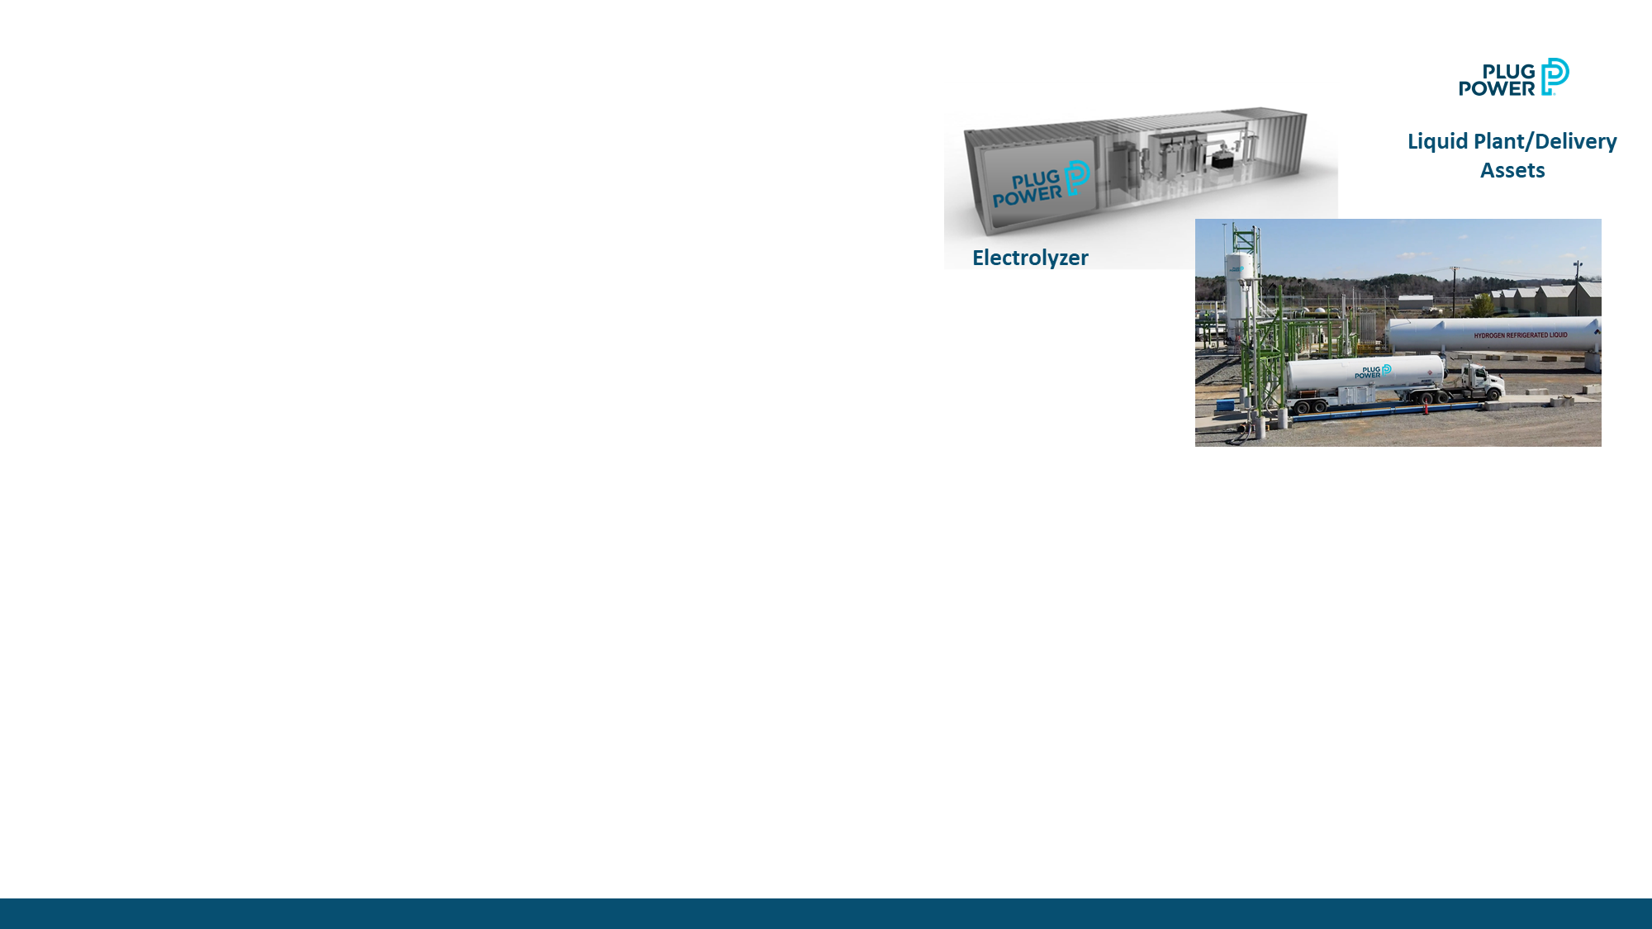
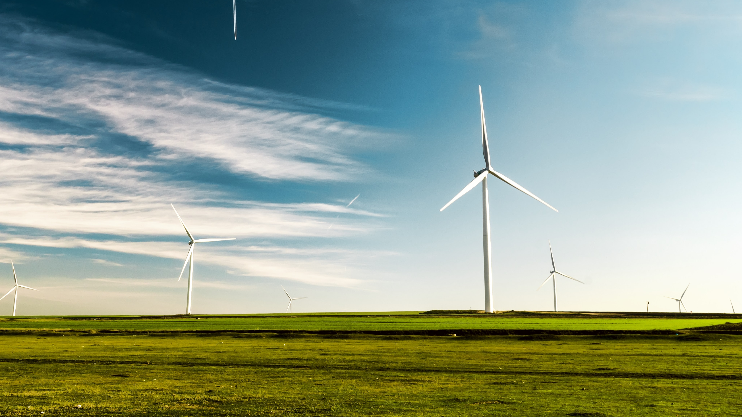
Vision for Green Hydrogen Network
\
Vision for Green
Hydrogen Network
Green Hydrogen Network
Focused on accelerating our transition from low carbon to zero carbon hydrogen
Our network of green hydrogen production will expand with market growth and strategic partners
Cost Roadmap
Levelized cost of green hydrogen will follow cost reduction roadmap of LCOE of renewables
Green Hydrogen Generation Activity
Two strategic announcements already made for new green hydrogen plants producing 40-ton per day with renewable energy partners. Multiple additional plants in process.
Renewable Costs

Slide 7
Corporate Headquarters
968 Albany Shaker Road, Latham, NY 12110
plugpower.com

