Slide 1
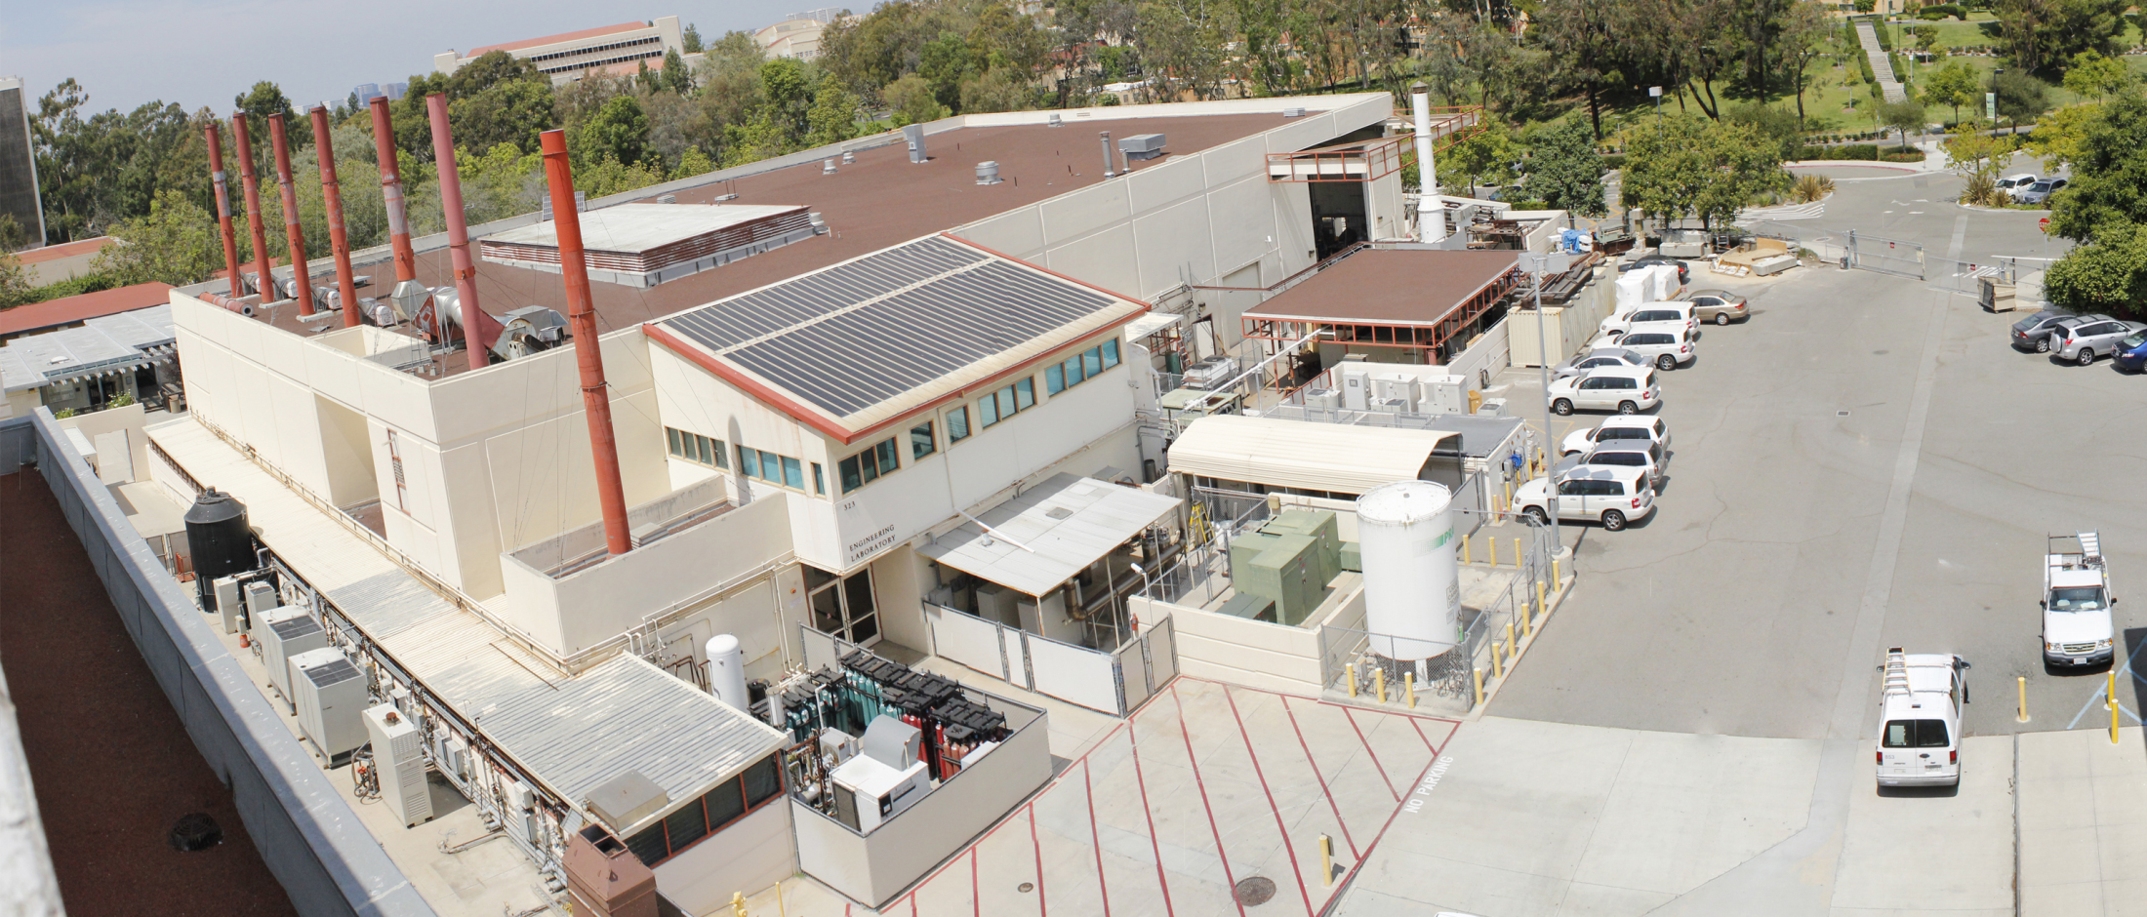


Research, Development & Demonstration (RD&D) Ideas for Diesel Back-up Generator Alternatives
Joint California Agency Workshop
21 January 2021
Jack Brouwer, Ph.D.
Director

Slide 2
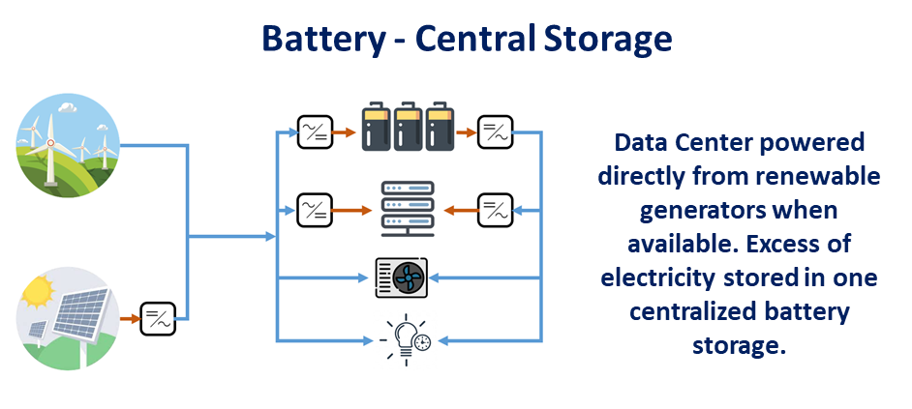
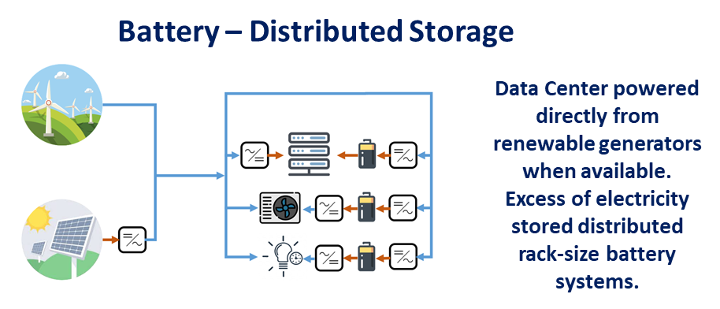
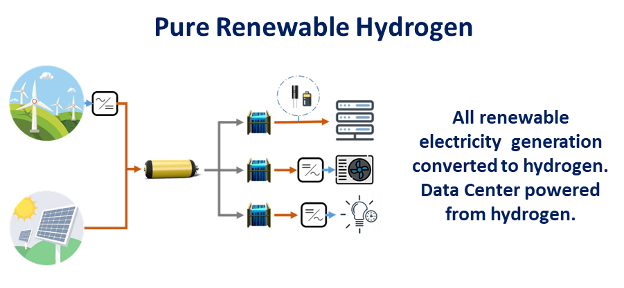
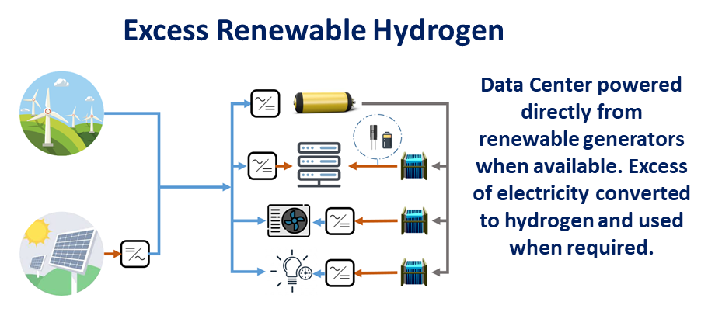
Can data centers become 100% renewable & zero emissions? Slide 2
Various configurations w/ batteries and/or hydrogen storage are considered

Slide 3
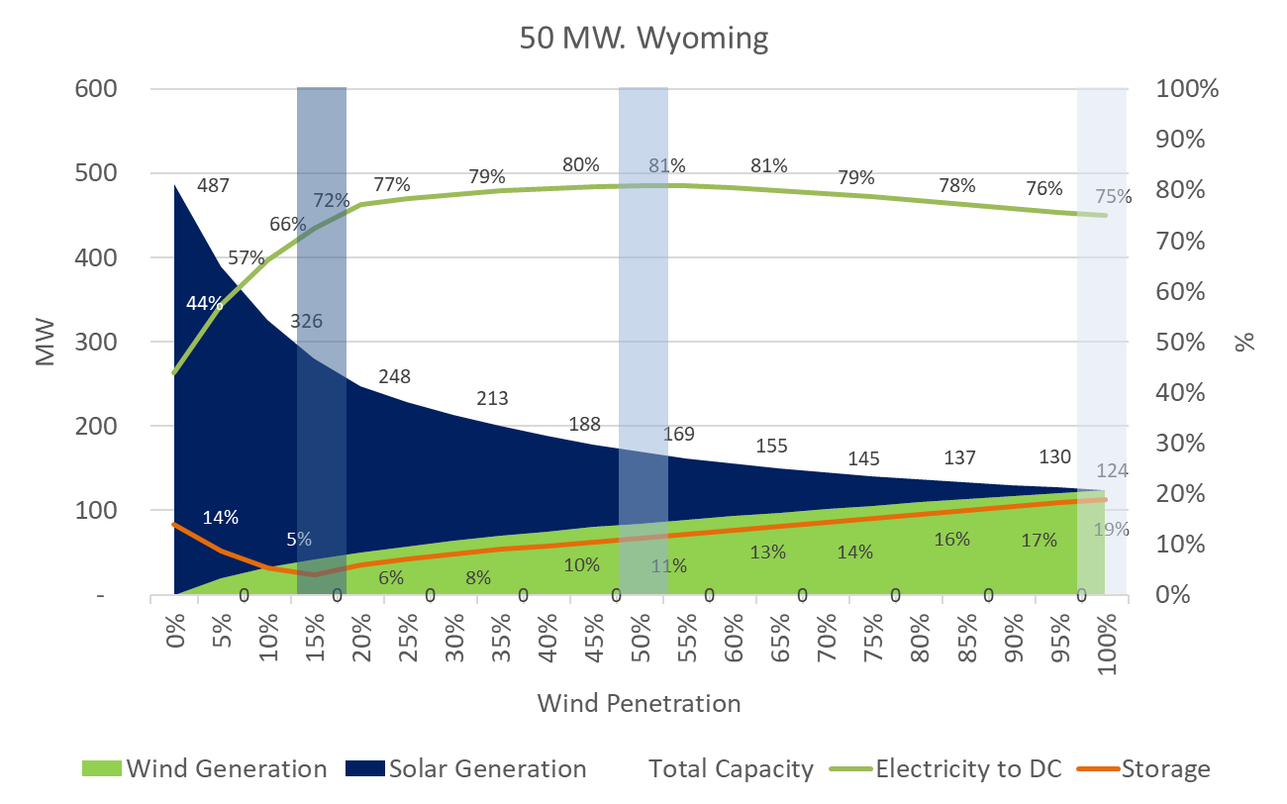
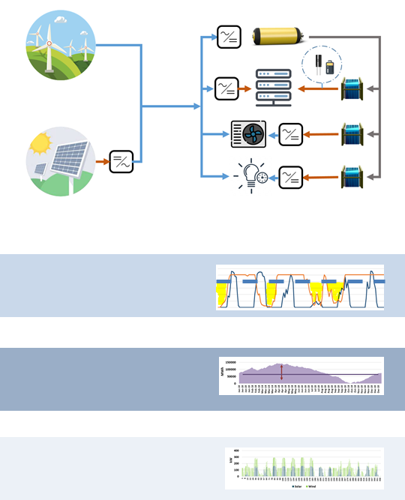
Can data centers become 100% renewable & zero emissions? Slide 3
Data Center designs can be optimized for smallest storage size, most direct renewable electricity use, or smallest installed capacity of renewable power
Notes:
3

Slide 4
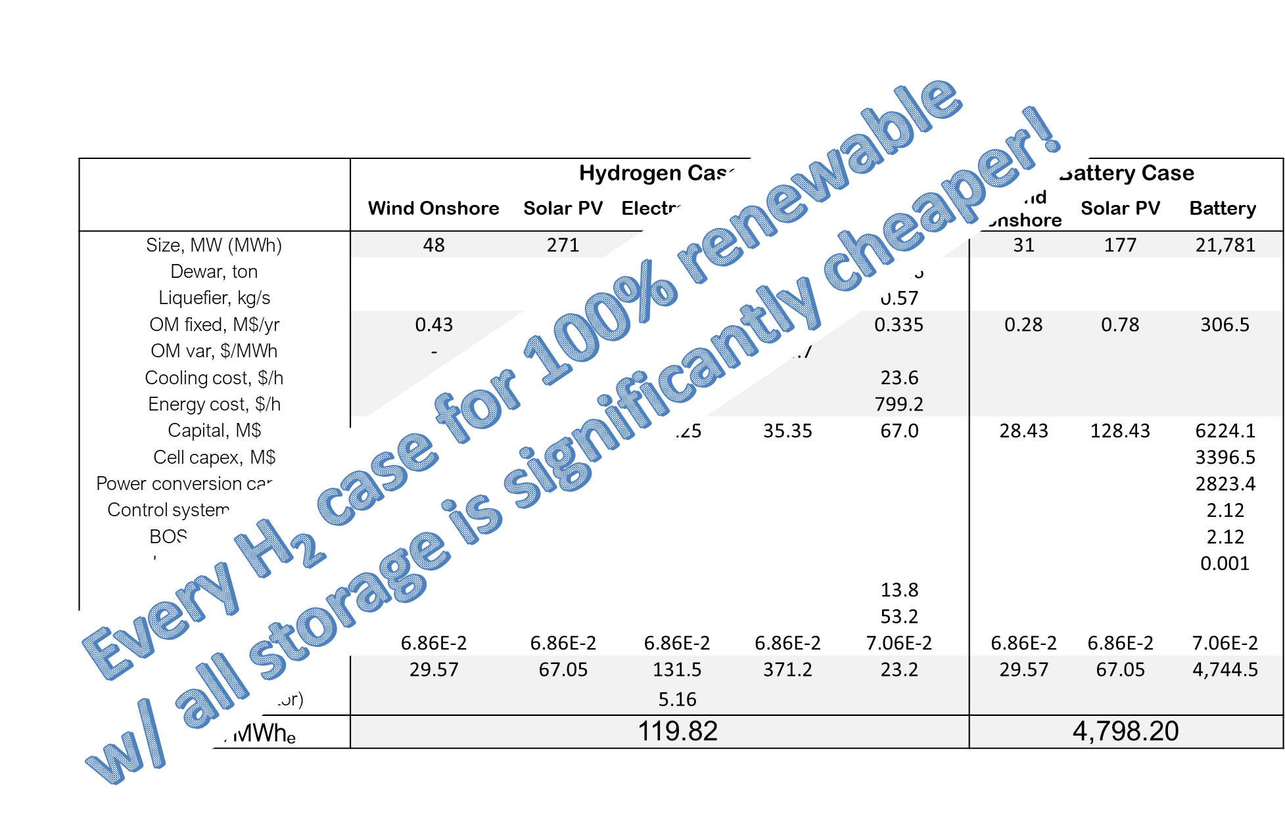
Can data centers become 100% renewable & zero emissions? Slide 4
Excess P2G & Battery Cases – Wyoming (smallest storage size optimal mix of solar/wind)
Notes:
4

Slide 5
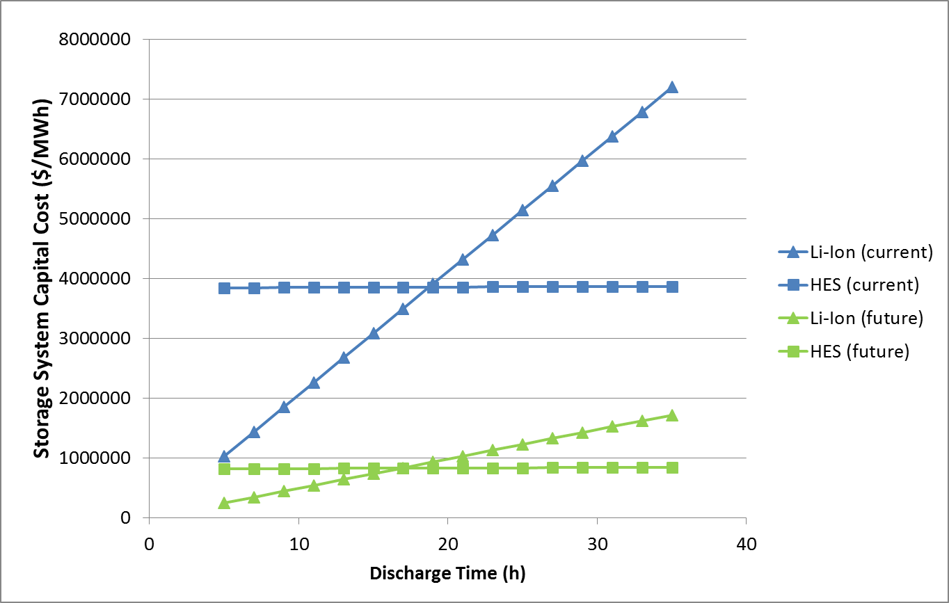
Hydrogen Energy Storage economics
Hydrogen energy storage is cheaper than Li-ion batteries for long-term storage due to separate power/energy scaling

Slide 6
RD&D ideas/concepts for consideration
Pilots to demonstrate 100% renewable data centers (both primary and backup power with all storage required) – starting with containerized data center
Pilot integrated solar, wind, battery & fuel cell microgrids for data centers
Alternative backup generation designs, e.g., use distributed generators for both primary and backup power generation (RD&D in switchgear, controls, design for reliability)
Integrated power and cooling for data centers, e.g., high temperature fuel cells with absorption chilling and/or dehumidification
Alternative data center designs for distributed generation, e.g., Microsoft idea of “in-rack” generation (by fuel cell, flow battery, …) to eliminate need for back-up generation
Hydrogen ecosystem – renewable H₂ & O₂ from data centers shared with other uses (e.g., vehicles, forklifts, waste water treatment, ammonia plant)
Reversible solid oxide cells plus solar/wind power using NG grid for long-term storage
Renewable electrolysis & biogenic hydrogen production demo’s for cost reduction
Investigations into reliability and resiliency of pipeline delivery of fuel, e.g., could renewable hydrogen delivered via pipeline meet data center requirements

