Slide 1

California Energy Commission Microgrid Workshop
January 21, 2021
Microgrids – Lessons Learned
Jorge Elizondo
jelizondo@heilatech.com

Slide 2
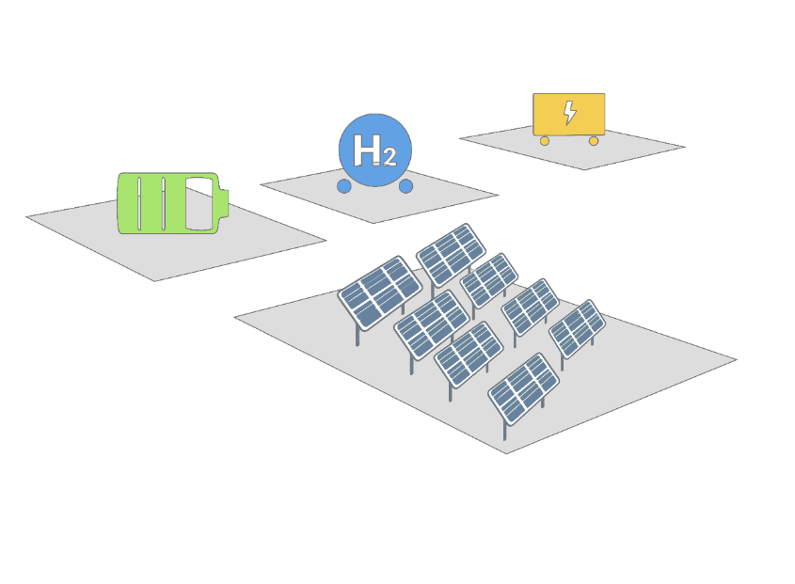


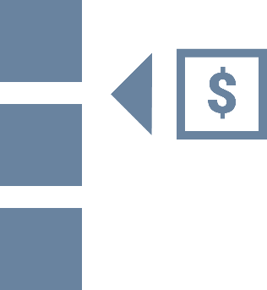
Microgrid Challenges
Challenges
A Microgrid is a collection of disparate energy resources that were not designed to work together
Main Challenges
Fuel Cells
Non-Standardized Ecosystem
Electrolyzer
Energy Storage
Complex Systems
Solar Panels
Rigid Structure
2

Slide 3
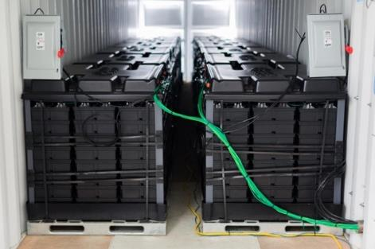
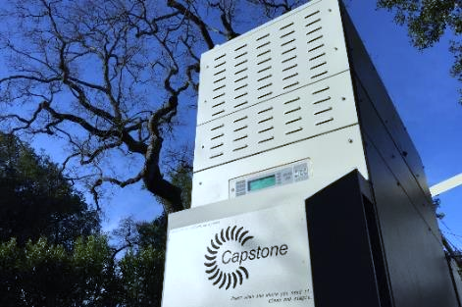
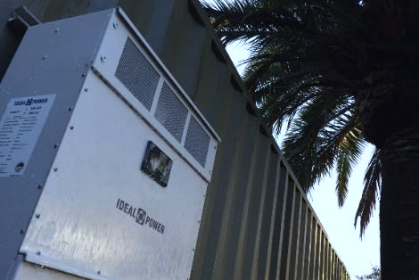
Stone Edge Farm (SEF): Living Laboratory of Technologies
Context
Controllable Elements
Solar panels with Enphase inverters with soft-curtailment
Aquion battery system
Capstone gas turbine
Simpliphi battery system
Tesla battery system
Hydrogen Electrolyzer with fueling station
Hydrogen fuel-cells system
Motor Load control
Controllable distribution panels
HVAC
Capabilities
Grid-tie mode:
  Peak shaving and load shifting
  Frequency and voltage response as a single entity
  Decentralized optimization
Island mode:
  Decentralized power sharing
  Master swapping
Seamless islanding / reconnection capabilities
Hydrogen production for a variety of uses
3

Slide 4

Lessons Learned
Lessons
Policy can incentivize innovation and equity
Incentivize open and fact-based exploration of ideas
Support for low-income communities
Diverse vendor ecosystem is key to growth
Competitive bids
Unique applications based on different features
Increased resiliency with different product failure modes
Modularity reduces long-term risks
Systems built overtime to exactly meet
Upfront capital costs
4

Slide 5
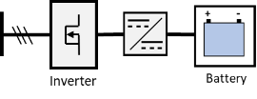
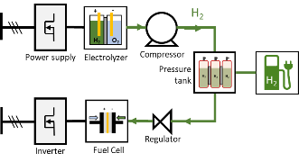
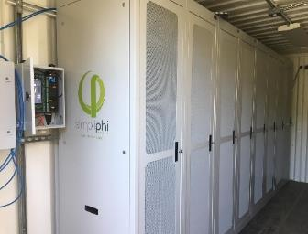
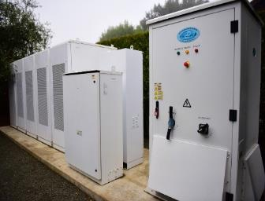
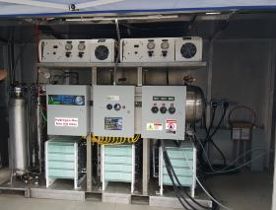
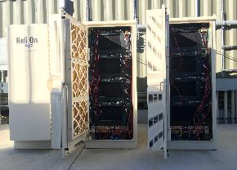
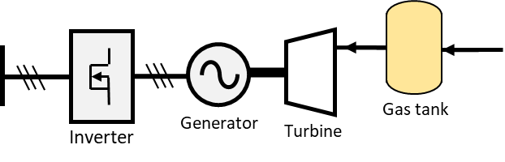
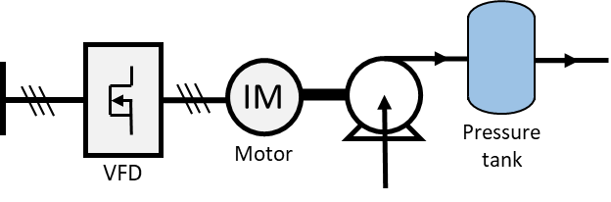
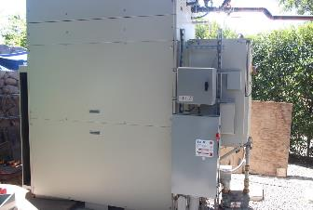
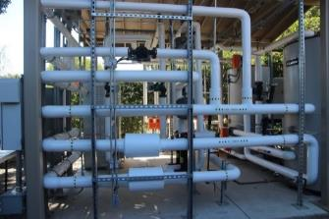
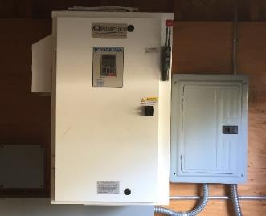
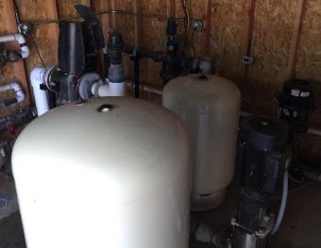
Concept 1: Technology Agnostic
Proposed Solutions
Hydrogen system
Electrical system
Gas / Heat System
Load (ex. water system)
5

Slide 6
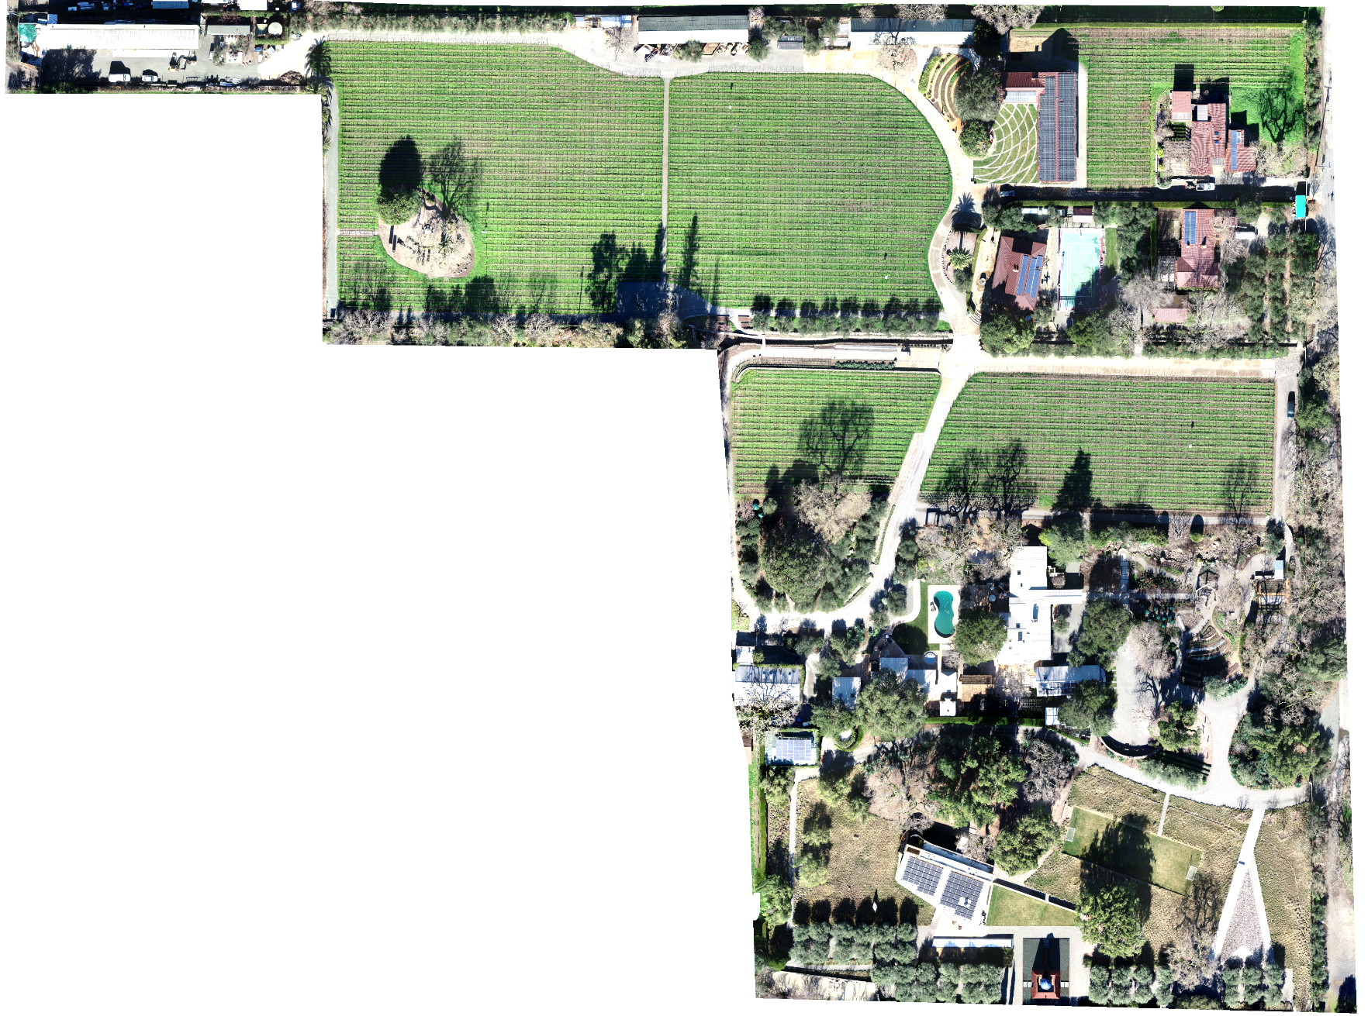
Concept 2: Vendor Agnostic
Proposed Solutions
1
2
3
4
1
Giner Electrolyzer
Utility
2
Plug Power Fuel Cells
3
SimpliPhi + Dynapower
16
15
5
4
Sparkplug + Schneider
6
5
Tesla + Dynapower
7
6
SimpliPhi + Schneider
7
LG Chem + SolarEdge
8
Capstone gas turbine
9
SimpliPhi + SMA
10
Solar Fronius
11
Sony + Outback
12
Solar SMA
14
8
13
Hitachi VFD
13
14
Aquion + Ideal Power
12
15
Hitachi VFD
11
16
Outback FLEXpower
10
9

Slide 7
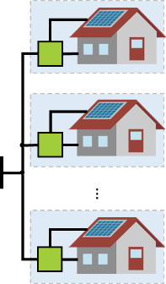
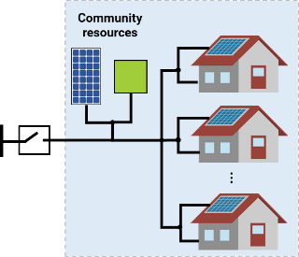
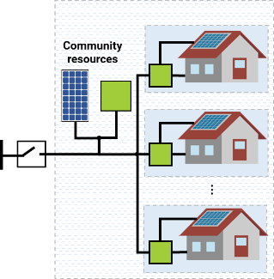
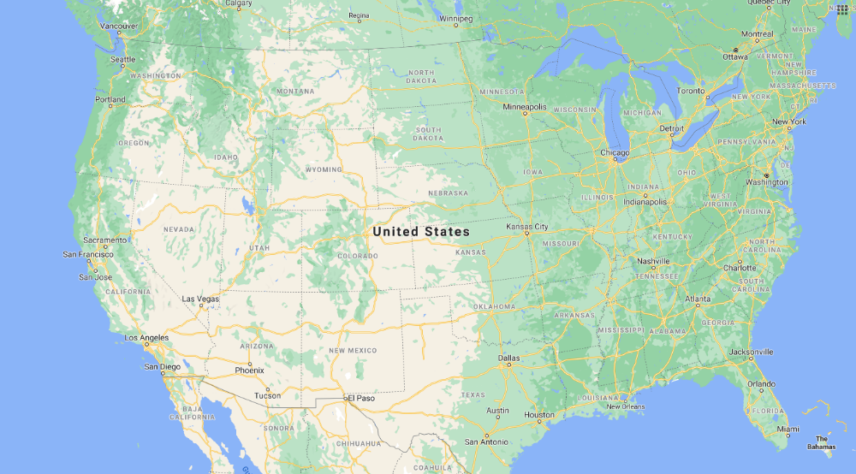
Concept 3: Architecture Agnostic
Proposed Solutions
Centralized architecture where resources are shared among all loads
Distributed architecture where each load has its own resources
Hybrid architecture where some resources are shared and some are individual
7

Slide 8
Microgrids – Lessons Learned
Jorge Elizondo
jelizondo@heilatech.com

