Slide 1
California Energy Commission Workshop
Research into Clean Energy Alternatives to Diesel Backup Generator Systems
January 21, 2021

Slide 2
Mandate: Net-Zero Carbon Electricity System
The Key Challenge:
Increasing the use of solar and wind by orders of magnitude while maintaining resiliency and low cost
Replacing diesel backup is
a prime example of this challenge

Slide 3



Onsite Generation Can Solve Backup and Enable Transition
Provide multi-day resiliency while eliminating diesel backup
Lower energy costs
Firm the increasing amount of renewables
Reduce renewables curtailment
Accelerate transition to net-zero carbon future with renewable fuels
Dispatchable, Fuel-Flexible, Onsite Generation
Delivers These Benefits

Slide 4
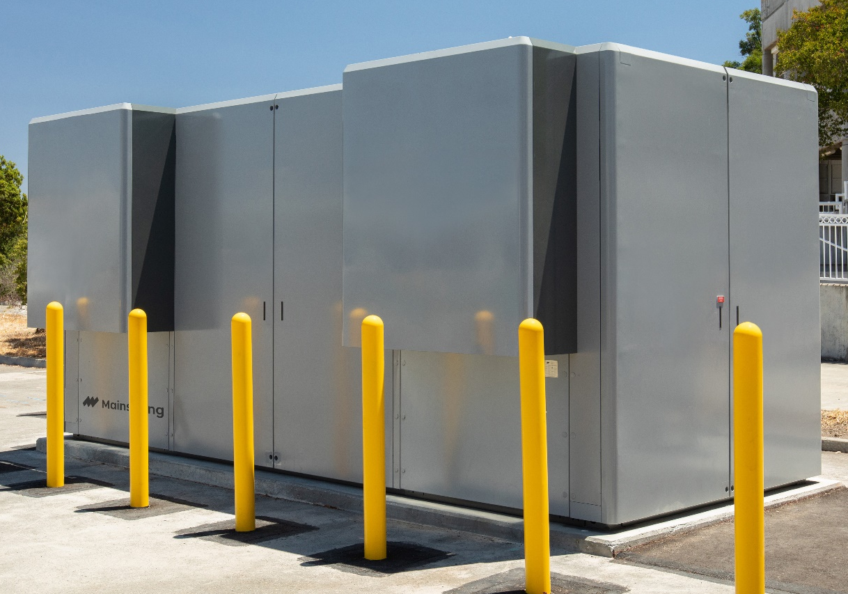
Linear Generator: A New Category of Power Generation
Dispatchable
Load tracking, fast on/off, blackstart
Complements renewables and energy storage
Fuel-Flexible
Dynamic switching between any gaseous fuel
Natural gas, biogas, and hydrogen
Low Cost
Standard materials
Long life without performance degradation
Commercial Pilot installation in CA, 2020.

Slide 5
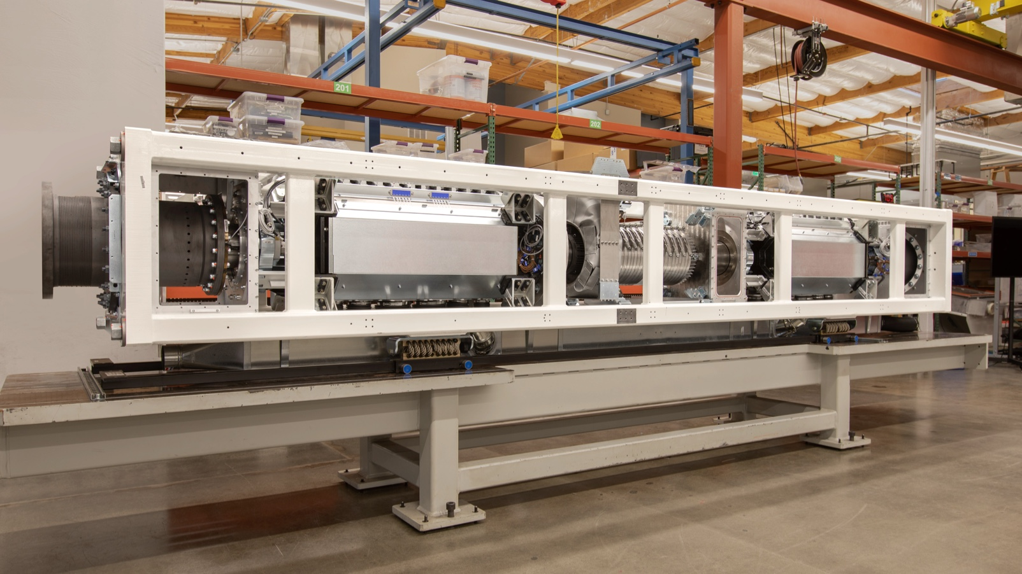
Mainspring’s Linear Generator Core
Video at www.MainspringEnergy.com

Slide 6
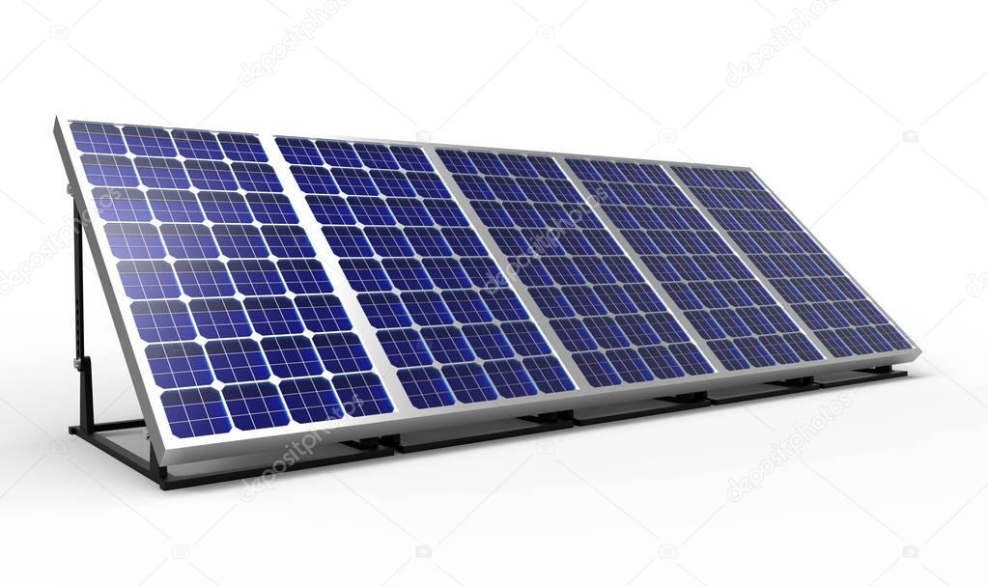
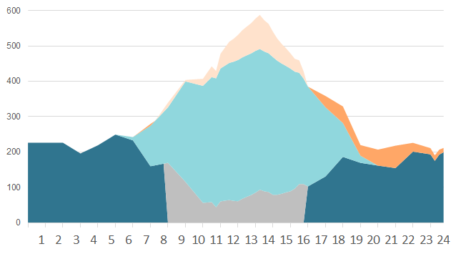
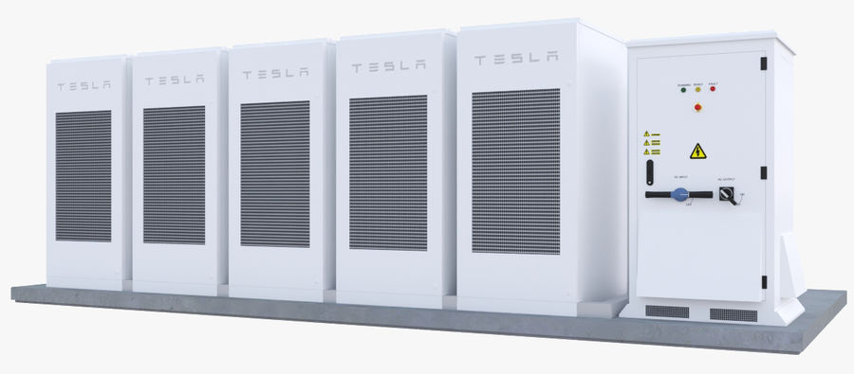
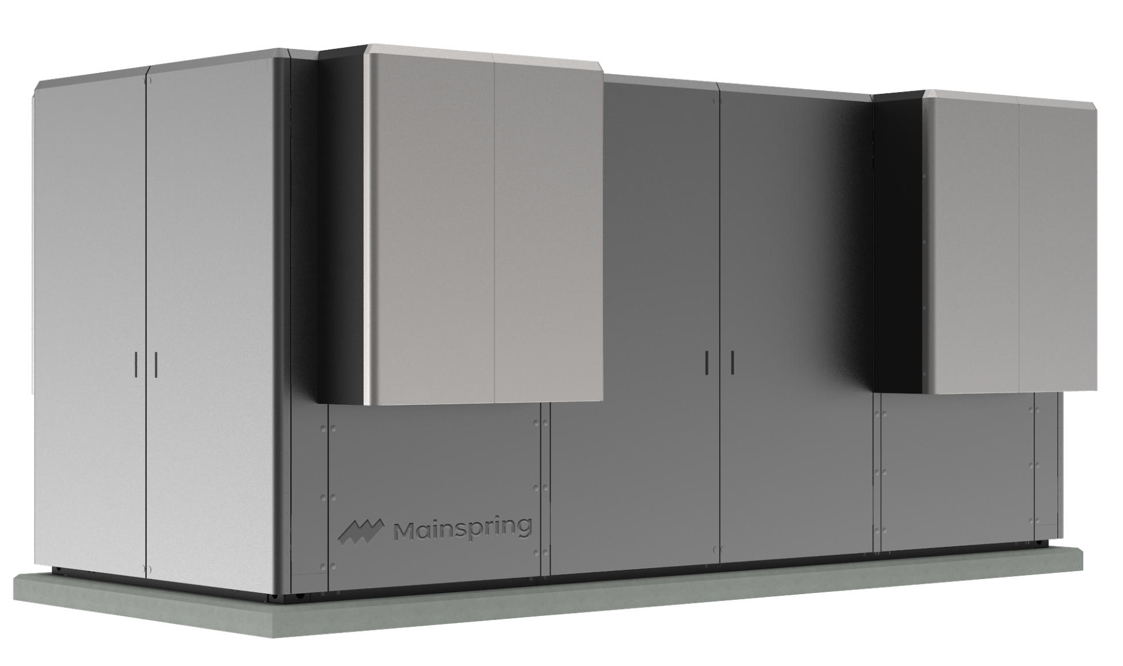
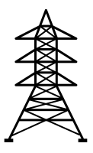
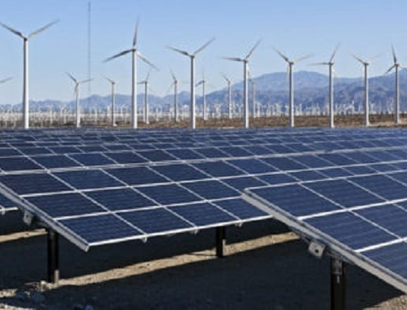
Renewable Microgrids are the Solution to Backup Diesel
Summer Day Building Load Profile

Slide 7
Research and Development Priorities
Renewable Fuels
Hydrogen - production, storage, distribution, electricity generation
Biogas - production and electricity generation
Renewable Microgrids
Demonstration projects
Controls and optimization

Slide 8
Thank You
www.MainspringEnergy.com

