Slide 1
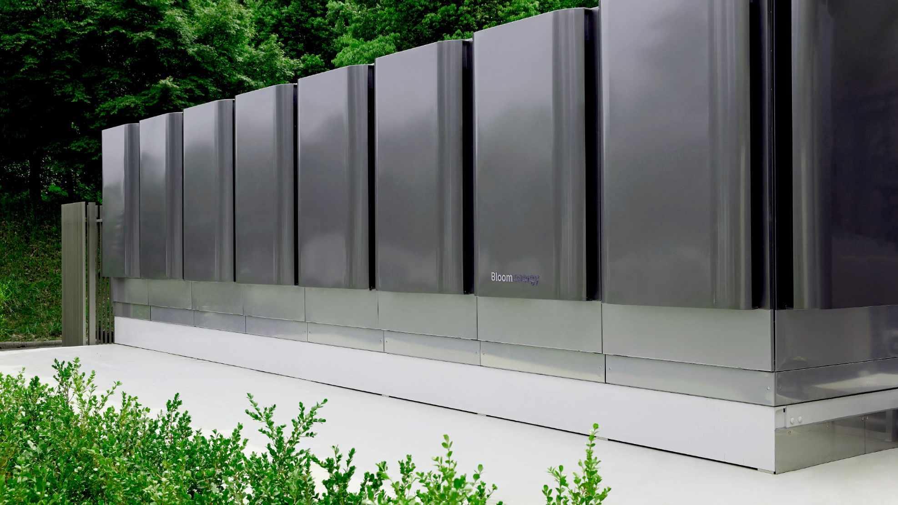

Current & planned research activities to develop clean alternatives to backup diesel generation
SCOTT REYNOLDS
Global Head, Structured Finance

Slide 2
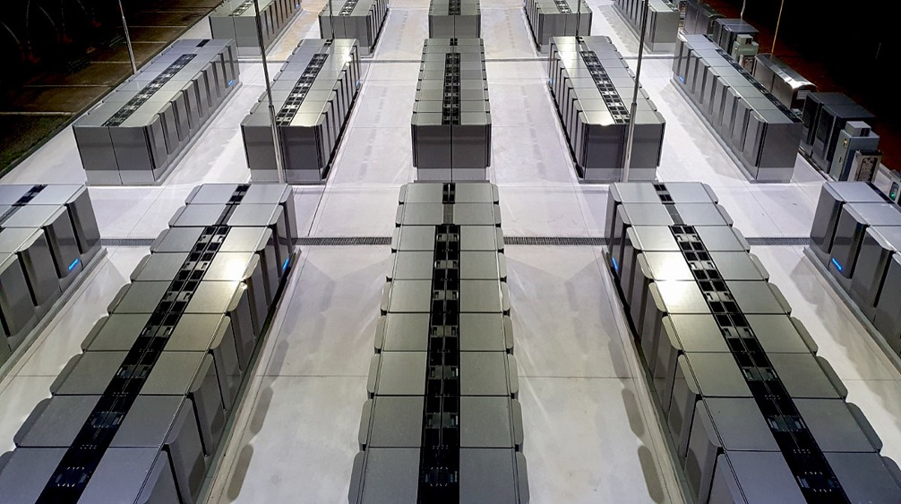

BLOOM ENERGY
Proven at Scale
500 MW Deployed
~500 sites operating in California
100+ Operating Microgrids, Thousands of Outages Avoided
Fuel Flexible and Future Proof Design

Slide 3
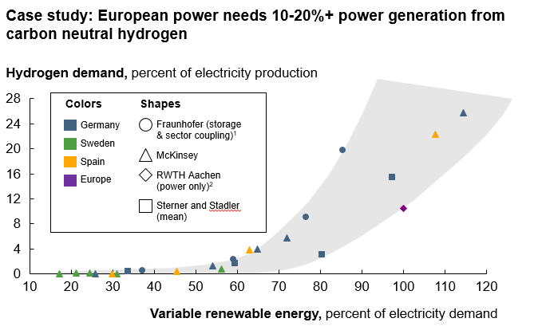
Hydrogen will be needed to decarbonize power
The Hydrogen Council projects that hydrogen could be ~18% of final energy demand by 2050

Slide 4
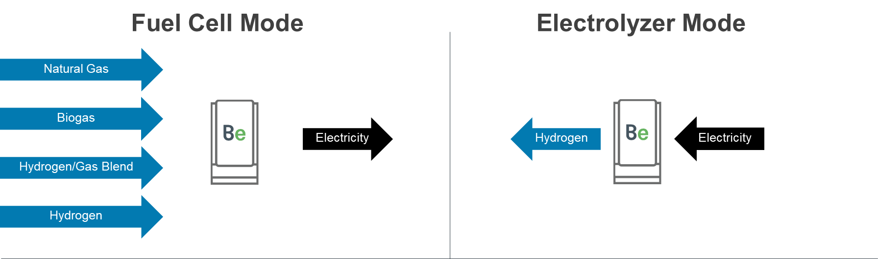
SOLID OXIDE: Flexible and future proof
Same
Core Platform
Same
Supply Chain
Same
Manufacturing
Process
Same
Partners
Same
Monitoring
Infrastructure

Slide 5
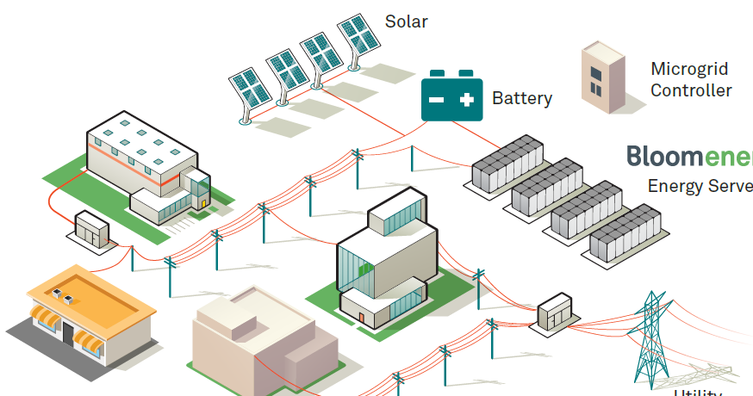
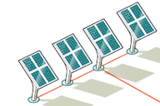
Case Studies
Business Campus
4 MW of Bloom Energy, 16 MW of Solar PV and
5 MWh of Batteries
A Bloom Microgrid protects a CA business campus from prolonged grid outages and from rising risk of cyber
attacks against the grid
Manufacturing Facility
4.3 MW Bloom Energy and 300kW Solar
During CA wildfire season, this Bloom microgrid
powered a manufacturing facility through a
5.5 day PSPS event

Slide 6
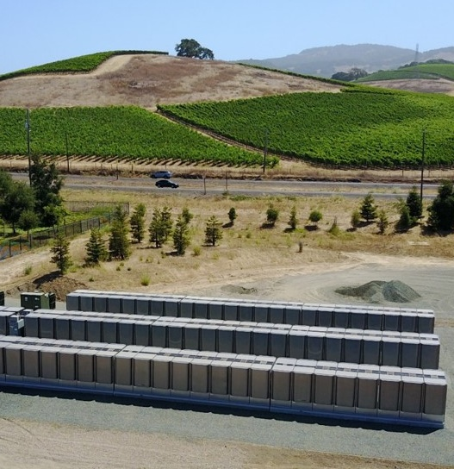
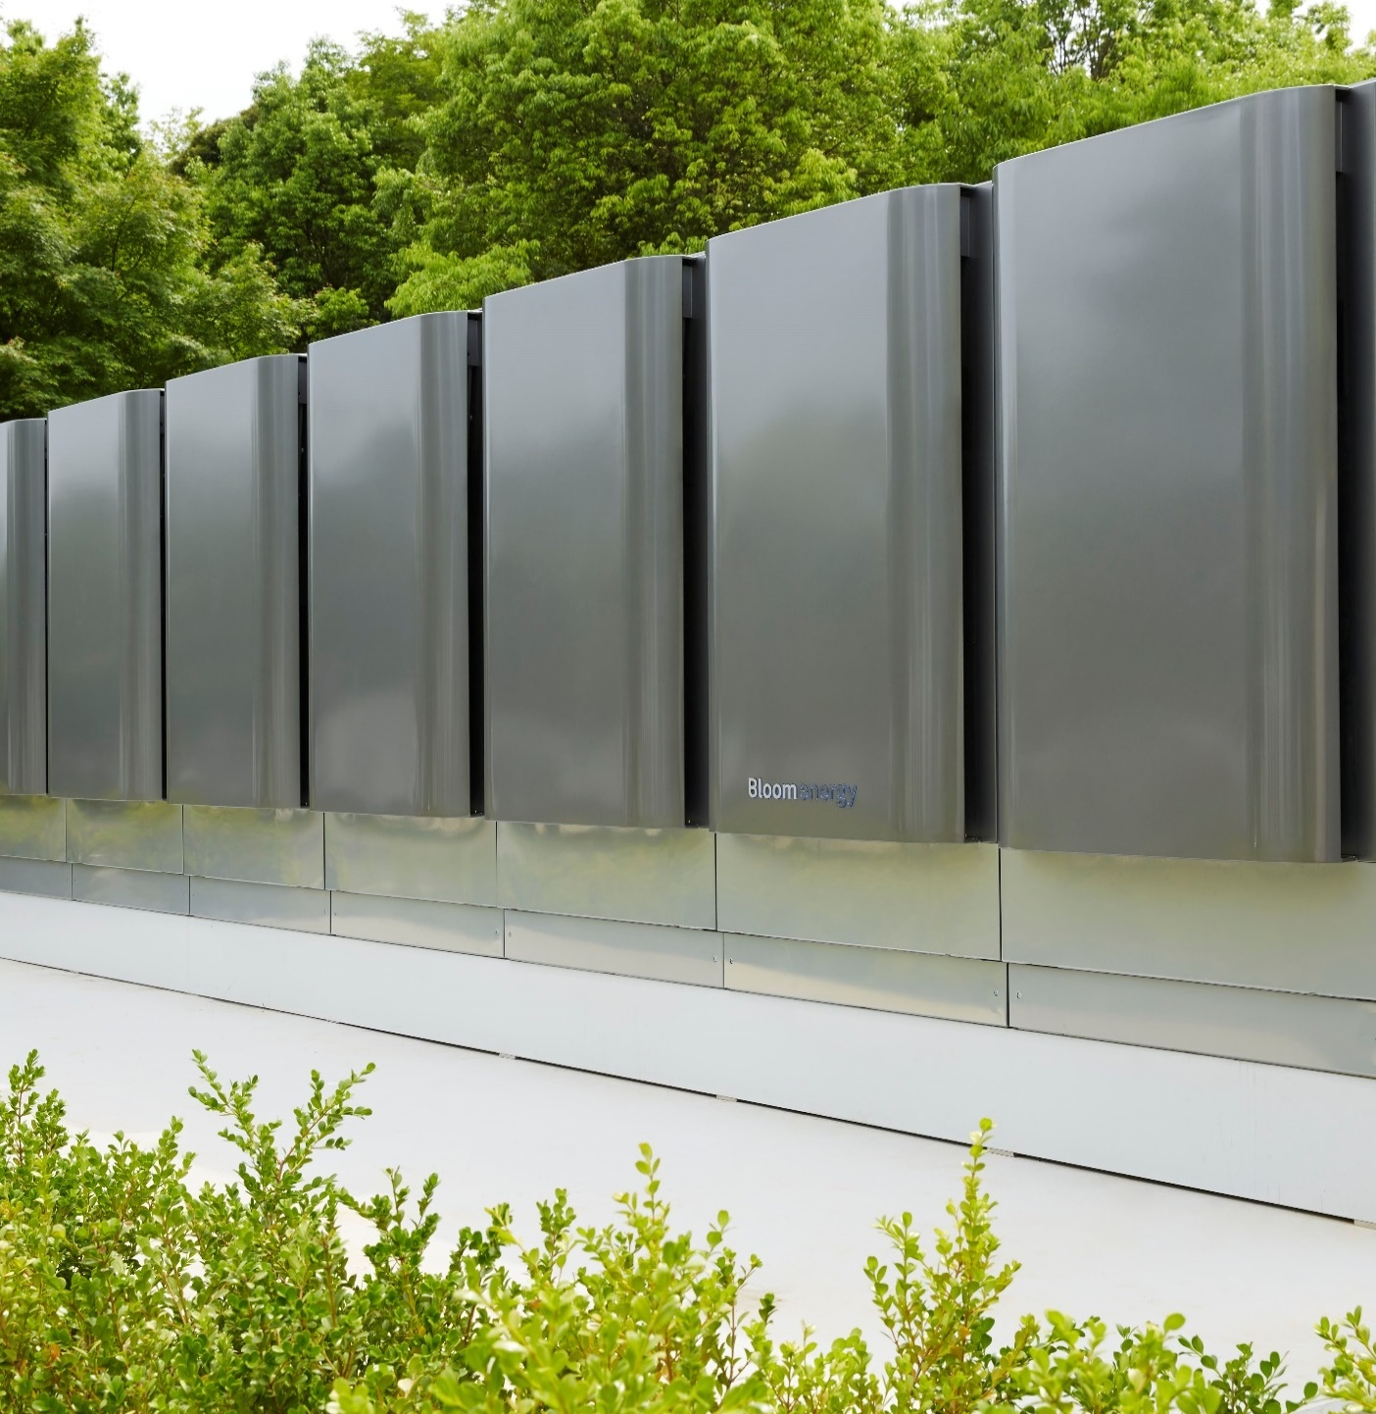

Path to enabling a fully decarbonized power system
Future Potential
650 GWh of energy storage potential in gas grid at 5% hydrogen
Turns grid into $130 billion battery asset (at DOE’s future battery costs)
Key Enablers
Leverage EPIC program to enable innovation around using the gas grid as energy storage with hydrogen, mirroring efforts underway
in Europe

