Slide 1

California Energy Commission
Research into Clean Energy Alternatives to Diesel Backup Generator Systems
Presentation by: Carsten Baumann, Director Strategic Initiatives – Solution Architect
E: carsten.Baumann@se.com
P: (949) 338-7827

Slide 2
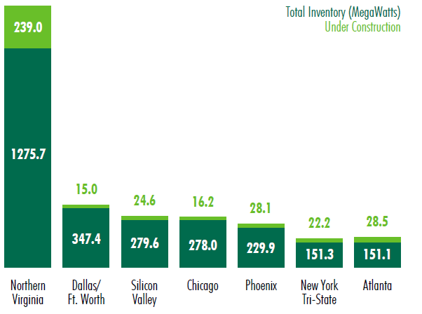
US Data Center inventory is expected to grow 13.8% in 2021*
California – Silicon Valley part of Primary US Data Center Market / SoCal secondary market
Trends:
Digitization everywhere
5G deployments
Edge computing
Sustainability
Resiliency
Risk mitigation
Energy cost certainty
* Source: CBRE 2021 U.S. Real Estate Market Outlook

Slide 3
Backup power alternatives are available at diff. maturity levels
From simple generator to increased resiliency using multiple DERs in a Microgrid
Simple
Complex
Inexpensive
Traditional Technology
Inexpensive
Emerging Technology
Distribution
Storage
Generation
Distribution
Storage
Diesel
Natural Gas
RNG
Biogas
Hydrogen
Green H₂
Prime mover
Baseload generation
Long-term backup
Generator
Generator
Fuel Cell
CHP / CCHP
Generator
Fuel Cell
CHP / CCHP
Fuel Cell
CHP / CCHP
Intermittent load
Supplement power
Short-term backup
Photo Voltaic, Wind, Battery & Energy Storage

Slide 4
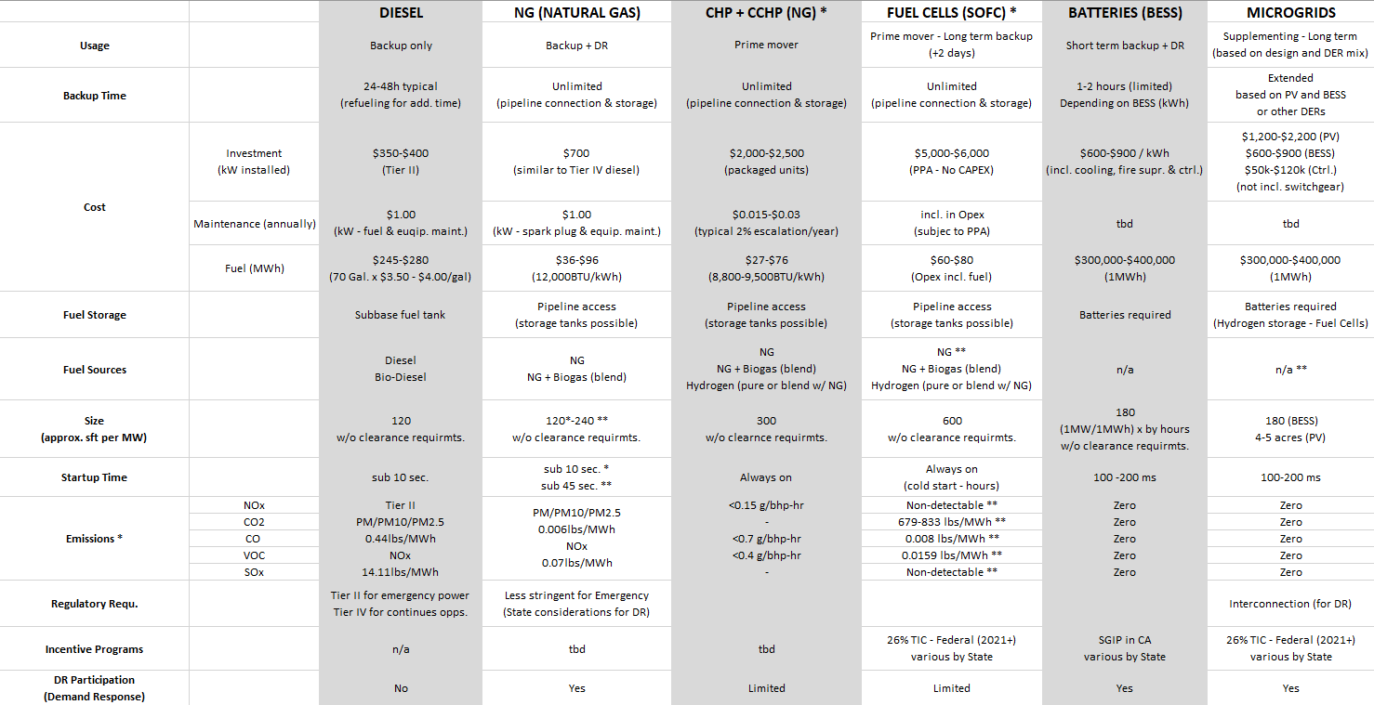
Onsite Generation - Technology Comparison

Slide 5
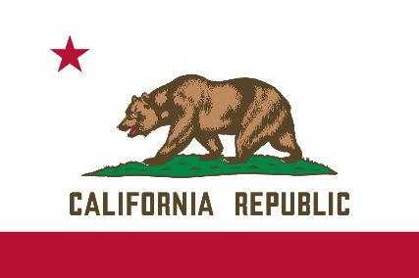
Actions that accelerate greater resiliency & sustainability?
Promote and incentivize diesel replacements (incl. partial replacement).
Promote energy transition from diesel to NG to Biogas and Green Hydrogen.
Simplify community microgrids (multiple participants).
Allow unregulated “behind-the-meter” generation to work with CAISO (24x7).
  Implement bi-directional signaling (demand response and value consumption & curtailment).
Count “behind-the-meter” sustainable resources to be part of the state-wide sustainability efforts.

Slide 6
Notes:
Closing slide

