Slide 1
Workshop to Discuss Research into Clean Energy Alternatives to Diesel Backup Generator Systems
Peter Asmus, Research Director
Guidehouse Insights
January 21, 2020

Slide 2
Why Data Centers Should Look Toward Microgrid Solutions
The role data centers will play in the economy continues to grow exponentially
  1 million new devices came online per hour in 2020 was one estimate pre-COVID-19. By 2025, at least 60% of computing will be taking place in the cloud
Parallels with military microgrid market
  A Pew Charitable Trust study estimated that the US Department of Defense could save between $8 and $20 billion in energy costs by switching to microgrids instead of backup diesel generators over the next 20 years
The average cost of a power outage for a data center is $9,000 per minute, according to Equinix
  A maximum duration outage can cost as much as $2.4 million
Top cause of data center power outages? Failure of backup power systems
Is there a better way to ensure uptime and resilience
  Diversify onsite generation assets
  Network these assets with smarter and cleaner power infrastructure

Slide 3
Global Microgrid Market Snapshot
Cumulative Identified Project Capacity: C&I Microgrids Rank Second
Source: Guidehouse Insights

Slide 4
DER in Microgrids Trends
Solar PV and Energy Storage Leading Choices Over Next Decade
Cumulative Microgrid DER Capacity, U.S.: 2Q2019
Cumulative Microgrid DER Capacity, California.: 2Q2019
Source: Guidehouse Insights
Source: Guidehouse Insights

Slide 5
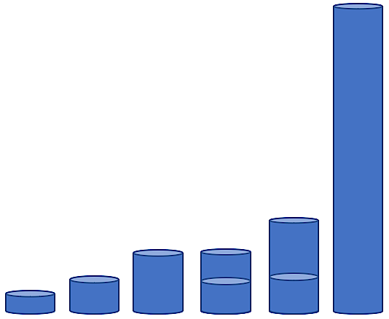
Fuel Storage Is a Central Challenge
Gaseous hydrogen has a very low volumetric density, so onsite compressed H₂ storage would require a much larger footprint than diesel fuel.
max
max
min
min
 | Diesel | Ammonia | Liquid H₂ | Metal Hydride* | LOHC | H₂ @200 bar
Relative volume | 1.0 | 1.6 | 2.7 | 1.6 - 2.8 | 1.8 - 4.1 | 13.3
* Theoretical maximum volume for metal hydride
Source: Analysis performed by Guidehouse under contract with CEC
Green electrolytic H₂ can provide clean power, supportive of SB100 goals
Storage of gaseous H₂ is most feasible when smaller quantities are required. Alternative storage methods are better, but have their own challenges or are immature technologies
For large backup scenarios, H₂ would need be supplied through pipelines to mitigate storage challenges

Slide 6

Onsite H₂ Storage for Data Center Backup Power
Compressed hydrogen storage in the volumes needed for data center backup is unrealistic.
 | Diesel | Ammonia | Liquid H₂ | Metal Hydride* | LOHC | H₂ @200 bar
Scenario volume (million Liters) | 2.7 | 4.3 | 7.3 | 4.2 - 7.4 | 4.7 - 11 | 36
Scenario volume (natural units) | 710,000 gal | 1,100,000 gal | 1,900,000 gal | 150,000 – 260,000 ft³ | 1,200,000 – 2,900,000 gal | 1,250,000 ft³
* Theoretical maximum volume for metal hydride
The volume required for compressed H₂ is on the order of magnitude of the largest pressure vessels in the world^{1,2}
Large Data Center Backup scenario:
100 hours of power
100 MW 24/7 load
38% diesel genset efficiency
58% fuel cell efficiency
If the footprint were one acre …
Compressed H₂
(200 bar)
…the height for 200 bar
H₂ storage would be
28.8 ft
Metal hydride
Ammonia
Diesel fuel
Liquid H₂
Source: Analysis performed by Guidehouse under contract with CEC

Slide 7
Contact
^{Peter Asmus}
^{Research Director}
^{peter.asmus@guidehouse.com}
⁽⁴¹⁵⁾ ³⁹⁹⁻²¹³⁷

