Slide 1
Context for Developing Clean Alternatives to Backup Diesel Generation
Allan Schurr, Chief Commercial Officer
CEC Workshop - January 21, 2021

Slide 2
Overview of
Enchanted Rock
Since 2009, Enchanted Rock provides affordable, long duration resiliency for commercial, industrial and institutional customers
Hurricane-tested microgrids proven at over 200 locations operating for up to 49 consecutive days
We provide utility-grade, long duration, full-service solutions with the cleanest available technology
99.9997%
Combined Reliability
460+
MW Commissioned
4,800+
Outage Hours Covered
300,000+
Unit Run Hours

Slide 3
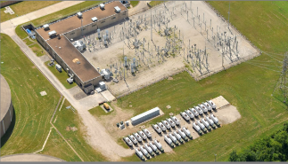
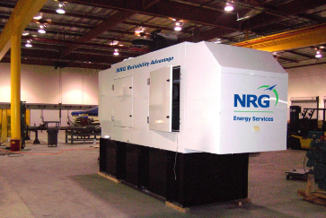
Journey from Diesel to Natural Gas 2009-2014
2009-2010
2012-2014
  73MW of Tier 2 diesel backup installed
  Dual capability for resilience and grid support
  165MW of Tier 4i diesel backup installed

Slide 4
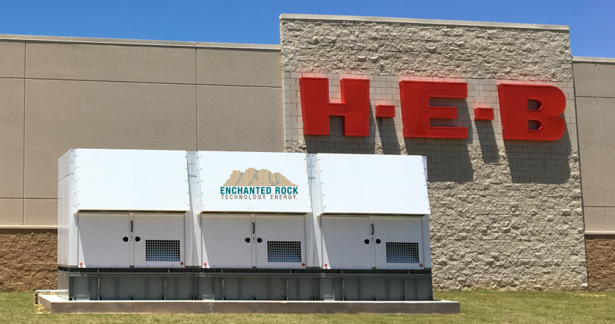
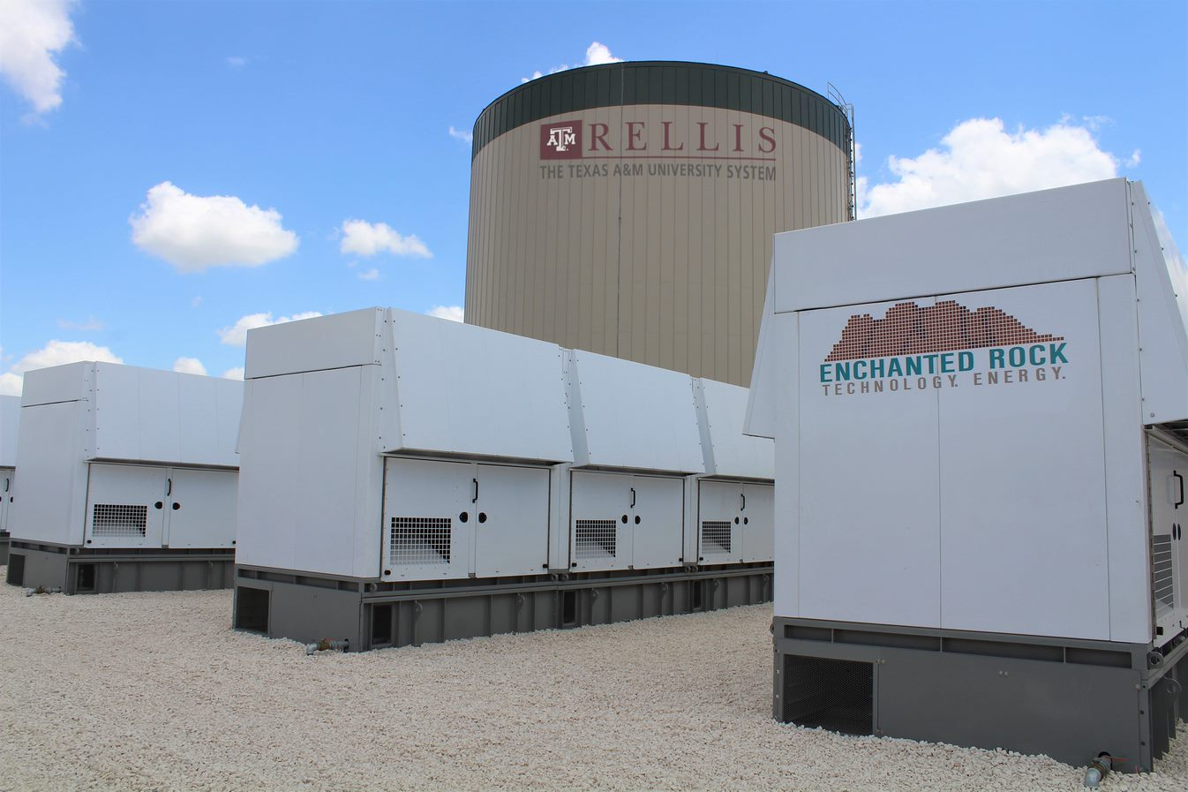
Journey from Diesel to Natural Gas 2014-2020
2014
2016-2020
  Shifted to cleaner natural gas gen set
  Multiple design iterations for enhanced performance
  First natural gas
  dual purpose microgrid
  installed in 2016
  Awarded patent in 2020
  300,000+ unit run hours

Slide 5
Local Emissions 10–100x Cleaner than Diesel

Slide 6
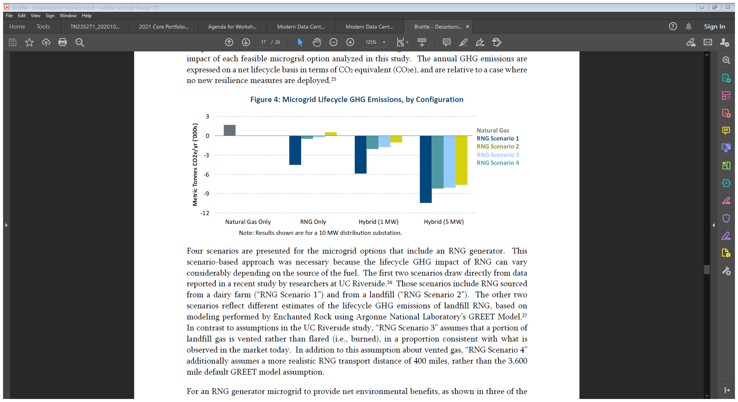
GHG-Negative Resiliency is Possible
Results for a 10MW system operating 250 Hours/year
RNG Scenario 1
  Dairy Gas
RNG Scenario 2
  Landfill Gas
RNG Scenario 3
  Assumes some landfill gas is vented, rather than flared
RNG Scenario 4
  Modifies Scenario 3 for a 400-mile RNG transport distance, rather than default 3,600-mile GREET default

Slide 7
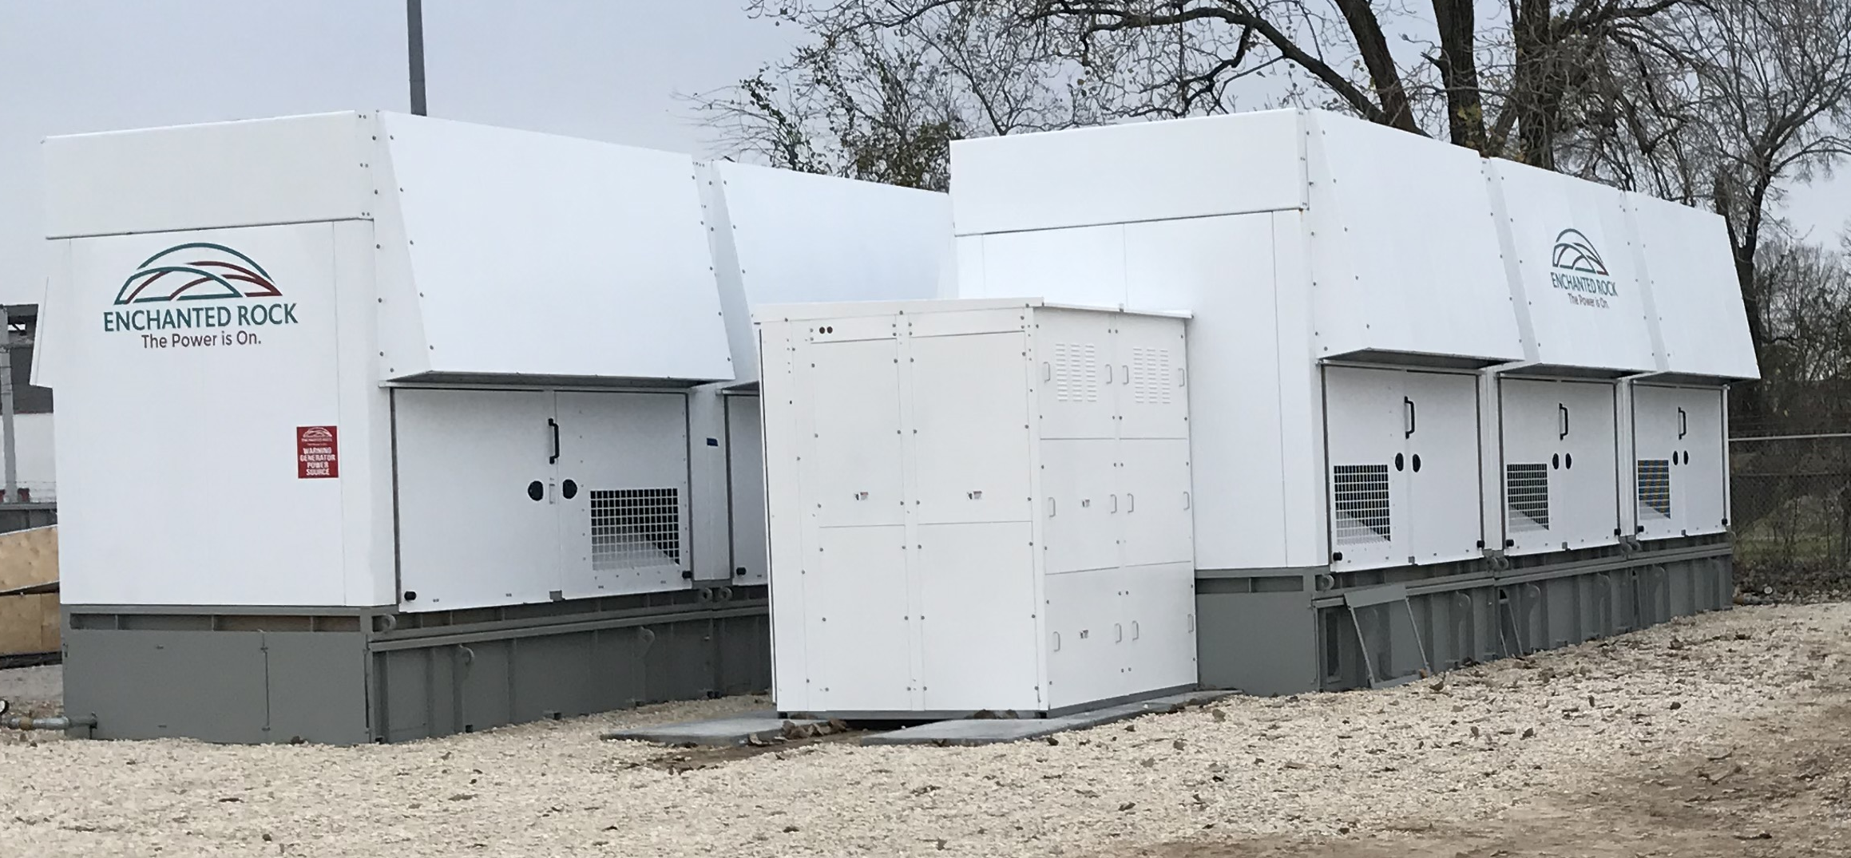
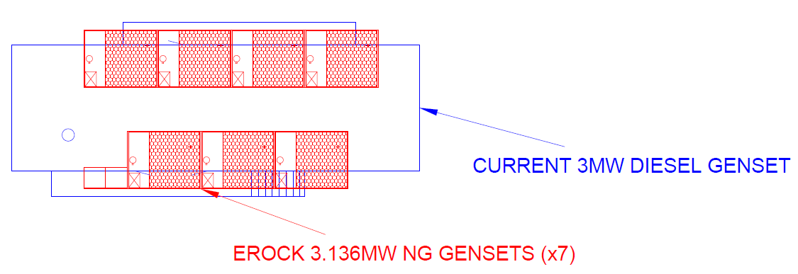
Diesel vs Natural Gas
3MW Footprint

Slide 8
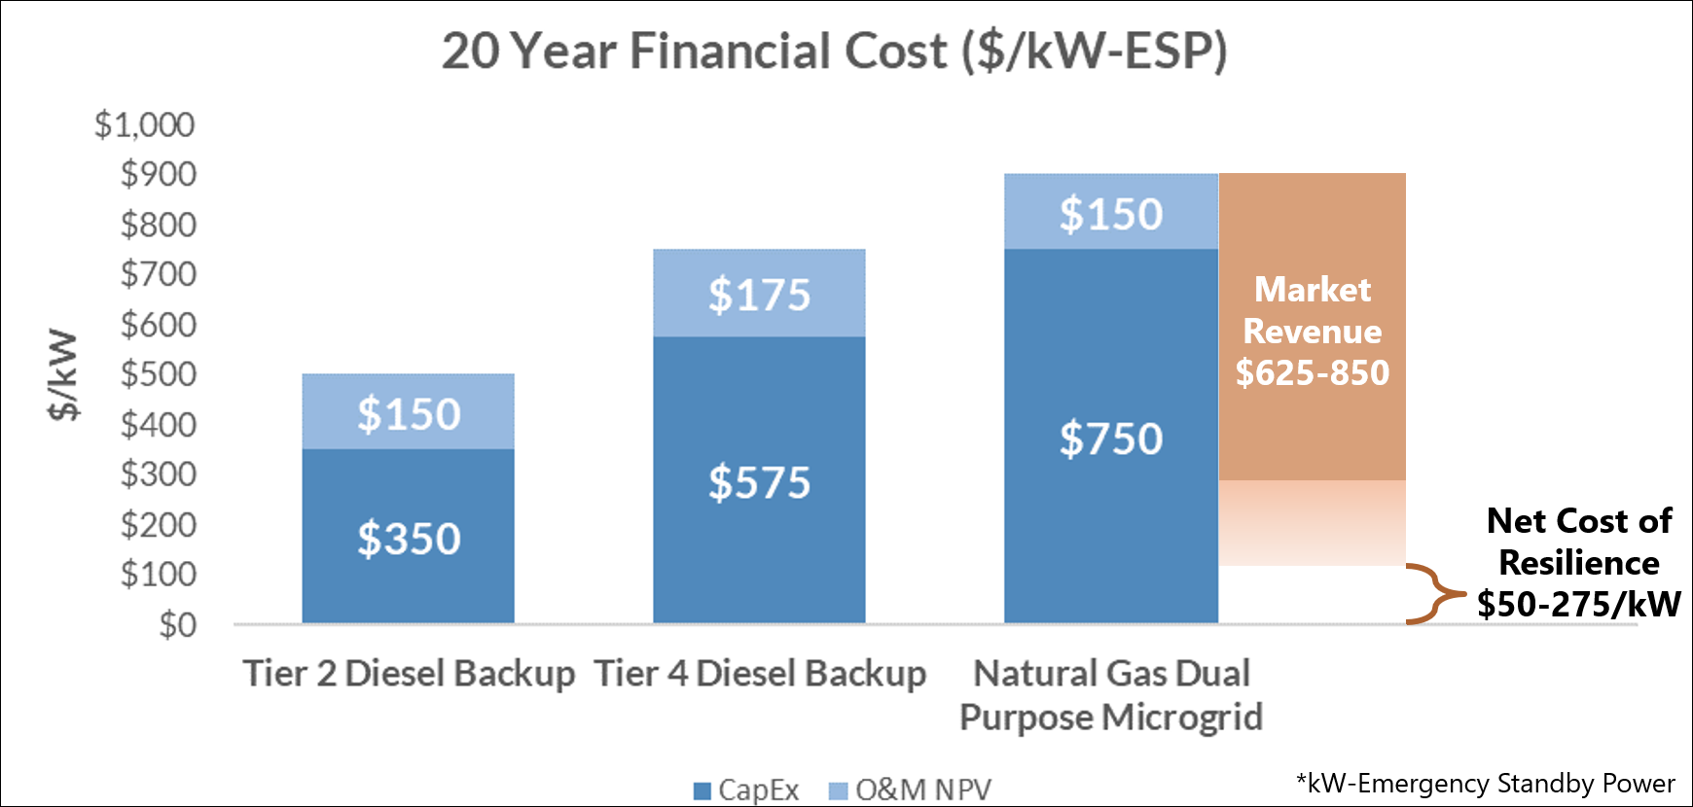
Natural Gas Economics

Slide 9
Performance Meets Requirements
Back Up Genset Requirements | Diesel | Enchanted Rock - Natural Gas
Technical Performance | < 10 sec to carry load, Transients meet ISO 8528 G-3 (e.g., load acceptance) | Matches diesel performance with advanced controls, stochiometric engine
Local Emissions | Higher emissions; Tier 4 requires SCR | 10-100x lower than Diesel; No SCR emissions control system required
GHG Emissions | Reduction with HVO diesel blends | Negative GHG possible with renewable natural gas
Power Density | Very Compact | Meets diesel space requirements due to unique package
Equipment Cost (at Data Center Scale) | $350-575/kW ESP | $750/kW-ESP dropping to < $150/kW-ESP after market revenues for grid services, using RNG
Fuel Security | Limited fuel on-site, subject to delivery interruptions in emergencies | Continuous supply from underground pipeline On-site storage possible

Slide 10
Policy & Research Opportunities
Investigate optimal market participation models to appropriately compensate natural gas or RNG-fueled BTM resiliency for contributions to grid reliability and resiliency, i.e., fast starting, high ramp rate, long-duration, fully dispatchable energy?
Evaluate the emissions impact of BTM natural gas resiliency assets compared to total emissions from marginal peaking units, including start up and no-load emissions.

Slide 11

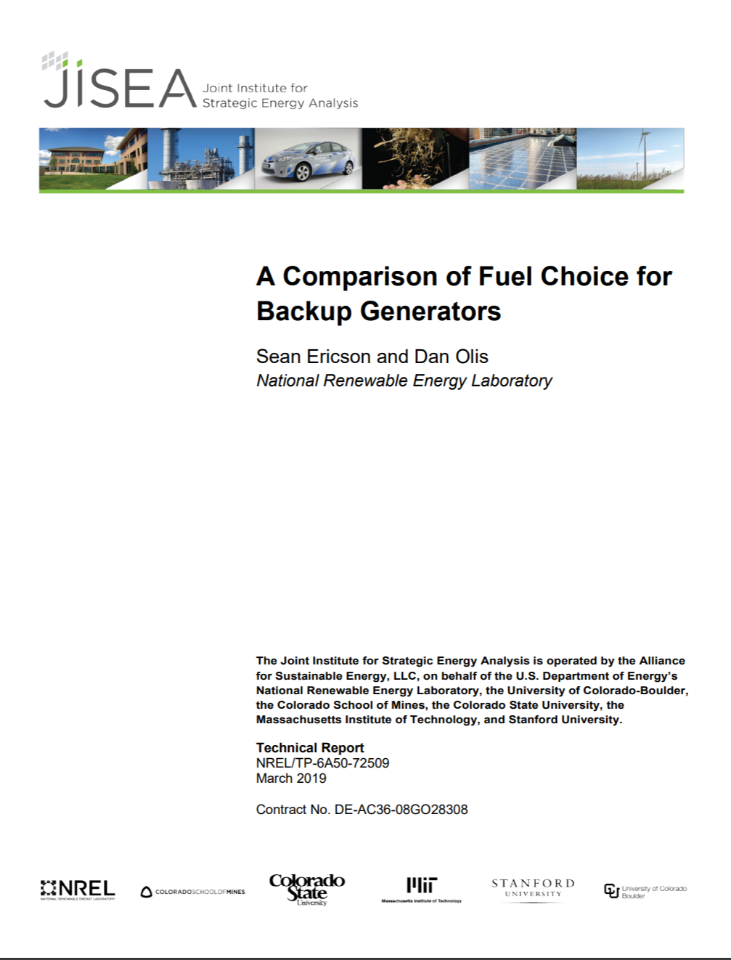
Additional Resources on www.EnchantedRock.com
aschurr@enchantedrock.com
info@enchantedrock.com
10

