Slide 1
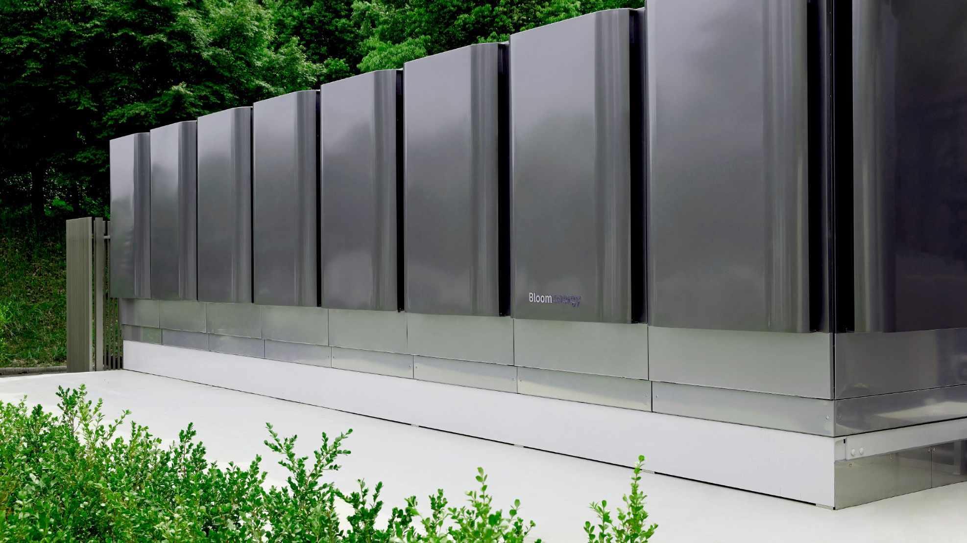

developing clean alternatives to backup diesel generation
BRIAN KANE
Head of Enterprise Systems Engineering

Slide 2
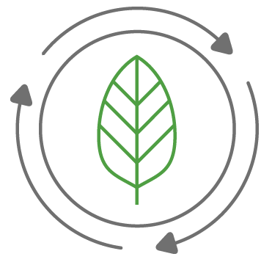
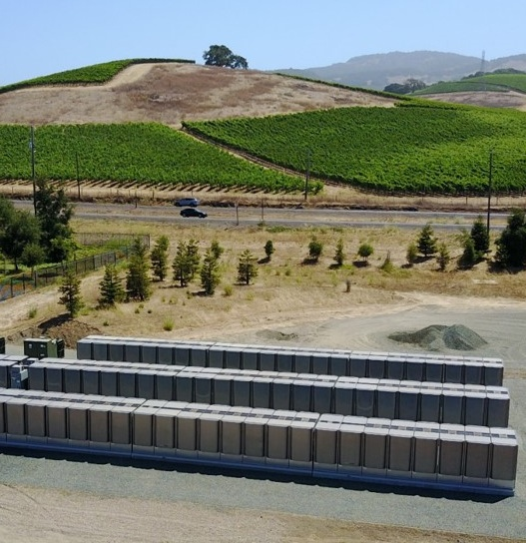
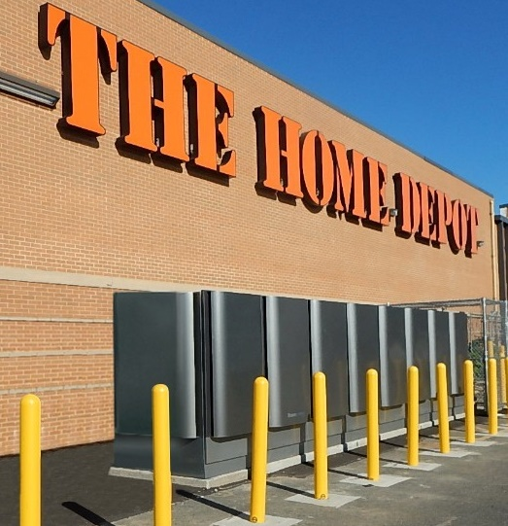
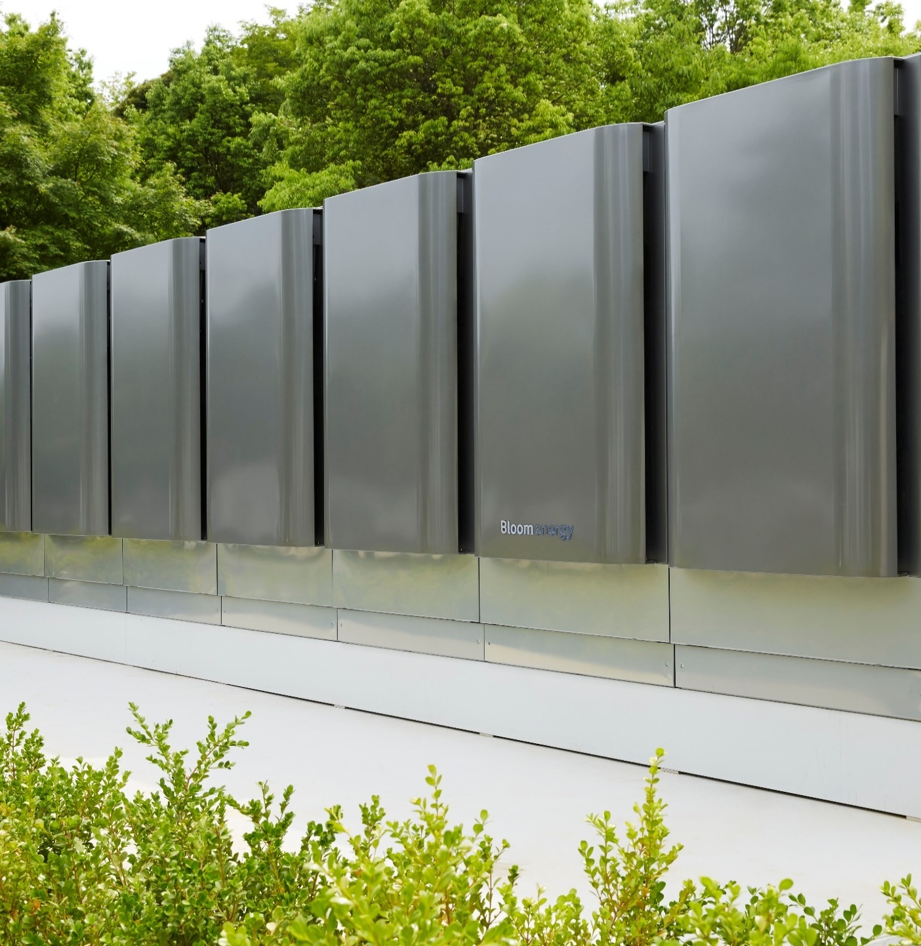







Bloom ENERGY OVERVIEW
We Deliver Clean, Reliable and Resilient Onsite Power
Microgrid Provider for Business Resiliency
AlwaysON
24x7
Electricity
Generates Electricity
without Combustion
Reduction in Smog-Forming Pollution
99%+
Designed and
Manufactured in US
Displaces Diesel
Generators

Slide 3

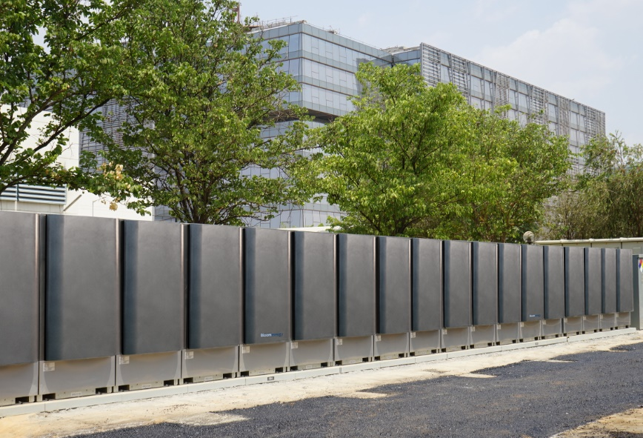
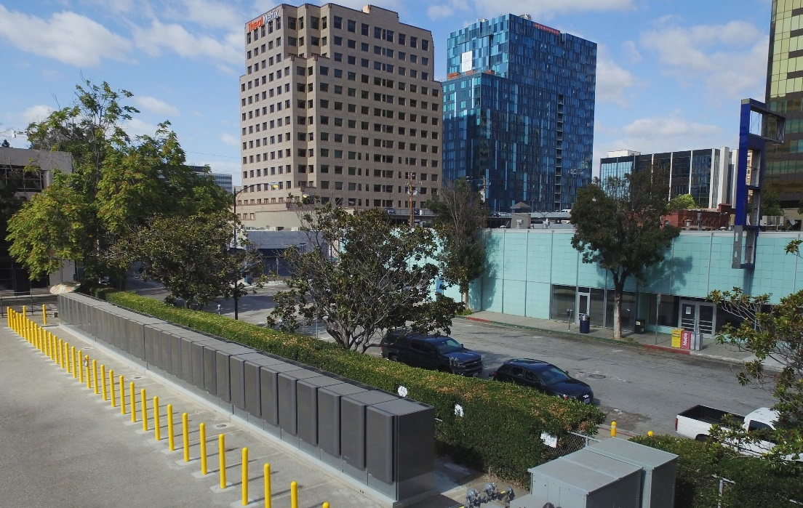
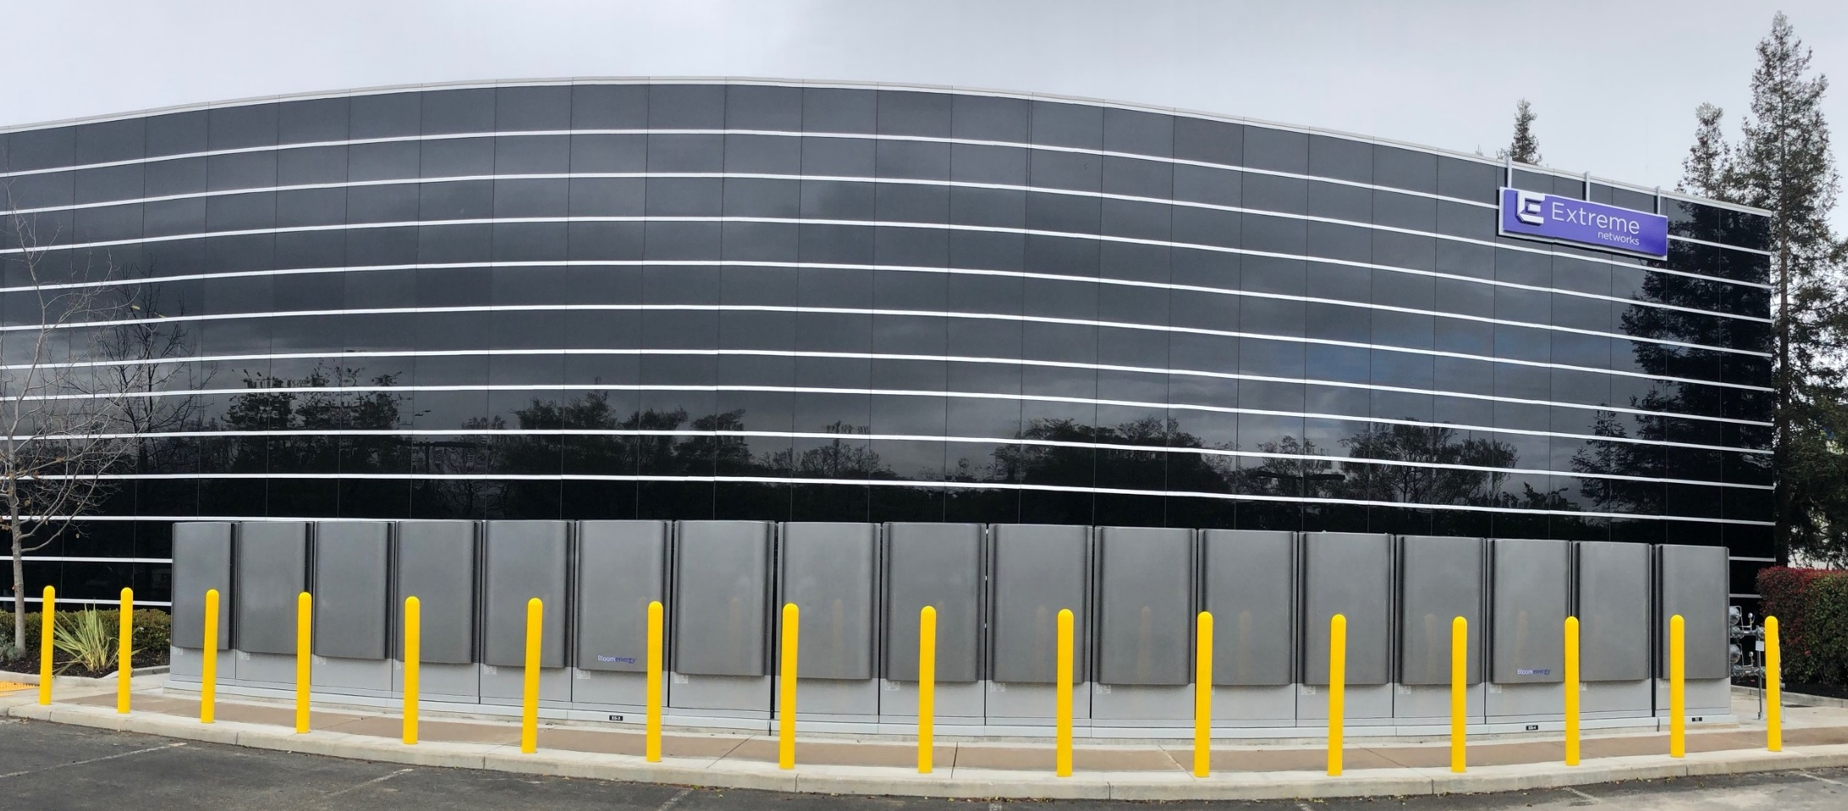
Bloom ENERGY CAPABILITIES
ENERGY PLATFORM
BUILT FOR PROTECTION
OVER 700 SITES &
100 MICROGRIDS DEPLOYED
265MW OPERATING IN CA
Cost Effective Resiliency
Intel
AT&T
H
Extreme Networks
Long Duration Protection of Critical Infrastructure
Capability to run on biogas or hydrogen
Virtually Zero NO_{x}, SO₂, Particulate Matter

Slide 4
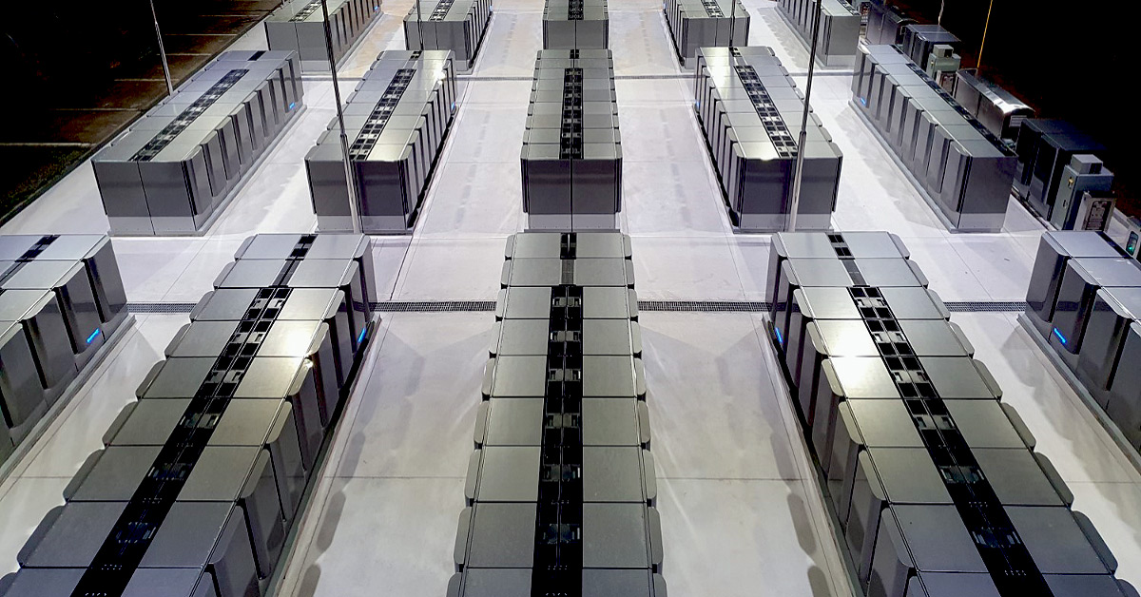



Considerations of microgrid design
CLEAN
RELIABLE
AFFORDABLE

Slide 5
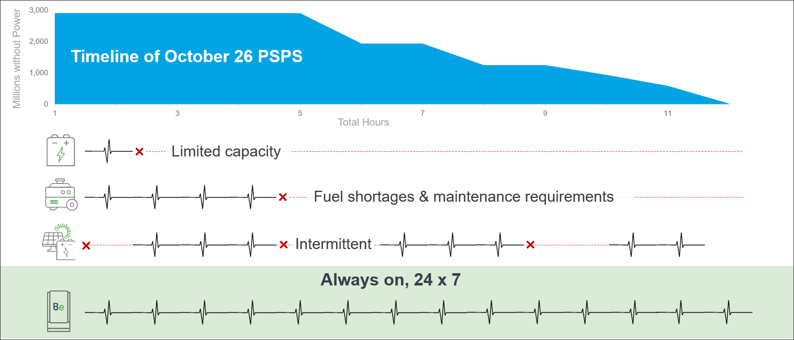
Bloom is the BEST solution for multi-day outages

Slide 6
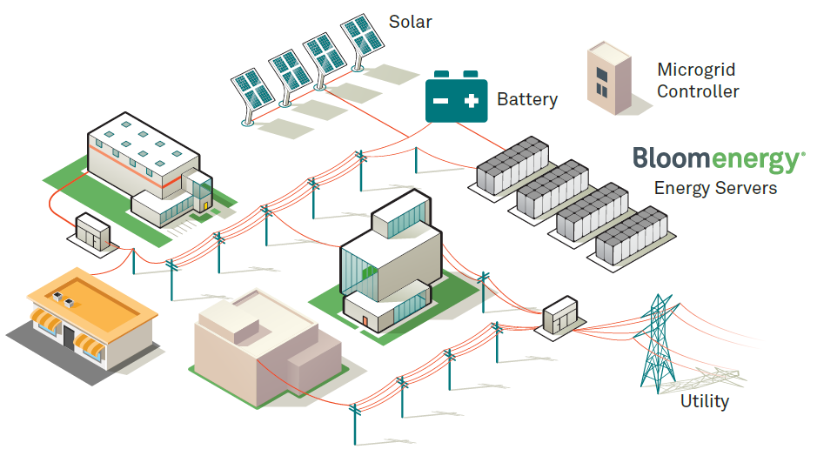
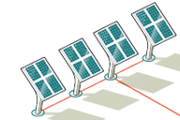
Santa Rosa Manufacturer MICROGRID
During CA wildfire season
last year, the microgrid
powered the facility through
a 5.5 day PSPS event
300 kW Solar
*Any combination of
renewable to provide this
much power for this long
would not fit on the
customer campus
15 kV

Slide 7

WHY NOT MORE?
OPTIMAL NG MICROGRIDS ARE
OPERATED 24X7X365
Current regulations penalize clean, constant
generation favoring standby or intermittent
renewable resources that do not fill the need
  Example: grid treats distributed resource as if there
  were no load, charging project with upgrades that are unnecessary given customer loads
Regs have existed for decades, thus incentivizing
mass production of diesel in liue of cleaner resources
Mis-placed requirement for onsite storage
  Pipeline ng is disconnected from electrical grid system. Storage of NG is an option, albeit not widely adopted. Codes/requirements often call-out diesel by name.
CALIFORNIA HEALTHCARE EXAMPLE
Requires 96 hours of onsite fuel
Pipeline as emergency source not an option
  Facilities already own this equipment and it is required to meet code
  Disincentivizes transition to more predictable,
  fully operable alternative solutions

