Slide 1
Alternatives to Diesel Backup Generation
CEC Workshop 21 Jan 2021
Mike Petouhoff

Slide 2
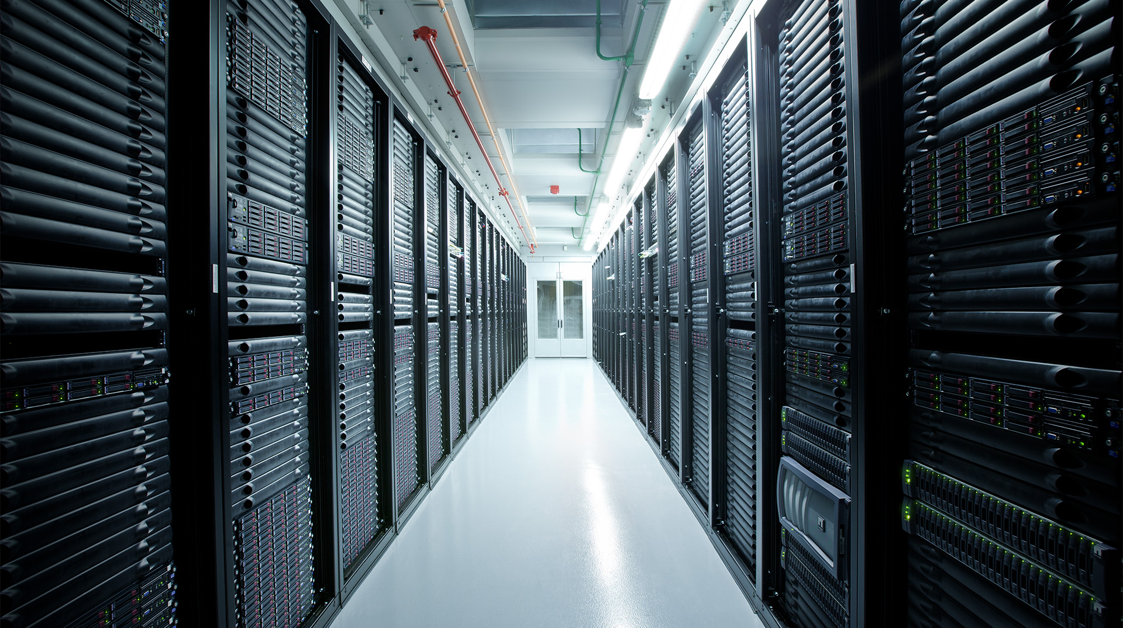
Data Centers and Backup Power
Notes:
Several years ago, Apple set an incredibly ambitious goal: We decided we were going to power our data centers with 100% renewable energy.
Many people thought it was impossible to do that with a facility that’s as energy-hungry as a data center. But we believed it could be done and set out to prove that through innovation.

Slide 3
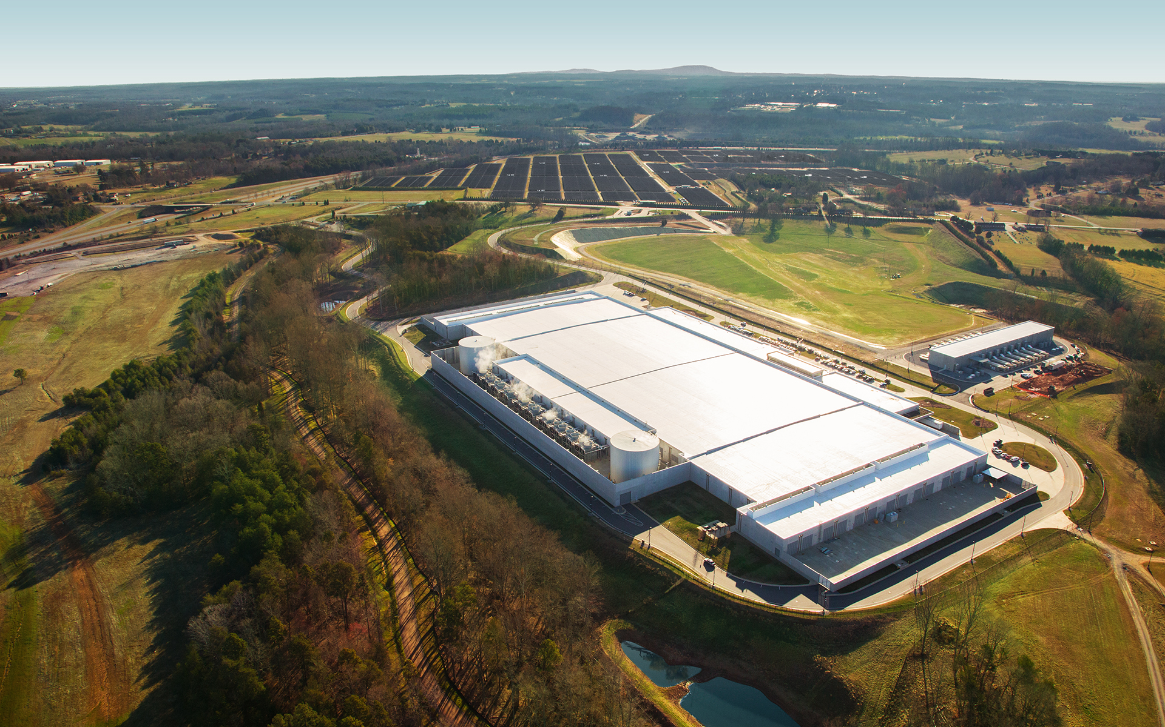
Apple’s
Maiden, North Carolina Data Center
Notes:
And we got there! We’re very proud that all of Apple’s data centers have been 100% renewable since 2013.
That means that every time you download a song from Apple Music, install an app from the App Store, or do a FaceTime video chat, the energy Apple uses is provided by nature and doesn’t contribute to global warming.
Let me show you a few examples of what it’s taken to hit this 100% goal.

Slide 4
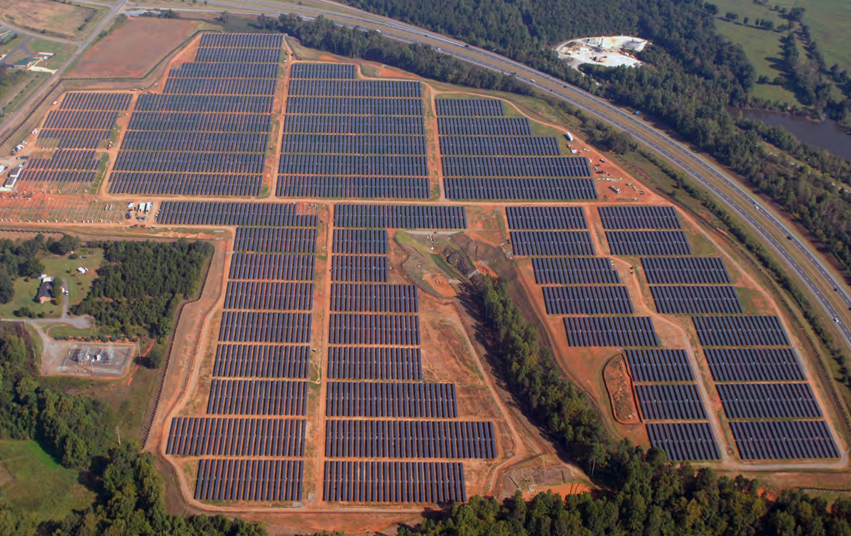
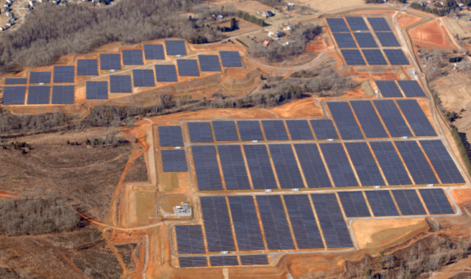
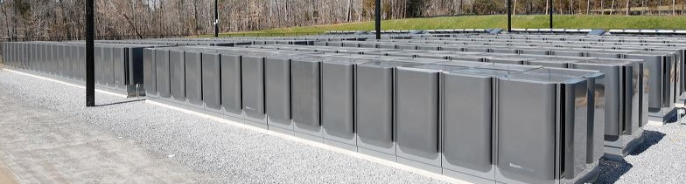
Apple Maiden Data Center Power
Apple Renewable Assets for NC
  PV1 — 20-MW PV array
  PV2 — 20-MW PV array
  FC — 10-MW biogas fuel cells
  PV3 — 17 MW PV array
Solar photovoltaic array (PV1)
Solar photovoltaic array (PV2)
Apple pioneered
Directed Biogas Fuel Cells as
part of the mix in
North Carolina
Maiden fuel cell (FC1 & FC2)

Slide 5
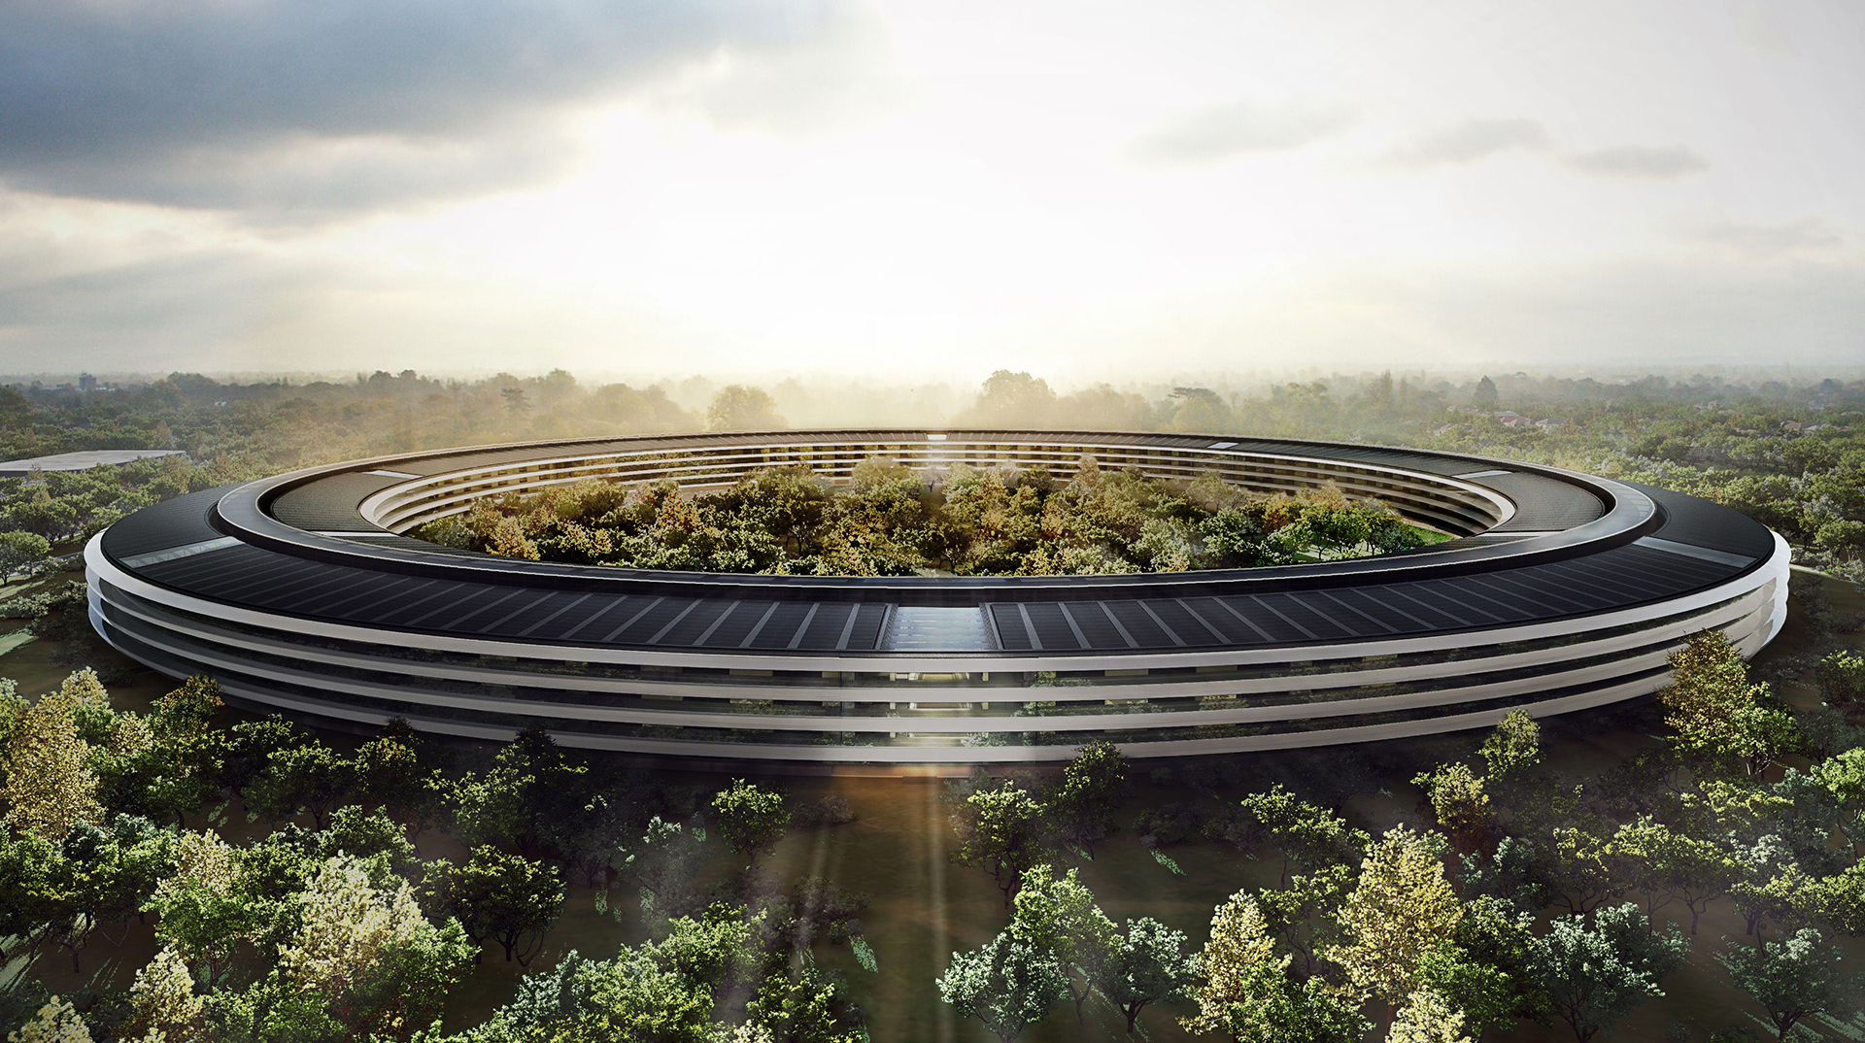
Apple Campus 2 - Cupertino
100% Renewable
Dispatch-able Microgrid Architecture
Notes:
We’re carrying the commitment through to our future corporate home: Apple Campus 2.
Apple Campus 2 will be the most energy efficient building of its kind.
Just under 80% of the site will be open space, populated by more than 7,000 trees, which includes more than 6,000 newly planted shade and fruit trees.
Sunlight will power one of the largest onsite corporate solar energy installations in the world.
And we’ll cover any of our remaining energy needs through a 130-megawatt solar project in Monterey County, Calif. The clean energy we’re procuring through a 25-year power purchase agreement with First Solar will provide more than enough energy for all of our California operations, including our Newark (CA) data center and all our retail stores in the state.

Slide 6
Nature of Backup Generation 1
Diverse and Changing
Data Centers are getting larger worldwide- owners trying to move to locations closer to higher reliability transmission lines- should mean lower expected outage durations

Slide 7
Nature of Backup Generation 2
Diverse and Changing
Data Centers are getting larger worldwide- owners trying to move to locations closer to higher reliability transmission lines- should mean lower expected outage durations
However, Climate Change is causing extreme weather events and more multi-day outages- creating stress for onsite diesel storage capacity- Hurricane Sandy 3-4 days in some locations

Slide 8
Nature of Backup Generation 3
Diverse and Changing
Data Centers are getting larger worldwide- owners trying to move to locations closer to higher reliability transmission lines- should mean lower expected outage durations
However, Climate Change is causing extreme weather events and more multi-day outages- creating stress for onsite diesel storage capacity- Hurricane Sandy 3-4 days in some locations
Public Safety Power Shutoffs (PSPS’s)- making scheduled outages more frequent, with more run hours (and # units) than in past permits

Slide 9
Nature of Backup Generation 4
Diverse and Changing
Data Centers are getting larger worldwide- owners trying to move to locations closer to higher reliability transmission lines- should mean lower expected outage durations
However, Climate Change is causing extreme weather events and more multi-day outages- creating stress for onsite diesel storage capacity- Hurricane Sandy 3-4 days in some locations
Public Safety Power Shutoffs (PSPS’s)- making scheduled outages more frequent, with more run hours (and # units) than in past permits
The size and type of critical loads vary greatly, e.g. smaller diverse communications and business uses- larger data center type loads- CEC currently is only reviewing the larger applications.

Slide 10
What are desirable features of back up power? 1
And who are the stakeholders?
Suggested Goals for Backup Power: | Local Social Justice Goals | Operator Goals | State Goals
Noise Reduction | x
Local Air Pollution Reduction (e.g. NOx,SOx,03, PM2.5) | x

Slide 11
What are desirable features of back up power? 2
And who are the stakeholders?
Suggested Goals for Backup Power: | Local Social Justice Goals | Operator Goals | State Goals
Noise Reduction | x
Local Air Pollution Reduction (e.g. NOx,SOx,03, PM2.5) | x
Start as fast as Diesel? Handle Step Load Increase? |  | x
Use Existing Kit/Configuration |  | x
Dependable non-exotic supply chain |  | x

Slide 12
What are desirable features of back up power? 3
And who are the stakeholders?
Suggested Goals for Backup Power: | Local Social Justice Goals | Operator Goals | State Goals
Noise Reduction | x
Local Air Pollution Reduction (e.g. NOx,SOx,03, PM2.5) | x
Start as fast as Diesel? Handle Step Load Increase? |  | x
Use Existing Kit/Configuration |  | x
Dependable non-exotic supply chain |  | x
SB100- Carbon Neutral |  |  | x
Support Resource Adequacy-Resilience |  |  | x

Slide 13
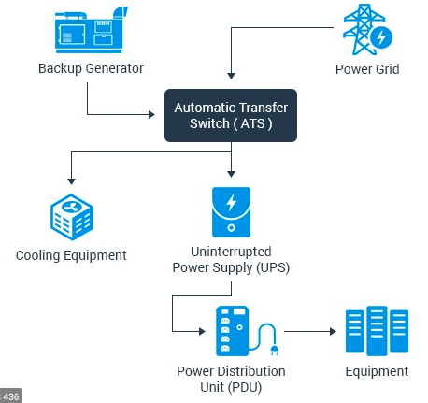
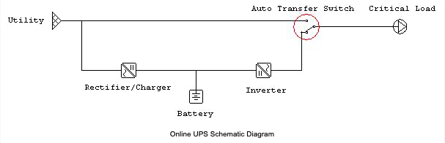
Traditional Back Up Power Configuration
Bottom Line: Diesel Gensets need to start quickly in an outage
In a typical Data Center Power Architecture, power is running through the Uninterrupted Power System (Batteries) even with Grid Power
In an outage, the batteries still feed the servers, but the Gensets must kick in quite quickly
UPS Batteries
Cooling equipment not covered by UPS may provide large step load- need to manage transients

Slide 14
Attributes-
What systems are currently available and how do they stack up? 1
Feature | Fuel Cell (Solid Oxide) | Gas Reciprocating Engine (not gas Turbine)

Slide 15
Attributes-
What systems are currently available and how do they stack up? 2
Feature | Fuel Cell (Solid Oxide) | Gas Reciprocating Engine (not gas Turbine)
Quieter | Yes | Yes
Cleaner Local Air | Yes | Yes

Slide 16
Attributes-
What systems are currently available and how do they stack up? 3
Feature | Fuel Cell (Solid Oxide) | Gas Reciprocating Engine (not gas Turbine)
Quieter | Yes | Yes
Cleaner Local Air | Yes | Yes
Start as fast as Diesel? Handle Step Load Increase? | No | Yes
Typical Configuration | Prime Base-load Power | back up power
Use Existing Kit/Configuration | No | Yes

Slide 17
Attributes-
What systems are currently available and how do they stack up? 4
Feature | Fuel Cell (Solid Oxide) | Gas Reciprocating Engine (not gas Turbine)
Quieter | Yes | Yes
Cleaner Local Air | Yes | Yes
Start as fast as Diesel? Handle Step Load Increase? | No | Yes
Typical Configuration | Prime Base-load Power | back up power
Use Existing Kit/Configuration | No | Yes
Use ubiquitously available pipeline gas? | Yes | Yes
Can be Carbon Neutral with directed biogas- support SB100 | Yes | Yes

Slide 18
Attributes-
What systems are currently available and how do they stack up? 5
Feature | Fuel Cell (Solid Oxide) | Gas Reciprocating Engine (not gas Turbine)
Quieter | Yes | Yes
Cleaner Local Air | Yes | Yes
Start as fast as Diesel? Handle Step Load Increase? | No | Yes
Typical Configuration | Prime Base-load Power | back up power
Use Existing Kit/Configuration | No | Yes
Use ubiquitously available pipeline gas? | Yes | Yes
Can be Carbon Neutral with directed biogas-- support SB100 | Yes | Yes
Entire Capacity Available for Grid Services (RA)? | No | Yes

Slide 19
Directed Biogas as one path to SB100 Goals
Can be a source of supply for back up power
Carbon accounting protocols have long supported Biogas as zero carbon fuel
Multiple paths for regulatory acceptance
  Apple sought and achieved North Carolina Utilities Commission NCUC Directed Biogas Declaratory Order (DO) (2012)
  FERC Certified NCUC DO, supporting that Directed Biogas meets “Qualifying Facility” (QF) requirements for a Renewable Energy, zero carbon facility, nationwide
Directed biogas can support dispatch-able renewable generation resources that can help integrate other forms of intermittent renewables, in the interim up to 2045, and long term

Slide 20
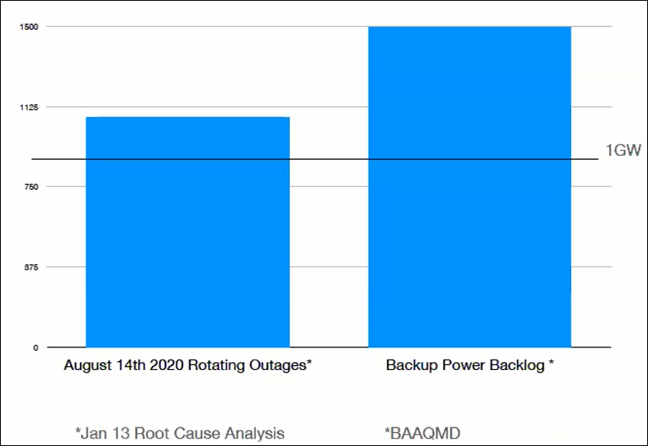
Back Up Power as Potential Clean RA Asset?
By 2045 what RA assets could be available?
Can backup generation have local air pollution cleaner than peakers?
Can backup generation have zero carbon emissions through use of biogas- meeting SB100 goals?
Can backup generation have a high response rate? (“Shown RA” has been as low as 40% in some categories)
Can distributed backup generation provide “Local RA”?

Slide 21
Research and Policy Questions
Grid of the future and back up power
Can CEC sponsor third party test and validation so as to create greater adoption rates?
Are mechanisms to access Grid Support services/RA readily accessible for behind the meter assets where appropriate?
Where is California on FERC Order 2222?
While the future may not include natural gas pipelines carrying fossil fuel sourced methane for end user consumption….
  What is the future of the natural gas pipeline system in a zero carbon economy?
  What role can zero carbon Directed Biogas play in a zero carbon economy?
    Renewable- zero carbon resource that can integrate other intermittent renewables and provide RA
  Could natural gas pipelines in the future carry:
    Carbon neutral Biogas (e.g. Agricultural waste sources)
    Carbon neutral synthetic methane (or green hydrogen up to a %) from electrolysis of otherwise curtailed wind and solar
    What % hydrogen is safe for pipeline distribution?
What is the regulatory status in CA of carbon free methane and biogas and what obstacles need to be addressed?
Can PEM or other fuel cells ramp up as fast as diesels, and handle step loads with good transients?
What other technologies need test and evaluation?
How will hydrogen be used and delivered in the future?

Slide 22
Thank you!
Questions?
Mike Petouhoff
One Grid Energy Solutions
mike@1grid.energy
(510) 435-2892

