Slide 1
Diesel Backup Generation in the Bay Area
CEC Workshop on Research into Clean Energy Alternatives to Diesel Backup Generator Systems
January 21, 2021
Jakub Zielkiewicz
Advanced Projects Advisor
jzielkiewicz@baaqmd.gov

Slide 2
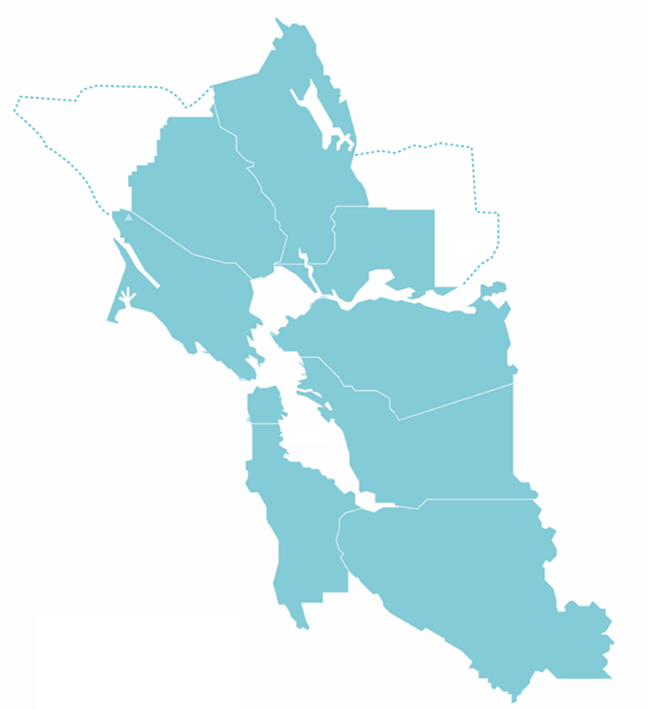
Air District Background
Responsible for air quality in the San Francisco Bay Area
  Over 100 cities
  Nearly eight (8) million residents
Five (5) million vehicles
Anticipated growth by 2040
Nine (9) million people
20% increase in driving
SONOMA
NAPA
SOLANO
MARIN
CONTRA COSTA
SAN FRANCISCO
ALAMEDA
SAN MATEO
SANTA CLARA

Slide 3
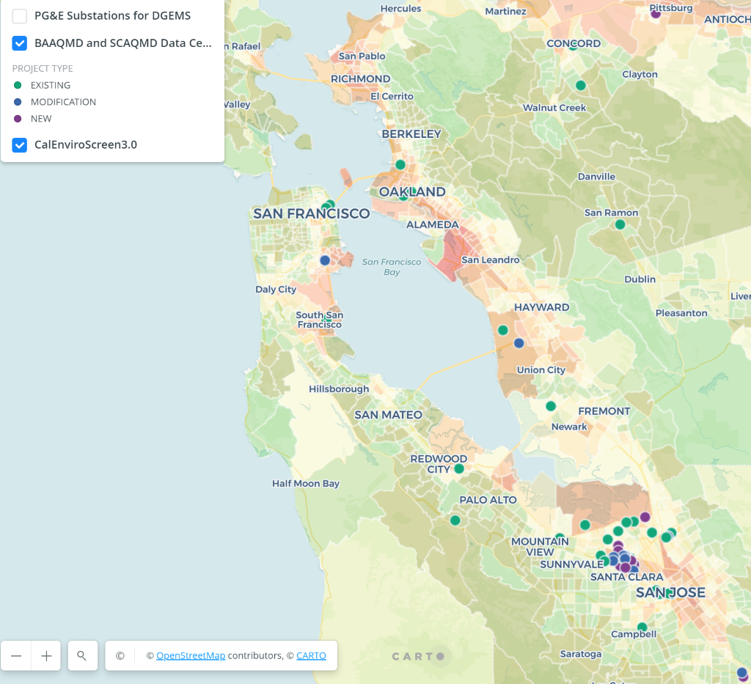
Overview: Bay Area Backup Diesel Generation
~10,000 total permitted diesel engines throughout Bay Area
Data Centers
  ~60 facilities identified with ~1GW diesel generator capacity
  At least 15 proposed facilities with >1.5GW capacity
  Diesel engines operating more than previously understood

Slide 4
Air District Policy Levers
CEQA Thresholds and Guidance
Permitting
Funding Programs
  Climate Protection Grants
    City of Santa Clara – Data center battery storage
  Climate Tech Finance
    Loan guarantees and low-interest loans
  Carl Moyer and AB 617 grants
CEC Workshop on Research into Clean Energy Alternatives to Diesel Backup Generator Systems
January 21, 2021

Slide 5
Public Policy Opportunities to Accelerate Clean Energy Alternatives
Air quality and climate regulations
  GHGs and “emergency operations” generally exempt
  Low carbon fuel incentives don’t currently apply to stationary sources
Recognition of clean energy alternative availability and feasibility
  CARB online technology clearinghouse
  Permitting alternative technologies
Capturing value of clean energy alternative services

Slide 6
Thank you !

