Slide 1
Identification of Clean Technologies to Support Disadvantaged Communities
January 21, 2021

Slide 2
Grid Reliability and
Need for Clean Backup Power
Near Term
Natural disasters
PSPS events
New large-scale installations
Telecommunications
Long Term
Transition to zero emission technologies
  Mobile
  Stationary
Renewable grid

Slide 3
CARB’s Role in Electricity Generation
Existing regulations – criteria, toxics, and GHG
Diesel ATCM
Distributed Generation regulation
Portable generators
Work with local Air Districts to prioritize reducing burden in disadvantaged communities

Slide 4

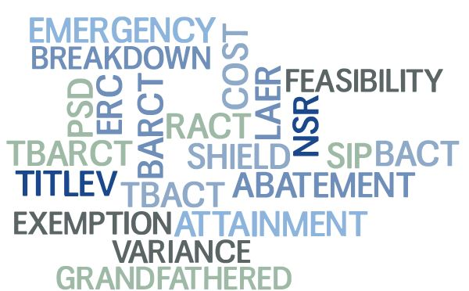
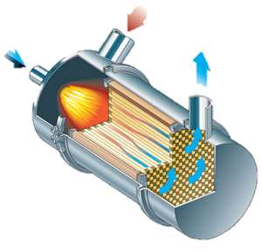
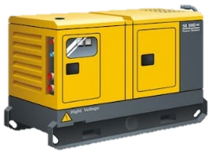



Background - Public Needs
From which device(s)?
What limits apply?
Approval Process?
Controls installed? Available?
AB 617 Requires Tools that Provide:
Transparency
Accessibility
Knowledge
What sources emit pollutants of concern?
Reduction Opportunities?
4

Slide 5
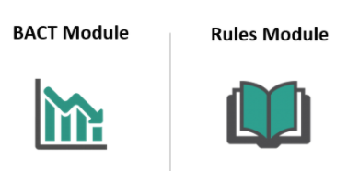
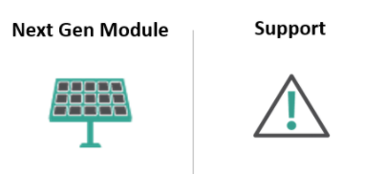
OCAP Technology Clearinghouse
This tool will be useful to many stakeholders including:
  Community members
  Other government agencies
  Emissions sources
  Next generation technology manufacturers
  https://ww2.arb.ca.gov/our-work/programs/technology-clearinghouse

Slide 6
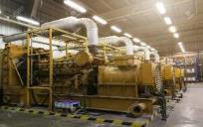


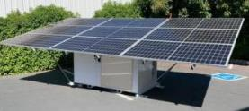

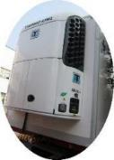
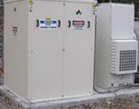
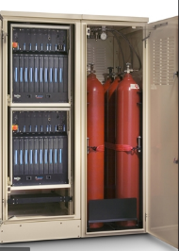
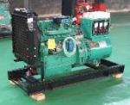
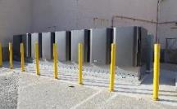
Typical Backup Power
Residential
  Small
Commercial
  Small
  Medium
  Large
  XXXXL

Slide 7
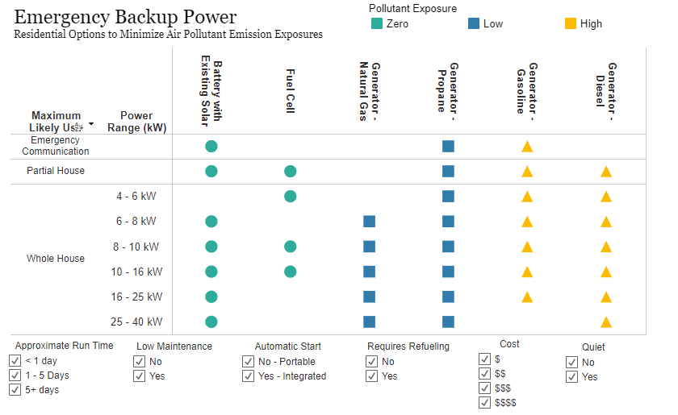
Existing Residential Backup Power Tool
https://ww2.arb.ca.gov/our-work/programs/technology-clearinghouse/technology-clearinghouse-tools/next-gen-tools

Slide 8
Commercial Tool Overview
Challenges:
  Installations are custom and have custom pricing
  Commercial backup power requirements are much more use-specific
Solutions:
  Include installation data, the tool does not include technology without installation data.
  Include each “industry of use”

Slide 9
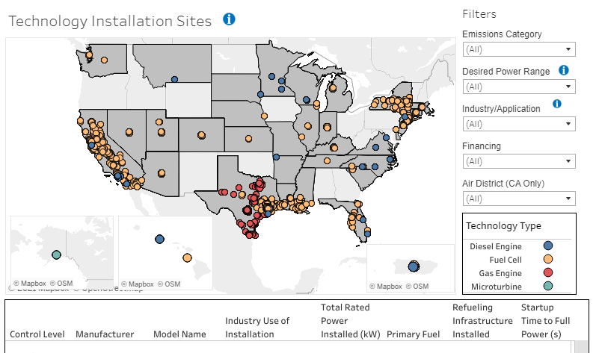
Emergency Backup Power Options – Commercial Tool
https://ww2.arb.ca.gov/our-work/programs/technology-clearinghouse/technology-clearinghouse-tools/next-gen-tools

Slide 10
Next Steps
Continue to update this tool as tech becomes available
Integrate this next-gen database into larger technology clearinghouse, so user can determine:
  What limits apply to existing sources (rules)?
  The lowest limits required today (BACT)?
  Cleaner technology beyond BACT (next gen)?
Develop similar next gen tools for other source types

Slide 11
Contact Information
Contact info:
Pippin Mader: pippin.mader@arb.ca.gov
Cassie Lopina, Manager: cassandra.lopina@arb.ca.gov
Vernon Hughes, Branch Chief: vernon.hughes@arb.ca.gov

