Slide 1
California Energy Commission Research Programs
Laurie ten Hope, Deputy Director
January 21, 2021

Slide 2
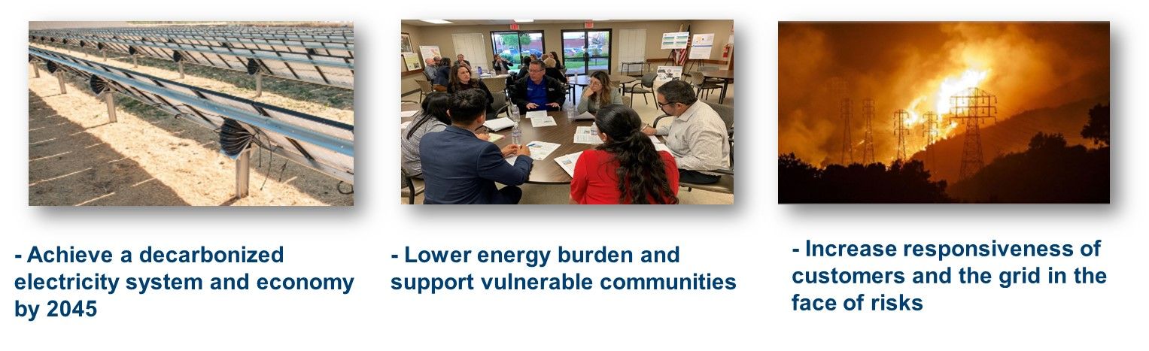
EPIC Background
The EPIC Program was established by the CPUC in 2011 to fund technology research to support California in meeting its clean energy goals, with a focus on providing ratepayer benefits, including reliability, lower costs, and safety. Research is driven by state energy and climate policies.

Slide 3
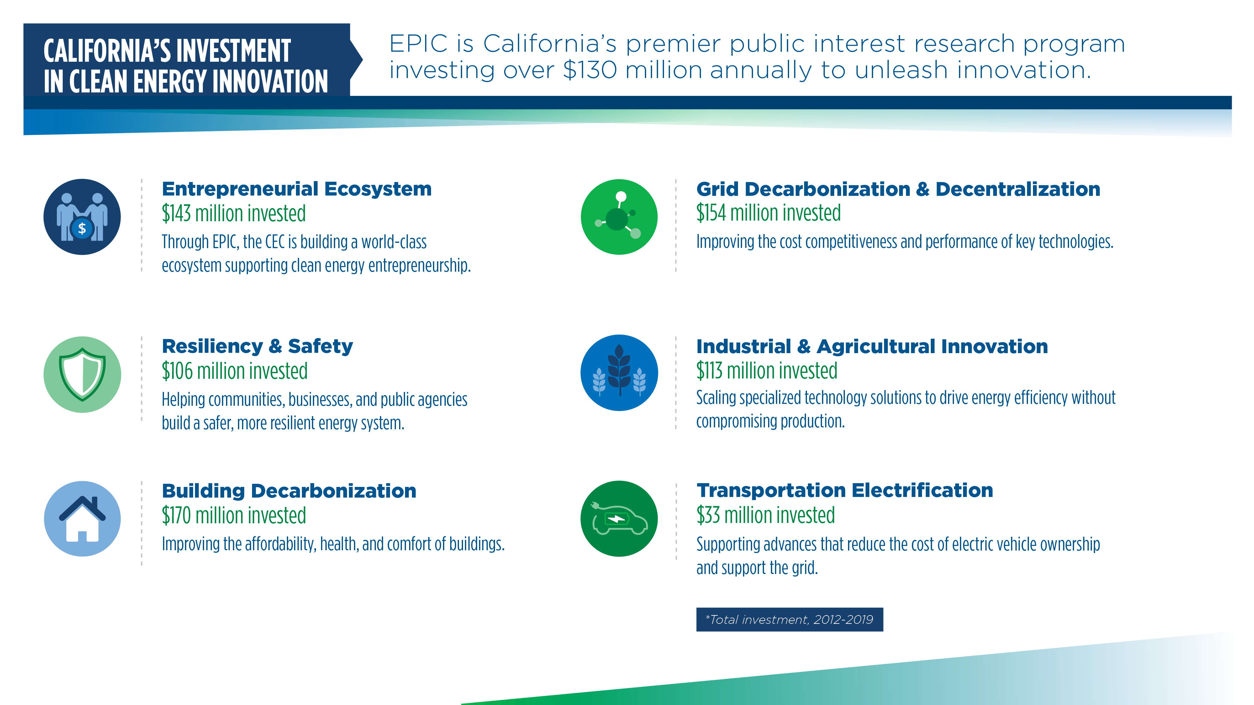
California’s Investment in Clean Energy Innovation

Slide 4
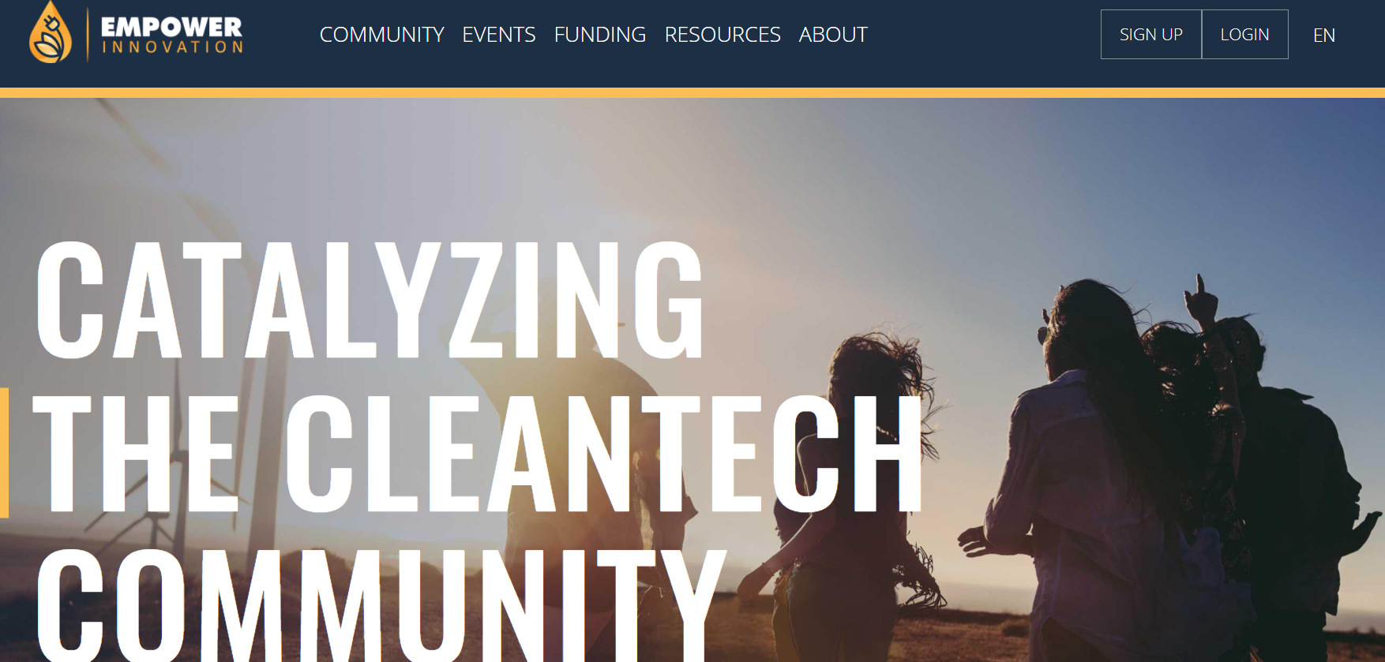

Benefiting All Californians
A minimum of 25% of EPIC demonstration funding must be invested in disadvantaged communities and an additional 10% in low-income communities.
To date, 65% of EPIC demonstration funding occurred in disadvantaged or low-income communities.
Selection criteria include localized health impacts & project benefits.
Solicitations require inclusion of community-based organizations as paid project partners.
Empower Innovation Tool: Connect under-resourced communities with clean energy resources. www.empowerinnovation.net

Slide 5
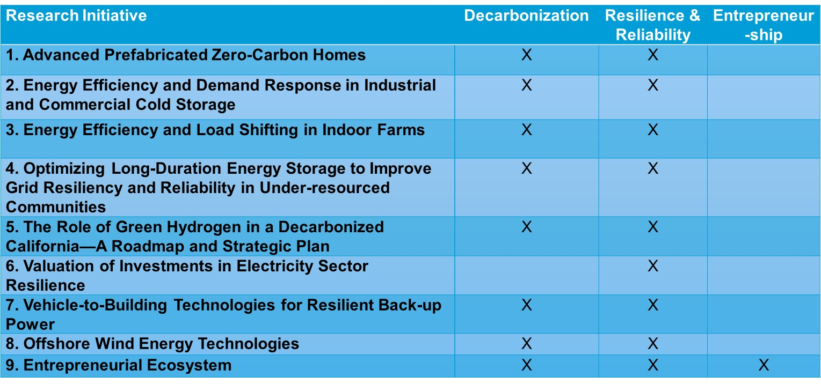
Draft EPIC Interim Plan

Slide 6
Long-Duration Storage in Under-resourced Communities
Description: Demonstrate increased resiliency and reliability of clean long-duration energy-storage systems to critical facilities in under-resourced communities.
  Couple smart inverters, energy management systems, or a microgrid controller with storage, and document performance needs for critical loads while minimizing cost.
  Clean alternative to back-up diesel generators and ability to “ride out” PSPS events and other grid power-loss events.
  Operate during grid outages that last 24-36 hours.
Goal: Increase customer resilience in under-resourced communities and demonstrate how these facilities can rely on clean renewables and energy storage to protect the community during unexpected grid outages.

Slide 7
The Role of Green Hydrogen in a Decarbonized California
Description: Analyze green hydrogen and make recommendations on its role in meeting the zero-carbon goals of SB 100 by 2045.
  Green hydrogen is a technology that can play a key role in the carbon-free energy sector.
  Fundamental questions include:
    How much of the energy-storage capability should green hydrogen meet?
    What are the highest value uses of green hydrogen?
    Does the success of green hydrogen in one sector influence potential success in another sector?
Goals: Create a roadmap for the possible applications and uses of green hydrogen to help California meet future planned decarbonization goals, especially in sectors with few other viable options.

Slide 8
Draft NG Research Initiatives-Topic for 1/29/21 Workshop
  Energy Efficiency
  1. Hydrogen and natural gas blending for industrial end-use applications
  2. Industrial Carbon Capture and Utilization
  Natural Gas Infrastructure Safety & Integrity
  3. Technologies for Monitoring Ground Movement Around Pipelines and Mitigating Natural Force Damages
  4. Technology Development and Demonstration for Plastic Pipeline Repair and Integrity Improvement
  Renewable Energy and Advanced Generation
  5. Developing and Demonstrating Hydrogen-Based Power Generation Systems
  Energy-related Environmental Research
  Quantify Exposures to Indoor Pollutants in Multi-Family Homes that Cook with Natural Gas or Alternatives
  7. Location-Specific Analysis of Decommissioning to Support Long-Term Gas Planning
  Transportation
  8. Advanced Hydrogen Refueling Infrastructure Solutions for Heavy Transport
8

Slide 9
Thank You!
Docket for EPIC Investment Planning: https://efiling.energy.ca.gov/Lists/DocketLog.aspx?docketnumber=20-EPIC-01
Sign up for updates on the “EPIC” Listserve: https://ww2.energy.ca.gov/listservers/index_cms.html
Empower Innovation Network Tool: www.empowerinnovation.net

