Slide 1
California Energy Commission
Committee Conference
Application for Small Power Plan Exemption for the Sequoia Backup Generating Facility
(19-SPPE-03)
December 16, 2020

Slide 2
Today’s Agenda
Call to Order
Discussion of Responses to the Committee Questions and Request for Information:
Public Comment
Individuals may speak up to three minutes on any matter concerning the application for a small power plant exemption for the Sequoia Backup Generating Facility, including the items on this agenda. Comments may be limited to one person per entity.
Committee closed session deliberations on the application for a small power plant exemption for the Sequoia Backup Generating Facility. (California Government Code section 11126, subdivision (c).)
Adjourn.

Slide 3
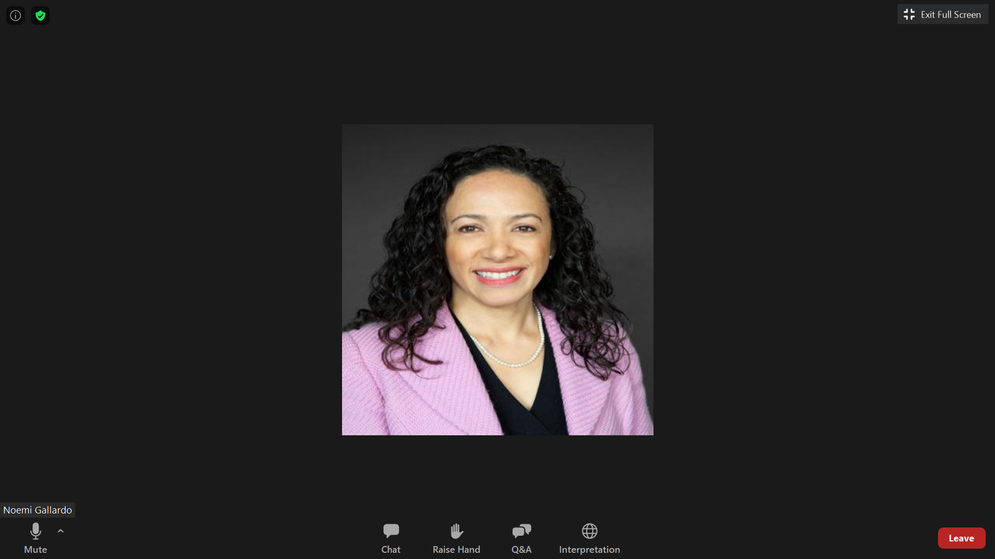
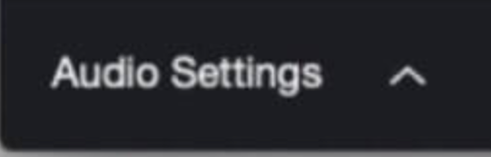
Zoom Instructions
For participation options, look for black bar at bottom of screen
To un/mute, click on microphone/phone/headphones
in lower left corner
Use “Raise Hand” to comment

Slide 4
Zoom Technical Support
Zoom technical support (888) 799-9666, ext. 2 https://support.zoom.us/hc/.
or
Noemí O. Gallardo, Public Advisor
(916) 654-4489 or
(800) 822-6228
Email: PublicAdvisor@energy.ca.gov

Slide 5
Public Advisor’s Office
SPPE Committee Conference:
Sequoia Data Center 12/16/2020
Noemi O. Gallardo
Public Advisor

Slide 6
“Informal” Participation
Attend events (via Zoom until further notice)
Share public comment for the record:
  Speak during live public comment period
  Email comments before event for Public Advisor to relate; and
  Submit written comments to Docket Unit

Slide 7
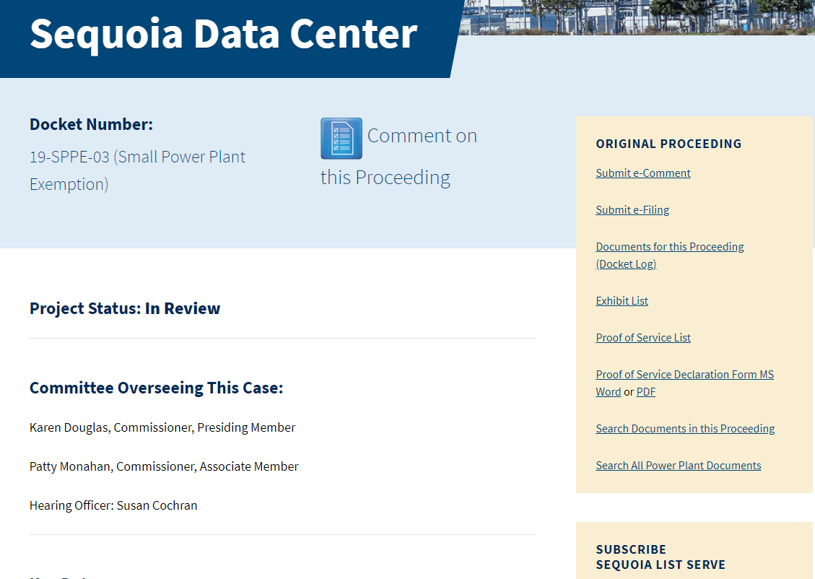
Project Info
https://ww2.energy.ca.gov/sitingcases/sequoia/
For anyone
For parties to proceeding; staff
All material docketed
Sign up for list serve

Slide 8
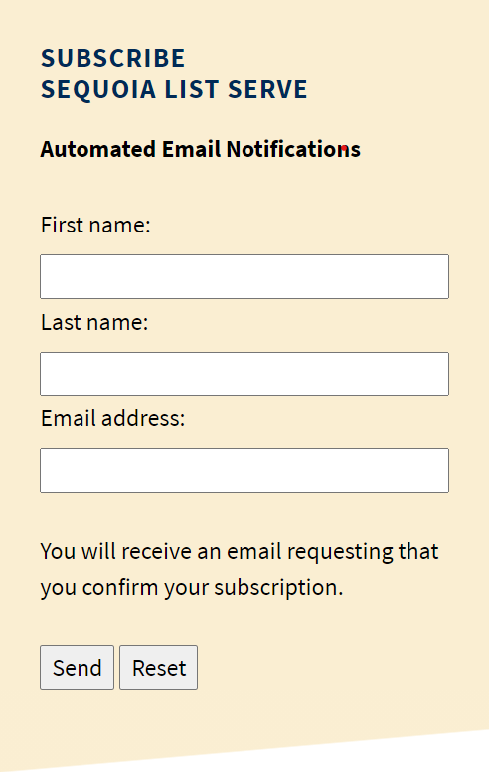
Sign up for List Serve
Step 1: Go to https://ww2.energy.ca.gov/sitingcases/sequoia/
Step 2: Enter your name, email address and click send
Step 3: Open "confirmation" email; click on link
to complete subscription
Step 4: Look out for email verifying subscription accepted
Once accepted, you'll receive email proceeding notifications and materials.

Slide 9
Upcoming Participation Opportunity
Committee Progress Report at the January 2021
CEC Business Meeting

Slide 10
Public Advisor Contact Information
Phone: (916) 654-4489
Email: PublicAdvisor@energy.ca.gov
Web: https://www.energy.ca.gov/about/divisions-and-offices/office-public-advisor
Mail:
California Energy Commission
1516 Ninth Street, MS-10
Sacramento, CA 95814-2950

Slide 11
Today’s Agenda
Call to Order
Discussion of Responses to the Committee Questions and Request for Information:
Public Comment
Individuals may speak up to three minutes on any matter concerning the application for a small power plant exemption for the Sequoia Backup Generating Facility, including the items on this agenda. Comments may be limited to one person per entity.
Committee closed session deliberations on the application for a small power plant exemption for the Sequoia Backup Generating Facility. (California Government Code section 11126, subdivision (c).)
Adjourn.

Slide 12
Availability of Documents
ww2.energy.ca.gov/sitingcases/sequoia
or
Noemí O. Gallardo, Public Advisor
(916) 654-4489 or
(800) 822-6228
Email: PublicAdvisor@energy.ca.gov

Slide 13
Commission Order on Remand
The Committee is directed to conduct limited additional proceedings to consider those comments raised by the California Air Resources Board and the Bay Area Air Quality Management District in this proceeding that address 1) input assumptions regarding NO₂ impacts from routine testing and maintenance; and 2) direct and cumulative impacts of emergency operations of the Project’s backup generators. The Committee may address additional issues that arise during those proceedings.
In order to facilitate a timely resolution of this matter, the Committee is directed to report on progress in this proceeding to the full California Energy Commission at the January 2021 business meeting.

Slide 14
Committee Questions
The parties are directed to meet and confer, and invite participation by CARB and BAAQMD, to determine whether any of the outstanding issues identified in the Order can be resolved among the parties and what issues remain in dispute. The parties are encouraged to prepare a joint statement setting out their positions as to the identified issues, as well as responses to the questions set forth below. If the parties are unable to prepare a joint statement, then they are to submit individual statements.
a. Is the Applicant’s modeling, relied upon by Staff in the IS/PMND, adequate for the analysis of NO₂ impacts from routine testing and maintenance operations? If not, describe why the analysis is not adequate and what would cure the described inadequacies?
  Can scenario modeling be used to bound a range of potential impacts from emergency operations? Are there other options to assess impacts of emergency operations? If so, how long will it take to perform those options?
The Committee asks CARB or BAAQMD, respectively or jointly, to provide any additional information/data they deem relevant to resolving the outstanding issues identified by the CEC in the Order. Further, the Committee requests that CARB and BAAQMD explain the relevance of any such information/data and how the Committee should utilize such information/data.

Slide 15
Today’s Agenda
Call to Order
Discussion of Responses to the Committee Questions and Request for Information:
Public Comment
Individuals may speak up to three minutes on any matter concerning the application for a small power plant exemption for the Sequoia Backup Generating Facility, including the items on this agenda. Comments may be limited to one person per entity.
Committee closed session deliberations on the application for a small power plant exemption for the Sequoia Backup Generating Facility. (California Government Code section 11126, subdivision (c).)
Adjourn.

Slide 16

Public Comment
Zoom:
  Use the "raise hand" feature to make verbal comments
Telephone:
  Dial *9 to raise hand
  Dial *6 to mute/unmute yourself using Zoom. You may also use the mute feature on your phone.
When we ask you to speak:
  Your microphone will be opened
  Spell your name for the record,
  then start your comments
3-MINUTE TIMER

Slide 17
Closed Session
The Committee is in closed session.
Estimated time to return is: -:-- p.m.

Slide 18
Return from Closed Session
Thank you for participating at today’s Committee Conference

