Slide 1
SB 100 Draft Report Briefing
Disadvantaged Communities Advisory Group Meeting
November 20, 2020

Slide 2
SB 100 Review
Expands RPS
Establishes 100% Policy
It is the policy of the state that eligible renewable energy resources and zero-carbon resources supply 100 percent of all retail sales of electricity to California end-use customers by December 31, 2045 and 100 percent of electricity procured to serve all state agencies by December 31, 2045.
60% by Dec 31, 2030
PUC 399.11(a), 454.53 (a)

Slide 3
SB 100 Review
CEC, CPUC, and CARB to issue a Joint-Agency report every four years including the following:
  A review of the policy (technical, safety, affordability, reliability)
  Reliability benefits and impacts
  Financial costs/benefits
  Barriers/Benefits of achieving the policy
  Alternative scenarios and costs/benefits of each
PUC 454.53 (d)

Slide 4
SB 100 Report Process
Activity​ | Date ​
Kickoff Workshop (Sacramento) ​ | September 2019​
Scoping Workshop 1: Central Valley (Fresno) ​ | September 2019​
Scoping Workshop 2: Northern California (Redding)​ | October 2019​
Scoping Workshop 3: Southern California (Diamond Bar)​ | October 2019​
Technical Workshop (San Francisco)​ | November 2019​
Modeling Inputs & Assumptions Workshop (Sacramento)​ | February 2020​
Draft Modeling Results Workshop (Remote Only)​ | September 2020​
Draft Report Workshop (Remote Only)​ | December 4, 2020​
Report due to Legislature​ | January 1, 2021​

Slide 5
Equity and Health
Stakeholders recommended an equity scenario that excludes combustion resources and includes social costs and non-energy benefits (NEBs)
  NEBs include land-use impacts, public health and air quality, water supply and quality, economic impacts, resiliency.
The joint agencies modeled a study scenario which excludes all new and existing combustion resources.
Modeling of the NEBs listed above was not feasible in this analysis, given the modeling tools available, remaining unknowns about where generation resources will be located, and when and how specific resources will be used.
Plan to continue engaging with stakeholders to explore opportunities to better integrate these topics into future analyses.

Slide 6
Resource Planning Modeling & Analytics
Inputs
Portfolio Development
Portfolio Reliability
May include, but not limited to:
Existing System
Demand Forecasts or Scenarios
Resource Costs
Reliability Metrics
Policy Goals
Resource Potential
Land Use Screens
Operability/ Full Dispatch:
Production Cost Modeling
Resource Adequacy:
Probabilistic Production Cost Modeling
Local Reliability:
Power Flow Modeling
Capacity Expansion Modeling
Portfolio Impacts
May include, but not limited to:
Rate Impacts
GHG Emissions
Land Use Impacts
Current SB 100 Report
Air Pollutants/ Air Quality Impacts
Workforce Impacts

Slide 7
Core & Study Scenarios
Core Scenarios
The core scenarios modeled for the SB 100 Report are consistent with the joint-agency interpretation of the statute.
Include the joint-agency criteria for loads subject to SB 100 and zero-carbon resource criteria.
Study Scenarios
Exploratory analyses that examine outcomes outside the core modeling assumptions or outside the scope of the joint-agency interpretation of the SB 100 goal.
Intended to provide additional information for consideration and support broader state agency energy planning.

Slide 8
Core & Study Scenarios
Core Scenarios
The core scenarios modeled for the SB 100 Report are consistent with the joint-agency interpretation of the statute.
Include the joint-agency criteria for loads subject to SB 100 and zero-carbon resource criteria.
Study Scenarios
Exploratory analyses that examine outcomes outside the core modeling assumptions or outside the scope of the joint-agency interpretation of the SB 100 goal.
Intended to provide additional information for consideration and support broader state agency energy planning.

Slide 9
Core & Study Scenarios
Scenario Classifications | Scenario Descriptions
60% RPS (Counterfactual) | 60% RPS through 2045
Core Scenarios
SB 100 Core Scenario | Core Load Coverage; High Electrification Demand; All candidate resources
SB 100 Core, Demand Sensitivities | Change: Demand Scenarios
SB 100 Core, Resource Sensitivities | Change: Candidate Resource Availability
Study Scenarios
Expanded Load Coverage | Core Load Coverage plus storage and T&D losses
Generic Zero Carbon Firm Resources | Add generic zero carbon firm resources to candidate resources
Accelerated Timelines | Accelerate 100% target to 2030, 2035, 2040
No Combustion | No combustion candidate resources; retire combustion resources
A complete list of scenarios will be included in the SB 100 Report

Slide 10
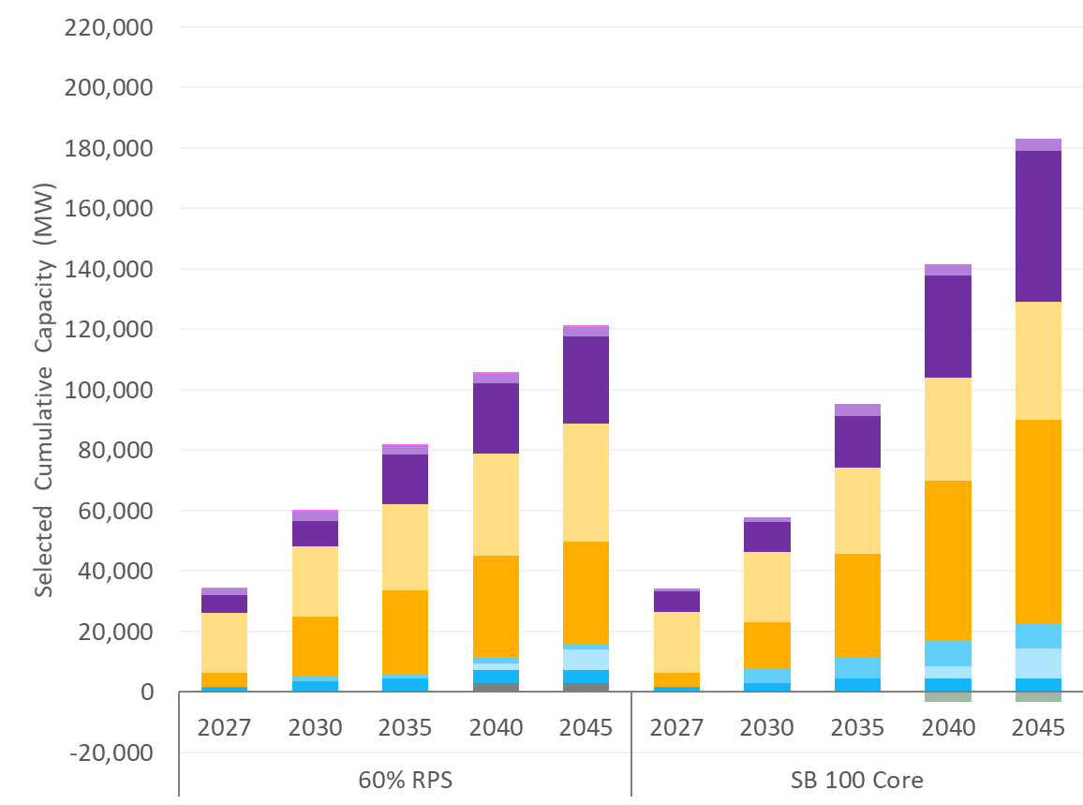
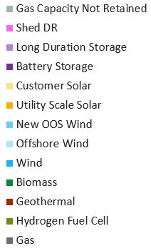
Core Results: New Generation Capacity
Customer solar shown here is a demand-side assumption. No additional customer solar was selected.
Demand: High Electrification; Resource Options: All
Notes:
This represents roughly a tripling of the electric grid (in terms of in-state generation resources). As of 2019, there is 80 GW of in-state capacity in California.

Slide 11
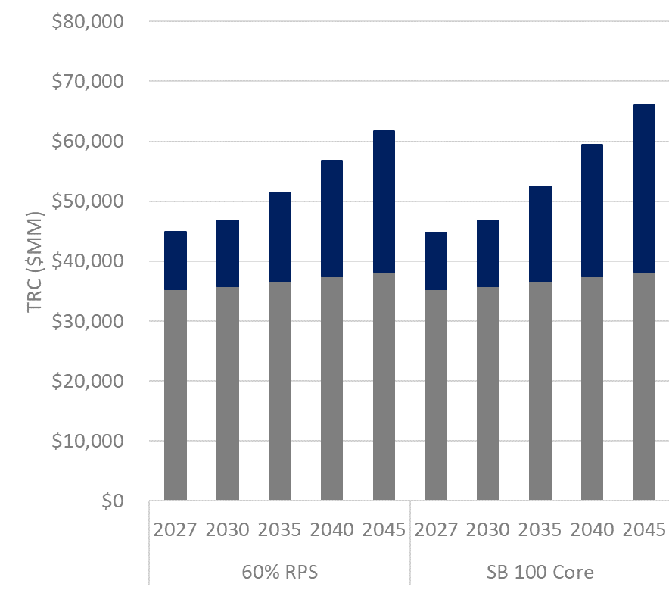

Total Resource Cost
2045 Scenario Costs
Scenario | Total Resource Cost ($B) | Average Cost (¢/kWh)
60% RPS | $62 | 14.8
SB 100 Core | $66 | 16.0
High Flex | $65 | 15.7
Total resource cost (TRC) includes existing system costs (baseline costs), capital investments and operation costs.
Demand: High Electrification; Resource Options: All

Slide 12
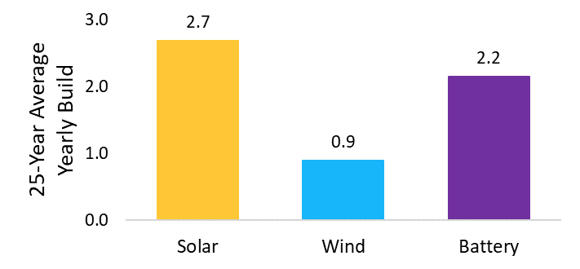
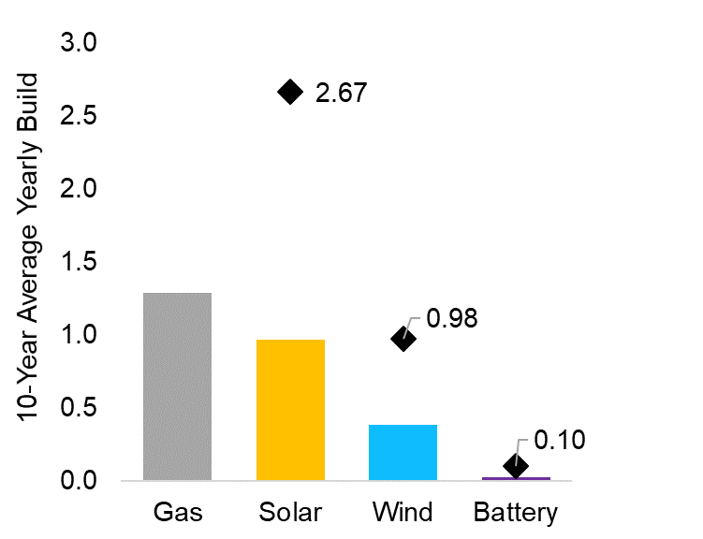
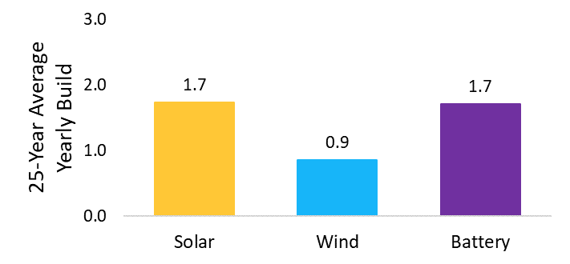
Resource Build Rates
Average Build Rate to 2045
High Electrification Demand
Average Build Rate to Date
Maximum single year build
Reference Demand
All build rates shown in “GW/year”
Load Coverage: Core; Resource Options: All

Slide 13
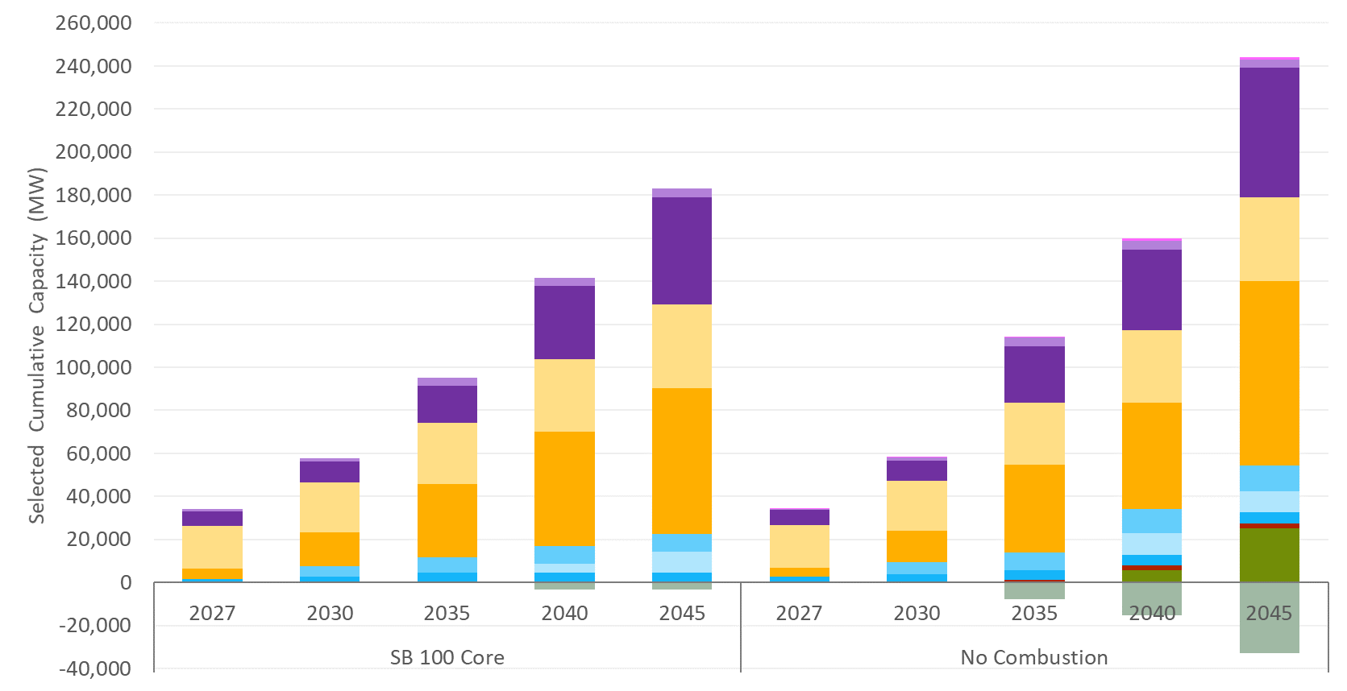
Study Scenario: No Combustion
Demand: High Electrification

Slide 14
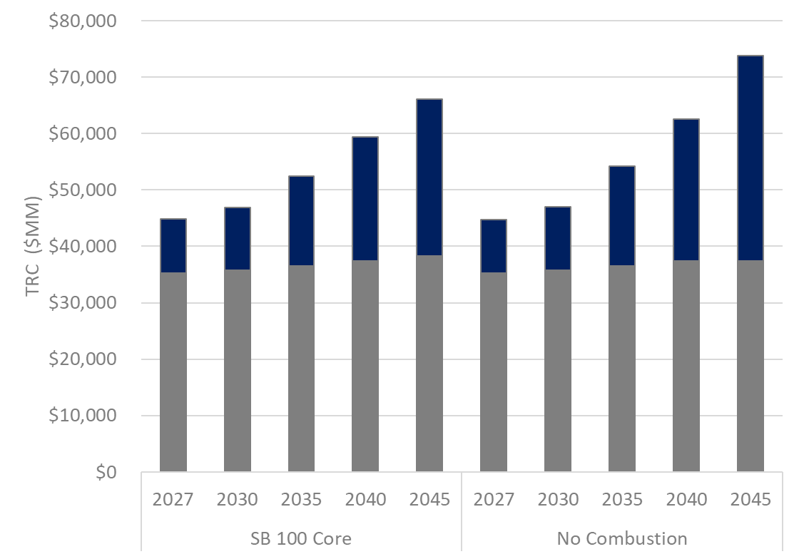
Study Scenario: No Combustion
2045 Scenario Costs
Scenario | Total Resource Cost ($B) | Average Cost (¢/kWh)
No Combustion | $74 | 18.1
SB 100 Core | $66 | 16.0
Demand: High Electrification

Slide 15
DRAFT: Key Takeaways from Modeling
SB 100 is Achievable with Existing Technologies.
  Increased Resource Diversity Lowers Overall Costs
  Gas Capacity is Retained for Reliability Needs but Cost Reductions and Innovation in Zero-Carbon Firm Resources and Storage May Reduce Gas Capacity Needs
Sustained Record Setting Build Rates Will be Required to Meet SB 100 in a High Electrification Future.
Goals Beyond SB 100 May Be Achievable but Require Additional Analysis.
Current SB 100 Analysis is Directional and Further Analysis is Necessary.
Notes:
This initial analysis demonstrates that SB 100, as interpreted by the Joint Agencies, is technically achievable with existing technologies.
Even with relatively conservative cost projections, the total resource cost of achieving SB 100 is approximately 6 percent higher than a 60% RPS future in 2045. Cost reductions and innovation in zero-carbon technologies, as well as load flexibility and energy storage development, can further reduce implementation costs.
Portfolio diversity, both technological and geographical, is generally valued by the model. In scenarios where out-of-state or offshore wind are available, the model always selects a significant quantity, if not all, of the resource potential.
Additionally, even a modest amount of load flexibility can reduce battery storage requirements, decrease economic gas retention and decrease the total resource cost of achieving SB 100.Commercialization of cost-competitive zero-carbon firm technologies could reduce overall system costs and decrease gas capacity needs. If these technologies reach a cost of approximately $60/MWh, they could reduce system costs by an estimated $2B annually in 2045.
Natural gas capacity is largely economically retained in the SB 100 Core scenario, but utilization decreases by half compared to a 60% RPS. Retention primarily due to existing natural gas capacity being the most economic option to provide capacity for reliability needs with the current resource assumptions.
Cost reductions and innovation in zero-carbon firm resources and storage resources may reduce economic gas fleet retention.
Further analysis is needed to evaluate costs associated with maintaining aging gas capacity operating in a high renewables system, including an evaluation of existing gas capacity maintenance costs and the impact of additional gas retirements.
Demand is a significant driver of resource build rates in the SB 100 scenarios. The added electric demand from the various pathways to achieve economy-wide decarbonization creates a significant resource need, regardless of the SB 100 policy.
This has implications for land use planning, supply-chain and regulatory and permitting processes that must be considered for successful implementation of SB 100.
Innovation and cost reductions, leading to greater portfolio diversity may reduce utility-scale solar and storage build rates necessary to meet the SB 100 policy goals.
Eliminating all in-state combustion resources results in a significant increase in storage and zero-carbon firm resource selection to replace natural gas capacity. This scenario adds an estimated $8B to annual system costs in 2045 compared to the SB 100 Core scenario. Further analysis may determine whether the public health benefits outweigh the additional costs.
Accelerating the SB 100 timeline to achieve the 2045 target by 2030, 2035, or 2040 results in increased total resource costs and required additional capacity in the target year. All scenarios resulted in similar annual resource costs and resource portfolios by 2045.
Reliability: Further analysis is necessary to determine resource adequacy of the portfolios
Long duration storage is not fully valued by RESOLVE.
Demand-side resources: Load flexibility should be further evaluated. Factors outside of system costs, such as customer preference and resiliency benefits, may impact customer-side resource adoption. Customer storage was also not selected but may provide local capacity and resiliency value not captured by the model.
Hybrid resources are not represented in RESOLVE.
Emerging technologies, such as hydrogen and 100% CCS, should be incorporated in future analysis.

Slide 16
DRAFT: Recommendations
Four “Buckets”:
  Areas for Further Study
  Process and Engagement
  Alignment with Related State Efforts
  Successful Implementation

Slide 17
DRAFT: Recommendations
A. Areas for Further Study
Perform a comprehensive reliability assessment as the next step in the modeling process.
Continue to assess the role and impacts of emerging technologies and non-generation resources.
Analyze projected land-use impacts of scenarios and opportunities to mitigate environmental impacts.
Define and include social costs and non-energy benefits (NEBs) in future analyses.

Slide 18
DRAFT: Recommendations
B. Process & Engagement
Increase community outreach and accessibility.
Leverage advisory groups to guide equitable planning and implementation.

Slide 19
DRAFT: Recommendations
C. Alignment with Related State Efforts
Incorporate the CEC’s energy demand forecasts, including electrification trends and updates for extreme climate event planning.
Coordinate with state transmission planning and development efforts.
Align with reliability planning efforts, including possible updates to resource adequacy requirements.
Reflect relevant outcomes and insights from resiliency and microgrid planning efforts.
Ongoing coordination among relevant state programs and proceedings.

Slide 20
DRAFT: Recommendations
D. Successful Implementation
Continue state support for research and innovation in clean energy technologies.
Continue to prioritize energy efficiency and load flexibility to minimize resource build requirements and total implementation costs.
Identify and address bottlenecks in project permitting and development.
Promote workforce development programs that focus on high-quality job creation.

Slide 21
Draft Report Workshop
December 4, 2020
9:30AM – 12:30PM
Virtual attendance only
Join workshop at:
https://energy.zoom.us/j/92215574446?pwd=VjZDWG9rb2pYTnlQZWhZZzVsMEg5Zz09
Meeting ID: 922 1557 4446
Meeting password: 956865
Please submit comments to the SB 100 Docket (19-SB-100)
Filing deadline December 18, 2020
https://efiling.energy.ca.gov/Ecomment/Ecomment.aspx?docketnumber=19-SB-100

