Slide 1


Advancing Energy Equity
11/18/2020 1:00 PM
Noemí Gallardo
Kathleen Yip

Slide 2
DACAG
Purpose
Obtain DACAG’s advise to guide and advance CEC and CPUC’s equity work to benefit DACs and other communities of concern
Objective
Gather initial input about current CEC and CPUC approaches to engage DACs and address equity
Process
Begin iterative discussion today and dive deep into essential topics in future meetings
      Review DACAG’s Equity Framework
      Share agency use of DAC definitions and metrics
      Highlight gaps to measure programmatic impact, outcomes

Slide 3
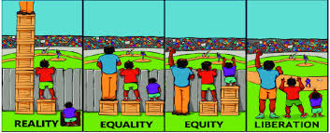
Steps to liberation

Slide 4
Disadvantaged Communities
DACAG adopted definition in the Energy Equity Indicators tool, and advocates for equitable programming to reach the following (including community residents, workers, and businesses):
◆CalEnviroScreen, as defined by Cal EPA,
◆Tribal Lands,
◆Census tracts with area median household income/state median income, less than 80%, and
◆Households with median household income less than 80% of Area Median Income (AMI).
https://www.cpuc.ca.gov/uploadedFiles/CPUCWebsite/Content/UtilitiesIndustries/Energy/EnergyPrograms/Infrastructure/DC/DAC%20AG%20Equity%20Framework%20(Revised).pdf

Slide 5
DACAG Equity Framework
Focuses on 5 key areas:
1) Health & Safety
2) Access & Education
3) Financial Benefits
4) Economic Development
5) Consumer Protection

Slide 6
IDEA Initiative
Inclusion Diversity Equity Access
Noemí Gallardo
Carousel Gore
Darcie Houck
Courtney Smith

Slide 7

IDEA Initiative
  IDEA-In
IDEA-Ex
  Focus: Internal-facing
  Purpose: Create welcoming workforce environment
  Facilitation: Carousel & Courtney
  Operations: Agency-wide task force identifies and prioritizes action – for workforce by the workforce
  Focus: External-facing
  Purpose: Increase benefits for and participation of stakeholders and communities
  Facilitation: Noemi & Darcie
  Operations: Leadership develops strategy for programmatic action

Slide 8
IDEA-In(ternal)
Convenings
Multiple Task Force convenings
100+ attendees, robust discussion
5 Subgroups with Co-chairs:
  Hiring/Recruitment
  Transforming Culture
  Staff Development/Promotions
  Access/Resources
  Tracking Progress/Accountability

Slide 9
IDEA-Ex Planning Considerations
Develop strategy and roadmap
  Define key terms: “energy equity communities”
  Adopt baseline equity framework as lens for efforts
  Develop metrics for accountability and evaluation
  Determine action (priorities & goals)
    Community needs assessment/listening session
    Technical assistance

Slide 10
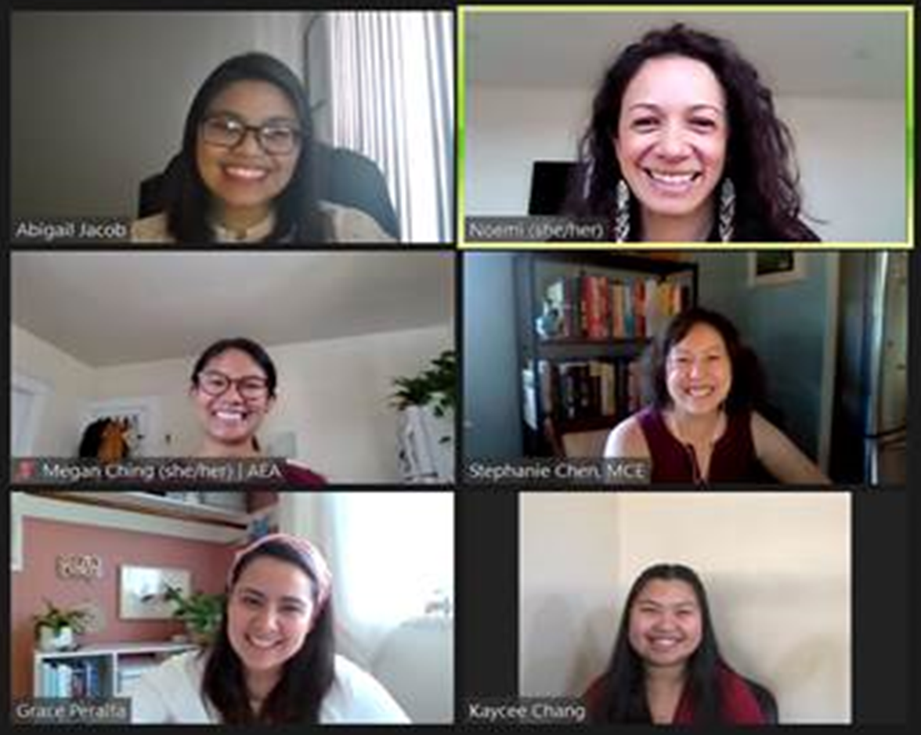
Additional Equity Efforts
DACAG Ambassador program
Energy Equity Toolkit
Energy Equity webpage
Energy Equity Summit

Slide 11
2015 Resolution
Diversity Policy Statement = Supplier Diversity and Energy Equity
“…it is the policy of the [CEC]…to optimize fair and equal opportunities for small businesses, and women-, disabled veteran-, minority-and LGBT -owned businesses, as well as economically disadvantaged and underserved communities, to participate in and benefit from [CEC] programs..”
        Annual Diversity Report
2015 Resolution: https://www.energy.ca.gov/sites/default/files/2020-07/diversity_policy_resolution_ada.pdf

Slide 12
Objectives & Metrics
Increase Participation
Increase Benefits
Metrics
Metrics
Outreach
Engagement
Funding
Workforce Dev.
Events
Networks
Panels
Input
Grants
Loans
Contracts
Training
Jobs
Careers

Slide 13
Commitment to Tribes
“…the [CEC] recognizes the importance of Tribal Consultation in energy planning and policy and is committed to ensuring California Native American tribes have the opportunity to participate in and benefit from [CEC] programs…”
Consultation Policy: https://www.energy.ca.gov/sites/default/files/2020-01/2017CEC_Tribal_Consultation_Policy_ADA.pdf

Slide 14
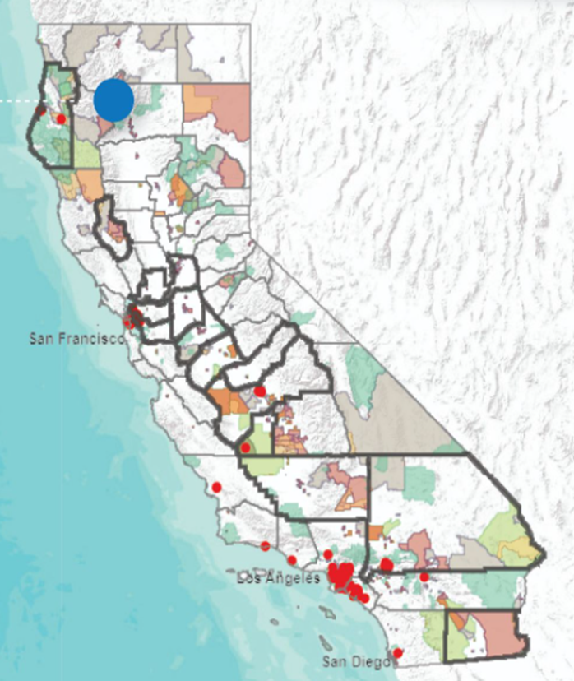
Prior Efforts
SB 350: Clean Energy and Pollution Reduction Act of 2015
https://leginfo.legislature.ca.gov/faces/billTextClient.xhtml?bill_id=201520160SB350
Retail sales of renewable electricity to 50% by 2030
Double energy efficiency savings in electricity and natural gas by 2030
Mandated report exploring barriers to and opportunities for expanding low-income customers’ access to energy efficiency, weatherization, and renewable energy investments.
DAC = Health and Safety Code Sec 39711 (CalEnviroScreen)

Slide 15
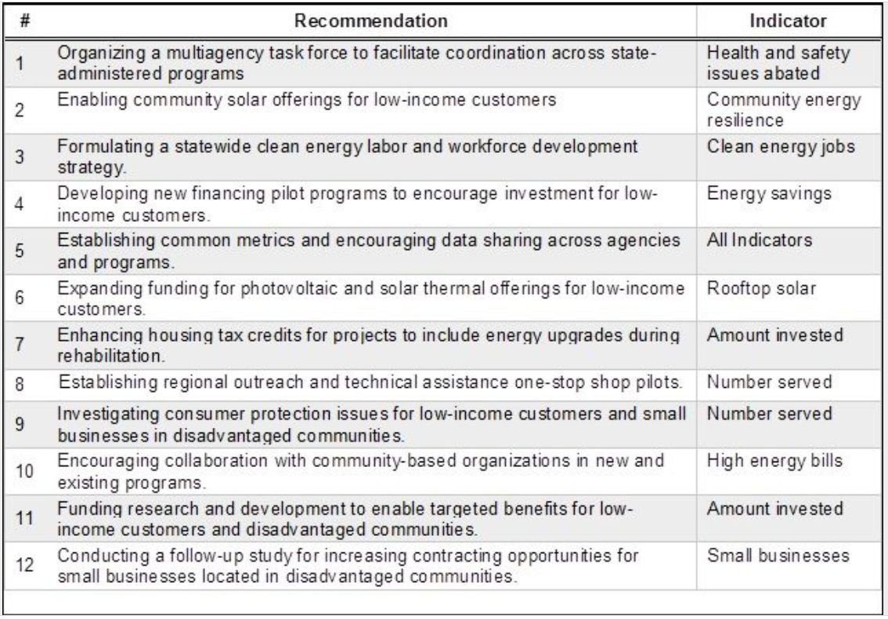
SB 350 Barriers Study

Slide 16
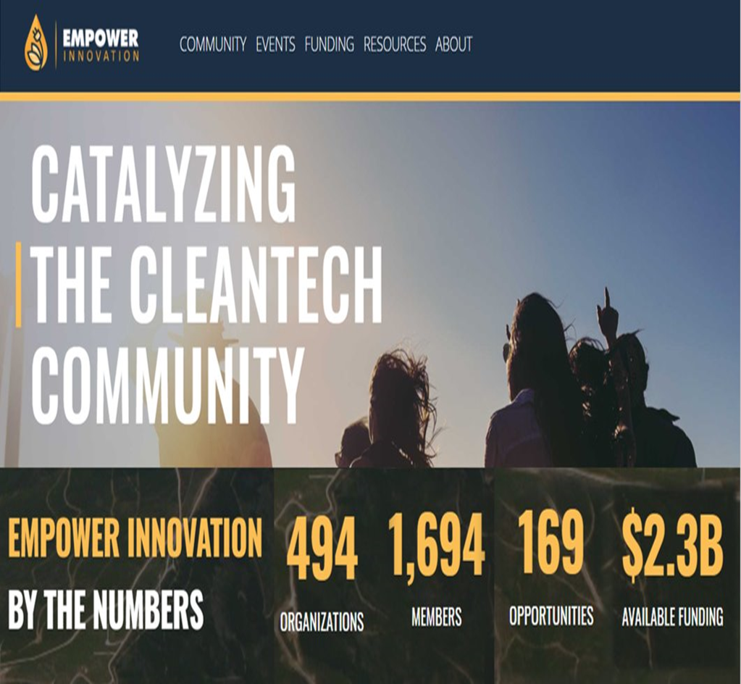
Current Efforts
AB 865 State Energy Resources Conservation and Development Commission (2015)
https://leginfo.legislature.ca.gov/faces/billNavClient.xhtml?bill_id=201520160AB865
Develop and implement an outreach program to inform certified women, minorities, disabled veterans, and LGBT businesses about CEC workshops, training, and funding opportunities.
Track diversity of contractors, loan recipients, and grant recipients.
https://www.empowerinnovation.net/

Slide 17
AB 523 EPIC Demonstration Requirements
AB 523: Electric Program Investment Charge - EPIC (2017)
https://leginfo.legislature.ca.gov/faces/billNavClient.xhtml?bill_id=201720180AB523
DAC = CalEnviroScreen top 25%
LIC = AB 1550 (has 2 categories not included in AB 523). Link to CARB’s AB 1550 mapping app: https://ww3.arb.ca.gov/cc/capandtrade/auctionproceeds/communityinvestments.htm

Slide 18
EPIC Demonstration Funding
As of 12/31/19, 65% of TDD funds invested to projects in disadvantaged and low-income communities
= $186 M

Slide 19
EPIC TD&D Projects in DACs and LICs

Slide 20
EPIC Scoring Criteria Change
Proposed Scoring Criteria | Maximum Points
8. Benefits to Disadvantaged/Low-Income Communities and Localized Health Impacts
8.1 Benefits to Disadvantaged/Low-Income Communities 8.2. Community Engagement Efforts 8.3. Localized Health Impacts 8.4. Technology Replicability 8.5. Project Support Letters | 15 10 15 5 5
Total Possible Points for criteria 8 (Minimum Passing Score for criteria 8 is 70% or 35.00) | 50
Total Possible Points for Proposal | 150

Slide 21




Community Based Organization Requirements
Has an office in the region and meets the demographic profile of the communities they serve
Has deployed projects and/or outreach efforts within the region
Employs staff specialized in and dedicated to – diversity, equity, inclusion, or is a 501(c)(3) non-profit
Have official mission and vision statements that expressly identifies serving DAC or LI communities

Slide 22
DAC Funding Opportunities
Total as of Oct 2020: $811 Million for DAC projects
Clean Energy Jobs Act, K-12 (Prop 39)
$419 Million
Food Production Investment Program (FPIP)
$88.9 Million
Local Government Challenge Grant (LGCG)
$7.85 Million
Geothermal Resources Development Account (GRDA)
$3.45 Million
New Solar Homes Partnership (NSHP)
$32.8 Million
Clean Transportation (ARFVTP)
$256 Million
Renewable Energy for Agriculture Program (REAP)
$2.97 Million

Slide 23
DAC Funding Opportunities
As of Oct 2020, percent each program allocated to DAC projects
28%
Clean Energy Jobs Act, K-12 (Prop 39)
76%
Food Production Investment Program (FPIP)
77%
Local Government Challenge Grant (LGCG)
19%
Geothermal Resources Development Account (GRDA)
14%
New Solar Homes Partnership (NSHP)
28%
Clean Transportation (ARFVTP)
31%
Renewable Energy for Agriculture Program (REAP)

Slide 24
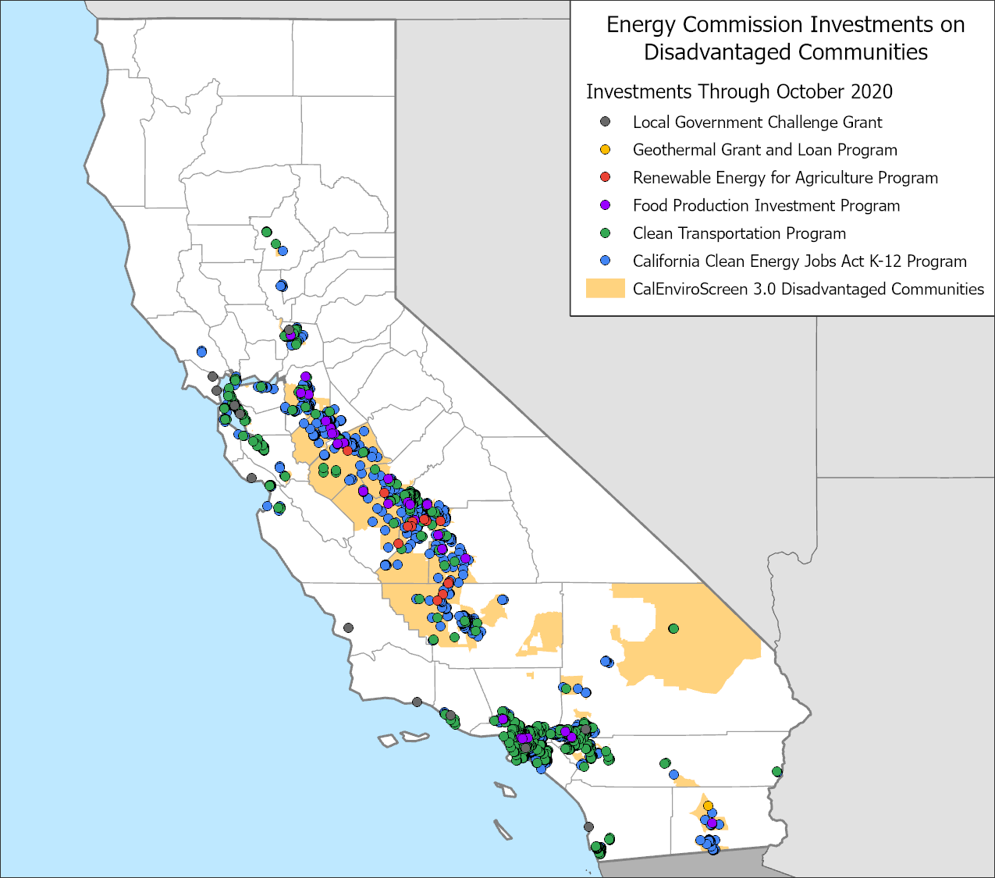
Map of Grant-funded Project Sites in DACs

Slide 25
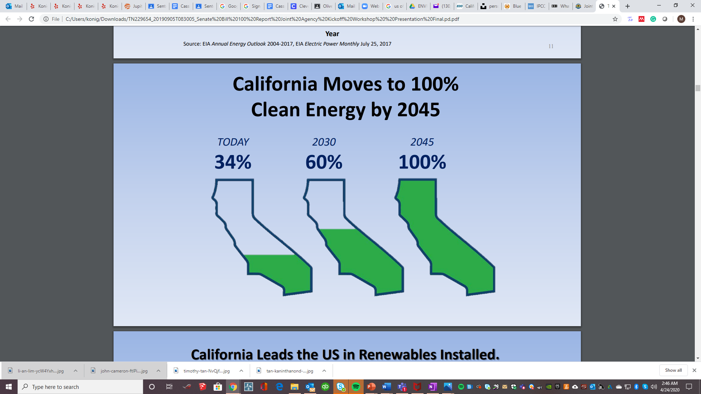
Current Efforts
SB 100 100% Clean Energy Act of 2017 (2018)
https://leginfo.legislature.ca.gov/faces/billTextClient.xhtml?bill_id=201720180SB100
Renewable energy and zero-carbon resources must supply 100% of electric retail sales to end-use customers by 2045.
Requires CEC, CPUC, and CARB to complete joint agency report evaluating 100% zero-carbon electricity policy.
Accelerates 50% mandate for clean renewable energy from 2030 to 2026 and establishes new RPS benchmark of 60% by 2030.
DAC = CalEnviroScreen top 25%

Slide 26
New Effort
AB 841 Healthy Schools, Healthy Air, Healthy Recovery Bill (9/30/2020)
https://leginfo.legislature.ca.gov/faces/billTextClient.xhtml?bill_id=201920200AB841
35% of electrification vehicle charging infrastructure investments must be made in underserved communities burdened by dangerous air pollution and poverty.
25% of projects funded by those programs be in underserved communities and those near freeways or industrial facilities.
(e) “Underserved community” means a community that meets one of the following criteria:
(1) Is a “disadvantaged community” as defined by subdivision (g) of Section 75005 of the Public Resources Code.
(2) “low-income communities” as defined by paragraph (2) of subdivision (d) of Section 39713 of Health and Safety Code.
(3) CalEnviroScreen top 25%
(4) At least 75% of public school students in project area are eligible to receive free or reduced-price meals under the National School Lunch Program.
(5) Is a community located on lands belonging to a federally recognized California Indian tribe.

Slide 27
Observations
Advanced equity even before formal commitments
Applies definitions provided in mandates/legislation - most frequent is CalEnviroScreen
Hasn’t adopted agency-wide equity framework
Meets objectives and has consistently exceeded compliance requirements
Exploring ways to measure impact and outcomes beyond monetary investment and location
Faces challenges including legislative constraints, constant new and multiple legislation demands/deadlines, limited resources, limited time

Slide 28
EQUITY RELATED: definitions and data at the CPUC
Kathleen Yip

Slide 29
Equity related definitions at the CPUC

Slide 30
HISTORY OF EQUITY DEFINITIONS AT THE CPUC
Some designations created before CalEnviroScreen​
  Example: EV charging infrastructure installation through NRG settlement used low-income census tracts identified by PUMA (U.S. Census) data (2013)​
  Example: MASH program determines eligibility by identifying homes that receive low-income housing tax credits, bonds, or grants​
Pursuant to SB 535, CalEnviroScreen was created to identify disadvantaged communities​
CPUC starting using CalEPA’s definition of top 25 percent most affected census tracts in CalEnviroScreen ​
Party comments and DACAG Equity Framework helped expand CPUC thinking on who are the target communities for CPUC programs
CPUC Environmental and Social Justice Action Plan adopted similar definition as DACAG Equity Framework

Slide 31
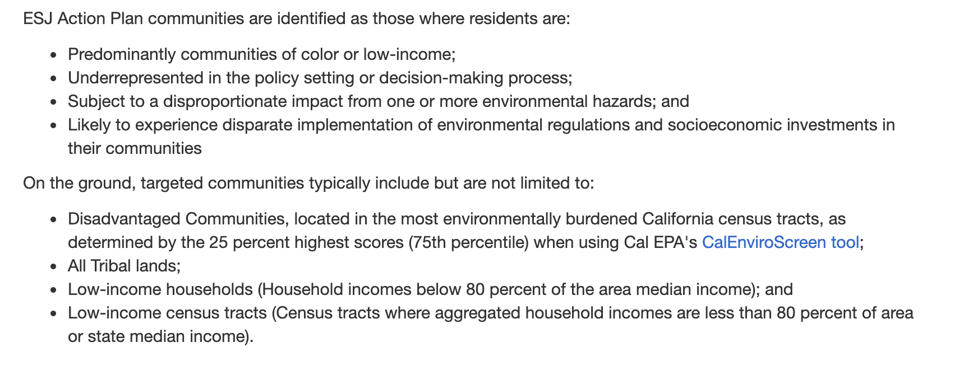
ENVIRONMENTAL AND SOCIAL JUSTICE COMMUNITIES DEFINITION AT THE CPUC​
Source: CPUC Environmental & Social Justice Action Plan (2019)

Slide 32
SELECTED EXAMPLES OF DISADVANTAGED COMMUNITIES DEFINITION AT THE CPUC

Slide 33

FEEDBACK ON DISADVANTAGED VULNERABLE COMMUNITIES DEFINITION IN
CLIMATE ADAPTATION PROCEEDING

Slide 34
EXAMPLE OF PARTY COMMENTS IN RESPONSE TO DVC DEFINITION IN CLIMATE ADAPTATION PROCEEDING
Some parties commented DVCs should be limited to <80% statewide median income
Some parties commented DVCS definition should be limited <60% statewide median income to prioritize communities that have the most significant adaptation issues because of income.
  “to create meaningful prioritization of limited climate adaptation actions and investments, the definition of low-income communities that are disadvantaged should reflect about 20% of state census tracts, which represents about 20% of the state population and is consistent with other legislature and studies regarding the most impacted low-income disadvantaged communities.” -Joint opening comments: CEJA, CBE, Leadership Counsel, and UC Berkeley

Slide 35
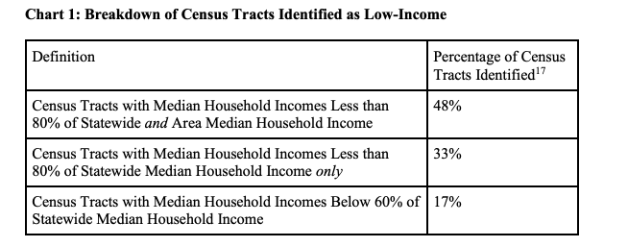
EXAMPLE OF PARTY COMMENTS IN RESPONSE TO DVC DEFINITION IN CLIMATE ADAPTATION PROCEEDING
Source: Joint Opening Comments from CEJA, CBE, Leadership Counsel,
and UC Berkeley on R.18-04-019 (2018)

Slide 36
ADOPTED DISADVANTAGED VULNERABLE COMMUNITY DEFINITION IN CLIMATE ADAPTATION PROCEEDING
Top 25% most affected census tracts as identified by CalEnviroScreen (CES), or score within the highest 5% of CES’ pollution burden, but does not receive an overall CES score
60% statewide median income
All tribal lands

Slide 37
QUESTIONS FOR DACAG ON DAC DEFINITION
How can we create a template-like definition that allows for modification of DAC definition to fit different needs?
What are data sources to identify vulnerable communities beyond CES?
How to identify tribal communities?

Slide 38
Data sources to identify vulnerable communities

Slide 39
WHAT ARE SOURCES TO IDENTIFY VULNERABLE COMMUNITIES BEYOND CALENVIROSCREEN?
CalEnviroScreen is used to identify communities most impacted by air pollution
Parties identified other tools like Cal-Adapt and CCHViz in the climate change adaptation proceeding
Gaps:
What are other resources to identify vulnerabilities that are not captured by CES – for purposes of wildfire, PSPS, climate adaptation, etc.
What are the right indicators to measure/track?

Slide 40
How to identify tribal communities

Slide 41
HOW TO IDENTIFY TRIBAL COMMUNITIES
Currently using “All tribal lands” in CPUC ESJ Action Plan definition
  Mostly using Bureau of Indian Affairs (BIA) data to identify federally recognized tribal lands; however, many tribes in California do not enjoy federal recognition status
Staff is exploring using California’s Native American Heritage Commission’s data to identify tribal communities
Gaps
  How do we identify/map tribal lands that are not federally recognized?
  What are the sources CPUC should be using to identify tribal communities?
  Should we explore using “all tribal communities” instead of, or in conjunction with, “all tribal lands”?

Slide 42
Next steps

Slide 43
TIMELINE OF PARALLEL PROCESSES
Environmental and Social Justice Action Plan CPUC-wide update
  Public workshop in late 2020/early 2021
  Plan update in 2021
AB 52: Tribal lands consultation policy
  Ongoing

Slide 44
OTHER GAPS FOR FUTURE DISCUSSIONS
How should we measure impact in DACs?
  What are the right indicators to measure/track?
  How do we measure impact in areas where data is less available? I.e. rural areas that are not captured in census data
  How should we use this data?
    How do we ensure we’re collecting data for a purpose, and not just to create a data repository that is never used.
    How should we use data to create transparency?

Slide 45
Questions and Discussion with DACAG

Slide 46
QUESTIONS FOR DACAG re DACs
What do you suggest as a template-like or baseline DAC definition that allows for flexibility to fit different needs?
What data sources do you suggest we use to identify beneficiaries beyond CalEnviroScreen?
What indicators to track, measure, and evaluate do you suggest?
What approaches do you suggest for us to identify gaps of unmet community needs?
What approaches do you suggest for us to inform/alert communities about funding and other opportunities?

Slide 47
QUESTIONS FOR DACAG re Tribes
What sources do you suggest we use to identify tribal communities?
How should we identify tribal lands that are not federally recognized?
What are your thoughts about using “all tribal communities” instead of, or in conjunction with, “all tribal lands”?
What are your thoughts about applying AB 1550’s additional ½ mile radius boundaries to tribal communities?

