Slide 1
Item3: CEC Building Decarbonization Overview
October 16, 2020
Michael J. Sokol
Deputy Director, Efficiency Division

Slide 2
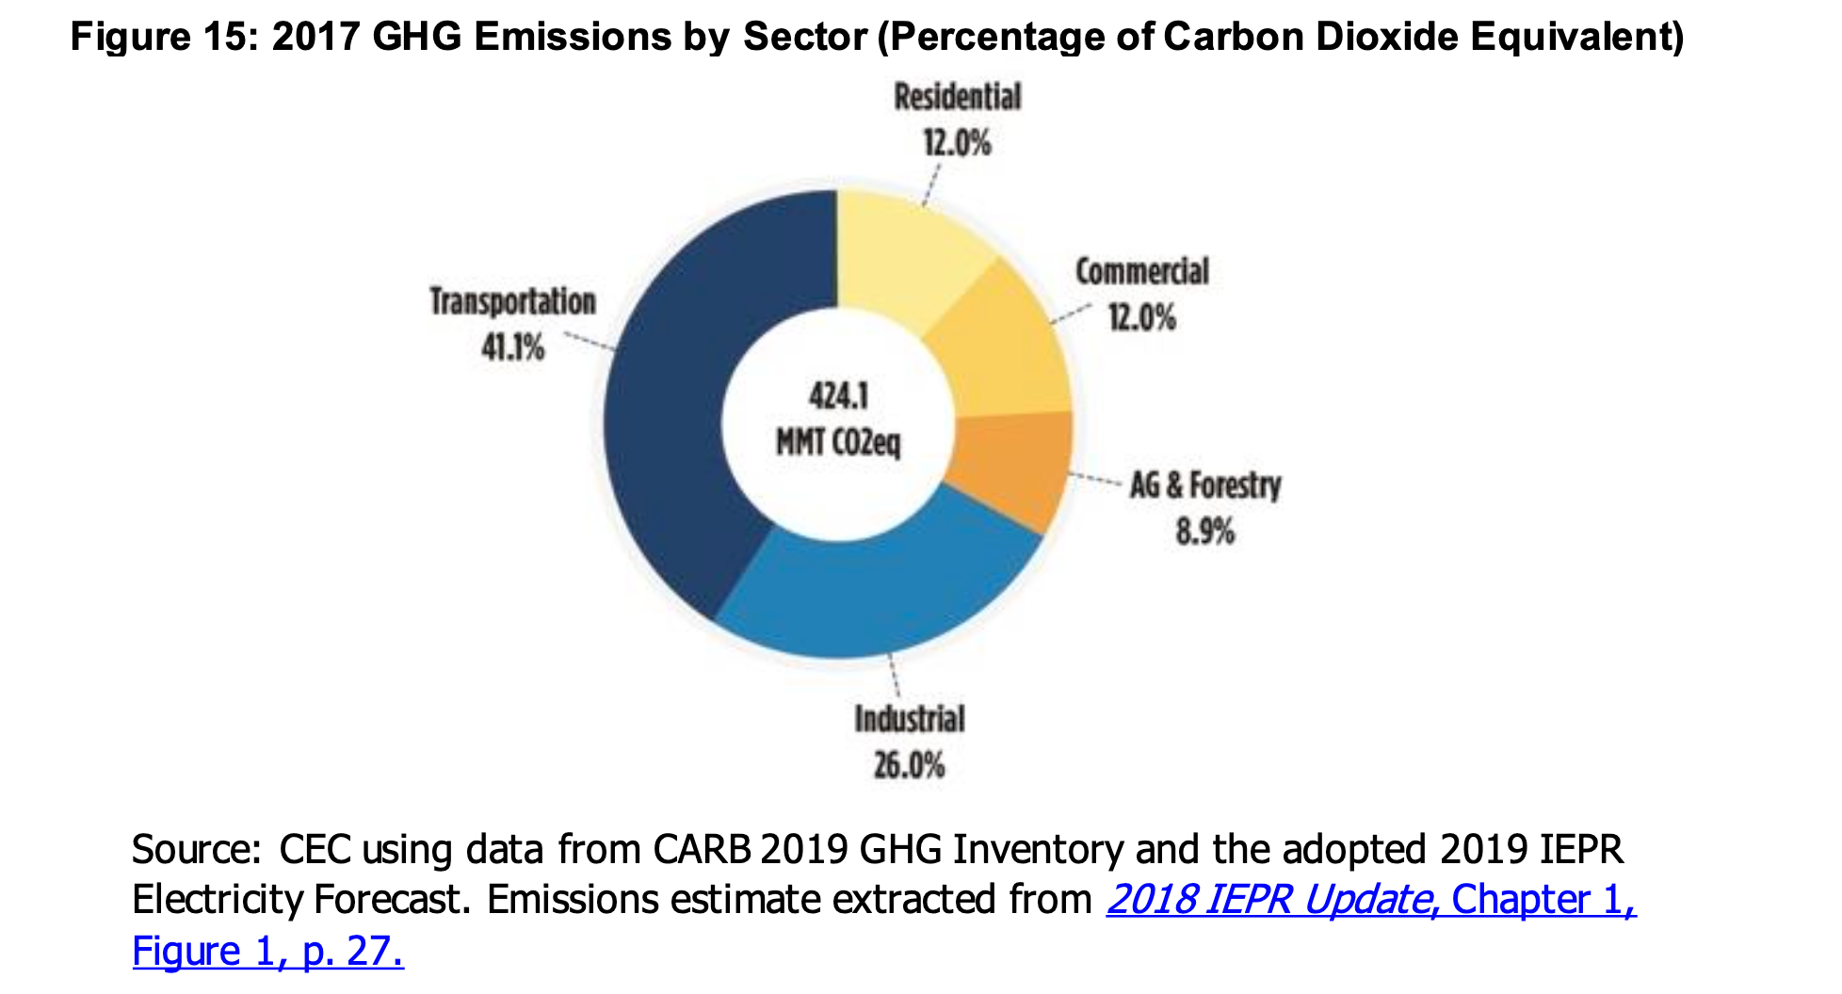
California’s Greenhouse Gas Emissions

Slide 3
CEC’s Key Building Decarbonization Proceedings
Assembly Bill 3232 – Building Decarbonization Assessment
Load Management Standards
Senate Bill 49 – Flexible Demand Appliance Standards
Senate Bill 1477 – Building Initiative for Low-Emissions Development (BUILD) program
2022 Building Energy Efficiency Standards
*Also a range of other CEC and other agency policies and proceedings related to building decarb that will not be covered in detail today

Slide 4
Assembly Bill 3232 Building Decarbonization Assessment
Primary question – How can California reduce GHG emissions in its commercial and residential buildings 40% below 1990 values by 2030?
  Strategies
  Studies and Pilot Programs
  Barriers and Impacts
  Findings
  Next Steps

Slide 5
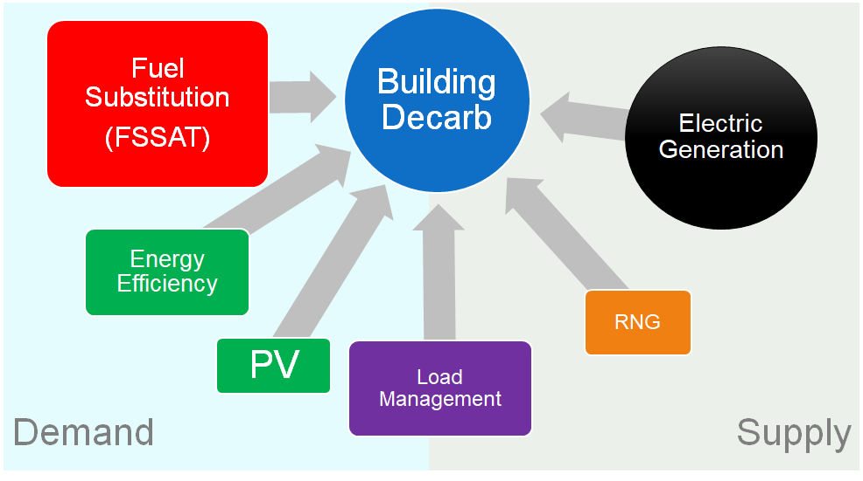
Building Decarbonization Strategies

Slide 6
AB 3232 Building Decarbonization Assessment Timeline
Workshop/Milestone | Date
Workshop: Building Decarbonization Assessment | December 4, 2019
Webinar: Fuel Substitution Scenario Analysis Tool | February 27, 2020
Webinar: Building Decarb Opps and Challenges | May 22, 2020
Webinar: Fuel Substitution Scenarios | June 9, 2020
Post: Draft Building Decarb Assessment | December 31, 2020
Webinar: Draft Building Decarb Assessment | January 2021
Post: Proposed Building Decarb Assessment | April 2021
Vote: CEC Business Meeting | April 2021
Deliver: Assessment to Legislature | June 1, 2021
2021 IEPR: Update on topic/issues | November 2021

Slide 7
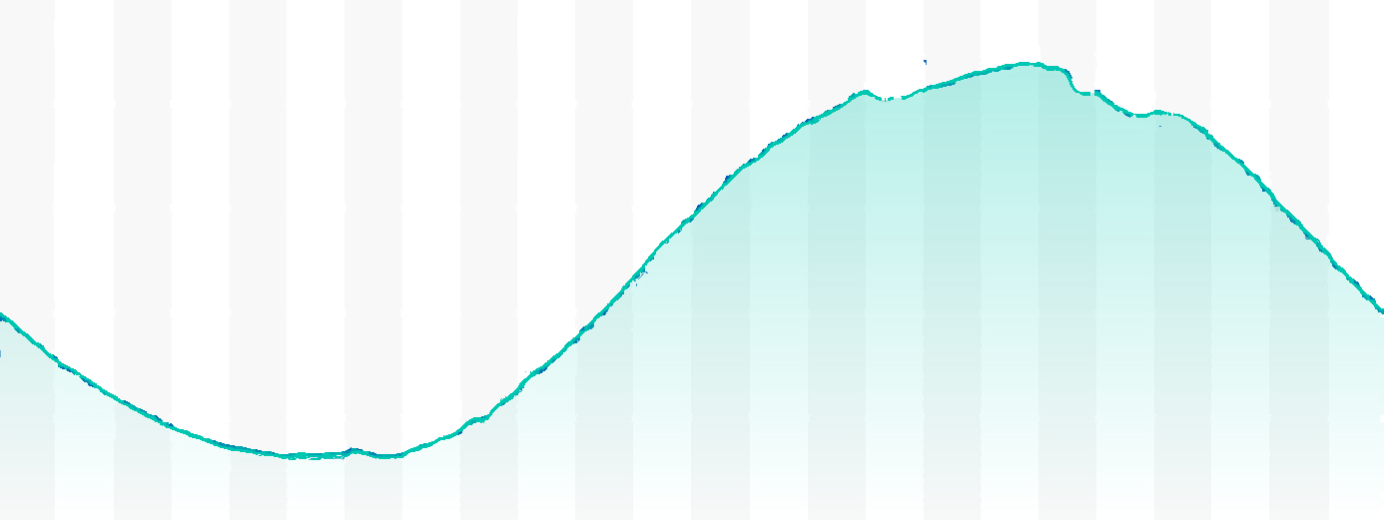
Load Management Standards
Utility Programs for Electrical Load Management
Consumer Protection
Voluntary & Automatic
Save Money & Reduce Impacts
Load management aims to automatically shift flexible electricity use without reducing customer quality of service.

Slide 8







Load Management Standards
Load Management Standards
Rate
Database
2019-2021 Rulemaking
In Progress
Load Serving Entities ¹
Rates
Rates + GHG
Rates + GHG
Rates + GHG
DR signals
Tariff ID
Aggregators
& Automation Manufacturers
DR signals
Electric Vehicle Charging
Batteries
Electric Water Heating
Smart Plugs
Space Heating & Cooling
DR Devices
Rates
Responsive Devices
1. Load Serving Entities include IOUs, POUs, CCAs, Etc.

Slide 9

Load Management Standards
LMS 19-OIR-01 Rulemaking Schedule
2021 JAN: Publish Draft Staff Report
2021 FEB: Workshop on Draft Staff Report
2021 MAY: Final Report
2021 JUNE: Formal Rulemaking
2021 Q4: Adopt Final Rules

Slide 10
Senate Bill 49 Requirements
Requires CEC to develop Flexible Demand Appliance Standards, in coordination with LSEs and CPUC
  Cost-effective, including GHG and grid benefits
  Requires consumer consent
  Open source and user-friendly
  Cybersecurity
Report on progress in the Integrated Energy Policy Report

Slide 11
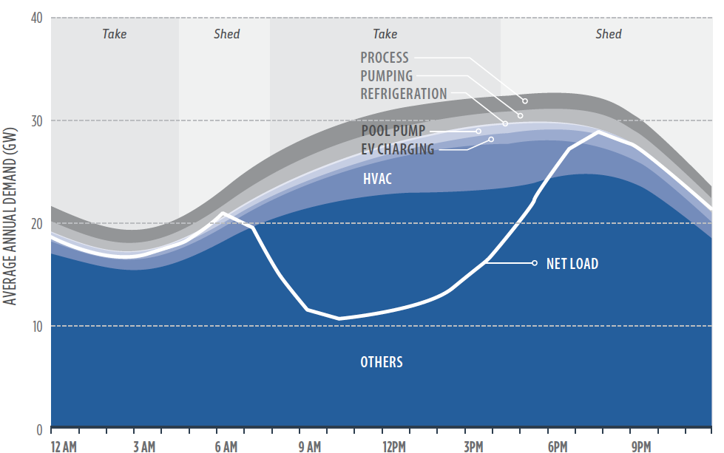
Appliance Load Shift Potential
Source: Final Report, CPUC working group on “Load Shift” January 31, 2019

Slide 12
Benefits to California
  Support efforts to decarbonize California's energy and building sectors
  Improve grid reliability and emergency response capability
  Make utility bill savings available to all consumers
  Reduce future electricity sector infrastructure costs

Slide 13
Steps Towards New Standards
Order Instituting Rulemaking October 2020
Invitation to Participate Q4 2020
Public Workshop Q4 2020
Draft Staff Report Q2 2021
Initiate Formal Rulemaking Q3 2021
Initial Standards Adopted Q2 2022
* All dates are tentative based on results of research and pre-rulemaking activities

Slide 14
Senate Bill 1477 Summary
 | BUILD | TECH
Goal | Promote GHG emission reductions and bill savings in new low-income residential buildings | Statewide market development for low-emission space and water heating equipment for new and existing residential buildings
Administrator | CEC | 3rd Party Implementer
Budget | $80 million | $120 million
LI/DAC Component | ≥ $60 million for new low-income residential housing Projects are offered technical assistance Implement an outreach plan to encourage applicants | Implement outreach strategies for hard-to-reach customers
Evaluation Metrics | No. low emission systems installed Projected utility bill savings $/MT avoided GHG emissions | Market share for eligible technology Projected utility bill savings $/MT avoided GHG emissions

Slide 15
SB 1477 Key Milestones
Date | Milestone
9/13/2018 | SB 1477 approved by Governor
1/31/2019 | CPUC instituted building decarb rulemaking (R.19-01-011)
4/8/2019 | Joint agency workshop, Los Angeles
7/16/2019 | CPUC files SB 1477 Joint Staff Proposal
7/30/2019 | Public workshop, San Francisco
2/12/2020 | CPUC Proposed Decision establishing pilot programs
3/26/2020 | CPUC adopted Decision establishing framework and requirements (D.20-03-027)
6/15/2020 | Joint agency public workshop on BUILD Implementation Plan, virtual
7/24/2020 | CEC staff submitted the initial BUILD Implementation Plan to CPUC
9/29/2020 | Updated BUILD Implementation Plan submitted to CPUC

Slide 16
SB 1477 Next Steps
Date | Milestone
Q4 2020 | CEC issue RFP for technical assistance provider
Q1 2021 | CEC publish draft BUILD Program guidelines
Q2 2021 | CPUC finalize contract with TECH Implementer and BUILD/TECH Evaluator
Q3 2021 | CEC publish final BUILD Program guidelines
Q3 2021 | Launch TECH Initiative
Q3 2021 | Launch BUILD Program

Slide 17
2022 Building Energy Efficiency Standards - Highlights
Multifamily Restructuring to set a foundation for improved compliance, simplification, and setting more appropriate requirements for the multifamily industry
Contributing to California's energy and climate goals through support of electric construction to reduce greenhouse gas emissions, grid integration to support the transition to renewables, and innovative measures that move beyond keeping up with model codes
Examining incentive concerns or needs related to Controlled Environment Horticulture, controls for building systems measures, and software and modeling challenges.
Enhancing electric and PV measures to ensure buildings are best equipped to benefit from renewable energy resources.

Slide 18
2022 Goals for Decarbonization & PV
Building Electrification Baselines For:
  Low-rise Residential Buildings
  High-rise Multifamily
  Selected Nonresidential Occupancies
PV & Battery Storage Requirements For:
  High-rise Multifamily
  Selected Nonresidential Occupancies
Support development of local reach codes moving toward decarbonization

Slide 19
Proposed Measures Connected to Decarbonization
Nonresidential (6 measures)
  Demand Response Lighting Systems
  Thermal Energy Storage Systems
  Heat Pump Water Heaters (HPWH) with Load Management Capabilities
  Communications Protocol Clean Up
  HVAC Controls – Dedicated Outdoor Air Systems
  Drainwater Heat Recovery
Multifamily (3)
  Central HPWH
  Ducted Heat Pump
  Appliances and Plug Loads MF
Single Family (9)
  Alterations and Additions: prohibit electric resistance water heating
  Alterations and Additions: prohibit electric resistance space heating
  Alterations and Additions: Compliance Options for Alterations
  Alterations and Additions: Compliance Options
  Battery Storage Systems
  HVAC Load shifting
  HPWH Load shifting
  Home Energy Management
  Variable Capacity HVAC Compliance Software Revisions

Slide 20
2022 Building Standards Update Schedule
2022 STANDARDS UPDATE SCHEDULE
DATE | MILESTONES
November 2018 - November 2019 | Updated Weather Files
November 2018-December 2019 | Metric Development
November 2018-July 2019 | Measures Identified and approval
August 2019 to October 2020 | Stakeholder meeting/workshop & final staff workshop
August 2020-October 2020 | CASE Reports submitted to the CEC
February 2021 | 45-day Language Hearings
July 2021 | Adoption of 2022 Standards at a Business Meeting
July 2021 to November 2021 | Staff work on Software, Compliance Manuals, Electronic Documents Available to Industry
December 2021 | Approval of the Manuals
December 2021 | Approval of the Energy Standards at CBSC
January 2022 | Software, Compliance Manuals, Electronic Documents Available to Industry
January 1, 2023 | Effective Date

Slide 21
For More Information
Proceeding | Website | Primary Contact
AB 3232 Building Decarbonization Assessment | 19-DECARB-01 Docket | Jennifer Nelson Jennifer.Nelson@energy.ca.gov
Load Management Standards | 2020 Load Management Rulemaking | Gabriel Taylor Gabriel.Taylor@energy.ca.gov
Senate Bill 49 | Flexible Demand Appliances | Pierre DuVair Pierre.DuVair@energy.ca.gov
Building Energy Efficiency Standards | 2022 Building Energy Efficiency Standards | Payam Bozorgchami Payam.Bozorgchami@energy.ca.gov
SB 1477 BUILD | Building Initiative for Low-Emissions Development Program | Jordan Scavo Jordan.Scavo@energy.ca.gov

