Slide 1
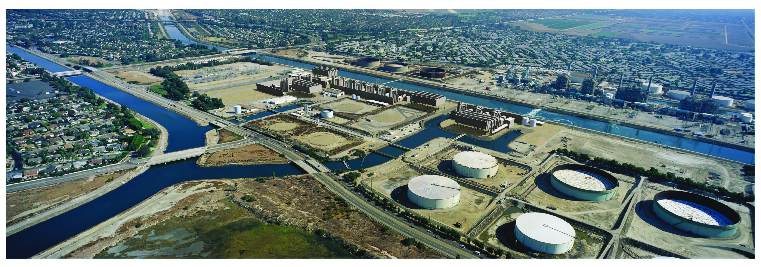
CALIFORNIA ENERGY COMMISSION
Site Visit, Environmental Scoping Meeting and Informational Hearing
ALAMITOS ENERGY CENTER 13-AFC-01
Notes:
HO slide

Slide 2
Purpose of Today’s Proceedings
Provide information about the proposed power plant,
To describe the Commission’s process in reviewing the Application,
To provide information about opportunities for the public to participate in this process and to comment on any
aspect of the proposed project,
To inform the Committee, the parties, and the community about the project, its progress to date in the application process, and perceived issues that need resolution, and
To meet and confer about the project schedule.
Notes:
HO slide

Slide 3
Today’s Agenda
3:30 p.m. Site Visit—bus tour to site
4:30 p.m. Presentations and Discussion
        Commissioners’ Opening Remarks
        Hearing Adviser — Energy Commission’s Role
        Applicant — Project Description
        Energy Commission Staff — Environmental Review Process
        Staff’s Issues Identification Report
        Staff’s Proposed Schedule for the Licensing Process
        Public Adviser’s Office — Opportunities for Public Participation
5:30 p.m. Public Questions and Comments
Notes:
HO slide
Board busses to HBEP project site

Slide 4
Energy Commission’s Role
Energy Commission has permitting authority over thermal power plants that are 50 megawatts or greater.
The Commission is the lead state agency for California Environmental Quality Act (CEQA) review and ongoing compliance.
The Commission Chairman has appointed Commissioners Douglas (Presiding Committee Member) and Scott (Associate Committee Member) to oversee the licensing process for this project.
Following staff review and evidentiary hearings, the Committee will issue a Presiding Member’s Proposed Decision (PMPD) that makes a recommendation to the full Commission to approve or deny the proposed project.
Notes:
HO slide

Slide 5
Ex Parte Rule
All decisions made in this case will be made solely on evidence contained in the public record.
No off-the-record contacts concerning substantive matters are permitted to take place between interested parties and the Commissioners, their advisors, this Committee, or the Hearing Officer.
Notes:
HO slide

Slide 6
Ex Parte Rule
Contacts between interested parties and the members of the Committee regarding any substantive matter must occur in a public forum or in a writing distributed to all the parties and made available to the public.
Purpose: to provide full disclosure to all participants of any information that may be used as a basis for the future Decision on this project.
Notes:
HO slide

Slide 7
Ex Parte Rule
Energy Commission staff is an independent party in the proceeding. Staff will prepare an independent evaluation of the environmental, engineering, and public health/safety aspects of the proposed project.
Commission Staff will hold public workshops at locations near the site or at the Energy Commission in Sacramento. These workshops provide additional opportunities for the parties and governmental agencies to discuss substantive issues with the public.
Notes:
HO slide

Slide 8
Public Participation
Public participation is encouraged!
Intervene as early as possible to ensure adequate and effective participation.

Slide 9
Pause for Applicant’s Presentation
Notes:
AES presentation

Slide 10
Overview of Licensing Process
1. Data Adequacy
  Minimum requirements to accept application
2. Staff Discovery and Analyses
  Issues Identification
  Data Requests/Discovery-180 days
  Public Workshops
  Preliminary Staff Assessment and public comment
  Final Staff Assessment
3. Committee Evidentiary Hearing and Decision
  Evidentiary Hearings on FSA and other information
  Presiding Member’s Proposed Decision (PMPD) and public comments
  PMPD hearing and Commission decision
Notes:
Good afternoon, I’m Felicia Miller, the California Energy Commission’s project manager for the Huntington Beach Energy Project.
My job is to facilitate the Huntington Beach Energy Project through the Energy Commission’s environmental review and certification process and this presentation is an overview of that process.
There are three phases in the Commission’s licensing process:
Data Adequacy - Discovery and Analysis - Committee Evidentiary Hearing & Decision
In the data adequacy phase, staff reviews the application to determine if it meets the minimum requirements for our technical review. When the application is accepted as complete, the Discovery & Analysis Stage begins.
During the Discovery & Analysis Stage activities take place to help staff acquire the required information they need in order to complete their analysis. Staff holds public workshops to discuss project issues. Staff then publishes two environmental documents: the Preliminary and Final Staff Assessments – also known as a PSA and an FSA.
After the FSA is published, the Committee will begin Evidentiary Hearings that will include formal testimony from all participants in our process. The Committee will produce the Presiding Member’s Proposed Decision or PMPD, which is a recommendation on the proposed project. The PMPD will go before the full Commission for a final decision on permitting the project.

Slide 11
Discovery and Analysis Process
Determine if the project proposal (AFC) complies with Laws, Ordinances, Regulations, Standards (LORS)
Conduct engineering and environmental analysis
  identify issues;
  identify environmental impacts and propose mitigation measures;
  evaluate project alternatives and
  recommend conditions of certification.
Facilitate public and agency participation
Staff products: Preliminary Staff Assessment (PSA) and Final Staff Assessment (FSA)
Make recommendations to the Committee
FSA will be staffs testimony
Notes:
During the Discovery and Analysis Process, staff analysis is dependent upon input from the applicant, agencies, formal intervenors, and the public. The Public Advisor’s office can provide assistance to intervenors and the public on how to participate in the overall Siting and permitting process for the project.
Staff’s Discovery and Analysis process examines the project application to determine if the project complies with all Laws, Ordinances, Regulations and Standards – commonly known as LORS.
Staff conducts independent engineering and environmental analysis of the project. This includes identifying issues, evaluating a reasonable range of alternatives, including the impacts of a No Project Alternative in comparison with the environmental effects of the proposed project; and identifies measures that could mitigate or reduce any potentially significant impacts. Staff also recommends Conditions of Certification that would govern development and operation of the power plant.
During this process, staff facilitates public and agency participation in workshops, completes their analysis and produces a staff assessment which makes a recommendation to the Committee.

Slide 12
Local, State and Federal Coordination
Energy Commission staff work closely with local, state and other federal agencies, for example:
  Local: City of Long Beach
  Regional: Los Angles County, South Coast Air Quality Management District , Regional Water Quality Control Board
  State: Department of Fish and Game, Coastal Commission, State Parks, Cal ISO, Department of Toxic Substances Control
  Federal: Environmental Protection Agency, Fish and Wildlife Service
Notes:
Staff’s analysis and input to the Committee’s final decision requires that staff seek input from agencies at the local, state and federal levels.
Staff’s participation with these agencies assists us in identifying issues, environmental impacts and appropriate mitigation measures.

Slide 13
Evidentiary Hearing & Decision Process
Committee conducts hearings to create evidentiary record
Issues Presiding Member’s Proposed Decision (PMPD). The PMPD contains findings relating to:
    Environmental impacts, public health, engineering
    Project’s compliance with LORS
    Recommends conditions of certification
    Recommends whether or not to approve the project
Full Commission issues a Final Decision
Appeals: Reconsideration by Commission; California Supreme Court
Energy Commission monitors compliance with all conditions of certification, through constructions the life of the project, and closure
Notes:
RR slide

Slide 14
Staff’s Issues Identification Report
Purpose
  Inform participants of potentially significant issues staff believes it will encounter;
  Provides an early focus on important topics;
  The Issues Identification Report is not limiting. Staff, agencies and other stakeholders may identify additional significant issues going forward.
Criteria
  Significant impacts that might result from the project that may be difficult to mitigate
  The project as proposed might not comply with applicable laws, ordinances, regulations or standards (LORS)
  Conflicts might arise between the parties about the appropriate findings or conditions of certification
  Issues that might delay the 12-month siting process
Notes:
Early in the process, Staff develops the Issues Identification Report. This report was docketed and issued on August 31st.
The purpose of the report is to inform the applicant, project participants and the Committee of potential issues staff finds relating to the project.
In addition, the Issues ID Report provides focus on the important topics that may affect the project and staff’s analysis of the project.
The criteria staff uses for determining whether something is identified as an issue include:
The potential for any significant impacts that might be difficult to mitigate
Non-compliance with laws, ordinances, regulations, and standards
- Or if there is a conflict that could affect the schedule.

Slide 15
Staff’s Potential Issue Areas
    Energy Commission staff has evaluated the AFC and has found no potential major issues at this time. The Committee and all interested parties should be aware that this report may not include all of the significant issues that may arise during the case, since discovery is not yet complete and other parties have not had an opportunity to identify their concerns.
15
Notes:
For the purpose of this report, staff has identified the following issues:
Alternatives
Transmission System Engineering
Waste Management
California Coastal Commission Issues

Slide 16
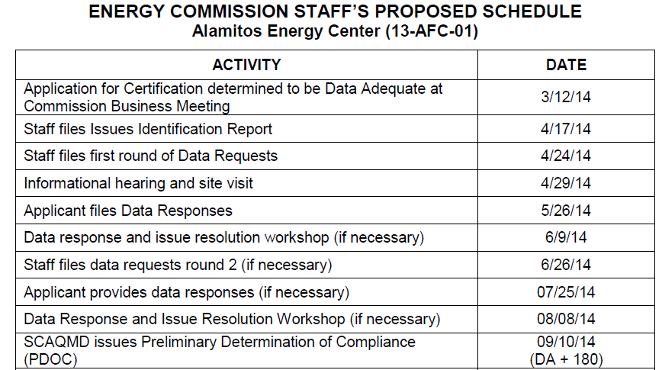
Staff’s Proposed Schedule
ALAMITOS ENERGY CENTER (13-AFC-01)
Notes:
Staff prepared and submitted a proposed schedule on August 31.
The proposed schedule is subject to several external factors including:
- staff’s ability to meet schedule deadlines
- the applicant’s timely response to information requests
- required actions or comments by associated agencies
- resolution of the identified issues
The Committee will review this schedule and issue a Scheduling Order, usually several weeks after the Informational Hearing and Site Visit which will include the official project schedule and additional instructions or comments.

Slide 17
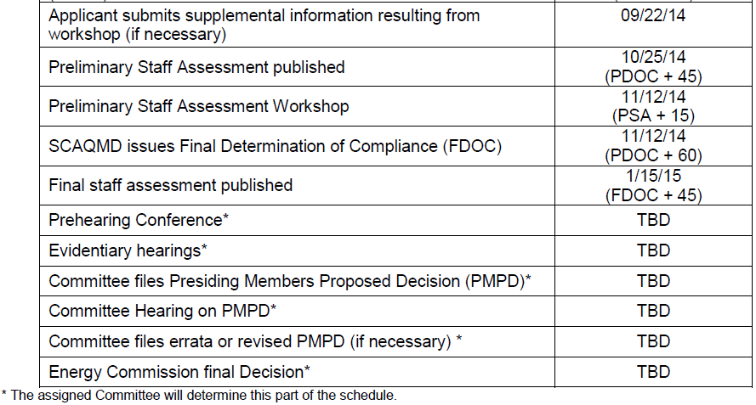
Staff’s Proposed Schedule

Slide 18
Post-Licensing
Project Compliance Oversight
  If the project is approved:
  The Compliance phase would apply during construction, operation & decommissioning
  Purpose: To assure compliance with all Conditions of Certification, applicable LORS and building codes
  Compliance Project Manager (CPM) – provides oversight of construction and operation.
Notes:
If the project has been granted a license by the Energy Commission, the project moves into Post-Licensing activities with oversight by the Compliance Project Manager at the Energy Commission.
Most projects include a number of conditions of certification that must be met before ground-breaking activity occurs, and during construction, operation and decommissioning of the project.
It is the responsibility of the Compliance Project Manager to work closely with the applicant to meet these conditions of certification once the project has been approved.
The Compliance Project Manager also oversees the work of the Commission’s delegate Chief Building Official, who approves plans and inspects all project construction.

Slide 19
Alamitos
Docket No. 13-AFC-01
Blake Roberts
Assistant Public Adviser
April 29, 2014

Slide 20

The Public Adviser is an independently appointed attorney who:
Helps the public understand the process
Recommends the best way to be involved
Assists in successful participation in proceedings
Notes:
Three main responsibilities
PAO assists in successful participation through making comments (blue cards), translation services, and outreach to different groups. PAO does not mean legal advocacy.

Slide 21

Outreach for Site Visit, Environmental Scoping Meeting, and Informational Hearing
Who: Local city and county officials, tribal officials and members, schools, hospitals, non-profit groups and community organizations, property owners, public members who have contacted our office
How: Paid local newspaper advertisement, local libraries, local TV and radio, mailing lists, email blasts, informational meetings

Slide 22


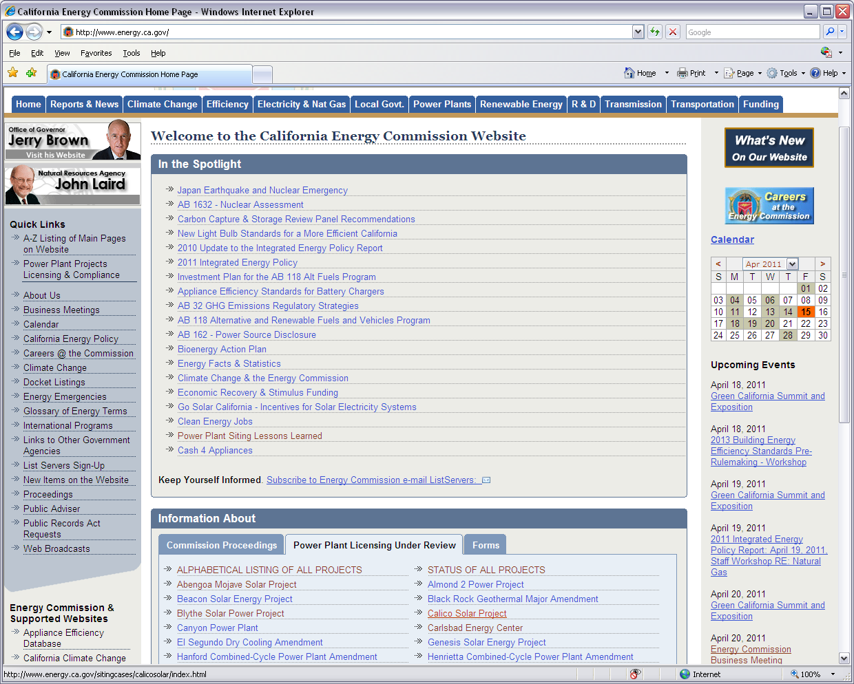
At the Commission
First Level – Public Comments (Informal Participation)
Verbal comments at public meetings through Blue Cards
Electronic comments through Commission e-filing system
Written comments to the Commission Dockets Unit:
a) Hand deliver to the Public Adviser or representative
b) Dockets Unit
California Energy Commission
1516 Ninth Street
Sacramento, CA 95814
www.energy.ca.gov

Slide 23
At the Commission
DOES YOUR VOICE MATTER?
ABSOLUTELY!
Public comments are considered by the Commissioners
Public comments help inform the Commissioners, staff, and interested parties
Public comments are necessary
Public comments are not considered evidence but are part of the official record
www.energy.ca.gov

Slide 24
Second Level – Intervening (Formal Participation)
An Intervenor is a party to the proceeding
Anyone may file a Petition to Intervene
You do not have to be or have an attorney to intervene
The PAO can provide a sample Petition to Intervene
Petition is considered by the assigned Committee; determination within 30 days

Slide 25

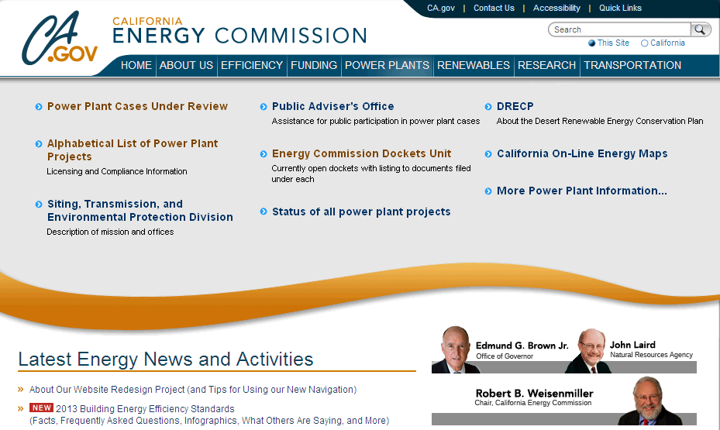
www.energy.ca.gov

Slide 26
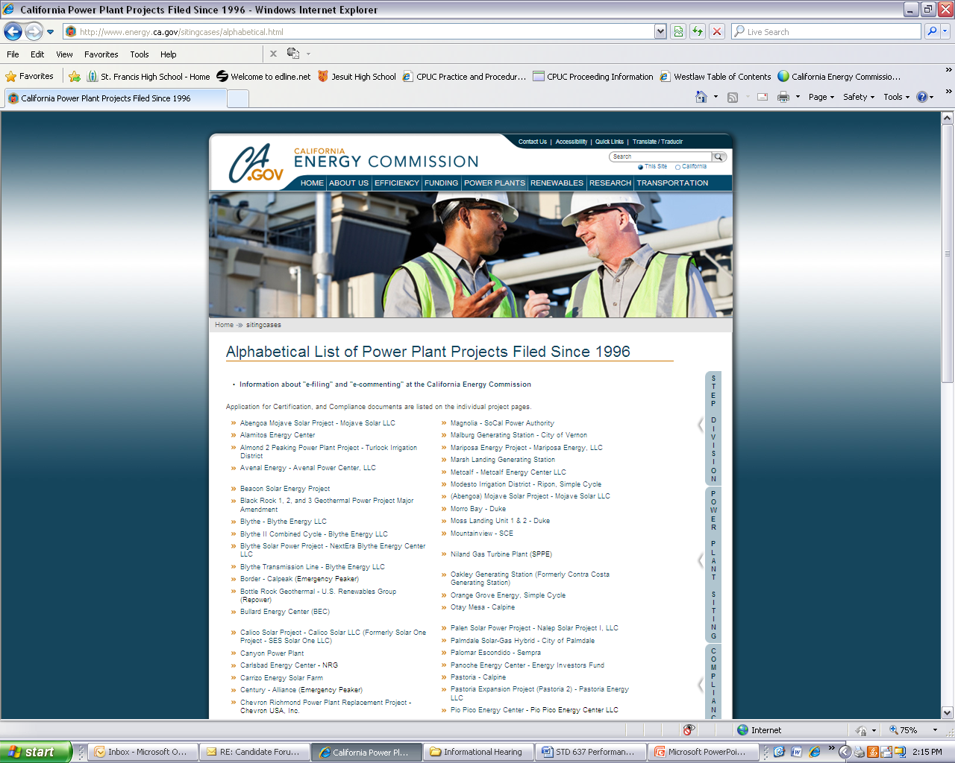

Slide 27
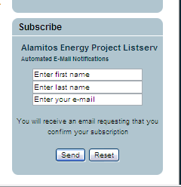

  Things To Do
Sign up for Alamitos listserv: www.energy.ca.gov/listservers
Submit written comments:
Provide oral comments
Attend public project events
  In person or via WebEx or conference call
  Non-English speakers welcome
  Special accommodations for persons with disabilities:
  Lourdes Quiroz, (916) 654-5146, lou.quiroz@energy.ca.gov

Slide 28

Alana Mathews, Public Adviser
Phone (916) 654-4489
Toll Free (800) 822-6228
Fax (916) 654-4493
Mailing 1516 Ninth St, MS-12
Sacramento CA 95814-2950
Email publicadviser@energy.ca.gov
Website www.energy.ca.gov/public_adviser

Slide 29
Energy Commission Contacts
Committee
  Commissioner, Karen Douglas, Presiding Member
  Commissioner, Janea A. Scott, Associate Member
Hearing Officer
  Ken Celli, Commission’s Hearing Officer
    (916) 654-3893, e-mail: ken.celli@energy.ca.gov
Commission Staff
  Keith Winstead Project Manager
    (916) 654-4640 e-mail: keith.winstead@energy.ca.gov
Public Adviser’s Office
  Alana Mathews
    (916) 653-5898 or (800) 822-6228
    e-mail: PublicAdviser@energy. ca.gov
Notes:
PAO slide

Slide 30
Public Participation and Sources of Information
Open Public Process
  Workshops/Hearings are noticed at least 10 days in advance
  Mailing lists
  List Server: www.energy.ca.gov/listservers
The Application for Certification is available for public review at the following libraries:
  Long Beach Main Library, Los Alamitos-Rossmoor Library in Seal Beach, Long Beach Public Library in Los Altos, Brewitt Neighborhood Library in Anaheim, Bay Shore Library in Long Beach
All project documents are available for public review at:
  Energy Commission Web site: http://www.energy.ca.gov/sitingcases/alamitos/
  Dockets Unit at the Energy Commission
  1516 9th Street, MS - 4
  Sacramento, CA 95814-5512
Notes:
PAO slide

