Slide 1
SDG&E’s Demand Response Pilot Plan for Disadvantaged Communities Update
September 18th, 2020

Slide 2
SDG&E DAC Pilot – Synopsis
SDG&E’s DAC Pilot is broken into two parts: Part A. Battery Storage and Part B. Market Research/Outreach.
For Part A, SDG&E has contracted with experts in the operation and control of batteries to study the annualized economic benefits as well as maximizing demand response participation. The Boys and Girls Club (BGC) of National City was selected as the Battery Recipient for this pilot. The Boys and Girls Club is a non-profit commercial enterprise that provides services to the local community in which it is located and will receive a 60kWh battery for their participation in the Pilot.
For Part B, The pilot looks to quantify small business and residential customer responses to various types of messaging, assess current levels of energy awareness, barriers to program participation in demand response and make known available rebates and incentives for DR program participation. SDG&E has contracted with a local Diverse Business Enterprise marketing firm that has expertise in the local area to do our marketing research and outreach in the area. They will conduct customer surveys, outreach activities, data collection and analysis for the Pilot.

Slide 3
Boys and Girls Club – Implementation Stages
March 6th: Preliminary site walk through & initial battery site location.
March: Covid-19 – Stay at home orders, Public Offices and Businesses closed
May 15th : Covid-19 delayed second pre-contract walk through with contractors.
  June 16th: Revisit of post preliminary design: Alternative indoor site selected.
July 1st: Final layout approved by Boys and Girls Club
July 15th: Permit application submitted to the city of National City.
August: Battery Delivery and Assembly
Sept 1st: Permit approved and issued by city of National City.
Sept-Oct: Finalize Battery Installation and electrical connections, meters, city inspection and start up testing.
October: Go Live!

Slide 4
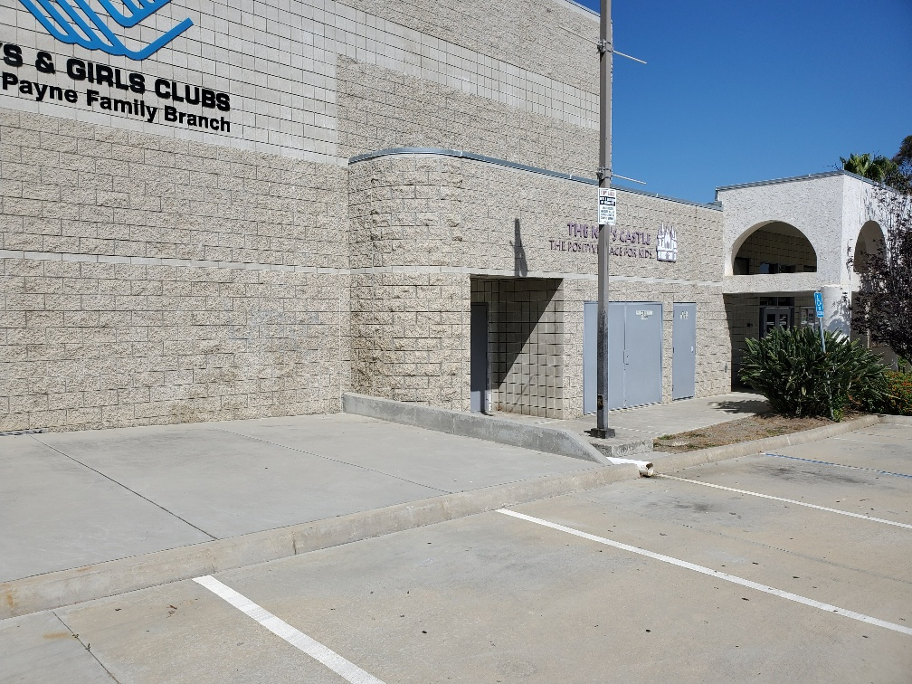
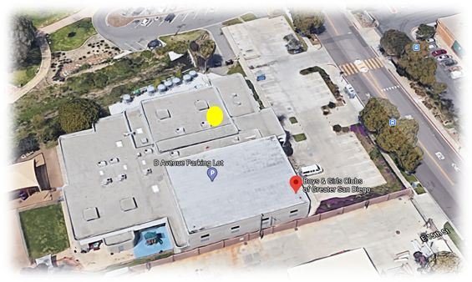
Boys and Girls Club – National City

Slide 5
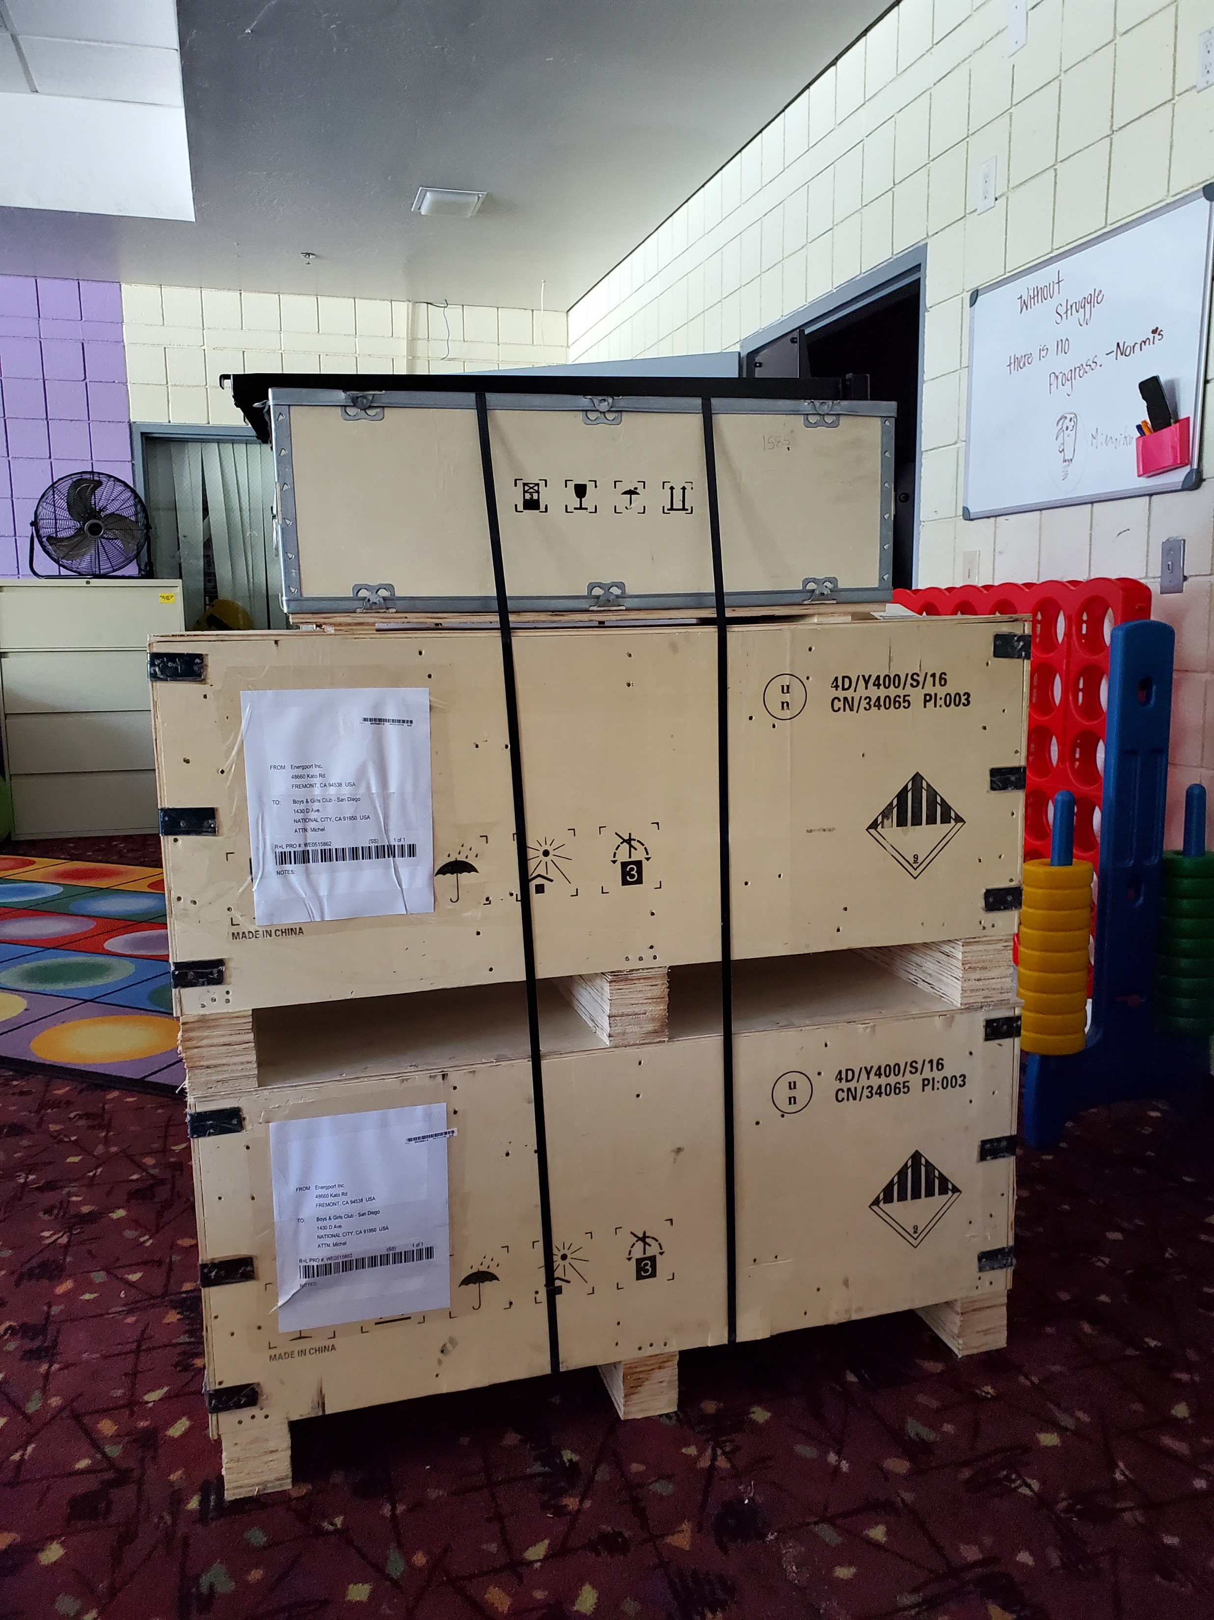
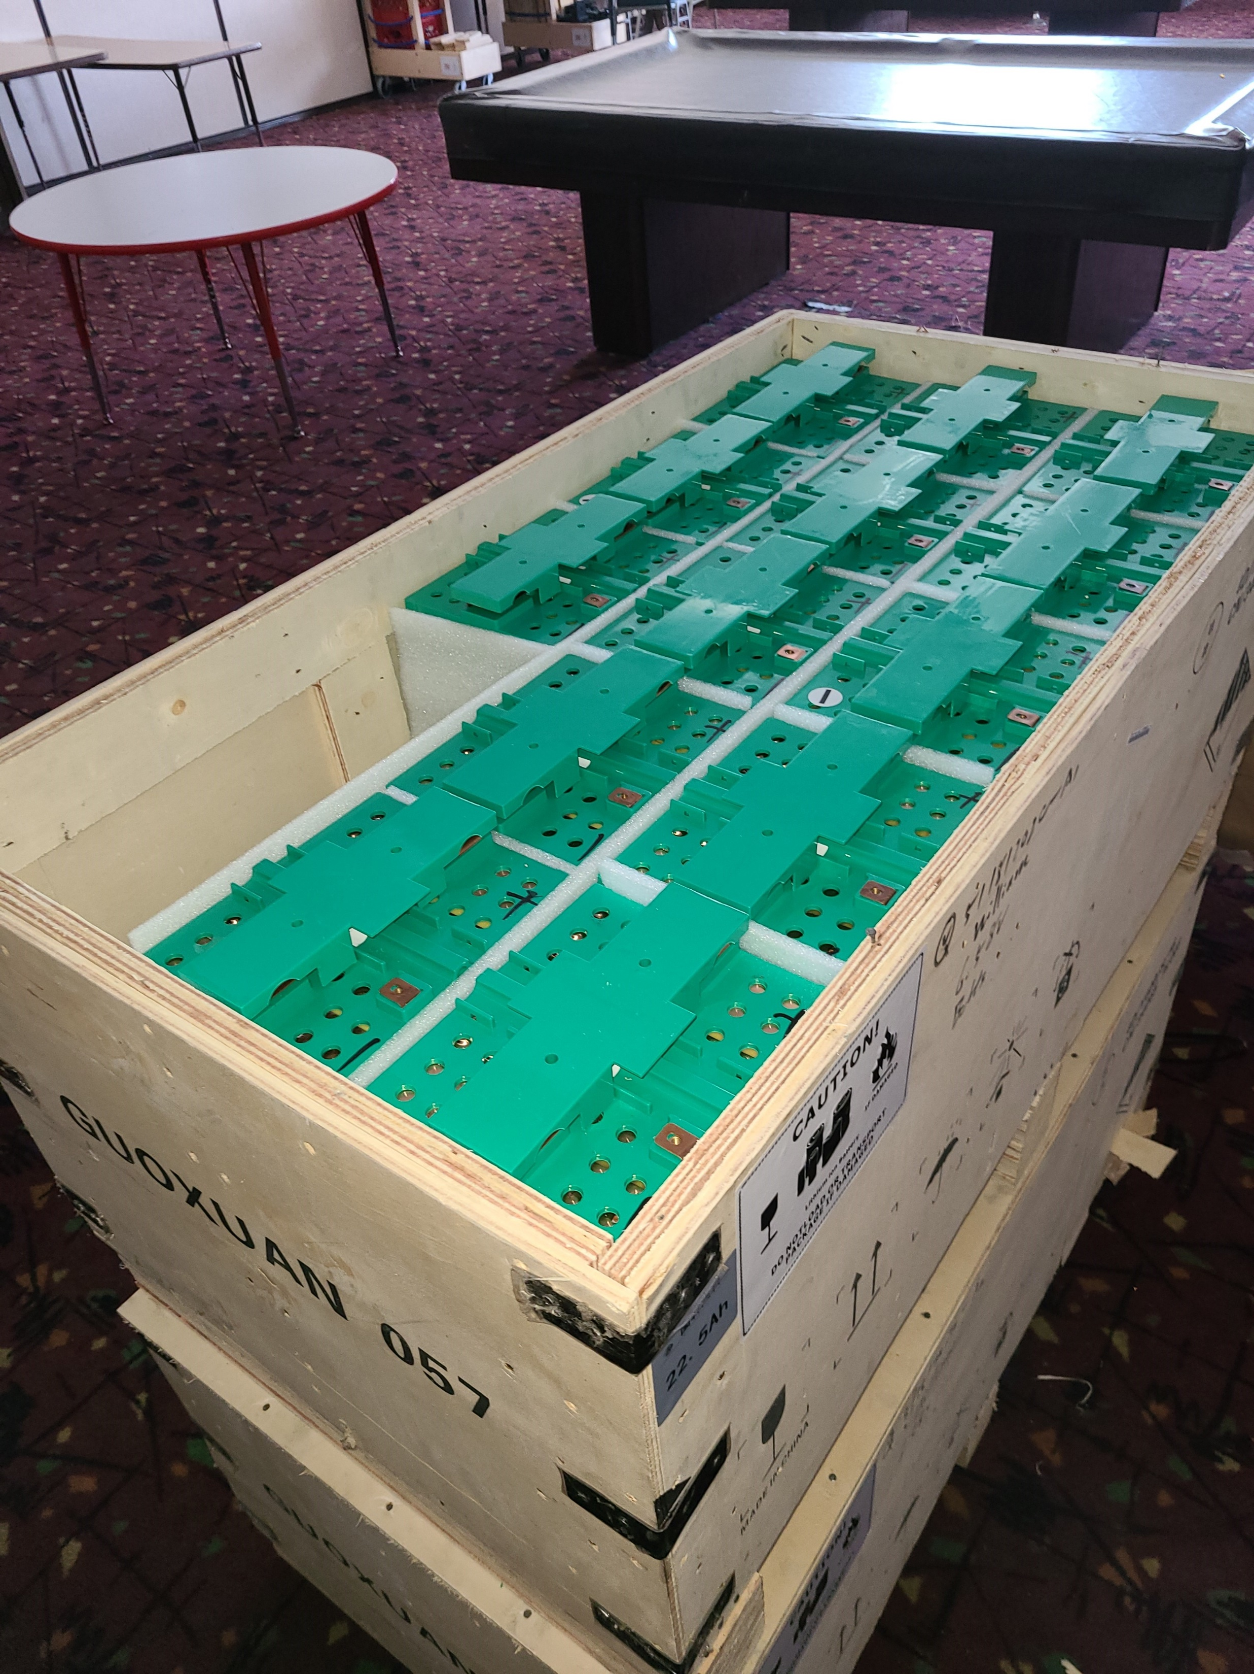
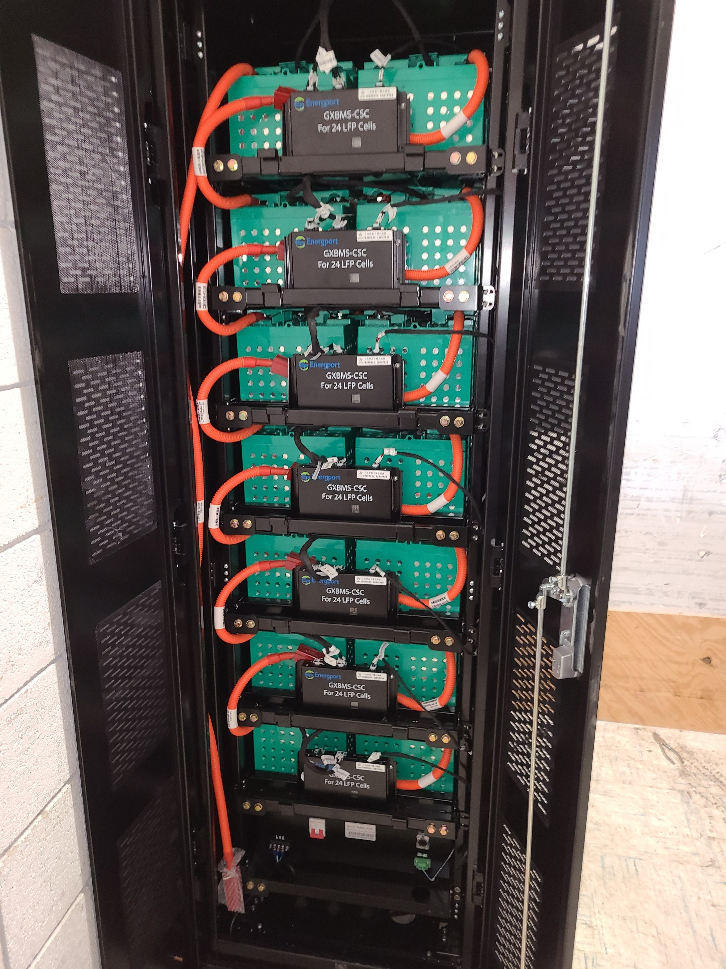
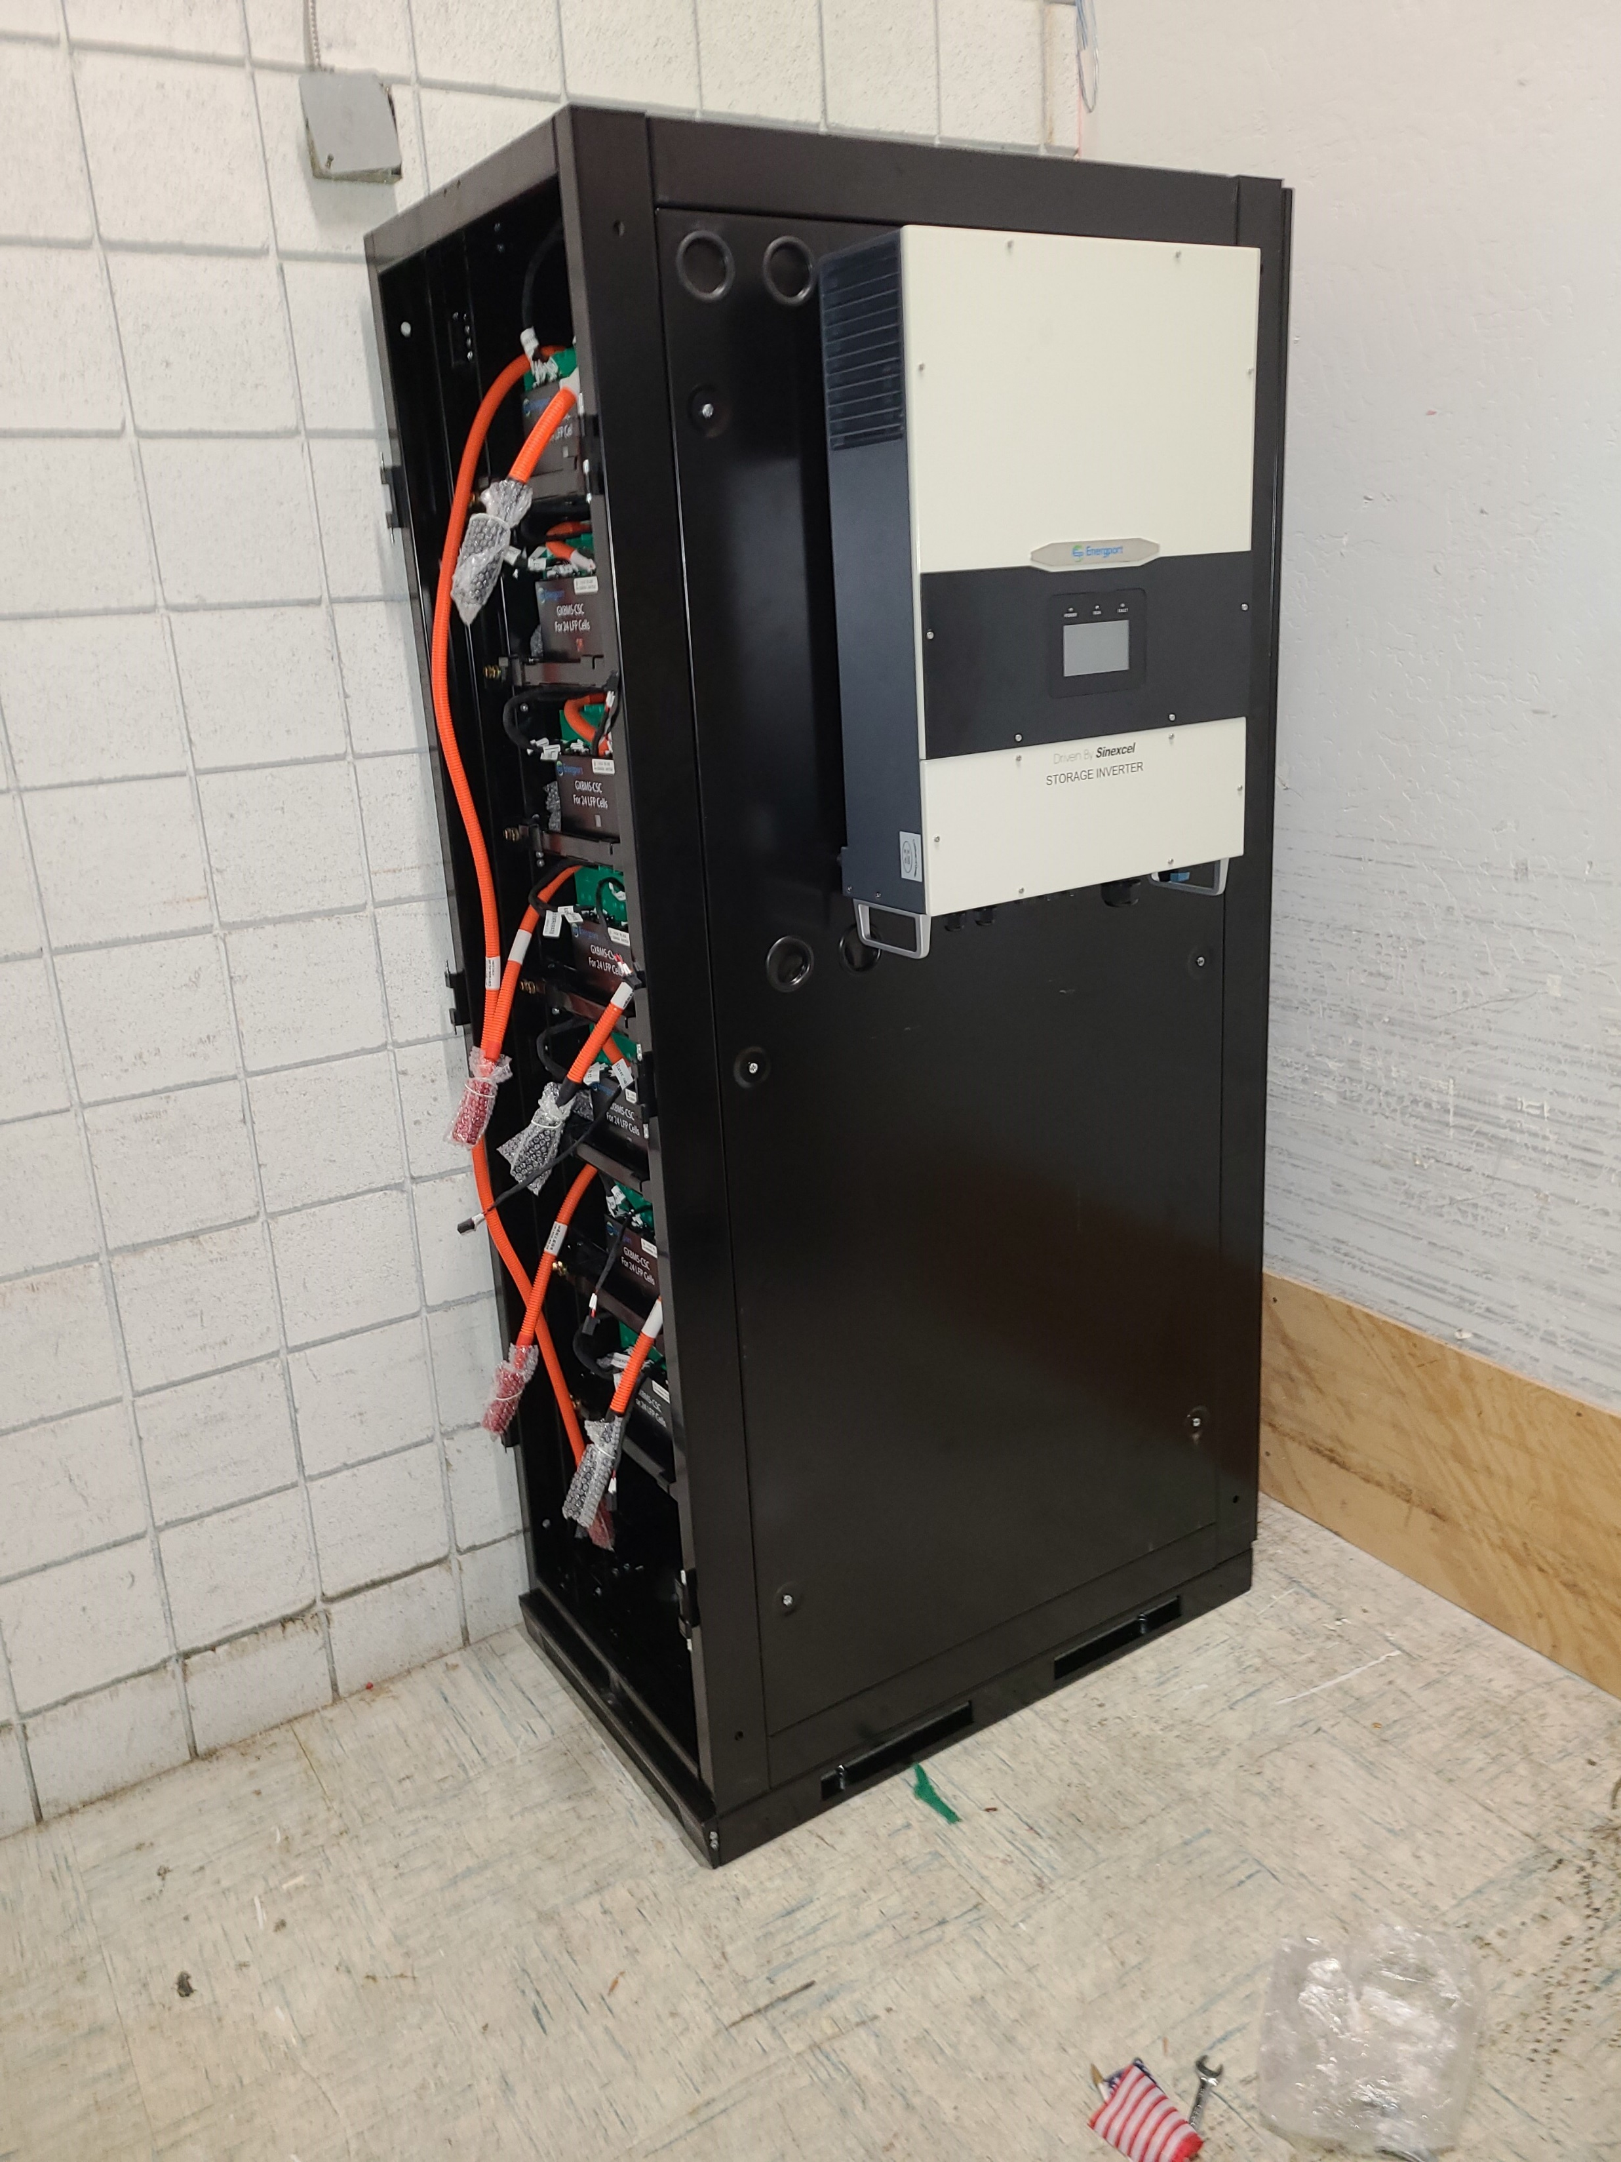
Boys and Girls Club – Battery Install

Slide 6
BGC – Marketing Implementation
Marketing Implementation:
Survey Development in process focusing on:
  75+ small commercial customers
  200+ residential customers
  Results completed and compiled by December 2020.
Physical Outreach postponed due to Covid-19 restrictions:
  Community events and door to door canvasing postponed.
Energy Fair:
  Postponed until Q1 2021 pending lifting of the States Covid-19 restrictions.

Slide 7
SDG&E DAC Pilot Update
SDG&E’s DAC Pilot is on schedule pending no additional implementation delays related to Covid-19.
Thank You.

