Slide 1
Southern California Edison
Demand Response and San Joaquin Valley Pilots - Update
Disadvantaged Communities Advisory Group Meeting
September 18, 2020

Slide 2
Purpose & Agenda
Purpose
Provide an update on:
San Joaquin Valley Disadvantaged Communities Pilot Projects (SJV Pilot)
Demand Response Pilot in Disadvantaged Communities (DR Pilot)
Agenda
Overviews
Implementation Timeline
Pilot Activities
Preliminary Results
Looking Ahead
Questions & Comments

Slide 3
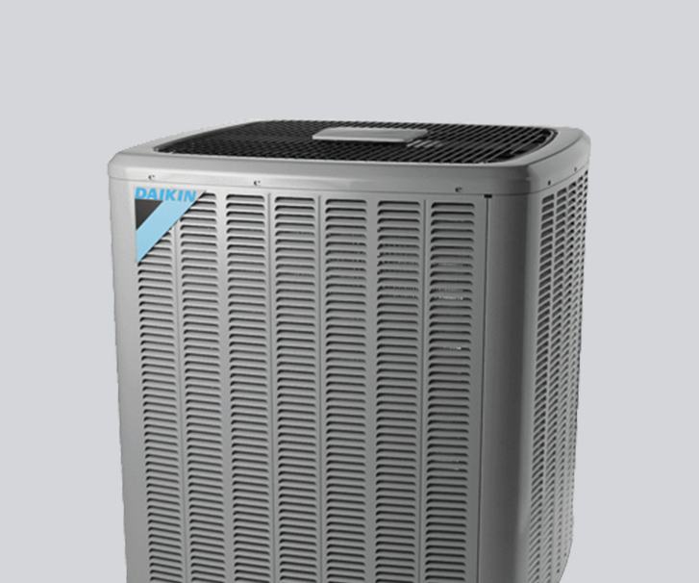
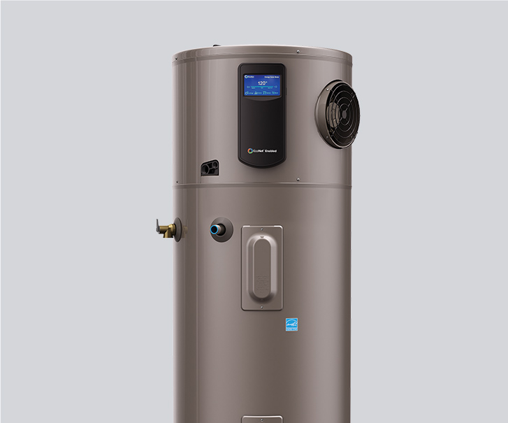
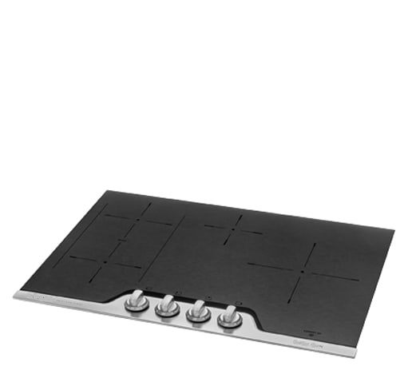

SJV Pilot Overview
Implement a cost-effective solution to increase access to affordable energy for residents of disadvantaged communities in the San Joaquin Valley.
Pilot Communities
California City = 100 households Ducor = 222 households West Goshen = 127 households
Budget
$15,653,000
Measures
Heat Pump HVAC System; Heat Pump Water Heater; Electric Cooktop; Electric Dryer
The product images are for illustration purposes only and may not be an exact representation of the product.

Slide 4
SJV Pilot Overview cont.
Outreach & Enrollment
Self-Help Enterprises - Community Energy Navigator Program Manager (CPM)
  Will hire and manage community-based organizations and/or community leaders
  Educate customers and provide technical assistance throughout the Pilot
Assessment & Installation
Proteus & Synergy - General Contractors
  Will determine viability of home for electrification
  Will procure appliances & provide warranty/service coverage
Inspections
SCE Inspectors
  Will perform post-installation verification
Local Building & Safety Department
  Close-out permit
Community Energy Navigator Program Manager (CPM): Entity approved in D.18-12-015 to educate residents on the details of the SJV pilot, and among other things, manage aspects of outreach and enrollment in the SJV Pilot.
Community Energy Navigator (CEN): community-based organizations (e.g. Leadership Counsel for Justice & Accountability) and/or individuals’ that perform the actual outreach and enrollment.

Slide 5
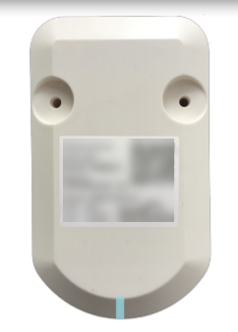
DR Pilot Overview
Implement traditional demand response shed strategies on heat pump water heaters installed through the SJV Pilot. Ensure heat pump water heaters are a viable and reliable source of water heating while supporting demand response capabilities.
Pilot Target
299 households within the three (3) SJV Pilot communities
Budget
$1,000,000
Incentives
$175 bill credit per period (i.e. 12 months) - credit will be prorated if participation is less than 12 months
Outreach & Enrollment
CEN will educate and enroll eligible customers
Installation
Contractors will install CTA-2045 control device on heat pump water heaters
Consumer Technology Association (CTA) (formerly the Consumer Electronics Association, CEA) developed the ANSI/CTA-2045
(formerly CEA-2045) Modular Communications Interface for Energy Management standard

Slide 6
Implementation Timeline

Slide 7
Pilot Activities
March 2020
May 2020
August 2020
September 2020
June 2020
March 2020 - SCE suspended all face-to-face interaction between SCE contractors and SCE customers to comply with the State of California “stay at home” orders to slow the spread of COVID-19. SCE and the CPM collaborated on a letter sent to potential participants to notify them of the change to virtual outreach/enrollment for the SJV Pilot.
May 2020 – SCE provided CPM customer contact information (name, address, phone, email – if available). CEN started outreach and enrollments in Ducor via phone campaigns.
June 2020 - SCE removed previous restrictions on face-to-face interactions between SCE contractors and SCE customers. Contractors are to follow SCE’s safe work practices guidance at minimum as well as the most restrictive state, county, or local orders for all relevant work activities.
CEN started outreach and enrollment in West Goshen via phone and in-person (with willing customers)
August 2020 – First assessment completed in Ducor and West Goshen. Contractors coordinating with SCE Engineering group and Local Building & Safety Department to evaluate electrical upgrades and identify any efficiencies to streamline process.
September 2020 – Contractors starting to ramp-up assessments and start installation on first SCE approved projects.
SCE and CEN to collaborate on outreach and enrollment plan for California City.

Slide 8
Preliminary Results
As of August 31, 2020
NOTES:
“Not Eligible” – includes homes without propane appliances, landlord refusal, or customer not interested.

Slide 9
Leveraging Other Programs
During the outreach and enrollment process, the CEN educates customers on additional programs, such as but not limited to:
California Alternate Rates for Energy (CARE), an income qualified program that reduces energy bills for eligible customers by about 30%.
  54% of “Completed” applications are currently on CARE.
Energy Savings Assistance (ESA) Program, customer who meet the CARE income guidelines may be eligible to receive energy efficient measures, such as Light Emitting Diode (LED) bulbs, smart power strips, refrigerators, and weatherization services at no-cost.
  Both general contractors are authorized to provide ESA Program services.
Disadvantaged Communities Single-family Affordable Solar Homes Program (DAC-SASH), modeled after the Single-family Affordable Solar Homes (SASH) Program, may help in the form of up-front financial incentives towards the installation of solar generating systems on the single-family homes of low-income homeowners.

Slide 10
Looking Ahead
Contractors completing installations in Ducor and West Goshen;
CEN starting outreach and enrollments for DR Pilot; and
CEN starting outreach and enrollments in California City.
Applying lessons learned:
  Customers are not trusting CEN or legitimacy of Pilot; therefore, second round of outreach and enrollment may be necessary for Pilot communities.
    Cancellation of community outreach events (COVID-19) impacted CEN ability to engage and establish themselves within community of Ducor.
  Continue to improve communication among CPM/CEN, general contractors, and SCE; ensure CPM electronic tool is utilized to track touchpoints throughout the customer journey.

Slide 11
Questions & Comments
Thank you
Davi Ibarra
davi.Ibarra@sce.com

