Slide 1


Approaches to Assessing Funding Program Benefits
August 19, 2020
Anthony Ng
Energy Research & Development Division
California Energy Commission

Slide 2

Fostering Innovation Across the Energy Sector
  Mission: strategically invest funds to catalyze change and accelerate achievement of policy goals
  Strategy: advance energy technology, facilitate customer learning, and strategic targeted intervention
  Funding:
  Electric Program Investment Charge (EPIC),
  $133 million annually
  Natural Gas Research, Development and Demonstration Program,
  $24 million annually
  Food Production Investment Program,
  $124 million biennially
  Low Carbon Fuels R&D Program,
  $18 million, one-time general fund expenditure authority

Slide 3
Program Level Metrics
Technology Advancement and Commercialization
Follow-on funding (private and public)
Commercialized Technologies
Company Exits (mergers, acquisitions)
Technology Diffusion
Inclusion into Codes and Standards
Diversity of Funding Recipients
Dispersion of Project Demonstrations
Knowledge Generation and Dissemination
Publications and Citations
Diversity and Equity
Direct funding to projects in communities
Diversity of funding recipients
$1.8 billion in follow-on funding
More than 34 technologies and services have been commercialized
5 Companies have had successful exits
34 EPIC projects have improved the effectiveness of energy related codes and standards
CEC EPIC funding has reached over 580 organizations
Results of CEC EPIC-funded projects have been published in more than 230 academic publications with more than 1,300 citations
65 percent of the TDD funds have gone to projects located in and benefitting low-income or disadvantaged communities
19 percent of EPIC agreements include a women-, minority-, or LGBTQ-owned business as the prime recipient or a subcontractor

Slide 4
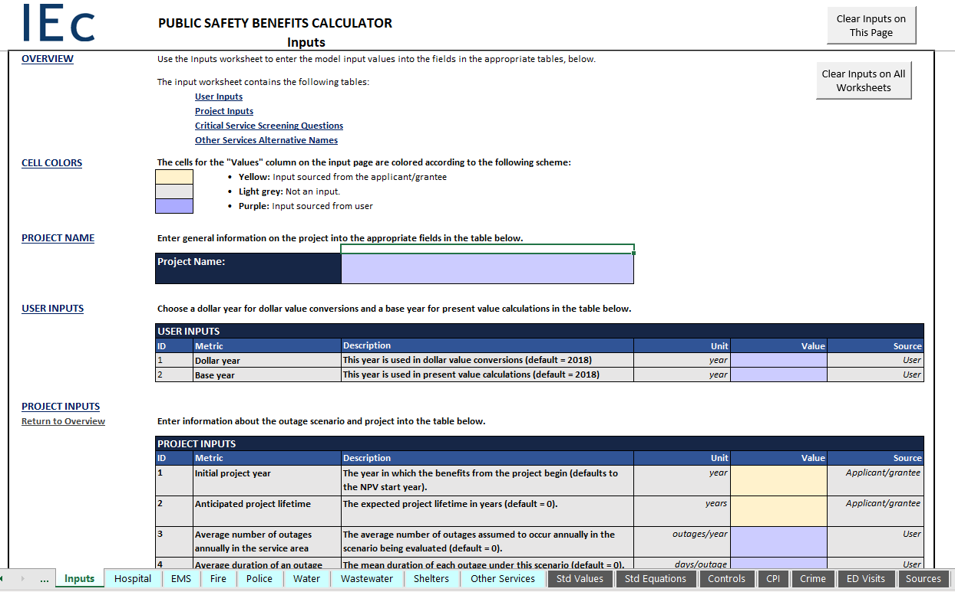
Technology Specific Benefits
Direct Benefits
On-Bill Savings (energy and water efficiency)
LCOE (renewable generation)
Load Shift (storage, demand response)
Peak Load Reduction (storage)
Indirect Benefits
System Level Savings (avoided generation, transmission)
Increased Reliability (storage, microgrids)
Public Safety (microgrid on critical facilities)
Public Health (emission and pollution reduction)

Slide 5
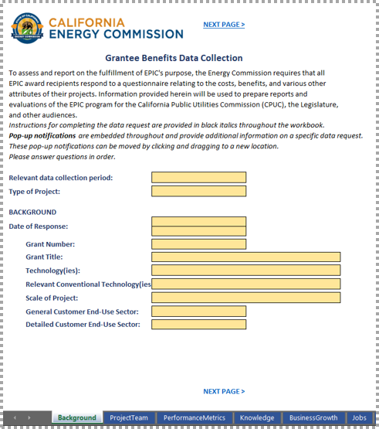
Data Collection Methodology
Administer questionnaire at beginning and end of project
The data will be used to conduct analysis through a suite of tools and methodologies by CEC staff
The use of standard tools and methodologies will allow the CEC to better aggregate results and report benefits at higher levels

Slide 6
Impact Framework
Benefits methodologies can inform research program more broadly than just retrospective analysis
Refine solicitation scoping
Potential for innovation over current performance/cost benchmarks
Viable path-to-market
Who are the users of the research results
Identify and track metrics of success for projects
What does success look like for a specific project
Lower and upper bounds of performance
Can be technology specific or programmatic metrics

Slide 7
Thank You
Anthony Ng
Anthony.Ng@energy.ca.gov

