Slide 1


Approaches to Assessing ZEV Funding Program Benefits
2020 IEPR Update – August 19, 2020

Slide 2
Measurement is important…

Slide 3
…and difficult.

Slide 4
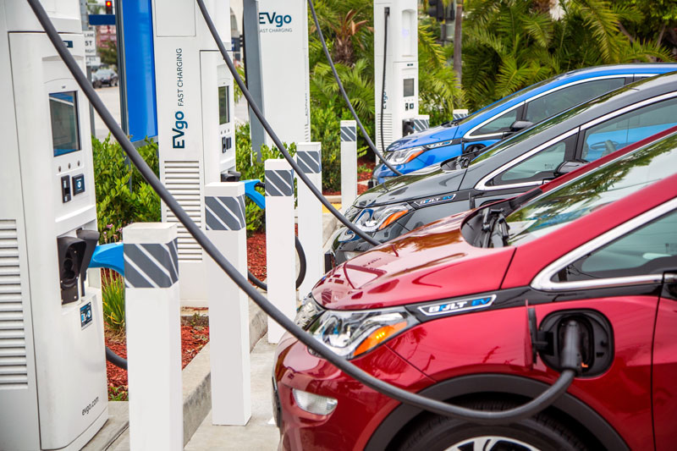
GM & EVgo Partner to Accelerate EV Adoption
More than 2,700 new EV charging plugs in the next 5 years
Triple the size of its existing network
Source: https://www.evgo.com/about/news/general-motors-and-evgo-aim-to-accelerate-widespread-ev-adoption-by-adding-fast-chargers-nationwide/

Slide 5







Slide 6
Driving ZEV to Scale
CA Targets & Benefits
Market Health
Private $
Scale
Why?
At scale, significant benefits emerge
  GHG reductions, air quality, equity/access, job growth
Ultimately, it’s about improving people’s lives

Slide 7
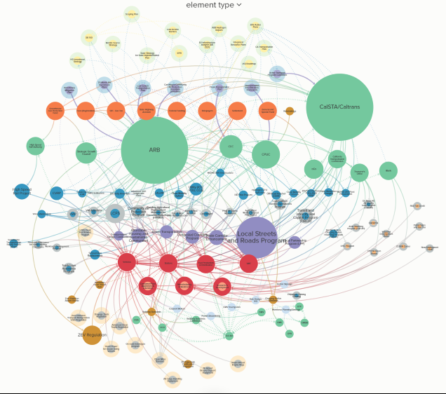
Clean Transportation Funding Landscape

Slide 8
CEC Clean Transportation Program

Slide 9
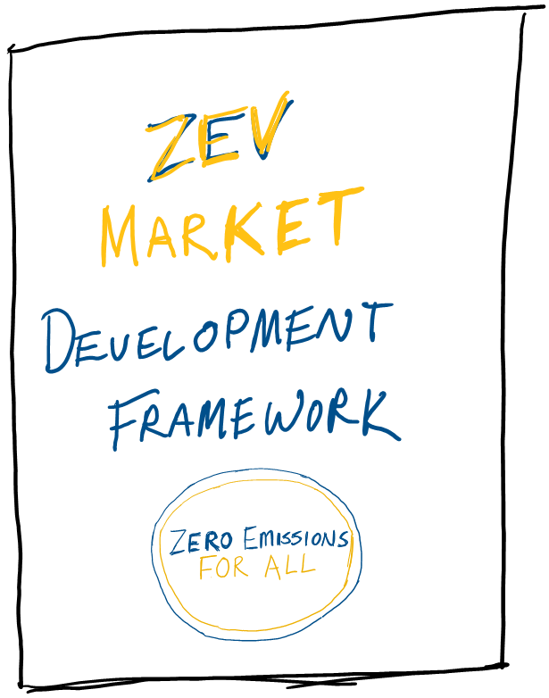








ZEV Market Development Framework
  Articulate core principles for collective action
  Clearly identify targets
  Establish Roles/objectives of agencies and major stakeholder groups
  Organize collective problem solving Increase transparency and target stakeholder engagement
  Ensure lessons learned are accessible and incorporated
Empower actors to exceed expectations
Notes:
The strategy behind the Framework can be summarized in five steps: 1) articulate the core principles that underpin our collective action, 2) clearly identify our targets, 3) establish the roles and objectives of each agency and major stakeholder group in meeting the targets, 4) organize collective problem solving on core issues, and 5) ensure lessons learned are easily accessible so that successes can be repeated and failures avoided. The ideal result is for agency leadership, staff, and stakeholders to be positioned and empowered to meet and exceed high expectations.

Slide 10

























System Metrics

Slide 11

Tyson Eckerle
tyson.eckerle@gobiz.ca.gov
Gia Vacin
gia.vacin@gobiz.ca.gov
Hannah Goldsmith
hannah.goldsmith@gobiz.ca.gov
www.business.ca.gov

