Slide 1


Who is Pacoima Beautiful?
Established in 1996, we are an environmental justice organization based in the Northeast San Fernando Valley area of Los Angeles
Our mission is to educate, organize, and advocate in order to promote healthy, sustainable, and thriving frontline communities
We recognize the intersectional nature of equity in disadvantaged communities.
Issues do not exist in silos. Solutions cannot work in this way either
A wide net is needed to ensure all perspectives of the community are considered

Slide 2


Challenges to Clean Transportation Programs in DACs
Do projects fit the needs of a community?
Are community partnerships being established to ensure sustainable success of a project?
How does the project fit the intersectional nature of equity in a DAC?
Don't just check a box.

Slide 3
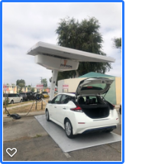
Recommendations
Recognize and embrace the geographic diversity of our State
Different regions will require different approaches to establishing successful clean transportation projects
Prioritize projects with clear partnerships among agencies and CBO
Evaluate with clear metrics the impact of projects built

