Slide 1
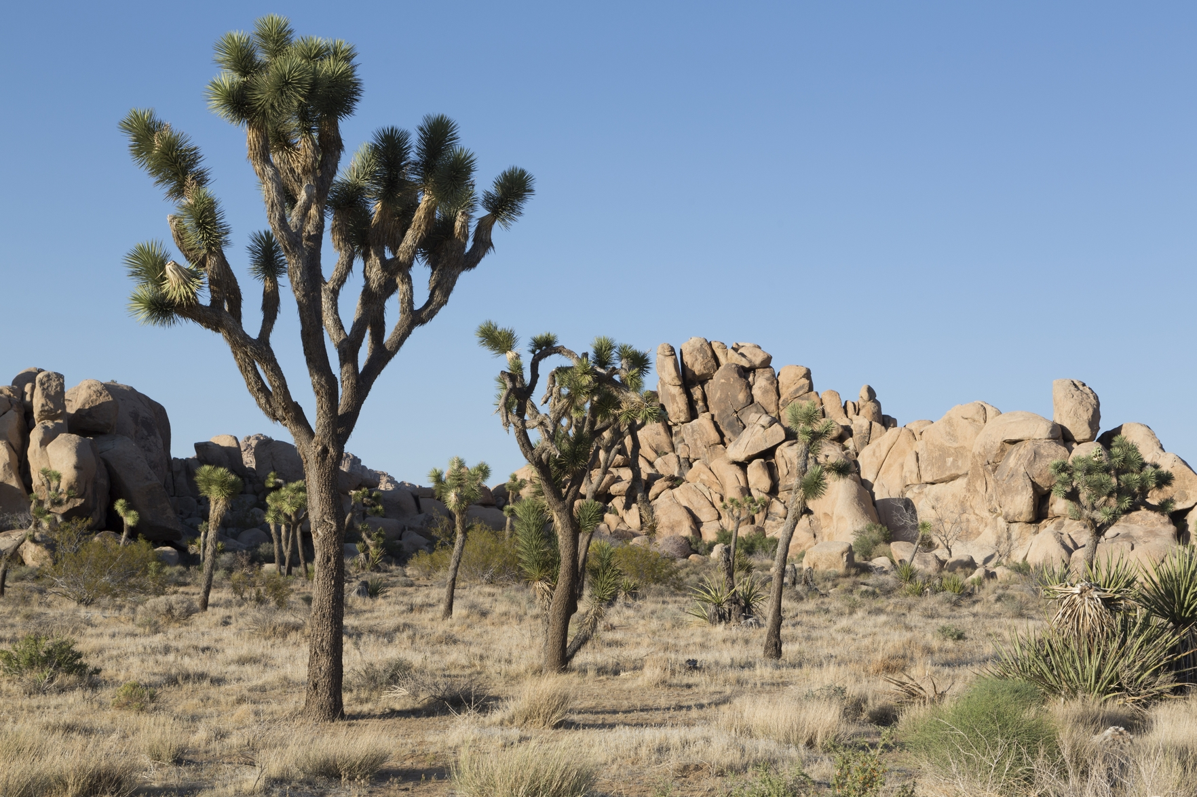

ITEM 4
California Native American Tribal Energy Storage Demonstrations
David Erne – August 21, 2020

Slide 2

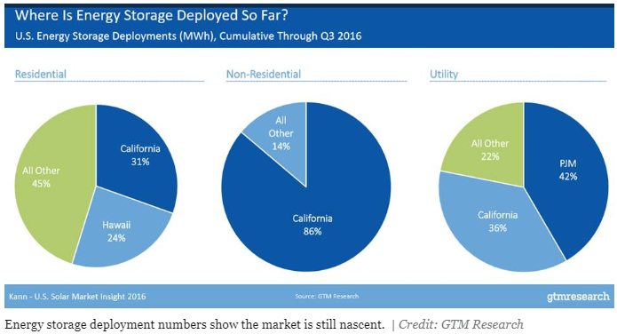
Growing Need for Energy Storage in California
Growing use in CA
Large scale (≥1MW) installations in 2016-2017 moved CA from minor player to 44% of U.S. energy capacity
Small scale installations were 90% of U.S. energy capacity (2017)
CA accounts for 77% of planned large scale storage
Drivers for growth in California
CPUC procurement targets
Title 24 (residential new construction code)
Customer demand
Resiliency

Slide 3
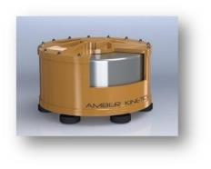
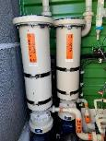
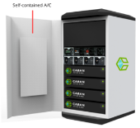
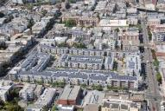

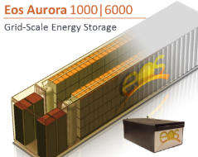

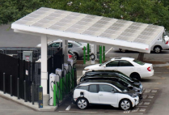


Energy Storage Research Strategies
Diversify
Demonstrate
Derisk*
*Lower manufacturing costs

Slide 4
Solicitation Overview
California Needs
  Longer duration energy storage for resilience and to capture excess renewable generation
    Most current energy storage designed for 4 – hour duration
  Energy code and PSPS increasing interest in residential storage
    Title 24 requires solar on all new construction
    PSPSs demonstrate the need to better use residential solar
Research Purpose
  Demonstrate energy storage that can provide at least 10 hours duration
  Demonstrate value of energy storage for residential customers

Slide 5
Solicitation Overview
Type | Group | Demo | Site | Awards
 |  |  |  | All | Tribal
Long Duration | 1 | 10 hr /400 kw | Any | 3 | 1
 | 2 | 10 hr/50 kw | CA Native American Tribe | 3 | 3
 | 3 | 10 hr/50 kw | Low-income/Disadvantaged Community | 2 | 0
Residential | 4 | 15 homes | 3 climate zones | 3 | 1

Slide 6

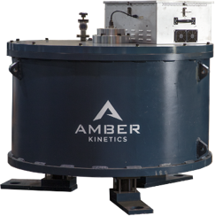

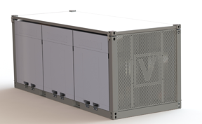

Group 1 (400 kw/10 hours)
Rincon Band of Luiseno Indians
Vanadium Redox Flow Battery + Flywheel
  Connected to solar
Provides resilience & energy savings to:
  Waste water treatment plant
  Gas station/convenience store
  Office building
  Harrah’s Resort - serves as emergency ops center & shelter

Slide 7



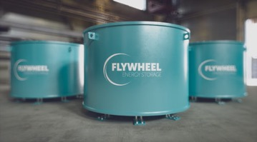
Group 2 (50 kw/10 hours)*
Flywheel
Viejas Band of Kumeyaay Indians
  Supports water wells supplying drinking water
Vanadium Redox Flow Battery
Soboba Band of Luiseño Indians
  Supports fire station
Kinetic Energy
Storage Corporation
*Pechanga Band of Luiseño Indians – proposed award, requiring Business Meeting approval
  Vanadium Redox Flow Battery supporting recreation center/emergency shelter

Slide 8
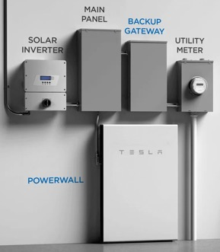


Group 4 (Residential Storage)
Commercially available Tesla systems
10 of 15 sites are homes in Tribal areas
  Sherwood Valley Band of Pomo Indians – 3 homes
  Bear River Band of Rohnerville Rancheria – 5 homes
  Campo Kumeyaay Nation – 2 homes

Slide 9
Questions

