Slide 1
ZEV Technology Rollout for Deep Emission Reductions
Joshua Cunningham
CEC AB 2127 Workshop
August 6, 2020

Slide 2
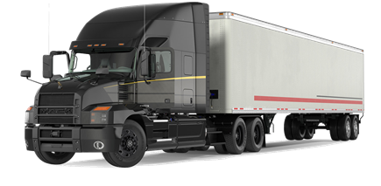

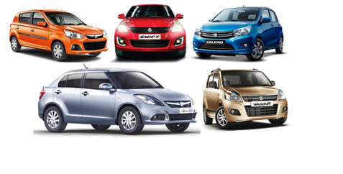
On-Road Sector
In 2017 on-road mobile sources contribute to 45% of statewide NOx emissions and 37% of statewide GHG emissions

Slide 3
Emission Reduction Targets
Criteria Emissions (NOx)
National Ambient AQ Std:
75 ppb ozone, attainment in South Coast by 2031
70 ppb ozone, attainment in South Coast by 2037
GHG Emissions
California:
SB 32: 40% below 1990 / 2020
Exec Order: Carbon Neutrality by 2045
Mobile Source Strategy update Fall 2020
Scoping Plan Update Late 2022

Slide 4
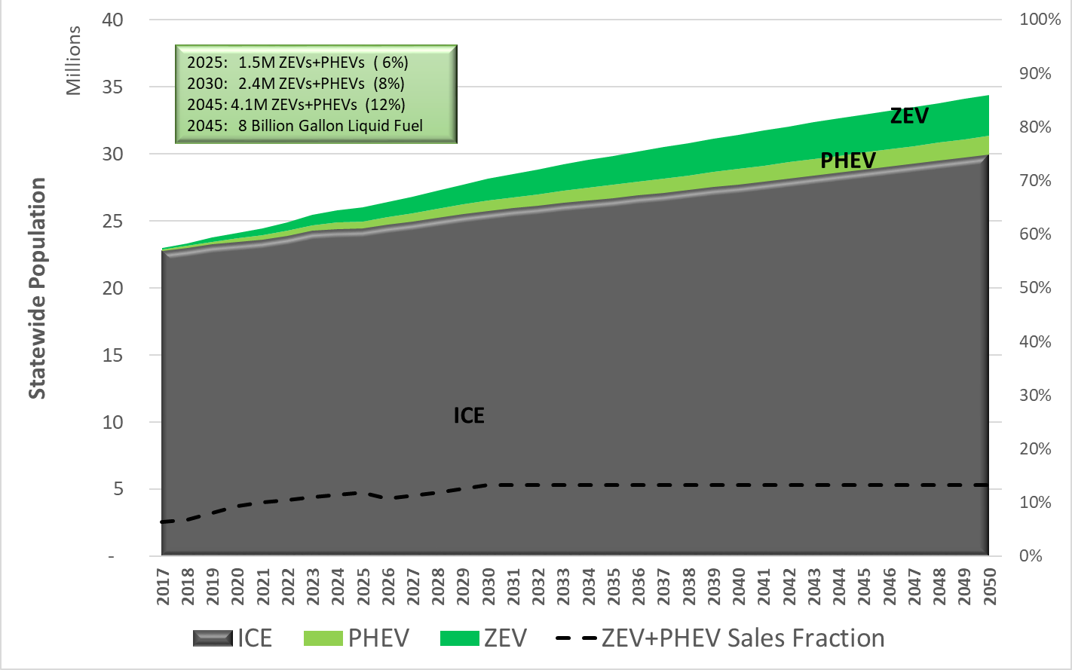
LDV Tech Projections in Baseline
Current policies expected to achieve on-road ZEV + PHEVs (and sales):
~1.5 M by 2025 (11%)
~2.4 M by 2030 (13%)
Notes:
We ran through several emissions scenarios to achieve future targets for air quality (2031, 2037, and 2045) and carbon neutrality in 2045. This figure shows the technology mix of the light-duty fleet for a really aggressive scenario in which 100% of sales in 2035 are ZEVs and PHEVs. Even with this very aggressive scenario, we still do not achieve carbon neutrality in 2045. Carbon neutrality requires a fully electrified fleet, but in this scenario about half the fleet still use combustion engines. CARB is continuing to look at other scenarios that will help us achieve carbon neutrality in 2045. For example, we can look into synergies with high mileage fleets like transportation network companies.

Slide 5
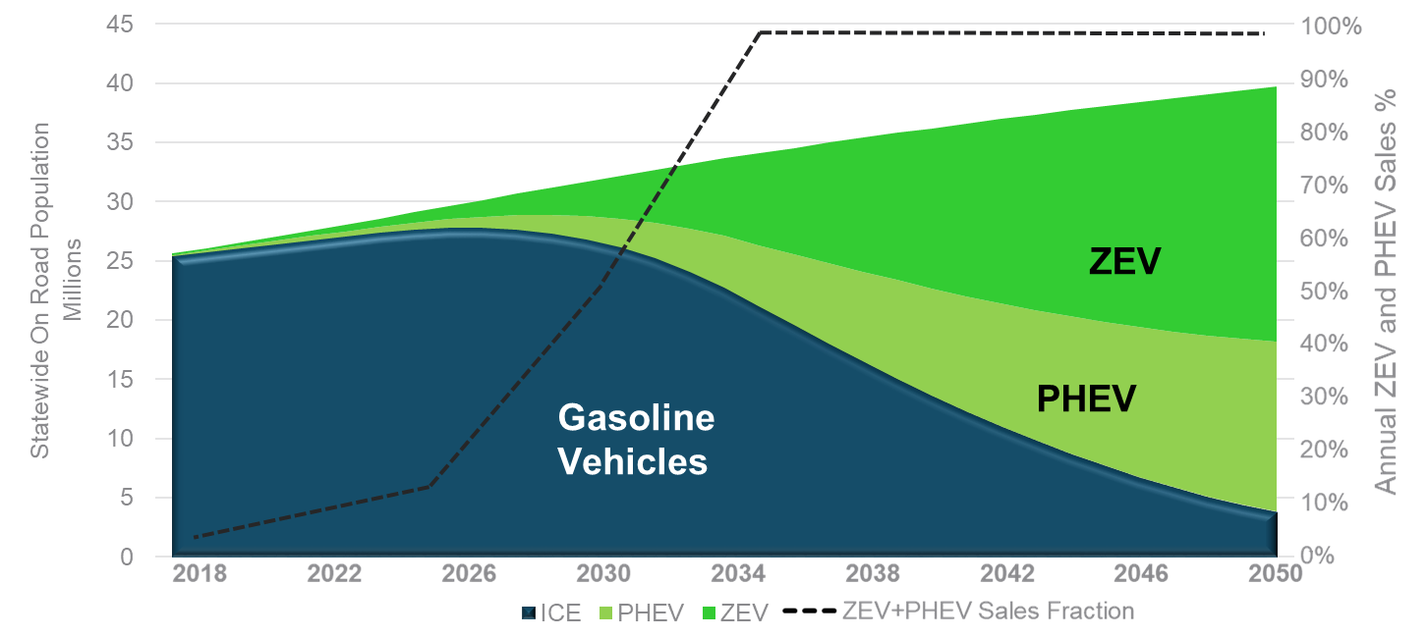
LDV Tech Needed for Deep Reductions
100% sales ZEVs & PHEVs by 2035; Not aggressive enough
PRELIMINARY – New scenarios to be released in fall 2020
More than 5M ZEVs + PHEVs needed by 2030 (at least 50% sales)
Notes:
We ran through several emissions scenarios to achieve future targets for air quality (2031, 2037, and 2045) and carbon neutrality in 2045. This figure shows the technology mix of the light-duty fleet for a really aggressive scenario in which 100% of sales in 2035 are ZEVs and PHEVs. Even with this very aggressive scenario, we still do not achieve carbon neutrality in 2045. Carbon neutrality requires a fully electrified fleet, but in this scenario about half the fleet still use combustion engines. CARB is continuing to look at other scenarios that will help us achieve carbon neutrality in 2045. For example, we can look into synergies with high mileage fleets like transportation network companies.

Slide 6
LDV Policies and Strategies
Stronger vehicle regs for post 2026 model years
  ZEV Regulation – Moving beyond early adopters
    With large population of ZEVs – implications on wide public EVSE/H2 needs
  LEV GHG – Pushing ICE GHG improvements on top of ZEVs
  LEV Criteria – Ensuring real world emission reductions
  Board hearing late 2021
Clean Miles Standard on TNCs, 2023 - 2030
  Increasing eVMT requirements (Uber, Lyft, etc)
    Implications for DCFC to support higher mileage TNC drivers
  Board hearing Dec 2020

Slide 7
2020 Mobile Source Scenario for MDV
Considered a scenario to achieve long-term climate goals
Strategy: Ambitious ZEV penetration for newer vehicles
ZEVs
ICE
6%
94%
25%
75%
60%
40%
Fuel Demand in 2045
(bil. gal.per year):
gasoline – 0.27
diesel – 0.16
2031
2037
2045
Medium-Duty ZEV
Internal Combustion Engines
(Mostly LEV Certified)

Slide 8
2020 Mobile Source Scenario for HDV
To achieve NOx reduction needed to meet near term air quality goals, and also maximize the number zero-emission trucks for longer term climate goals
A hyper ambitious ZEV penetration combined with accelerated turnover of older vehicles
Low NOx
HD ZEV & Accelerated Turnover
23%
21%
31%
44%
24%
76%
Classes 4-8
2031
2037
2045
Fuel Demand in 2045
(bil. gal. per year):
diesel – 1.01
gas – 0.08
Federal Low NOx
CA Cert. Low NOx
Sales
&
Accelerated Turnover
HD ZEV
2010 Cert.
Pre-2010

Slide 9
M/HDV Policies and Strategies
Medium-Duty Vehicles (MDVs – GVWR 8,501 -14,000 lbs) include:
  Zero-emission technology transformation starting in 2024
  Enhanced LEV regulations through Advanced Clean Cars 2.0
  Continued energy efficiency improvements
Heavy-Duty Vehicles (MDVs – GVWR > 14,000 lbs) include:
  Zero-emission technology penetration starting in 2024
  Cleaner diesel technology (i.e., Low NOx diesel) starting in 2024
  Use of renewable fuels where electrification is not feasible
  Continued energy efficiency improvements
  In-use performance measures

