Slide 1



Ride-Hailing’s Climate Risks
2020 IEPR Update Workshop
Session 3 – Electrifying Transportation Network Companies
July 16, 2020
Don Anair
Clean Transportation Program

Slide 2
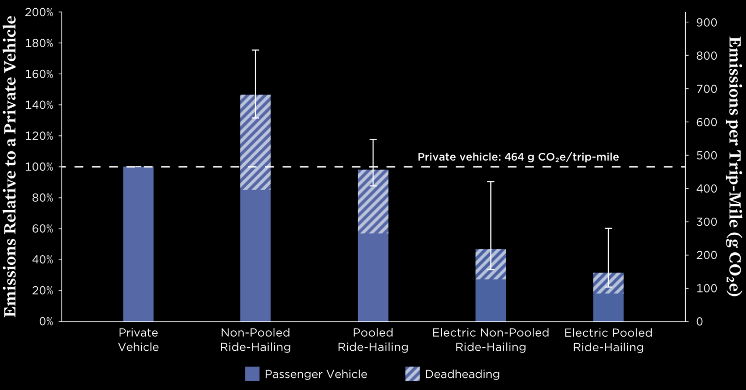
A non-pooled ride-hailing trip emits nearly 50% more than a comparable private vehicle trip
An electric, pooled ride-hailing trip can cut emissions by 68% compared with a private vehicle trip

Slide 3
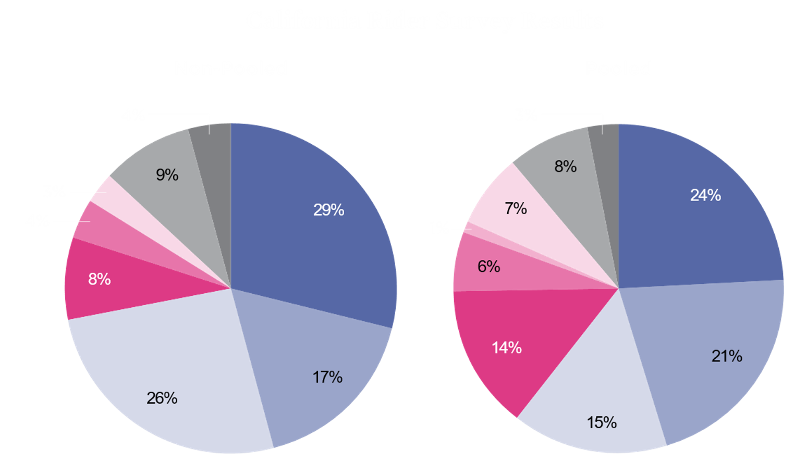

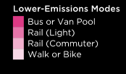

24% of non-pooled rides and 36% of pooled rides are replacing lower-emission modes
Source: Circella, Giovanni, Grant Matson, Farzad Alemi, and Susan Handy. 2019. Panel Study of Emerging Transportation Technologies and Trends in California: Phase 2 Data Collection.

Slide 4

Ride-hailing trips are nearly 70% higher emission than the trips they are displacing

Slide 5
Ride-Hailing’s Climate Risks
Report: Ride-Hailing’s Climate Risks available @
https://www.ucsusa.org/resources/ride-hailing-climate-risks
Don Anair
danair@ucsusa.org

