Slide 1
Economic Considerations for Microgrid Deployment
2020 Integrated Energy Policy Report Update
Remote Workshop
California Energy Commission
7/9/2020

Slide 2
Tribal Government Microgrid Investment Rationale
Resilience / reliability / continuity of operations
Decarbonization
Energy/electrified transportation lifeline sectors support social services and are “economy-enabling”
Track and reinvest ‘found’ revenues (e.g., bill savings)
Take a ‘patient payback’ approach for infrastructure (e.g., ~10 years)
Creates a positive feedback loop – more resilient infrastructure at predictable and/or lower costs and with rapid GHG reductions

Slide 3
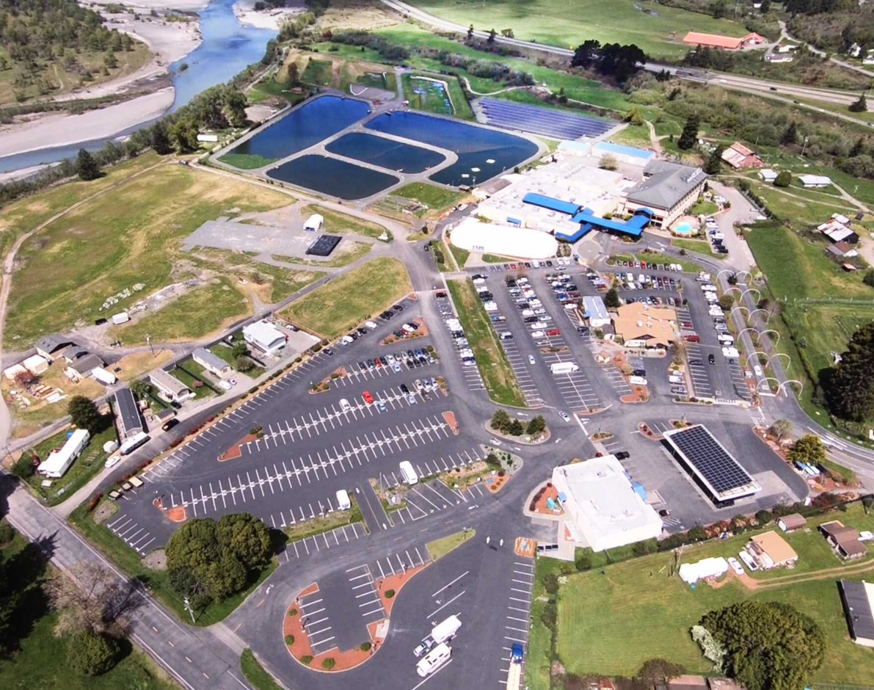

Blue Lake Rancheria has several microgrids
Community scale in operation
Facility scale in final commissioning / partial operation
Two expansion projects
Two campus-scale in design
Residential in design

Slide 4
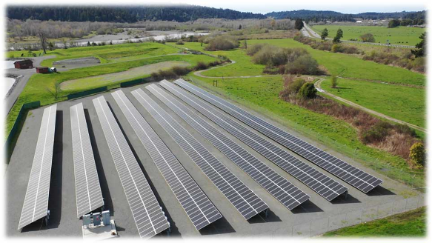
Community Microgrid
Public/private partnership
  Blue Lake Rancheria, Schatz Energy Research Center, PG&E, Siemens, Tesla, CEC, CPUC, Idaho National Laboratory, others
Funded by Tribe and a CEC EPIC grant
Solar + storage backbone
Powers a 6-building campus
  Tribal government offices, economic enterprises
  Critical infrastructure, lifeline sectors, EV charging
  American Red Cross shelter
Can seamlessly island and reconnect to grid
Reduces GHGs by ~200 tons per year; reduces electricity costs by $200,000 per year

Slide 5
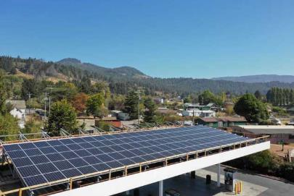
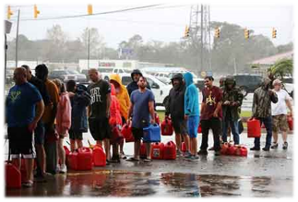
Facility Microgrid “Solar+”
Public/private partnership
  Blue Lake Rancheria, Schatz Energy Research Center, PG&E, SunPower, Tesla, CEC, Lawrence Berkeley National Laboratory, others
  Funded by Tribe and CEC EPIC
Powers fuel station / convenience store complex and EV charging
  Replicable, low-carbon ‘resilience package’ for commercial buildings
Solar + battery storage backbone; can seamlessly island
Advanced building controls – efficiency, demand response, balance
In business as usual (BAU): lowers costs, GHGs, improves COOP
In emergencies: supplies lifeline sectors to public; emergency responders
  Important where these facilities are the only community resource
Est. to reduce GHGs by ~50 tons per year; save ~40% on electric bills
Photo: Theindychannel.com

Slide 6
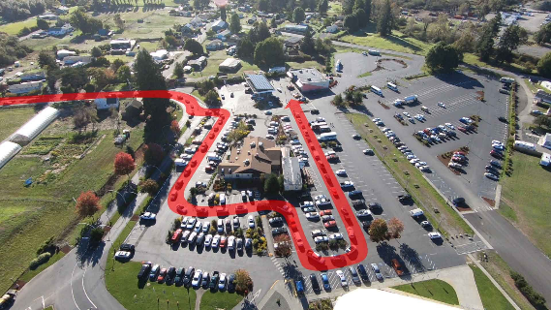
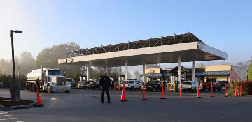

Climate-smart microgrids are working
Public Safety Power Shutoff (PSPS) - 10/9/19
Served ~10,000 people (~10% of the county)
Supplied general public & response agencies
  Provided critical medical housing in hotel
    Credited with saving lives in the event
  Fuels (electricity, gas, diesel, propane), ice, water, food, internet access, device charging, ATMs
    Fuel for local clinic to keep medicines cold
  Electric Vehicle (EV) charging
  Community Support Center | Business Center
    Times-Standard regional paper of record published onsite
The PSPS did its job – no wildfires
The microgrids did their job – regional support

Slide 7
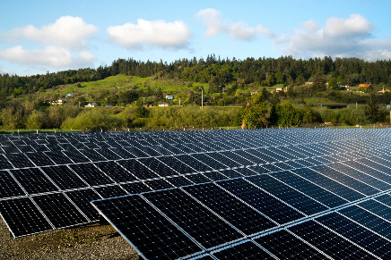
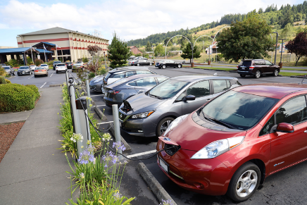
Microgrids as Solutions
Build low-carbon microgrids for stacked benefits
  Localized resilience, more jobs, GHG and pollution reduction
How are microgrids valued; how do we fund them?
  Value of reduced costs in business-as-usual operation
  Value of emergency continuity of operation – social and economic support
    FEMA, CalOES as operational and funding partners
  Value of leveraging private (non-grant) investment for zero-carbon power for energy, transportation
  Value need to move fast to incorporate zero-carbon resources, increase COOP in climate-change-amplified volatility (wildfires, floods, other disasters)
How to best build and manage microgrids?
  Increase regional expertise/capacity
  Ensure safety and wider grid ecosystem benefits
  Regional utility owned and operated?
  Inter-jurisdictional issues, interconnection policy lag
Microgrid knowledge transfer
  Avoid inappropriate technology, increase standardization, lower capital, O&M costs
Microgrids and/or grid segmentation?
  Humboldt County recent examples

