Slide 1


Lessons Learned from CEC EPIC Microgrid Research Activities
California Energy Commission

Slide 2

California Energy Commission Major Research Programs
Electric Program Investment Charge (EPIC)—Administered by the CPUC
  Ratepayer-funded program to benefit ratepayers
  Administered by the Energy Commission and three Investor Owned Utilities (PG&E, SCE, and SDG&E)
  Energy Commission Program ~ $130 M/year
Natural Gas RD&D—Administered by the CPUC
  Approximately $24 M/year
Special Funds (e.g., climate vulnerability, transportation research)

Slide 3
A Decade of Microgrid Research
Developing Commercially Viable Technology
2009 – 2015
2015 – 2019
2018 – 2023
Early Stage Microgrid Development
Overcoming Integration Challenges
Developing Commercialization Pathways
Supported microgrid controller development
Developed approaches to integrating multiple resources
Hardware testing for integrated systems
Demonstrated resiliency value of microgrids for critical facilities
Integrated large number of resources and refined controller designs
Creating business plans and commercialization pathways for microgrids in California

Slide 4
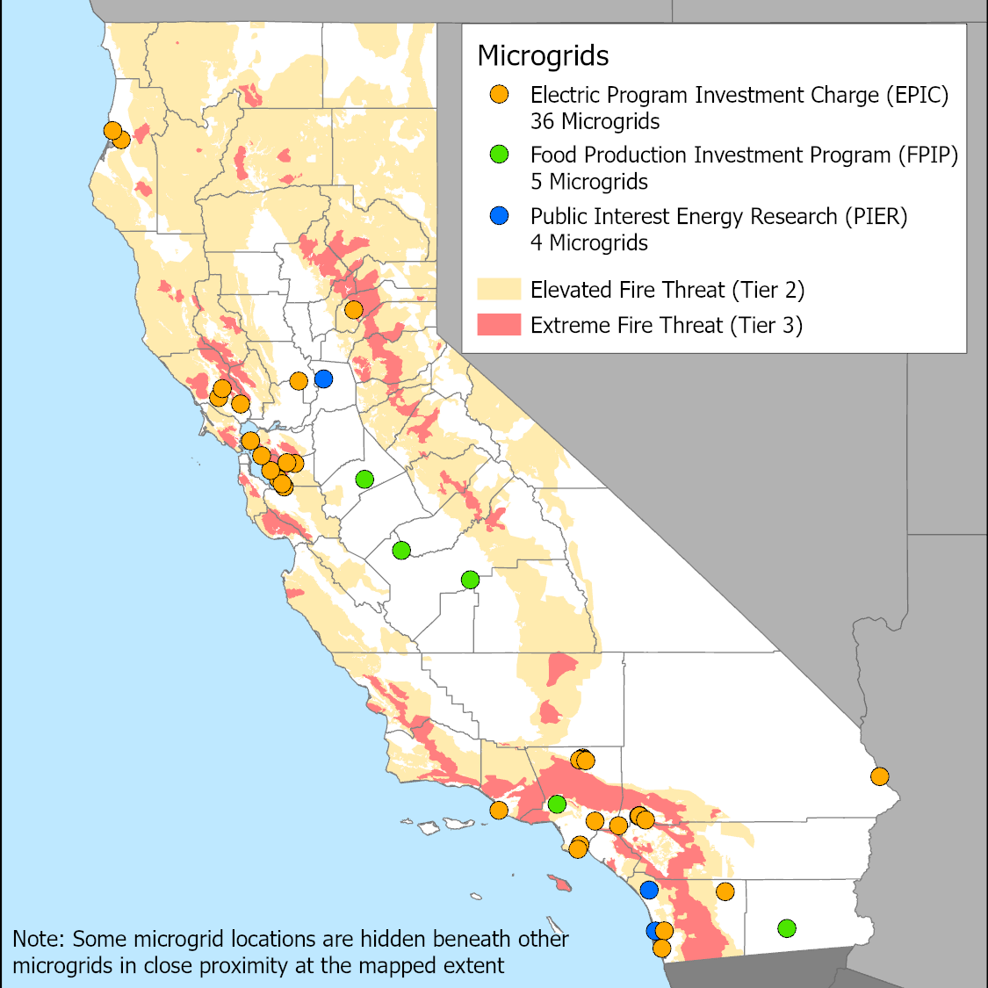
A Decade of Microgrid Research
Deploying the Largest Number of Installed Microgrids
45 microgrids|$136M invested |$101M match funding
Increasing resiliency
Maturing microgrid control technologies
Learning best approaches to integrating multiple resources
Sharing lessons learned and best practices
Driving down costs and establishing deployment norms

Slide 5
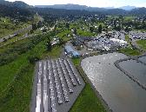



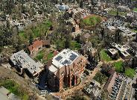
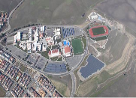
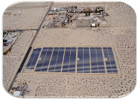

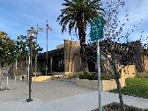

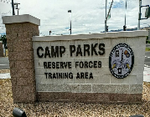
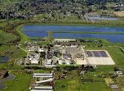


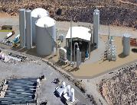

Microgrid Demonstration Projects by End Use
Critical Facilities
Ports
Communities
Shelter
Medical Center
Military
Fire Stations
City Hall, Police HQ, and Community Centers
Industrial
Waste Water Treatment Plant
Airport
Digester
Distribution Center

Slide 6
Site Level Lesson learned
PRE-DESIGN
DESIGN/BUILD
OPERATIONS & MAINTENANCE
Customers are motivated by financial, environmental, and resiliency benefits
Customer needs and site characteristics must be well understood
The microgrid integrator role is critical, along with good partnership between vendors and communication between all stakeholders
Interconnection processes and permitting can pose schedule and cost risks without significant up-front preparation and coordination with utility
Testing and thoroughly vetting emerging technologies – typically microgrid controllers and energy storage – remains important
O&M responsibility must be pre-planned: site staff or third-party service agreement
Microgrids are successfully achieving utility bill savings and optimizing demand charge reductions
Microgrids are successfully running islanding tests and in some cases have already islanded during power outages

Slide 7
Program Level Lessons Learned
Key Takeaways:
Microgrids have Huge Potential
Clear Business Case still under development
Need Clarifications on How Microgrids Best Fit
Desired Ownership Models Vary with End User
Grant and Incentive Funding Key in Microgrid Decision
Need Clear Benefits and Value Streams
  How to you value Reliability, Resilience, Social Value, etc.
  Need to open more markets or service opportunities
Need Government or Regulatory Guidance

Slide 8
Data Request For All Clean Energy Microgrids In California—Regardless of Funding Source
The Energy Commission would like to track and report on all clean energy microgrids in California. If you are willing to provide your microgrid information and location to be used in a publicly available data base, please send the information to the IEPR Docket address in the Public Announcement:
  Visit the CEC Electronic Add Comment page or visit https://efiling.energy.ca.gov/Ecomment/Ecomment.aspx?docketnumber=20-IEPR-04 ,
  which links to the comment page for this docket. Enter your contact information and a comment title describing the subject of your comment(s). Comments may be included in the “Comment Text” box or attached as a downloadable, searchable in Microsoft® Word (.doc, .docx) or Adobe® Acrobat® (.pdf) file. Maximum file size is 10 MB
Technical questions about the providing information to this data base should be directed to Mike Gravely at Mike.Gravely@energy.ca.gov or (916) 704-4339. A checklist on the desired data elements is available upon request from Mike Gravely.

