Slide 1

MCAS Miramar
Installation Microgrid
Prepared for:
CEC IEPR Webinar
Prepared by:
Mick Wasco, Utilities & Energy Management, MCAS Miramar

Slide 2



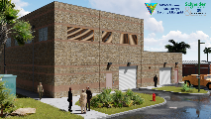




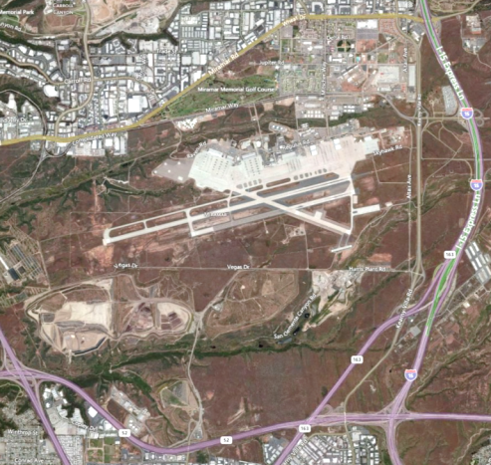

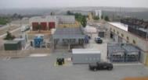
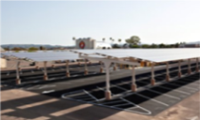
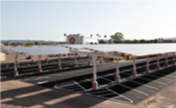
Installation Microgrid Map
Thermal Energy Storage Plant
AWEMS HVAC Controller
(80 Buildings)
DEMAND REPONSE (CEC Grant)
Microgrid Backup Power Plant
MW Tier 4 Diesel Generator Set
MW BACT Natural Gas Generator Set
Central Microgrid Controller
Li-ion Battery (CEC Grant)
Thin-Film PV Roof Systems
Backup Generator w/ATS Paralleling Switch Gear
Landfill Gas Energy Plant
PV Carports
PV Carports
Future

Slide 3
DER and Load Summary
Generation
3.2 MW Landfill Power
1.7 MW PV
3.7 MW Diesel in Power Plant
2.8 MW Natural Gas in Power Plant
1.6 MW Additional Landfill Power
2 MW Telecom Back up Generator
Total = 11.4 MW Current
15.0 MW Future
Battery Storage
2 MW / 2 MWH Li-Ion (CEC EPIC Grant)
250 kW / 600 kWh Li-Ion
25 kW / 125 kWh ZnBr Flow
Legend:
Black = P-906 Installation Microgrid (ERCIP Project)
Green = existing prior to installation microgrid
Blue = future projects
Orange = building microgrid (not controlled by installation microgrid)
Base Loads
Total base peak = 14 MW
Average load = 7 MW
Designed Island Critical Load = 3-6 MW
(Over 100 buildings)
Load Management
Thermal Energy Storage Plant
  (200 kW)
Area Wide Energy Management System (DDC)
  Automated Demand Response estimated 1.6 MW over 80 buildings (CEC EPIC Grant)
Electric Vehicle Charging Stations
(0 – 168 kW)

Slide 4
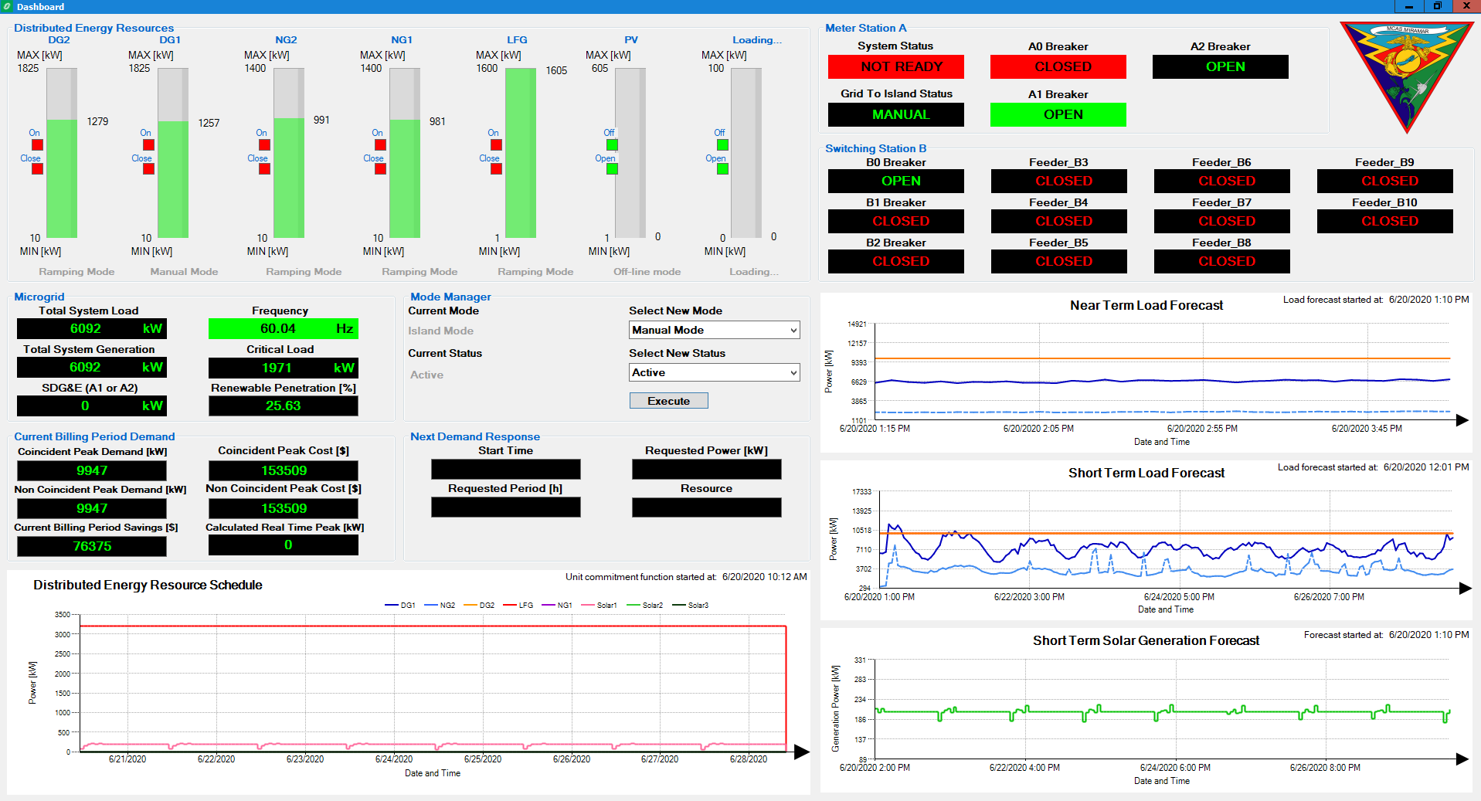
Island Test - June 20,2020

Slide 5

Testing Update

Slide 6
Thank you
Mick Wasco, PE, CEM, PMP
Branch Manager
Utilities and Energy Management
Marine Corps Air Station Miramar
Mick.Wasco@usmc.mil
(858) 307-6150

Slide 7
Back Up Slides
Reference material for question response

Slide 8





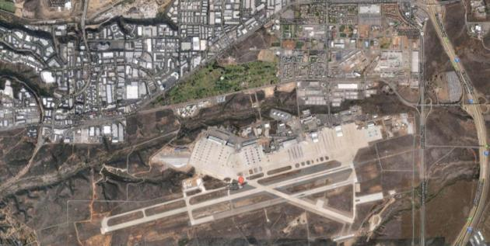

Installation Microgrid Project Overview
Project Details
FY2014 ECIP Project P-906
  Programmed Cost $18M
  Awarded in May 2016 for $20M
  Projected Completion 2019
2018 California Energy Commission Grant
  Awarded $5M to UCSD in 2018
  Project Completion 2022
Project Description
Install diesel (4 MW) and natural gas (3 MW) generation with the ability to power 100% of the flight line and support facilities (100+ facilities = 4 – 6 MW)
Incorporate existing onsite landfill power generation (3.2 MW) and existing PV generation (1.3 MW) into microgrid islanding as much as feasible.
Enable generation to participate in demand response during grid connection.
Build “Energy & Water Operations Center”
Cyber Security accreditation through Risk Management Framework
Grid Scale Energy Storage (CEC EPIC Grant)
Base wide HVAC Demand Response (CEC EPIC Grant)
Project Goals
Energy Resilience (Back-up Power)
Maximize Renewable Integration
Cost Savings/Grid Support

Slide 9
Microgrid Modes of Operation
Manual Mode
  Grid Connected, Landfill Power production, SDG&E providing power
  Power plant online and available (no automatic dispatch), Running monitoring, forecasting and optimization tools – creating “lost opportunity report”
Economic Mode
  Grid Connected, Landfill Power production, SDG&E providing power
  Power plant available for automatic dispatch of generation assets, based on economic algorithms in various opportunity categories
    Peak Optimization – system will keep track of each billing cycle with SDG&E and dispatch allocated generation in order to avoid the peak each month. Once peak has been avoided with new peak is created and generation will not dispatch unless necessary to avoid new peak (will not run if it does not have to)
    Landfill Gas Back Up – allocated generation supports landfill power plant
    Energy Optimization – allocated generation will run if the price of production is cheaper than price from WAPA/SDG&E
    Demand Response – On notification from SDGE, battery storage will be used to participate in SDG&E DR programs; currently a CPUC rule prohibits use generators in these programs despite having prime permits.
Test Mode
  Half of the base remains grid connected, other half is powered in island mode with the power plant, landfill and other onsite generation
  Purpose is to “practice” and exercise the system for islanding to ensure that when called upon in an emergency that the system will function as designed
  Tests expected 1-2 times per year in conjunction with other operational readiness drills/activities for mission assurance
    Reference DODI 4170.11, Energy Resilience (2) (b) 4. “DoD Components shall conduct full scale and routine testing…”
Island Mode
  “Blackout” SDG&E grid outage,
  Microgrid will use Power Plant to black start the critical loops at Miramar to create the microgrid island
  Microgrid will utilize as much renewable as possible while maintaining power quality

Slide 10
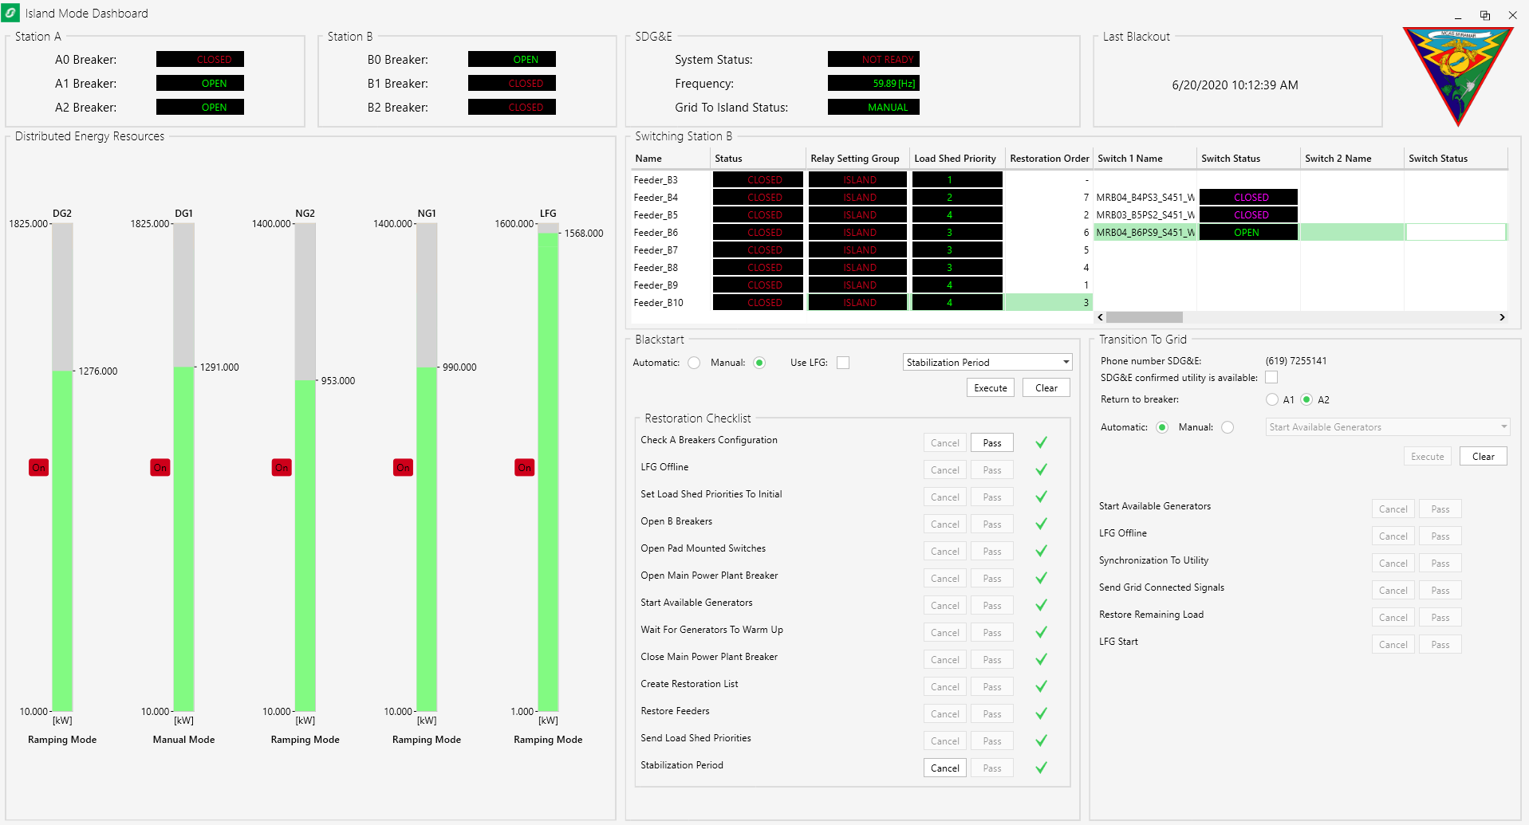
Island Test – All Loads
With the integration of landfill power, the microgrid was able to power the entire installation. However, the landfill power provided only additional spinning reserve and fuel savings – it was not needed in order to carry the full installation load.
NOTE: The installation load was lower than normal due to many reasons such as a weekend; non-operations; cool weather; and overall minimal activity on base.

Slide 11
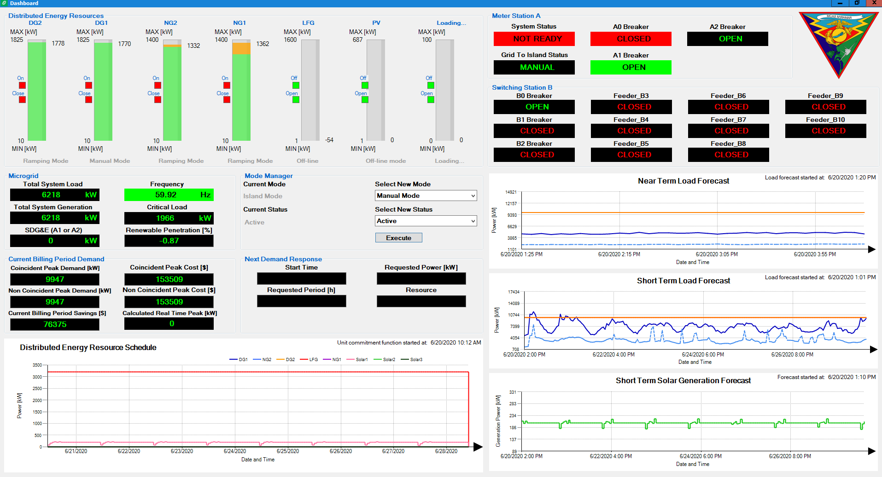
Island Test – Loss of LFG
  Additional stress testing of the microgrid was conducted through two major actions
    Dropping landfill power
      In this test, the power plant has no problem picking up all of the load require, and was able to maintain the entire base without dropping any loads.

Slide 12
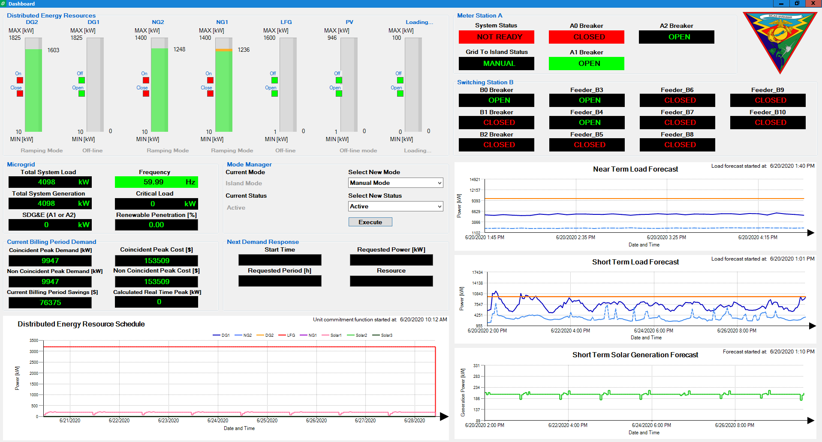
Island Test – Loss of Diesel
    Dropping one main diesel generator from the power plant
      In this test, the system performed exactly as designed by dropping designated non-critical feeders starting with the lowest priority, in order to maintain the microgrid island for all other more critical feeders.

Slide 13

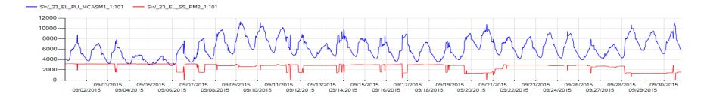
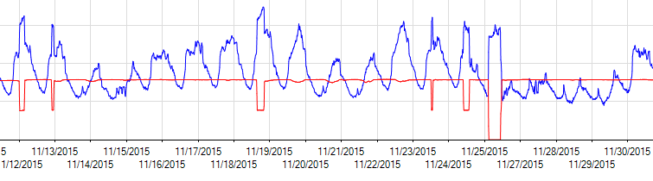
Landfill Gas Power Reliability
Landfill Power
Installation Load from SDG&E

Slide 14
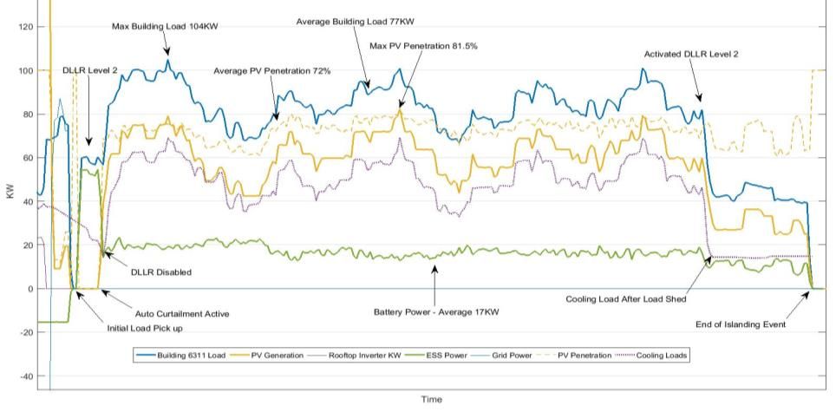
Building Microgrid Island Test
w/ Demand Limiting (June 2016)

Slide 15


















Partnerships

